Slide 1
What is social mobility – and does it still matter?
John Williams
© Hodder & Stoughton Limited 2024

Slide 2
New Labour and social mobility: Unleashing Aspiration (2009)
For New Labour in its 2009 report, Unleashing Aspiration, social mobility meant being able to leave behind one’s low-income, blue-collar family origins to become a high earning white-collar professional.
New Labour’s social mobility vision was: ‘Educational attainment unlocks social progress…[academic results] open the door to a university degree and a professional career.’
But critics on the political Left argued that this vision of mobility meant only a scramble for the few jobs that offered security. Its focus was on the talented few, which offered no hope for the many.
This was the critical view, for example, of educational sociologist Diane Reay and also historian Selina Todd, in her book Snakes and Ladders: The Great British Social Mobility Myth (2021).
© Hodder & Stoughton Limited 2024

Slide 3
The polarisation of the politics of social mobility
By the 2020s, the concept of social mobility was coming
  to a crossroads. Critiqued by sections of the Left, it was also now under critical discussion among Conservatives.
Here the argument was that social mobility for the Left implied a new type of social snobbery. Working-class people had their own distinctive intellectual life. Simply becoming ‘more middle-class’ added no social value to people’s lives.
Instead of seeing work for the lower class as ‘inevitable drudgery’, the vision of the political Right was simply for ‘dignified, high quality, fulfilling jobs for everyone’.
© Hodder & Stoughton Limited 2024

Slide 4
The Sutton Trust (2017): The State of Social Mobility in the UK
But a Sutton Trust report in 2017 was the first to see prospects for social mobility in the UK very differently.
Instead of a growing middle class, developed societies would become more polarised, with very high-skill jobs preserved, but other work becoming more ‘low-skill’.
Increasing automation meant the likely ‘hollowing out’ of the middle of the UK jobs market, making it harder to move from a low-skilled to a high-skilled ‘middle-class’ job.
Increased demand would be for ‘non-routine’ menial jobs.
© Hodder & Stoughton Limited 2024

Slide 5
The likely future decline of ‘white collar’ jobs (Maslen, 2022)
Even if Britain continued to need a strong manufacturing sector, New Labour’s initial projection (‘up to nine in ten new jobs in future will be professional jobs’) suddenly seemed misplaced.
That sort of traditional white-collar hegemony was now called into question by the rise of AI technology and automation. Different rules would now apply.
Conservatives argued that, anyway, most working people do not aspire to ascend into some professional elite.
Most people are ‘somewheres’; they are happily rooted in their own classed communities, with their own values.
© Hodder & Stoughton Limited 2024

Slide 6
Social mobility and opportunity (Latham, 2024)
But two, more recent, reports by the Sutton Trust throw new light on this debate. In a national survey in 2024:
Most of the public (83%) still thought there is a big class gap in Britain today, with 63% saying it is either bigger or the same as 50 years ago.
Most of the public think children from richer families are getting better opportunities than others.
Eight-out-of-ten of those asked said that the gap between social classes in Britain today is either ‘quite’ or ‘very big’.
Research had also shown that the UK is one of the least socially mobile among the 38 OECD countries.
© Hodder & Stoughton Limited 2024

Slide 7
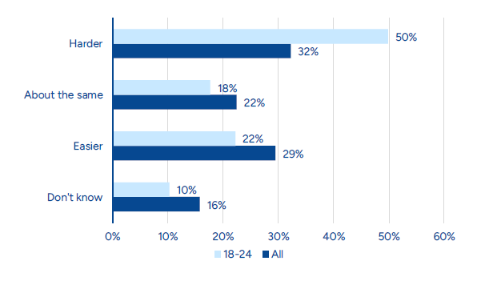
Figure 1: Is it easier or harder for someone to move from working class to middle class today than it was 50 years ago? All respondents and 18-24 year-olds (Latham, 2024)
Younger people were the most pessimistic about moving up the social ladder, with 50% of 18–24-year-olds saying it is harder to move from working class to middle class today.
Young people were also less optimistic about succeeding more generally, with 57% (47% in the general population) agreeing that it is harder for young people to succeed today than it was for older generations.
© Hodder & Stoughton Limited 2024

Slide 8
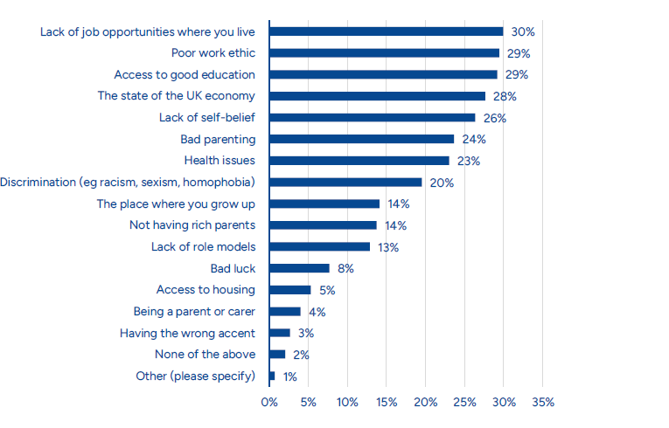
Figure 2: Which, if any, of the following are the biggest barriers to succeeding in life? (Up to three choices).
Geography, the economy and education all figure very prominently.
© Hodder & Stoughton Limited 2024

Slide 9
A class act: Social mobility and the creative industries (Holt-White et al, 2024)
Looking specifically now at education, mobility, and access into the creative arts, another recent Sutton Trust report is also very interesting:
It found that the Royal Academy of Music (60%), Royal College of Music (56%), Durham (48%), King’s College London (46%) and Bath (42%) all have very high proportions of privately educated students studying creative subjects.
Indeed, all of these have higher proportions of privately educated students than in Oxbridge’s creative subjects (32%). Creative subjects have collapsed in state schools.
Across television, film and music, high-profile figures in the creative industries are much more likely to have attended private school than the UK population (31% compared to 7%). These are not jobs at great threat yet from AI.
© Hodder & Stoughton Limited 2024

Slide 10
Recommendations on mobility and the creative industries include:
State schools should be incentivised to offer creative subjects and extracurricular activities.
The government should introduce an ‘arts premium’ for schools, so they can pay for arts opportunities, including music lessons.
Government should aim for every state school student to have access to at least one creative trip or activity a year.
Government should redouble its efforts on access to creative arts across the HE sector, with a focus on socioeconomic disadvantage.
Socioeconomic inclusion should be a condition of arts funding.
Employers in the creative industries should collect and analyse socioeconomic data for applicants and employees.
© Hodder & Stoughton Limited 2024

Slide 11
Sources
Erica Holt-White et al, (2024) A Class Act: Social Mobility & the Creative Industries. The Sutton Trust
A Class Act - The Sutton Trust
K. Latham (2024) Social Mobility and Opportunity, The Sutton Trust
Social mobility and opportunity - The Sutton Trust
Joseph Maslen (2022) ‘Do the Conservatives Believe in Social Mobility?’ The Political Quarterly, 93, (1) January–March: 104-111
Selina Todd (2021) Snakes and Ladders: The Great British Social Mobility Myth, Chatto & Windus
Sutton Trust (2017) The State of Social Mobility in the UK
BCGSocial-Mobility-report-full-version_WEB_FINAL-1.pdf
© Hodder & Stoughton Limited 2024

