Slide 1
What is happening to weath inequality in the UK?
John Williams
© Hodder & Stoughton 2024

Slide 2

Wealth distribution, class and inequality
Wealth distribution is closely tied to social class differences and the life chances of individuals.
Income is often the main focus in looking at inequality, but wealth is increasingly important in the UK as the value of many assets has increased faster than income.
© Hodder & Stoughton 2024

Slide 3
Wealth and social theory
Marx’s theory of class stratification saw wealth as the key to understanding social class.
According to Marx, the ruling class (or bourgeoisie) owed their privileged position to owning the means of production (particularly capital). The proletariat (working class) has to work for wages because they lack the means of production.
From this viewpoint, wealth provides political and social power which in turn shapes beliefs (or ideology).
© Hodder & Stoughton 2024

Slide 4
Types of wealth
Wealth takes several forms including:
Property wealth (such as houses and land).
Physical wealth (valuable objects such as cars, gold, antiques or paintings).
Financial wealth (cash, bank deposits, shares, unit trusts, bonds).
Private pension wealth (the cash equivalent value of assets in pension funds whether or not they can be easily accessed).
© Hodder & Stoughton 2024

Slide 5
Measuring wealth in the UK
There are many problems with measuring wealth. These include:
Wealthy people often conceal wealth to avoid tax, e.g. in offshore tax havens.
The value of assets can change rapidly.
It isn’t always obvious what should be included — e.g. the value of state pensions.
The main UK source The Wealth and Assets Survey uses survey data and is therefore based on a sample.
ONS (2022) ‘Wealth and Assets Survey : Quality and Methodology Information’ Available at Wealth and Assets Survey QMI - Office for National Statistics (ons.gov.uk)

Slide 6
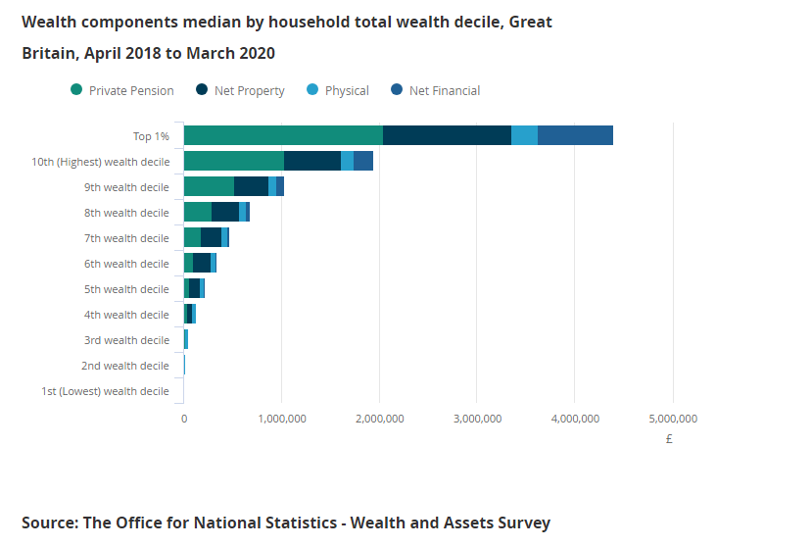
The distribution of wealth
Source: ONS (2022) ‘Household Total Wealth in Great Britain, April 2018-March 2020)[Online] Available at Household total wealth in Great Britain - Office for National Statistics (ons.gov.uk)

Slide 7
Key findings of the Wealth and Assets Survey (2018–20)
Median net wealth was just over £300,000, an increase of around 20% compared with 2006–08 after adjusting for inflation.
The richest 1% had household wealth of over £3.6 million, compared with £15,400 or less for the poorest 20%. This shows that wealth inequality is much greater than income inequality.
Poorer deciles have very little financial wealth and the poorest have mainly physical wealth.
Richer deciles have substantial pension wealth.
Source: ONS (2022) ‘Household Total Wealth in Great Britain, April 2018-March 2020)[Online] Available at Household total wealth in Great Britain - Office for National Statistics (ons.gov.uk)

Slide 8
The IFS Deaton Review
In 2022, The Institute for Fiscal Studies published a report into inequality in the UK.
Key findings included the following:
Wealth was increasingly important relative to income. It had grown from representing 3.5 times the total value of the economy each year (gross domestic product) to 7.0 times GDP between 1991 and 2022.
The monetary wealth gap between the ninth and fifth deciles in wealth distribution (the second and the fifth richest tenths of the population) had grown from £299,000 in 1991 to £432,000 in 2019-20.
IFS(2022) ‘The IFS Deaton Review’ [Online] available at Inequality: the IFS Deaton Review

Slide 9
The IFS Deaton Review
Key findings:
Because of the growing wealth gap, it was increasingly difficult to move up the wealth distribution through earning at work.
Rates of home ownership were falling among the young with the rise in house prices since the 1990s.
Young people were finding it difficult to get on the housing ladder, making it difficult to accumulate wealth through house price inflation and paying off a mortgage.
Therefore, the inheritance of wealth from parents rich in housing capital was increasingly needed for younger adults to accumulate wealth.
IFS(2022) ‘The IFS Deaton Review’ [Online] available at Inequality: the IFS Deaton Review

Slide 10
Wealth and meritocracy
It is often argued that the wealthy largely deserve their success due to talent, hard work and risk-taking, or that it is based on meritocracy.
Examples include Lord Alan Sugar and Stephen Bartlett of Dragon’s Den.
However, research by the Institute for Fiscal Studies found that inheritance has become an increasingly important component of wealth accumulation.
For those born in the 1960s, 9% of household income was inherited, but for those born in the 1980s this had risen to 16%
IFS (2024) ‘Inheritance and inequality over the Life Cycle’ [Online] Available at Inheritances and inequality over the life cycle: what will they mean for younger generations? | Institute for Fiscal Studies (ifs.org.uk)

Slide 11
The Sunday Times Rich List
Every year The Sunday Times conducts its own research to identify the richest people in the UK.
In 2024 it found that 350 families had between them a total wealth of over £795 billion (which was more than the annual GDP of Poland).
165 UK billionaires were identified by The Sunday Times.
Top of the list was Gopi Hinduja and family, worth an estimated £37.2 billion with interests in finance, entertainment, health, banking and media.
Source: ‘The Sunday Times Rich List 2024’ [Online] Available at: The Sunday Times Rich List 2024 | The Times and The Sunday Times

Slide 12
Why does wealth inequality matter?
A report by the Joseph Rowntree Foundation (2024) argued that wealth inequality mattered because:
Concentration of wealth among the very rich made it difficult to tackle poverty and fund public services and it underpinned wider inequality.
Justifications for extreme wealth (such as the rich fully deserved their success) tended to undermine belief that policies leading to greater social justice were possible
The wealthy disproportionately contribute to environmental harm.
Concentration of wealth distorted politics, giving the rich undue influence.
IFS (2024) ‘Changing the Narrative on wealth Inequality [Online] Availabe at Changing the narrative on wealth inequality | Joseph Rowntree Foundation (jrf.org.uk)

Slide 13
Sources
IFS (2024) ‘Changing the Narrative on wealth Inequality [Online] Availabe at Changing the narrative on wealth inequality | Joseph Rowntree Foundation (jrf.org.uk)
IFS (2024) ‘Inheritance and inequality over the Life Cycle’ [Online] Available at Inheritances and inequality over the life cycle: what will they mean for younger generations? | Institute for Fiscal Studies (ifs.org.uk)
IFS(2022) ‘The IFS Deaton Review’ [Online] available at Inequality: the IFS Deaton Review
ONS (2022) ‘Household Total Wealth in Great Britain, April 2018-March 2020)[Online] Available at Household total wealth in Great Britain - Office for National Statistics (ons.gov.uk)
ONS (2022) ‘Wealth and Assets Survey : Quality and Methodology Information’ Available at Wealth and Assets Survey QMI - Office for National Statistics (ons.gov.uk)
Sunday Times ‘The Sunday Times Rich List 2024’ [Online] Available at: The Sunday Times Rich List 2024 | The Times and The Sunday Times
Martin Holborn is a managing editor of Sociology Review

