Slide 1
Why are sociologists interested in climate change?
John Williams
© Hodder & Stoughton Limited 2024

Slide 2
‘Mainstreaming climate change sociology’ Stewart Lockie (2022)
For sociologists, discussion of social theory and climate change is embedded in consideration of the dynamics not only of climate, but of interrelated processes.
These involve, global environmental change, including climate, biodiversity, air quality, and nutrient flows, as well as natural resource use, food security, and so on.
Examining these processes provoke questions about who causes the most environmental damage — and who pays?
© Hodder & Stoughton Limited 2024
S. Lockie (2022) Environmental Sociology, 8 (1): 1-6

Slide 3
The polarisation of climate politics
The polarisation of climate politics is also central to sociological research today.
This polarisation is now as important to how people understand climate change as it is to possibilities for effective climate action.
Distrust in the motivations and findings of climate scientists influences how people who are exposed to dangerous climatic events interpret their experiences.
Distrust in science is a source of social identity for some and their expression of scepticism can be a strategy for challenging their marginalisation. (Lockie, 2022)
© Hodder & Stoughton Limited 2024

Slide 4
UN Development Programme: Climate Inequality Report 2023
The UN says climate impacts are not equally distributed across the world: low- and middle-income countries suffer greater impacts than their richer counterparts.
The consumption and investment patterns of a relatively small group of the population, directly or indirectly, contribute disproportionately to greenhouse gases.
The top 10% of global carbon emitters generate almost half of all greenhouse gas emissions (see next slide). Top emitters are relatively well protected from the consequences of climate change.
© Hodder & Stoughton Limited 2024

Slide 5
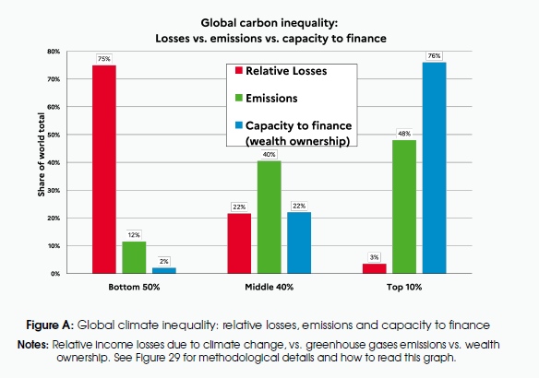
Source: Climate Inequality Report 2023, p.8
© Hodder & Stoughton Limited 2024

Slide 6
The global injustice picture
Over 780 million people globally are currently exposed to the combined risk of poverty and serious flooding, mostly in developing countries.
Many countries in the Global South are significantly poorer today than they would have been in the absence of climate change.
This trend is set to continue and result in income losses of more than 80% for many tropical and subtropical countries by the end of the century.
Within countries, it is the poor who suffer stronger losses from climate impacts than more affluent population groups.
© Hodder & Stoughton Limited 2024

Slide 7
Who has the largest per-capita carbon footprint?
Today, the carbon footprint of the average person living in the USA is almost ten times that of the average person living in India.
This ratio is even more extreme for many countries in southern and eastern Africa, which typically have the lowest per-capita carbon emissions in the world.
Sub-Saharan Africa is the only region where average per-capita emissions currently meet the 1.5°C target (see next slide).
All other regions overshoot the target considerably. North America is a noticeable outlier here with emission levels exceeding the 1.5°C budget by a factor of more than ten.
There are growing calls for a reparative mechanism to compensate the world’s most vulnerable and poorest communities, the members of which are bearing the burden of climate change.
© Hodder & Stoughton Limited 2024

Slide 8
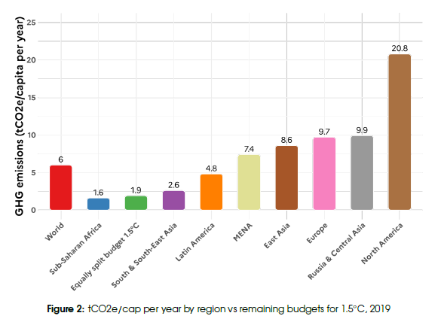
Source: Climate Inequality Report 2023, p.21
© Hodder & Stoughton Limited 2024

Slide 9
Oxfam (2024) Climate Equality: A Planet for the 99%
A recent report by Oxfam argues that the world faces two interrelated crises: climate breakdown and runaway inequality.
The richest people, corporations and countries are destroying the world with their huge carbon emissions. Meanwhile, people living in poverty, those experiencing marginalisation, and countries in the Global South, are impacted the hardest.
Women and girls, Indigenous Peoples, people living in poverty and other groups experiencing discrimination are especially disadvantaged.
The poorest 50% are responsible for only 8% of emissions — and yet they suffer the most (see next slide).
Only the richest people and countries have the wealth, power and influence to protect themselves against the impact of climate change. With that power comes huge responsibility.
© Hodder & Stoughton Limited 2024

Slide 10
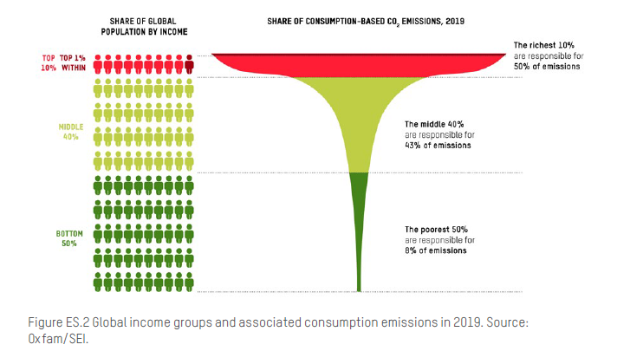
© Hodder & Stoughton Limited 2024

Slide 11
The super rich
In 2019, the super-rich 1% were responsible for 16% of global carbon emissions, which is the same as the emissions of the poorest 66% of humanity (some 5 billion people).
Since the 1990s, the super-rich 1% burned through twice as much of the carbon budget as the poorest half of humanity combined.
In particular, the super-rich 1% are key to the climate story in three ways:
1. Through the carbon they emit in their daily lives from their consumption, including from their yachts, private jets and lavish lifestyles.
2. Through their investments and shareholdings in heavily polluting industries and their vested financial interest in the economic status quo.
3. Through the undue influence they have over the media, the economy and policymaking.
© Hodder & Stoughton Limited 2024

Slide 12
What to do?
Oxfam argue for three key changes:
A radical increase in equality. We must rapidly reduce economic inequality to make it possible to reduce emissions and end poverty, and support the fight to end sexism, racism and other forms of oppression.
A fast, just transition away from fossil fuels. We must substantially reduce carbon emissions, particularly by the richest countries, individuals and corporations, to keep global warming temperature rise below 1.5°C. We must use taxation of the richest to raise the funds for this transition and to pay for the loss and damage already caused.
A new purpose for a new age. We must fundamentally change the goal of our economies to wellbeing for all, and planetary flourishing.
© Hodder & Stoughton Limited 2024

Slide 13
Sources
UNDP Climate Inequality Report 2023:
www.tinyurl.com/hjh83nf5
Oxfam (2023) Climate Inequality: A Planet for the 99%:
www.tinyurl.com/jfvtb39s
© Hodder & Stoughton Limited 2024

