Slide 1
Parental attitudes to education
Report from the Centre for Social Justice January 2024
Joan Garrod
© Hodder & Stoughton Limited 2024

Slide 2
Parental attitudes to education
The previous issue of the online version of Sociology Review looked at the level of pupils’ absences from school post-pandemic.
This level has remained alarmingly high, especially among pupils of secondary school age.
The definition of ‘persistent absence’ is missing 10% of school or more, the equivalent of at least half a day per week.
The definition of ‘severe absence’ is missing 50% or more of school time. These pupils are away from school more often than they are present.
The latest figures for severe absence reveal that it has returned to the record highs seen in Summer 2022, with 140,000 so-called ‘ghost children’ missing at least 50 per cent of their school time.
© Hodder & Stoughton Limited 2024

Slide 3
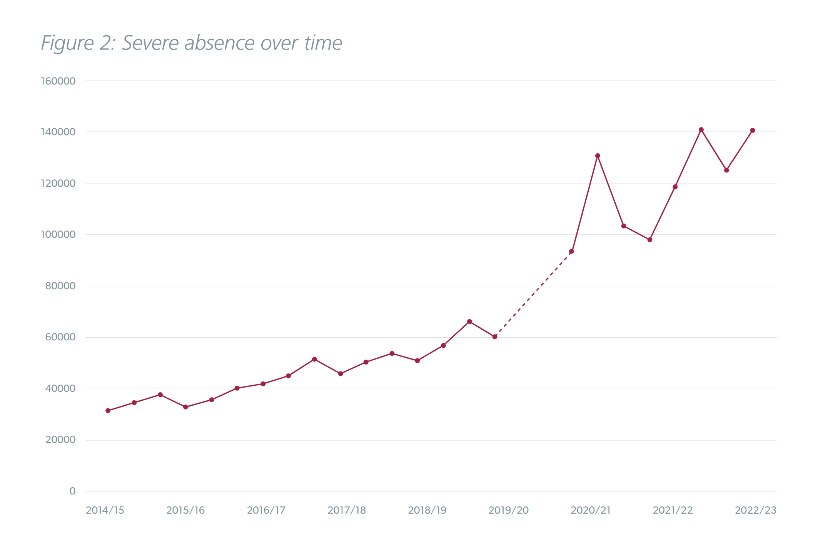
Severe absence from school
Source: CSJ January 2024
© Hodder & Stoughton Limited 2024

Slide 4
The Centre for Social Justice
The Centre for Social Justice (CSJ) is an independent think-tank that studies the root causes of Britain’s social problems and aims to address them by recommending practical, workable policy interventions.
The CSJ recently commissioned the polling organisation YouGov to conduct a survey into parental attitudes towards schools and education.
Question 1: If you were asked to research this issue, which method would you choose, and why?
Question 2: If you decided to use a large-scale survey, (i) what sampling method would you choose, and (ii) what are some of the questions you would ask?
The report was published in January 2024 and titled ‘The Missing Link’.
By this phrase, the CSJ was referring to the bond of trust between parents and schools, which the YouGov poll showed had, in many cases, been damaged or broken.
© Hodder & Stoughton Limited 2024

Slide 5
The Centre for Social Justice
Here are some of the findings of the research:
While a majority of parents agreed that ‘every single school day matters’, almost three in ten (28%) believed that the Covid-19 pandemic has shown that it is ‘not essential’ for children to attend school every day.
Why do you think that the pandemic caused some parents to feel this way?
A majority of parents said that their relationship with their children’s school since the pandemic had remained the same (56%) or got better (27%). However, 16% said that it had got worse.
Why might it be important for parents to feel that they have a good relationship with their children’s school? How might this impact on a child’s education?
© Hodder & Stoughton Limited 2024

Slide 6
The Centre for Social Justice
Over a third of parents (35%) said that they were concerned about their children’s educational performance and would welcome more support from the school. This figure rose to 42% among low-income families.
A further 18% of parents said that they were worried about their children’s attendance. This figure rose to 24% among low-income families.
This is significant because children in receipt of free school meals (used as a measure of deprivation) are three times more likely to be absent from school than their more affluent peers.
© Hodder & Stoughton Limited 2024

Slide 7
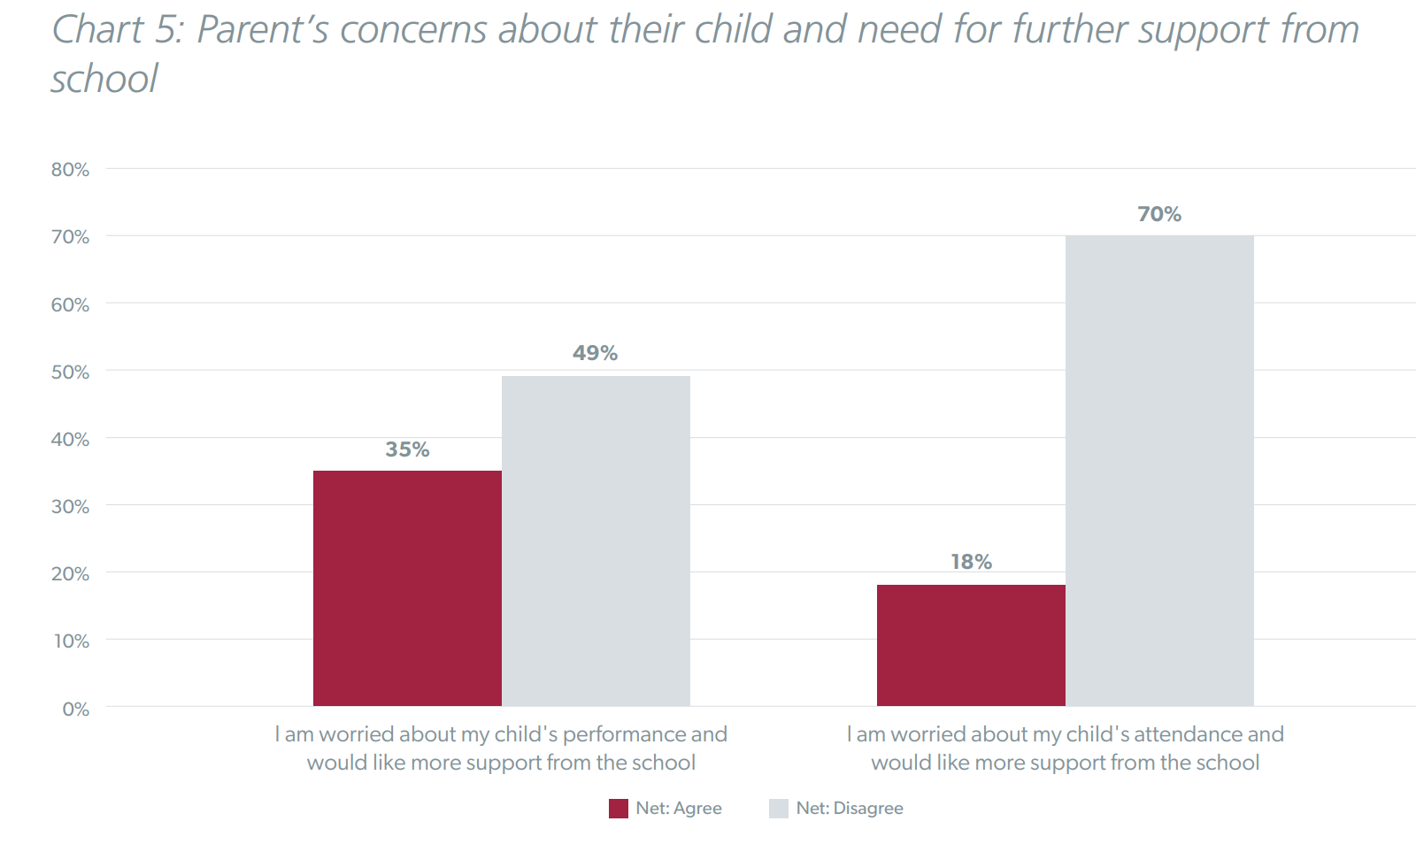
The Centre for Social Justice
Source: Centre for Social Justice January 2024
© Hodder & Stoughton Limited 2024

Slide 8
Absence by certain characteristics
The survey showed that levels of persistent or severe absence varied by certain characteristics. The figures relate to the spring term 2023 in state-funded schools.
School type
Persistent and severe absence was greater among secondary school than primary school pupils. Among primary school pupils, 17.1% were persistently absent, and 0.7% severely absent. The figures for secondary school pupils were 24.1% and 3.3%. This latter figure equates to 1 in 30 secondary school pupils being severely absent, that is, missing more than half of their allocated time at school.
Eligibility for Free School Meals
The rate of persistent absence for FSM children was 33%, compared to 15.9% of non-FSM children.
© Hodder & Stoughton Limited 2024

Slide 9
Absence by certain characteristics
Special education needs/disabilities
Children in this category were more likely to be persistently or severely absent than their peers.
Ethnicity
Absence rates vary by ethnicity, though the report did not break these down. However, the highest rates of persistent and severe absence were found among pupils who are Gypsy/Roma or Traveller of Irish Heritage.
Pupil residency
Data from the 2021–22 academic year showed that 30% of pupils living in the most disadvantaged areas were persistently absent, compared to 14.3% of pupils from the most affluent areas.
Gender
There were no significant differences in rates of absence by gender.
© Hodder & Stoughton Limited 2024

Slide 10
Recommendations
The report makes seven recommendations for policies to improve the rate of school attendance. Full details can be found in the report, but here is a summary:
The Department for Education should create a National Parent Participation Strategy, including ‘best practice’ guidance for schools and parents to engage more meaningfully with each other.
There should be a roll-out of 2,000 ‘attendance mentors’ to work with families to understand and remove the barriers to school attendance.
Ensure that families can access the right support. The government should also fast-track its commitment to establish a mental health lead in all schools.
© Hodder & Stoughton Limited 2024

Slide 11
Recommendations
4. Improve school attendance data — new ways of gathering and monitoring data should be developed.
5. Recognise the value of relational work through youth clubs and services, with the government building on its 2019 manifesto commitment to invest £500 million in new youth clubs and services.
6. Introduce a ‘Right to Sport’ in schools. All pupils should engage in two hours of extra-curricular sport each week, in addition to the already allocated time set aside for PE. This would close the ‘activity gap’ between state educated pupils and those in independent schools.
7. Ensure that fines are working. There should be a review into the effectiveness of fines and attendance prosecutions.
© Hodder & Stoughton Limited 2024

Slide 12
Discussion points
1. What do you see as some of the consequences, in both the short and the long term, of so many pupils being absent from school for so much of the time?
2. Do the consequences of missed schooling fall equally on pupils from different social groups?
3. What do you think of recommendation number 6 — the ‘Right to Sport’? How might this improve attendance — or would it?
You can read the full Centre for Social Justice report at:
http://tinyurl.com/yc2785ww
You could use the material here for questions on differences in the experience of education, or education and social policy.
© Hodder & Stoughton Limited 2024

