Slide 1
Pupil absences from school in England and Wales
Joan Garrod

Slide 2
Pupil absences
The closure of schools during the Covid-19 pandemic had a significant effect on children’s education.
Even before the pandemic, there were groups of pupils who were absent from school. Sometimes this was a result of generally poor health, or a particular short-term illness. Some pupils were persistently absent from school, putting their education at significant risk and with potentially disastrous effects on their future earning power.
However, since schools re-opened, a greater number of pupils than before the pandemic have been absent from school.
Why is this — and who are these pupils?
© Hodder & Stoughton Limited 2023

Slide 3
The current picture
FFT is an independent trust founded in 2001 to collect, analyse and publish data on a range of educational issues. Its Aspire programmes aim to help schools improve pupils’ learning experience.
Using the Aspire attendance tracker, schools can track, analyse and compare their attendance data with thousands of other schools in the programme.
The following FFT figures are based on attendance data from 7,200 primary and 2,700 secondary schools, and relate to the first 4 weeks of the 2023 autumn term.
© Hodder & Stoughton Limited 2023

Slide 4
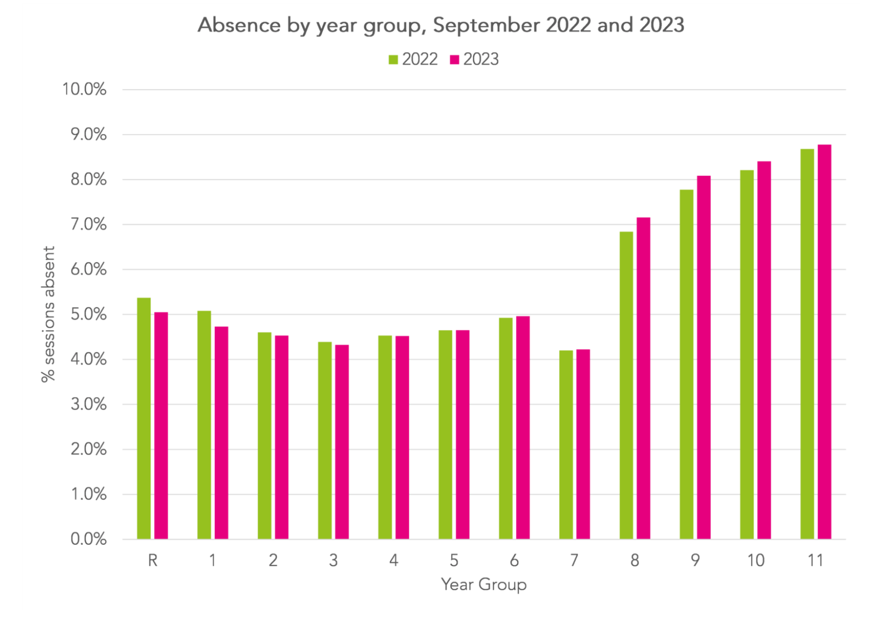
The current picture
Source: FFT Datalab, October 2023
© Hodder & Stoughton Limited 2023

Slide 5
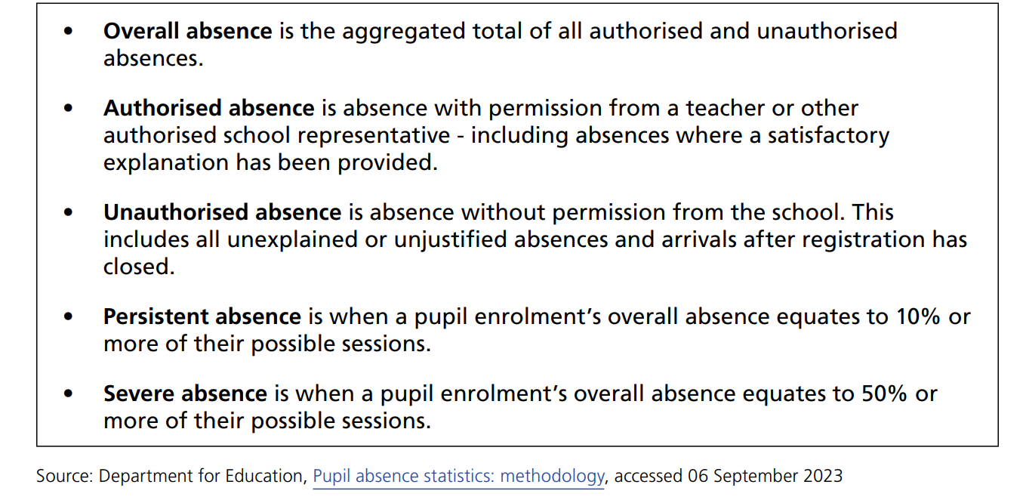
The current picture
Question: What did you notice about the different year groups when comparing 2022 and 2023?
Absences are recorded and monitored using the following definitions:
© Hodder & Stoughton Limited 2023

Slide 6
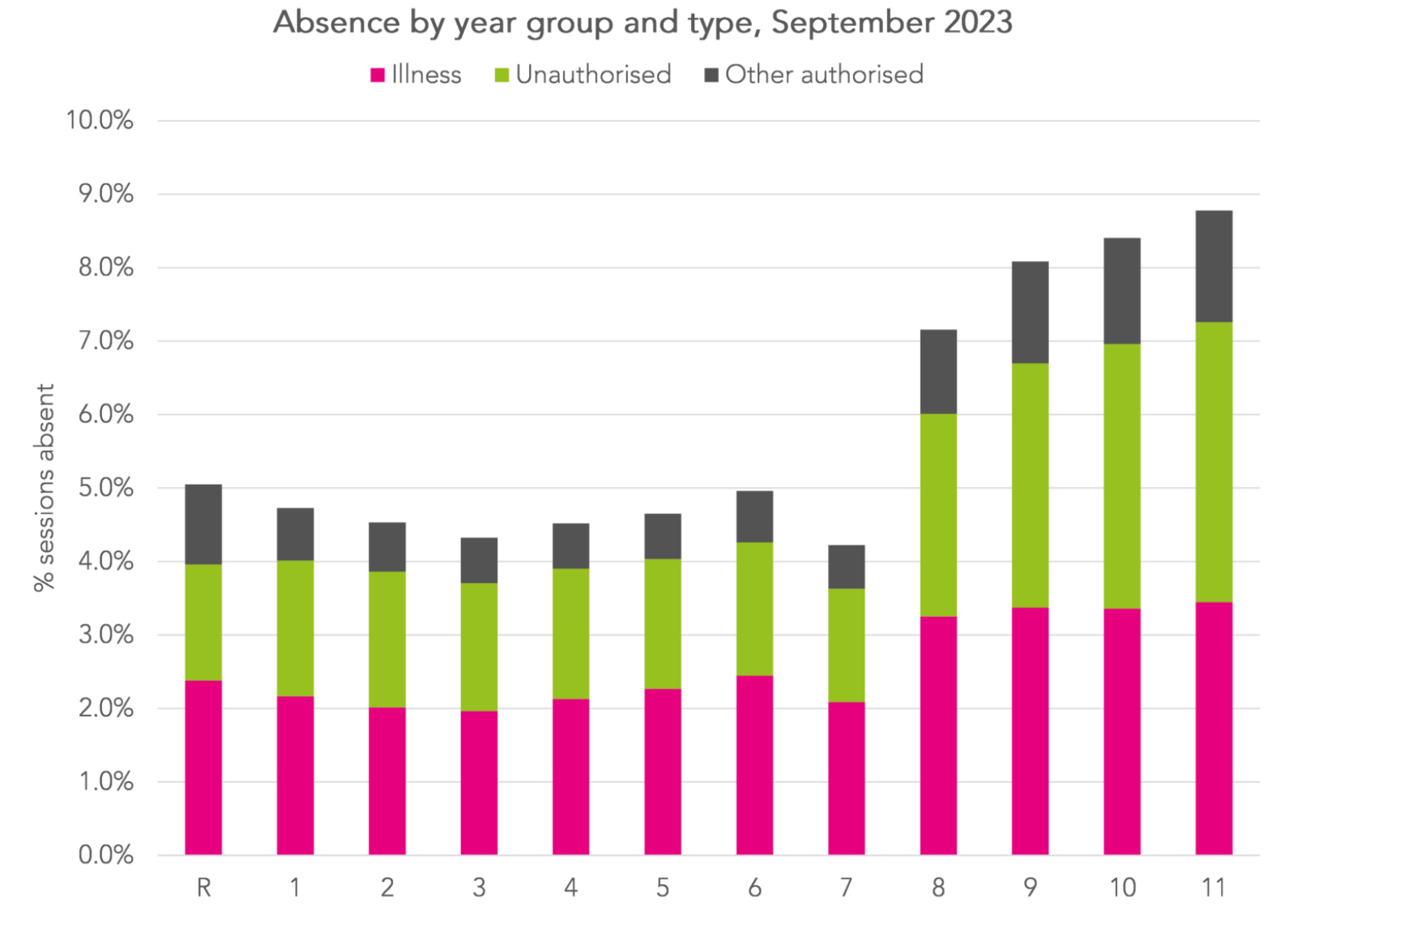
The current picture
Question: What observations could you make regarding the following data?
© Hodder & Stoughton Limited 2023

Slide 7
House of Commons Report September 2023
Such is the concern about pupil absences in England and Wales that the House of Commons Education Committee investigated the issue, and published a report in September 2023.
You can read either a summary or the full report at:
https://tinyurl.com/yum4tpnx
The following are some of the findings of the report.
The next issue of Sociology Review will look at some of the recommendations made by the Committee.
© Hodder & Stoughton Limited 2023

Slide 8
House of Commons Report September 2023
The committee identified a number of what they termed ‘barriers to attendance’, which affected different groups of pupils — note that pupils could fall into more than one category.
For each of the following, discuss why and how it could form a ‘barrier to attendance’. Consider practical issues, cultural lifestyles, and social policies — you may think of other factors.
In what ways do you think that the ‘cost-of-living crisis’ might impact on attendance?
© Hodder & Stoughton Limited 2023

Slide 9
Barriers to attendance
Pupils with health difficulties — these include both physical and mental health
Pupils from disadvantaged backgrounds
Pupils from certain minority ethnic groups
Migrant pupils
Pupils for whom English is an additional language (EAL)
Pupils from Gypsy, Roma and Traveller families (GRT)
© Hodder & Stoughton Limited 2023

Slide 10
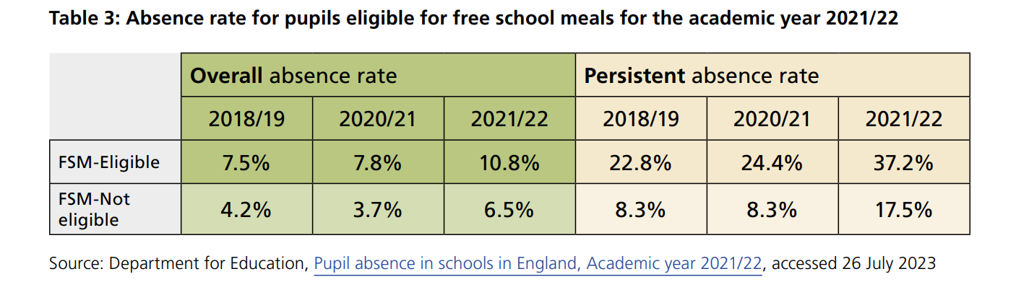
The effects of a disadvantaged background
Pupils from disadvantaged backgrounds (as measured by eligibility for free school meals [FSM]) were more likely than average to be persistently absent prior to the pandemic, but this has since worsened.
© Hodder & Stoughton Limited 2023

Slide 11
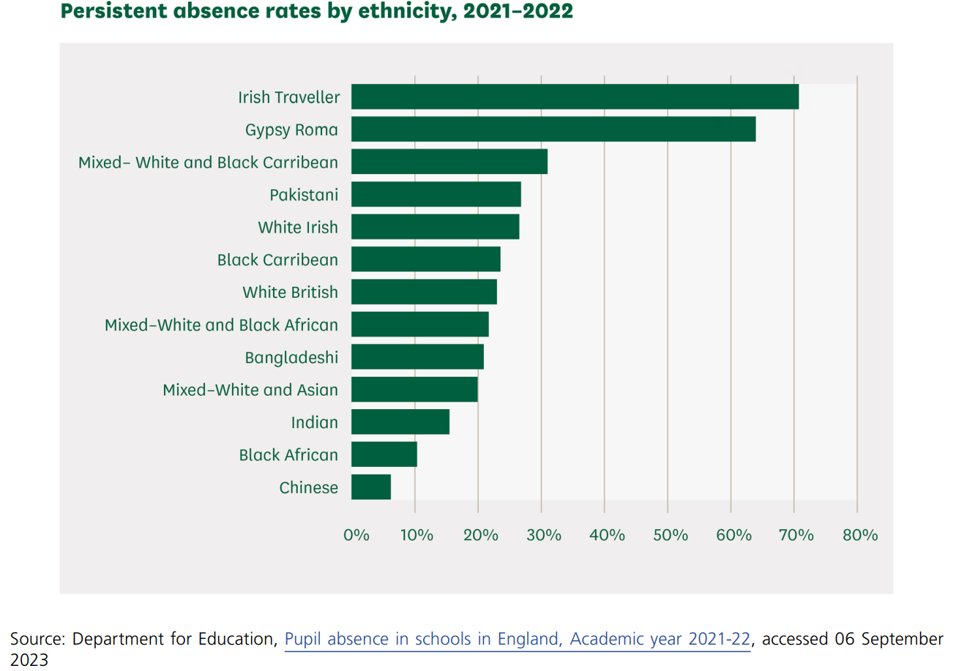
Attendance and ethnicity
(Note the DfE’s misspelling of ‘Caribbean’)
© Hodder & Stoughton Limited 2023

