Slide 1
Conspiracy theories
Joan Garrod

Slide 2
Conspiracy theories
The phrase ‘conspiracy theory’ is an umbrella term used to describe ideas and beliefs about events or issues that are generally not supported by reliable evidence. They cover a wide range of topics and areas, including politics, economics, historical events, health crises, scientific discoveries and environmental issues.
A common theme in conspiracy theories is that governments, organisations, groups or individuals are plotting to deceive people and manipulate events for their own ends, or are fabricating a cover-up to prevent populations from finding out the truth behind a particular event. Many believers see such actions as malevolent and designed to harm or instil fear in people.
Some conspiracy theories are very complex and elaborate, and claim that the conspiracies contain many layers of secrecy and the involvement of a considerable number of people.
© Hodder & Stoughton Limited 2023

Slide 3
Conspiracy theories
Here are some of the more common conspiracy theories. Each has different variations:
Princess Diana’s death was orchestrated by the British secret service at the request of the royal family.
The holocaust didn’t happen, or if it did, the number of deaths has been exaggerated.
The 1969 moon landings were faked, and the ‘moon walk’ film was shot in Nevada.
President Kennedy’s death was carried out by the CIA (or Fidel Castro or the KGB).
The Covid-19 vaccines are actually a way of tracking and controlling the population.
There is a ‘New World Order’ — a group of international elites who control governments, industry and the media with a view to establishing global hegemony.
The science behind climate change has been invented for ideological reasons.
Extra-terrestrial beings have visited Earth, and the remains of their crashed spacecrafts are kept at Area 51, a US Air Force base in Nevada.
© Hodder & Stoughton Limited 2023

Slide 4
Conspiracy theories
The rise of social media has made it much easier for conspiracy theories to spread, and for subscribers to them to link up with like-minded people.
However, there is an important question. Why do some people believe in them, despite evidence to the contrary?
Professor Karen Douglas at the University of Kent has published widely on this topic. She says that for many people, such theories fulfil a psychological need, helping them to make sense of events which they find disturbing and confusing, and allowing them to feel a sense of control.
Conspiracy theorists are able to ‘rationalise away’ evidence which appears to contradict their theory. For example, eyewitnesses to an event are believed to be either mistaken in what they saw, or to be part of the conspiracy.
However, conspiracy theories can have consequences for individuals, groups and societies.
Discussion: What might some of these consequences be?
© Hodder & Stoughton Limited 2023

Slide 5
Conspiracy theories
In June 2023, the Policy Institute published the findings of research into conspiracy theories carried out by King’s College London. This is worth looking at in detail. You can find it at:
www.tinyurl.com/2rbcvhwu
Here are some of the findings. Overall, around a third of the public say that various conspiracy theories are probably or definitely true. Examples include:
‘Central bank digital currencies will be used by governments to control people’s money and restrict their freedom.’
Definitely true: 12%; Probably true: 23%
‘The cost-of-living crisis is a government plot to control the public.’
Definitely true: 11%; Probably true: 22%
© Hodder & Stoughton Limited 2023

Slide 6
Conspiracy theories
‘The ‘great replacement theory’, the idea that white Americans and Europeans are being replaced by non-white immigrants, is actually happening.’
Definitely true : 12%; Probably true: 20%
‘The Covid-19 pandemic was part of a global effort to force everyone to be vaccinated whether they want to or not.’
Definitely true: 12%; Probably true: 19%
‘The ‘Great Reset’ announced by the World Economic Forum during the Covid-19 pandemic is a conspiracy to impose a totalitarian world government.’
Definitely true: 10%; Probably true: 20%
Discussion: How do you think that holding such beliefs will impact on people’s trust in government; willingness to be vaccinated; attitudes towards immigrants; feelings of fear and helplessness?
© Hodder & Stoughton Limited 2023

Slide 7
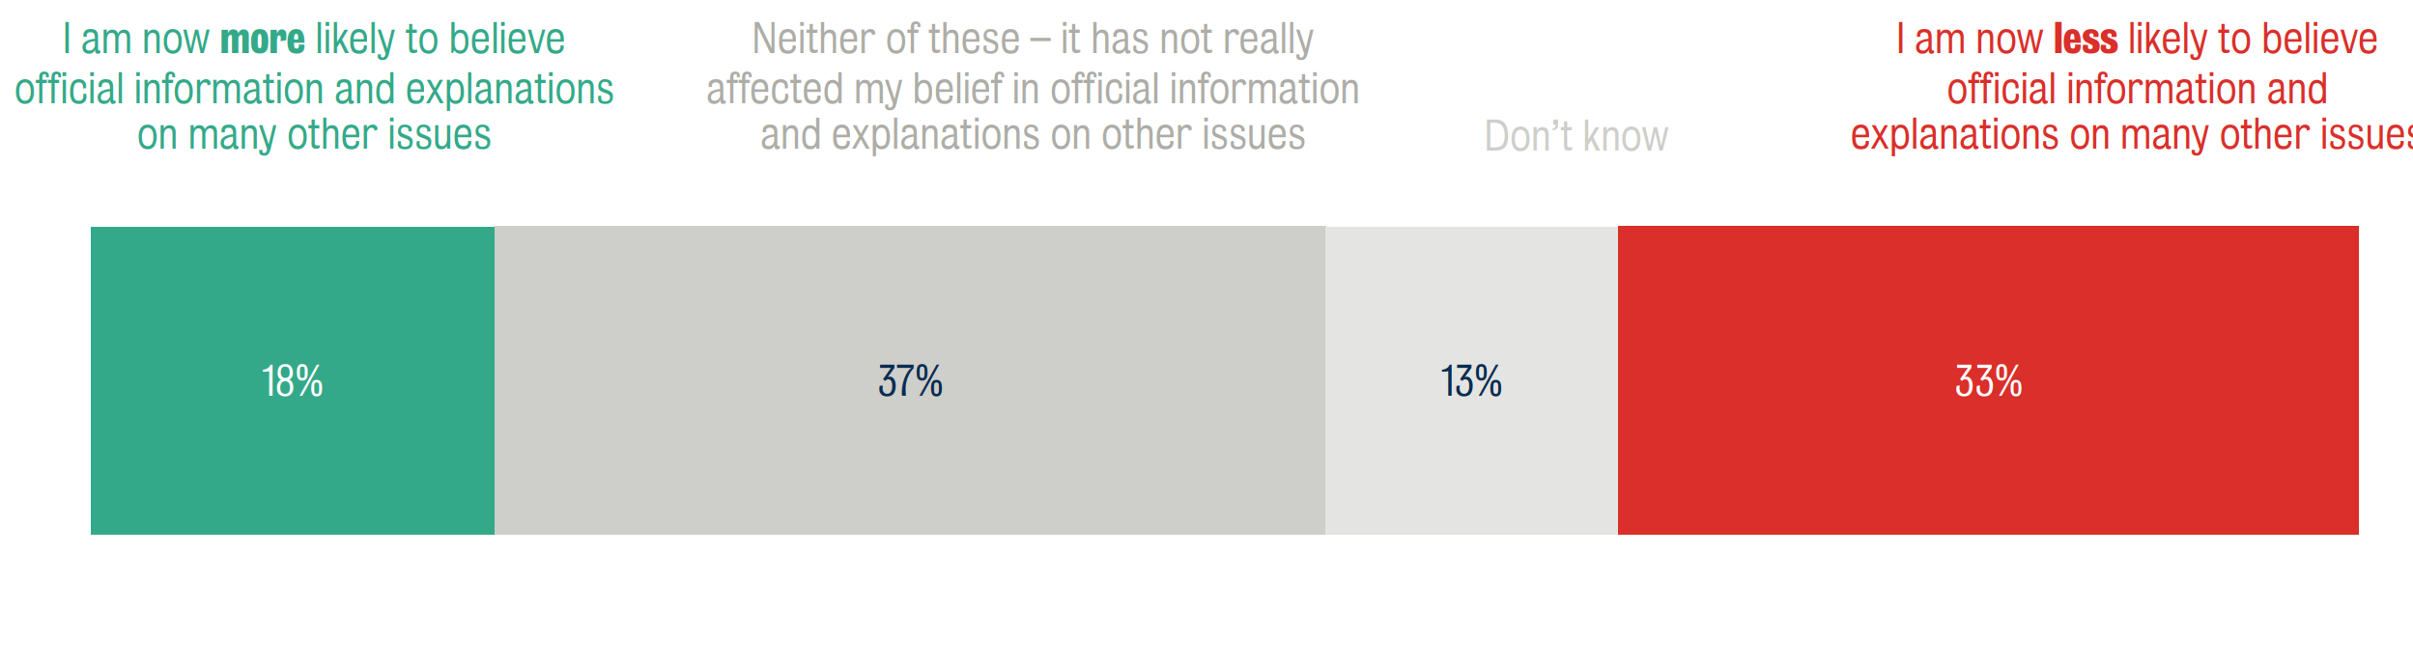
Conspiracy theories
A third of the public say they are now less likely to believe official information because of how government and the media behaved during Covid-19 — almost double the proportion who say the opposite.
Source: The Policy Institute June 2023
© Hodder & Stoughton Limited 2023

Slide 8
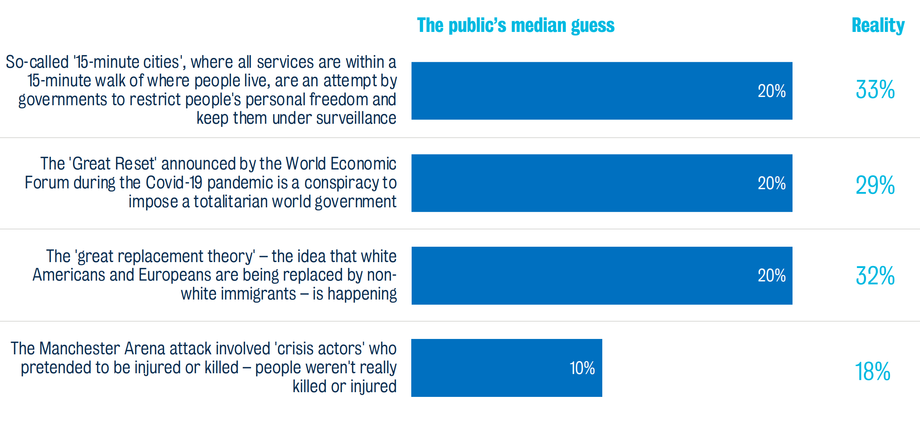
Conspiracy theories
Despite a majority of people (58%) thinking that belief in conspiracy theories is greater today than it was 20 years ago, they actually underestimate how widespread it is.
Source: The Policy Institute June 2023
© Hodder & Stoughton Limited 2023

Slide 9
Conspiracy theories
You are strongly recommended to go to the King’s College research discussed in this presentation, where there is a lot more information about the links between social media sites and conspiracy theories.
You may also like to listen to a podcast of Professor Karen Black discussing why some people are drawn to conspiracy theories. You can find it at:
www.tinyurl.com/46sz49x3
© Hodder & Stoughton Limited 2023

