Slide 1
Social policies and population size
The case of China
Joan Garrod

Slide 2
Population growth and decline
There are many factors that influence the size of a country’s population.
The most obvious are the birth and death rates, which in turn are themselves influenced by a range of social and demographic factors.
Question: What factors can you identify that will have an effect on a society’s birth and death rates?
Other factors that influence population size include:
Migration: inwards and outwards
Cultural norms regarding the desired age at marriage and number of children per family
Social policies

Slide 3
China’s population
China has long been one of the most populous countries in the world. Apart from the famine years of 1959–61, the population increased rapidly.
Chinese leaders grew concerned about the economic impact of population growth, and decided to introduce measures to reduce population growth.
The most extreme of these was the introduction in 1980 of the ‘one-child policy’, in which married couples were allowed to have only one child. Unmarried mothers were not allowed to register births. Couples experiencing a second pregnancy were reported to the authorities, and were heavily fined, with the women often forced to have abortions.

Slide 4
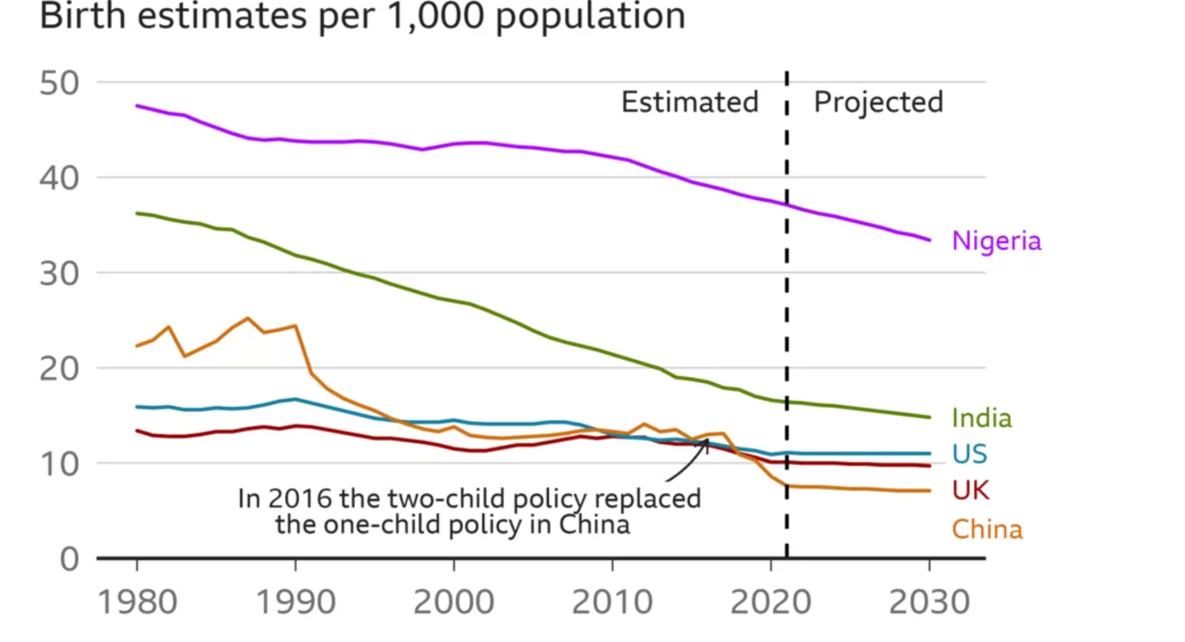
China’s population

Slide 5
China’s population
The government’s belief was that reducing the size of the population would free-up scarce resources, which in turn would improve the overall standard of living and boost economic growth. It was recognised that it would take several decades for the full impact on population size to be felt, and it was estimated that the population would not start to shrink until 2030.
The rate of population growth slowed over the following decades, but, as is sometimes the case with social policies, there were some unanticipated consequences.
Question: What consequences can you think of that might follow such a drastic action to influence fertility rates?

Slide 6
China’s population
China started to experience an ageing population, in which those of working age needed to generate sufficient income to support both the young and the growing number of elderly people past working age. Ageing populations mean an increased economic cost to provide social care for older people and also to continue to pay their pensions.
Another consequence was that, as sons are so highly valued in Chinese culture, it is believed that many female foetuses were aborted, or full-term girls allowed to die at birth. The result is that there is now a significant gender imbalance in the Chinese population, with many more males than females.

Slide 7
China’s population
China’s leaders became increasingly concerned at the economic impact of the one-child policy, and it was scrapped in 2016, with couples allowed to have at first two, then three children.
However, this did not halt the decline in the birth rate, and in 2022, for the first time, deaths in China exceeded the number of births — though it must be remembered that China suffered high death rates from Covid-19, though accurate statistics are almost impossible to come by.
A fertility rate of just over 2 is regarded as the minimum to keep a population at a stable size, and in 2020 the fertility rate in China was just 1.3.

Slide 8
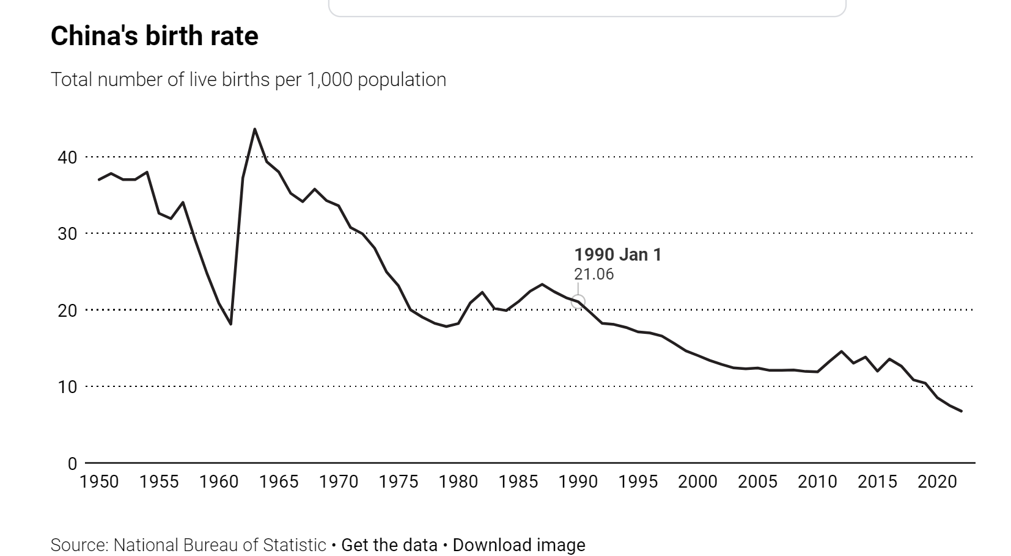
China’s population

Slide 9
China’s population
The Chinese government is now offering incentives to couples to have more children, and single mothers are now eligible for the same benefits.
Among the incentives are longer periods of maternity leave, and tax breaks for those with children. Some provinces have given cash payments to those having a second or third child, amounting to $5,500 for a third child.
In Sichuan province, in southwest China, couples may now have as many children as they wish.
However, in 2022, the population of China fell for the first time in 60 years, and as yet there are no signs that the fertility rate will increase.

Slide 10
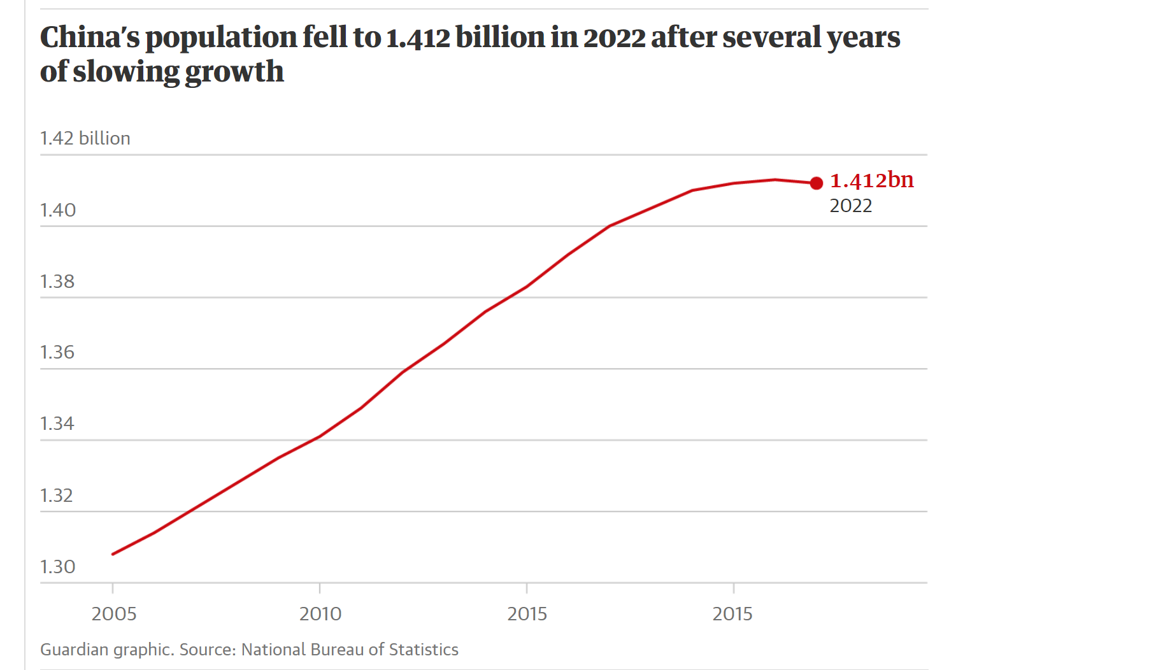
China’s population

Slide 11
China’s population
Many couples, particularly in urban areas, cite the high cost of living, of education and high rents as reasons not to have children. Some young adults refer to themselves as ‘the last generation’, meaning that their branch of the family will end with them. Even the financial incentives are not proving sufficient to alter their behaviour.
The idea of the just-one-child family has also become embedded in Chinese culture.
The case of China’s population shows that social policies can have unintended consequences, and also that individual decisions, such as whether or not to have children, are influenced by many complex factors.

