Slide 1
From sunrise to starlight:
Biological rhythms
Mandy Wood
© Hodder & Stoughton Limited 2024

Slide 2
What are biological rhythms?
Repeating patterns of physical, mental and behavioural changes;
They are influenced by…
  light, food, stress, physical activity, social environment and temperature.
They regulate bodily processes, states, behaviours such as…
  alertness, sleepiness, appetite, body temperature, hormone secretion and cell regeneration.
© Hodder & Stoughton Limited 2024

Slide 3
Three types of biological rhythm
 | Circadian rhythms | Infradian rhythms | Ultradian rhythms
Duration | Approximately 24 hours | Longer than 24 hours | Shorter than 24 hours
Frequency | Daily | Less frequent (e.g. monthly, yearly) | More frequent (e.g. multiple times per day)
Example | Sleep-wake cycle | Menstrual cycle | Sleep stages, hormonal release, and cellular processes
Controller | Internal biological clock (suprachiasmatic nucleus) | Hormones (e.g. reproductive hormones) | Physiological processes (e.g. muscle tone)
Adaptation to change | Takes time to adjust to new schedules (jet lag) | Longer adaptation time needed to match changes in environmental conditions | Rapid adaptation to changes in body activity or environmental factors
© Hodder & Stoughton Limited 2024

Slide 4
What are endogenous pacemakers?
Internal biological ‘clocks’ that help to regulate physiological and behavioural processes.
Example: The suprachiasmatic nucleus (SCN) located in the hypothalamus…
  receives input from the eyes so responds to changes in light/dark cycles;
  manages the timing of sleep and wakefulness in living organisms;
  when lower light levels (darkness) are detected, the SCN sends a signal to the pineal gland to release melatonin (a hormone).
  when light level increase, melatonin release is suppressed (inhibited)
© Hodder & Stoughton Limited 2024

Slide 5
What are exogenous zeitgebers?
External cues that synchronise the endogenous pacemakers with the external environment.
Examples:
  morning sunlight: inhibits melatonin production and promotes wakefulness;
  social cues: meal times and work schedules help synchronise our internal clocks with societal norms.
Interactions between endogenous pacemakers and exogenous zeitgebers help to maintain a synchronised and adaptive sleep-wake cycle.
© Hodder & Stoughton Limited 2024

Slide 6
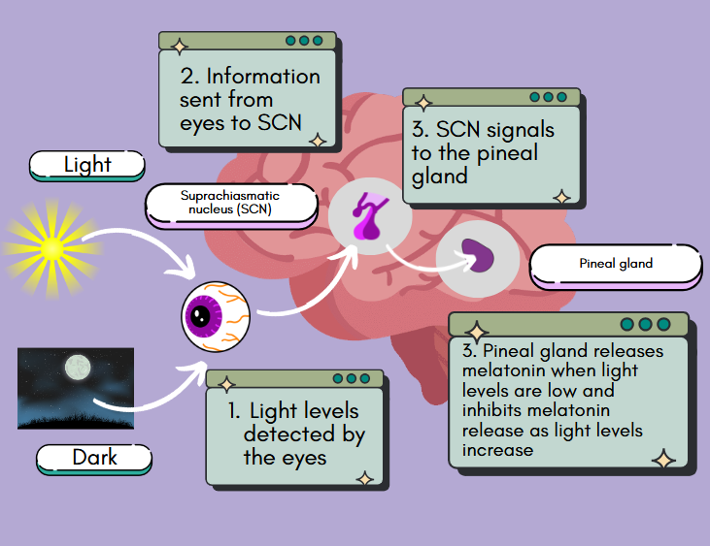
© Hodder & Stoughton Limited 2024

Slide 7
Disruption to biological rhythms
Shift work can disrupt our circadian rhythms due to irregular light exposure and changes in daily routines.
This can negatively affect health and well-being leading to problems such as…
  sleep disturbances, diabetes, obesity), cardiovascular issues, mood disorders such as depression and anxiety, even an increased risk of certain cancers.
Treatment may include light therapy, melatonin supplement and relaxation techniques.
Lifestyle changes can also help, e.g. increasing daily exercise and decreasing use of substances such as alcohol and caffeine.
© Hodder & Stoughton Limited 2024

Slide 8
An unusual occupation
Understanding biological rhythms is important for protecting the health and wellbeing of astronauts.
Circadian rhythms change during long-term space missions.
The International Space Station orbits Earth at a very high speed:
  one full orbit every 90 minutes
  astronauts see 16 sunrises and 16 sunsets every day
But regular daily routines for work, exercise and sleep help entrain their circadian rhythms.
© Hodder & Stoughton Limited 2024

Slide 9
Light pollution
Excessive artificial light exposure can disrupt circadian rhythms in humans and wildlife.
Mortazavi et al. (2022) found a positive correlation between night time exposure to artificial light and an increased risk of breast cancer.
Potentially due to melatonin inhibition.
Dim, warm-coloured lights and reduced screen time before bed could therefore help to reduce cancer risk.
© Hodder & Stoughton Limited 2024

Slide 10
Cognitive performance
Disrupted circadian rhythms can increase the likelihood of errors in tasks that require attention to detail and accuracy.
LaJambe and Brown (2008) found that one night of sleep deprivation impaired cognitive function on tests of attention, arithmetic, episodic and working memory
© Hodder & Stoughton Limited 2024

Slide 11
Think!
What could you do to encourage students and staff at your school of college to sleep better and feel more alert and awake during periods of wakefulness?
© Hodder & Stoughton Limited 2024

Slide 12
Practical idea: A correlation
Design a set of closed questions to assess sleep quality; these could be yes/no questions or ranked scales (e.g. from 1 to 7) and should result in a numerical (quantitative) score for each respondent;
Next design a cognitive task that will measure some aspect of attention or memory, you could look online for ideas. This task should also provide another numerical score, e.g. a time in seconds, a number of correct responses (or errors);
Create an informed consent form for potential participants;
  include details such as ‘right to withdraw’, confidentiality and a space for the person to sign their name;
  you must discuss all ethical considerations with your psychology teacher before collecting any data;
  under no circumstances should you carry out an experiment of sleep deprivation - use the information in this presentation to explain why!
This practical is a correlational study; what do you think the hypothesis should be?
Collect data from at least 10 people; plot the pairs of scores on a scattergram;
Which inferential statistical test should you use to test the significance of your data. Carry out the test and decide whether to reject or retain your null hypothesis.
© Hodder & Stoughton Limited 2024

