Slide 1

Mandy Wood
Is Piaget’s stage theory of cognitive development still relevant?
www.hachettelearning.com/psychologyreview
© Hodder & Stoughton Limited 2025

Slide 2
Who was Jean Piaget (1896-1980)?
He published his first academic article when he was aged 10 (about a rare albino sparrow).
His academic background was in biology and philosophy.
He became interested children’s thinking and how they acquire knowledge of the world.
He was fascinated by the wrong answers given by young children
to questions that seem obvious to adults.
© Hodder & Stoughton Limited 2025

Slide 3
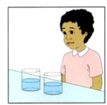
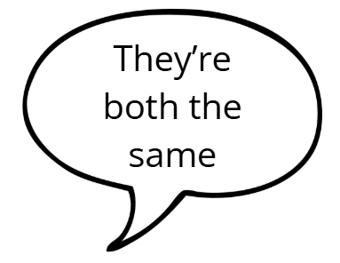
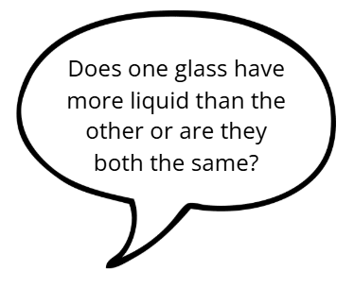
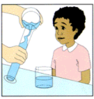

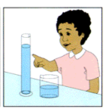
Conservation of quantity
When liquid is poured from a short fat container to a tall thin container, young children are unable to understand that the amount of liquid stays the same (despite looking different).
Piaget said this was not due to a ‘lack of knowledge’ but a difference in thinking and reasoning between children and adults.
© Hodder & Stoughton Limited 2025

Slide 4
How does thinking develop?
Babies are born with reflexes, e.g. grasp reflex.
Interaction with the environment leads them to the develop more complex ‘schema’ (representations of knowledge,
  e.g. grab the object (a rattle) and shake it to create a noise.he movement to hear the noise again
He called this the sensorimotor stage (0-2 years old).
© Hodder & Stoughton Limited 2025

Slide 5
Nature and nurture in cognitive development
For Piaget, active engagement and interaction with the environment are critical for development.
They help to explain HOW children actively construct an understanding of the world.
Cognitive development = brain maturation (nature) + environmental experiences (nurture).
© Hodder & Stoughton Limited 2025

Slide 6
Developing schema
Children seek equilibrium (balance) between existing schema and new information.
For example the child…
encounters garden birds; assimilates (fits in) bird knowledge to ‘bird’ schema: wings, beak, feathers, flies.
encounters penguins at the zoo; told they are birds; accommodates schema some birds swim not fly
© Hodder & Stoughton Limited 2025

Slide 7
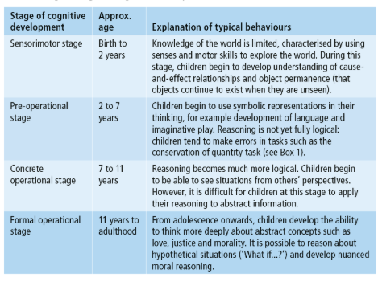
Piaget’s stages of cognitive development
Progress through the stages is linear.
Children progress at different rates.
Individual/cultural differences affect times at which different skills are developed.
Learning through play and manipulation of objects aids progress.
© Hodder & Stoughton Limited 2025

Slide 8
Recommendations for classroom practice
Emphasise play: provide a rich array of objects to discover and explore:
  e.g. blocks, containers, small toys/objects to sort/categorise/order, sand, water, modelling clay, paints, junk modelling etc.
Consider individual differences and ‘readiness’ when planning the curriculum; not everyone will be ‘ready; to learn certain concepts (e.g. time, measurement) at the same age.
© Hodder & Stoughton Limited 2025

Slide 9
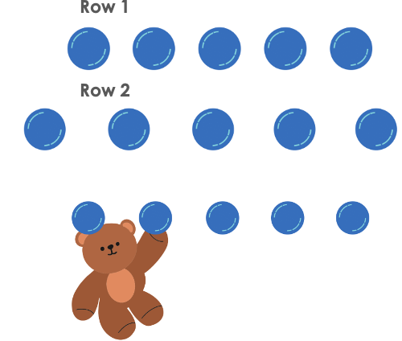
Piaget underestimated young children (1974)
Piaget believed children in the preoperational stage could not conserve quantity;
  e.g. they would say there were more counters in Row 2 where they are spaced apart)
But Donaldson and McGarrigle (1974) found that when the space between the counters was ‘messed up’ (increased) by a ‘naughty teddy’ , young children were able to say both rows were the same
The study showed that language and context are important.
© Hodder & Stoughton Limited 2025

Slide 10
Gopnik (2017)
18-month-old children were presented with broccoli and crackers).
Experimenter made facial expressions and noises (‘mmm, yummy’) to show preference for the broccoli over crackers
Even if the child preferred the crackers they offered the experimenter more broccoli (not crackers).
Suggests children of this age are not as egocentric as Piaget suggests.
© Hodder & Stoughton Limited 2025

Slide 11
Limitations and contemporary research
Piaget’s theory doesn’t account for cultural, social and emotional factors in cognitive development.
The focus on the individual contrasts with other developmental psychologists (e.g. Vygotsky) who focus on the social interaction as the main driver of development
Contemporary research focuses on individual differences in motivation and self-esteem as well as studying how biological factors such as brain plasticity affect development.
© Hodder & Stoughton Limited 2025

Slide 12
Overestimates abilities of teenagers
Piaget suggests that children enter the formal operational stage during secondary school years but…
  research suggests that the brain undergoes widespread neural reorganisation during adolescence;
  changes in regions such as the frontal lobe have important implications for cognitive processing at this age, e.g. logical thinking and planning.
Unrealistic therefore to assume that children in middle/lower secondary school would be capable of formal operational thinking.
© Hodder & Stoughton Limited 2025

Slide 13
Practical idea: Replicating conservation tasks
Working with children under the age of 16 requires parental consent which can be very time consuming to acquire.
Working directly with small children also presents a range of other practical and ethical issues, however you could still explore this topic for yourselves by talking to parents of young children (you could recruit family/friends if they have children under 7).
You could write up an information sheet describing the famous conservation of number studies, including Donaldson and McGarrigle’s Naughty teddy version (you could even create a role play of these studies and film it on your phone).
Ask the parents to play conservation games with their children and talk to them about what they observed.
© Hodder & Stoughton Limited 2025

Slide 14
Ethical considerations
Before you start recruiting parents, you must get your psychology teacher to check your information sheet/video and any standardised instructions that you have created for the parents:
  they will help you to decide if you need to add anything to make sure the study is ethical, e.g. explaining that a children develop at different rates and that most children cannot consistently conserve number/liquid at this age.
Create an informed consent form:
  include details such as ‘right to withdraw’, confidentiality and a space for the parent to sign their name;
  give them information about exactly what they will be doing and how long it will take.
Create standardised instructions. You should not need a debriefing statement as you will have provided the parents with everything they need to know about conservation before they report back to you with what they noticed.
© Hodder & Stoughton Limited 2025

Slide 15
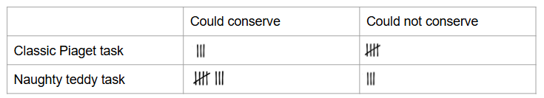
Doing some analysis
Write directional hypothesis (and a null hypothesis) for your study; make sure your variables are fully operationalised. Why do you think a directional hypothesis is better for this study than non-directional?
If you are able to recruit enough parents, you could record your findings in a frequency table. For example:
If you are using an independent groups design (different children complete classic versus naughty teddy test) a chi-squared is the most suitable inferential test but you need at least 5 tallies in each cell
If the parents complete both the classic and the naughty teddy conditions (repeated measures) you will need to do a sign test on the data.
You could use an online calculator such as socscistatistics.com to find your p value and decide whether to retain or reject your null hypothesis.
© Hodder & Stoughton Limited 2025

