Slide 1
Research ethics
Matt Jarvis

Slide 2
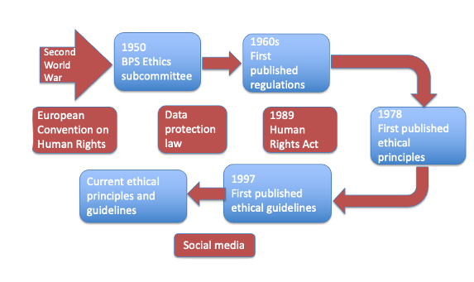
The development of ethics in UK psychology
© Hodder & Stoughton Limited 2023

Slide 3
The timeline explained
1950s and 1960s: The Second World War, and the resulting European Convention on Human Rights, triggered the discussions of ethics at the British Psychological Society.
2010 onward: The growth of the internet, especially social media, and the resulting changes to data protection and copyright law have influenced current guidance.
© Hodder & Stoughton Limited 2023

Slide 4
Data protection
Since 2018 there have been strict controls on how researchers can keep and use personal data.
But, data protection rules are complex and hard for researchers to interpret correctly.
© Hodder & Stoughton Limited 2023

Slide 5
Research ethics committees
Every university, hospital, thinktank and any other organisation conducting research has at least one ethics committee (REC).
The REC provides guidance on conducting research in ethical and legal ways.
When there is a proposal to conduct a piece of research, a written document detailing the procedure goes to the REC.
Research has to be approved by the relevant REC before it can be undertaken. Increasingly, academic journals only publish research once it has been REC approved.
© Hodder & Stoughton Limited 2023

Slide 6
Limitations of RECs
The existence of RECs has not solved all ethical problems:
Not all psychologists have access to an ethics committee and can be excluded from participating in research.
An oppositional dynamic can develop, so researchers see the REC as the enemy of research.
Individuals on RECs are fallible humans and subject to group processes like conformity.
Where substantial funds are attached to research, there is pressure to ‘fudge’ ethical issues.
© Hodder & Stoughton Limited 2023

Slide 7
Conclusions
Over the last few decades we have become increasingly aware of ethical issues in conducting research.
With changes in society and technology, different ethical issues emerge.
The British Psychological Society regularly publishes ethical principles and guidelines.
One major strategy in dealing with ethical issues has been to have a research ethics committee.
© Hodder & Stoughton Limited 2023

