Slide 1
Explaining Milgram

Slide 2
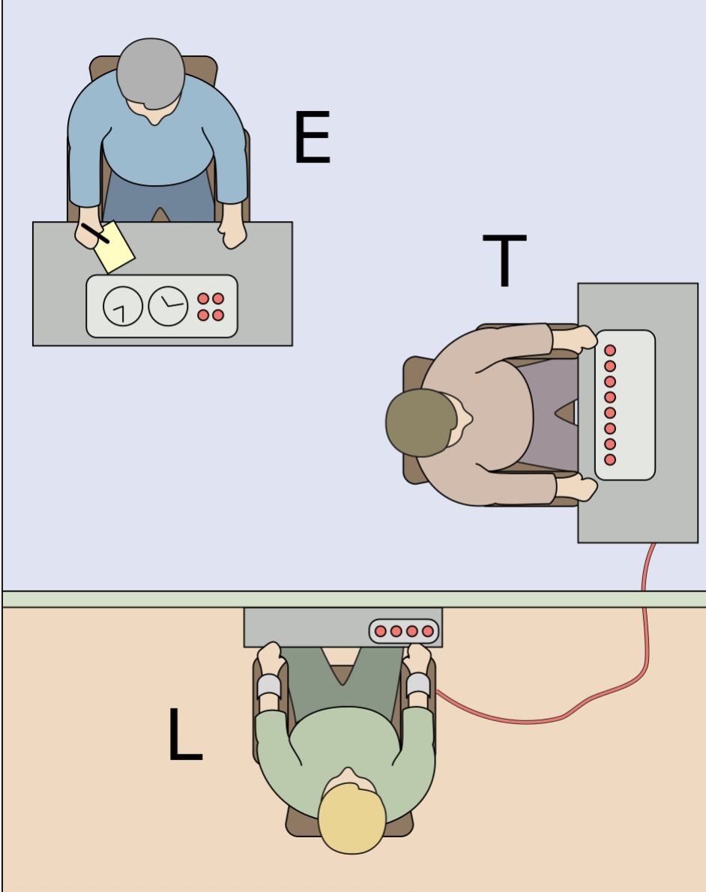
The Milgram study
Participants were told they were taking part in an experiment on learning. They were ordered to give increasing levels of electric shock to a learner whenever they got an answer wrong.
Most participants showed signs of distress but obeyed the orders. 100% gave at least 300V and 65% gave 450V.

Slide 3
What participants said…
Following instructions
‘I went on because I was told to go on.'
Importance of the experiment
‘This is research and this is important.’
The learner was not harmed
‘If it was that serious, you would have stopped me.’
Contract fulfilment
‘You’re paying me the money for my time.’

Slide 4
Milgram’s explanation
Milgram proposed that participants obeyed because in response to an order from someone in authority.
They entered an agentic state in which they surrendered free will in order to represent the collective best interest.
When not under orders from authority we live in an autonomous state.

Slide 5
Engaged followership
A newer explanation from Reicher and Haslam, based on social identity theory.
Participants obey because they actively identify on a cognitive and emotional level with the experimenter.
The experimenter is therefore seen as credible and participants accept the assurances that the learner is not harmed.

Slide 6
Doing being ordinary
Turowetz and Hollander propose a different explanation based on a closer look at what participants said. The four main explanations given by participants all indicate the same thing:
The attempt to make sense of a situation that was complex and increasingly confusing
In order words by ‘doing being ordinary.’

Slide 7
Conclusions
Milgram explained his results in terms of an agentic state.
Reicher and Haslam suggest an alternative explanation of engaged followership based on identification with the experimenter.
Turowetz and Hollander suggest a further explanation of ‘doing being ordinary’ based on the idea of participants making sense of a confusing situation.
With the benefit of hindsight, Milgram’s research design makes it hard to choose between explanations.
It is likely that Milgram’s results require a range of explanations.

