Slide 1
Learning styles
Hodder & Stoughton © 2023

Slide 2
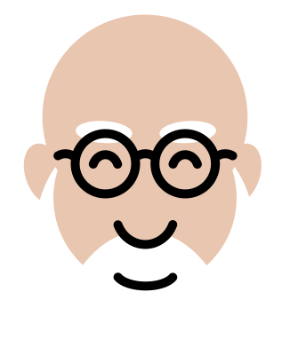

The idea of learning styles
We all have a preference for learning in particular ways. So, for example some people like to read, others to listen, others to watch and others to physically play around with objects.
VERDICT: TRUE…ISH
Hodder & Stoughton © 2023

Slide 3
So, do learning styles exist?
The claim that people have a preference for how they learn is the most modest claim of learning styles theory.
BUT even this is only partly true.
Our preferences are not consistent. They change over time and in different situations.
There are several hundred ways to classify learning styles. They can’t all be true!
The idea that we don’t all learn the same way is a truism.
BUT
Hodder & Stoughton © 2023

Slide 4
So, what can we do with learning styles?
The more ambitious aspects of learning styles theory are that we can measure learning styles and tailor how teaching and learning takes place to the style of the individual.
Research has not supported these ideas…
Hodder & Stoughton © 2023

Slide 5
The example of VARK
Classifies learning styles into four types:
VISUAL
Do you follow instructions, watch a video, listen to some explaining or just experiment?
AUDITORY
READ/WRITING
KINAESTHETIC
Hodder & Stoughton © 2023

Slide 6
Why VARK is nonsense
Questionnaires designed to measure VARK lack reliability and validity because people use different strategies to learn in different situations.
Classifying someone as visual, auditory, reading/writing or kinaesthetic does not help them. Targeting different activities to people based on their VARK type does not improve learning.
In fact, it’s worse than that. People label themselves with a learning style and don’t try to learn in other ways…
Hodder & Stoughton © 2023

Slide 7
What can you do?
If you’re given a learning styles questionnaire, don’t be mean (most teachers believe in learning styles), but either don’t complete it or at least ignore the result.
You could show the teacher the Psychology Review article…
BUT
DO try different ways to learn, just don’t label yourself.
If you are finding your textbook heavy going, try a YouTube video, and vice versa. If you struggle when your teacher explains something, read up on it. Try different ways of learning in different situations and see what works for you.
Hodder & Stoughton © 2023

Slide 8
Conclusions
Learning styles are a popular idea. However, while it is true that we learn in different ways, the idea that we can measure our learning preferences and tailor teaching to them is not.
There are hundreds of ways to classify learning styles. The most popular is VARK. There is no evidence to support the existence of these four learning styles.
By all means, try different ways of learning. There is however no point in giving yourself a label and trying to just learn in that way.
Hodder & Stoughton © 2023
Notes:
8

