Slide 1

Global Migration Essential Update 2024–25
Simon Oakes

Slide 2
Key global migration themes
Key global migration themes in this presentation | Different types of global migration, including the new World Bank classification matrix Global migration factors, causes and influences: including remittances, conflict and the Covid-19 pandemic Global migration patterns and corridors The issue of forced migration Migration, climate change and the carbon cycle Global migration and interdependence
Practice exam question | After viewing this presentation, you will be ready to attempt the following practice exam question: Evaluate the view that all global migration flows will continue to increase in size.

Slide 3
Migration glossary — do you know what these terms mean?
Click to reveal the definitions
Global North and Global South | Another way to say ‘developed’ and ‘developing’ countries. ‘Global South’ is increasingly preferred to the term ‘developing world’ that arguably de-values the peoples of Africa, Asia and Latin America.
Interconnectivity | All the human and physical linkages between people and places that make up global systems.
Interdependence | Many states, societies and businesses are mutually reliant on one another due to the growth of global systems. There are economic, social, political and environmental dimensions of interdependence.
IDPs (internally displaced people) | People forced to flee home who move elsewhere within their own country.
Irregular migrant | A person who has not entered a country in an official way, or whose work visa has expired. It is a preferred term to ‘illegal’ migrant, because it avoids labelling all such people as ‘criminals’.
Migration corridor | An area of land and/of water through which large numbers of people are migrating.
Refugees | People forced to leave their country to escape war, persecution or natural disaster.

Slide 4
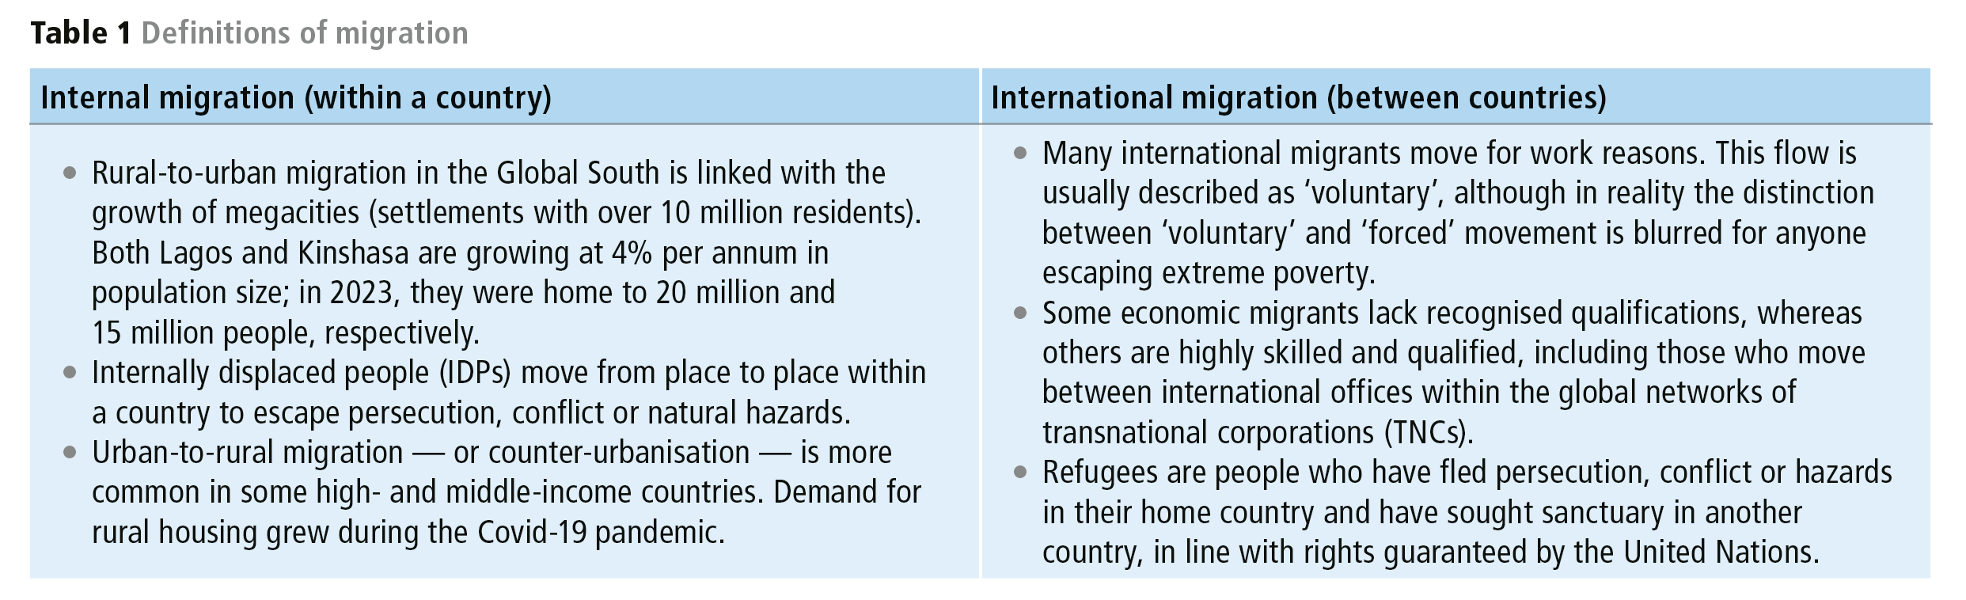
Different types of migrant
One of the most important ways to classify migration in Geography is by distinguishing between internal and international migration.
These are flows taking place at different spatial scales.
Make note of key terms in this table.

Slide 5
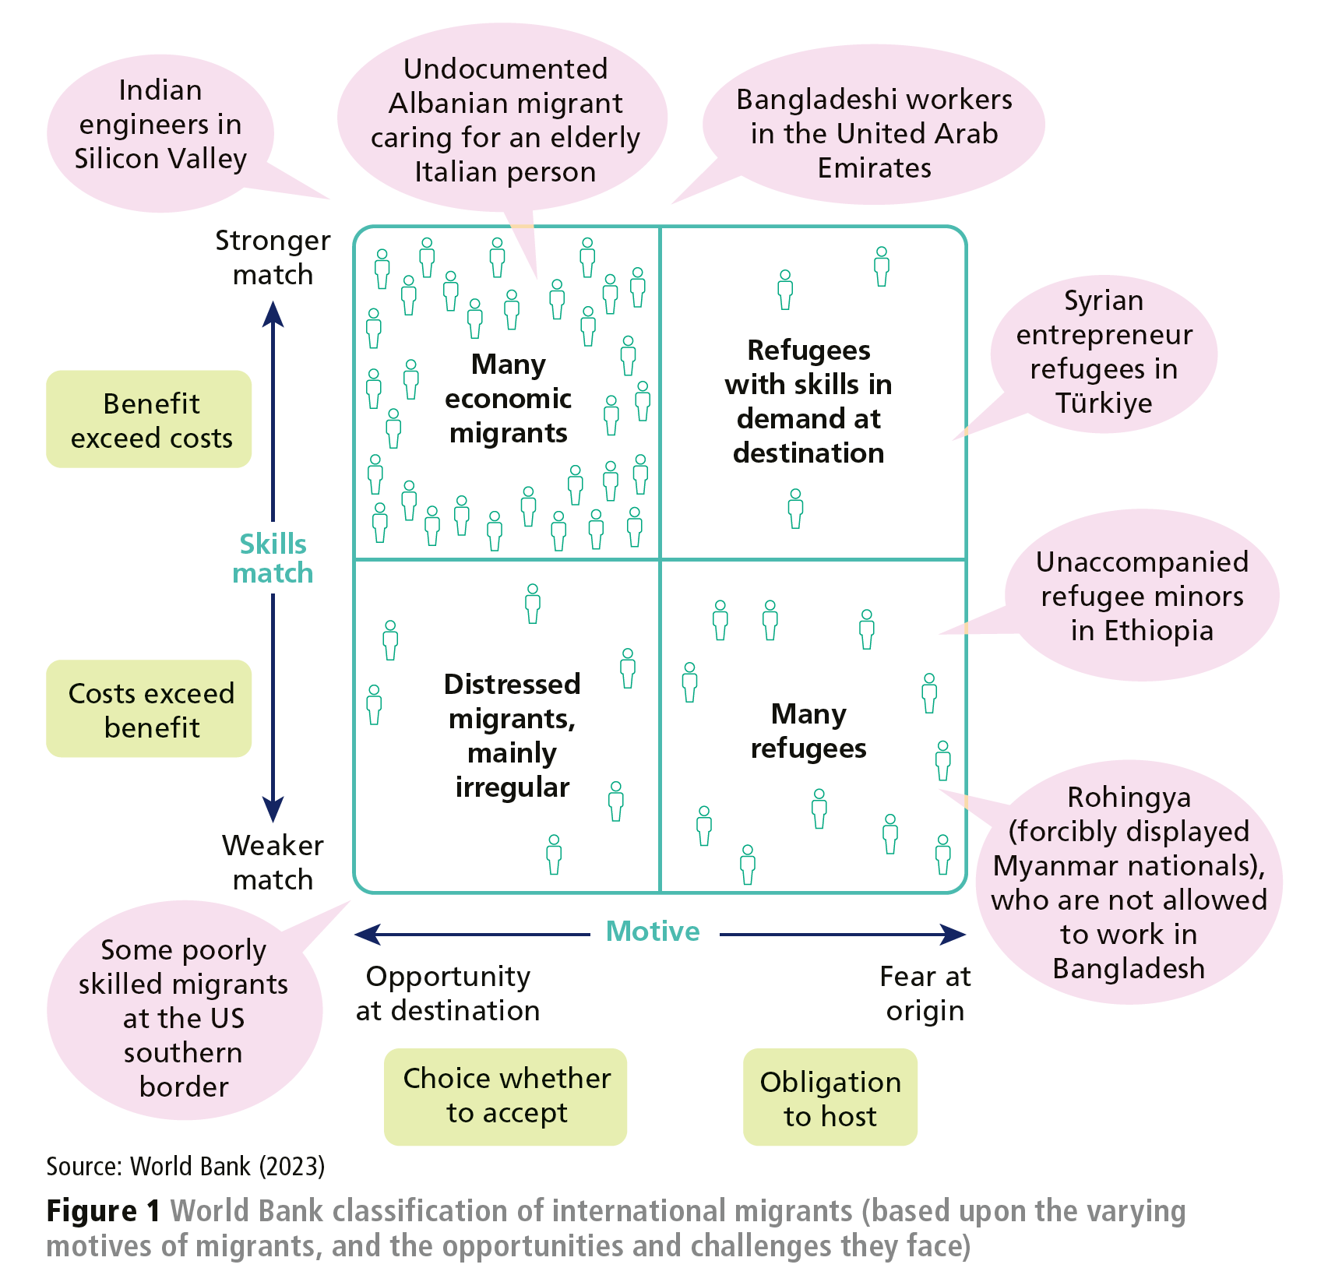
World Bank classifications
The World Bank recently adopted a framework for the classification of international migrants that factors in (i) the geographic contexts of the source and destination regions, (ii) the skills of people who are moving for work, and (iii) the welfare of the migrants. Figure 1 shows this framework, with its four distinct categories:
Many economic migrants - who have a ‘strong skill match’ with their destination.
Refugees with skills in demand at their destination.
Distressed migrants — many of whom are irregular.
Refugees — in need of help and support.
Study Figure 1 on the next slide.
Create a table naming the four types of migrants. Add details to the table outlining the characteristics of each group of migrants.
Notes:
9.57

Slide 6
Choose one type of migrant from Table 1. Carry out your own secondary research to find out more about one of the suggested case study examples.

Slide 7
Contemporary migration factors, causes and influences
Inequality between countries remains the key driver for voluntary economic migration. People move to find improved opportunities for themselves and their families.
Conflict is responsible for a threefold rise in the number of forced migrants since 2010 — up from 38 to 108 million (2023).
Climate change is acting to intensify rural poverty, conflict and migration in some countries. Changes in the global carbon cycle and atmospheric system are impacting on human economic systems in negative ways, forcing more people to migrate.
Covid-19 is an important factor that led to a temporary fall in global migration flows during 2020 (when the pandemic began) and 2021. Between April 2020 and April 2021, over 1 million Indian migrants returned home from UAE (though many have since returned). Global remittance flows also shrank in size, significantly impacting on the economies of India, China, Mexico, the Philippines and Egypt.
Notes:
9.57

Slide 8
Global trends and patterns
The number of people classified as international migrants has grown over time, more than doubling since 1995.
In 2023, an estimated 280 million people — around 3.5% of the world’s population - were living outside their country of origin.
More than two-fifths of international migrants live in low- and middle-income countries of the global South. Mumbai (India), Lagos (Nigeria), Dubai (UAE) and Riyadh (Saudi Arabia) have become major global hubs for international movers.
More than 80 million migrants live in Asia and another 80 million in Europe. Together this comprises around 65% of the world’s international migrant population.
North America is home to 60 million international migrants, 30 million international migrants are distributed throughout Africa’s 54 states, and 30 million live in Latin America, the Caribbean and Oceania.
Notes:
9.57

Slide 9
Global migration corridors
Large labour flows connect some neighbour countries - such as the USA and Mexico, Botswana and South Africa, or Poland and Germany.
Key migration corridors include Bangladesh–India, India–GCC, Kazakhstan–Russia and Abidjan–Lagos (Figure 2). Migration corridors link the US (the world’s largest global hub for migration) with India, the Philippines and China.
Notes:
9.57

Slide 10
Forced migration — update
Around 110 million people have been forced away from home in recent years (2024 data) by persecution, conflict, human rights violations and other events.
Just under half moved internationally while just over a half are IDPs.
The conflict in Syria, which started in 2011, has generated around 7 million refugees and over 6 million IDPs, half of whom are children.
In 2022, during the first year of Russia’s war against Ukraine, nearly 14 million were forced to migrate, following assaults Luhansk, Mariupol, Kharkiv and capital city Kyiv. That represented around 30% of the country’s population of 44 million. 6.5 million people have left Ukraine altogether; large numbers fled to neighbouring Poland and Hungary (Figure 3, next slide).
Nearly three-quarters of the world’s IDPs live in just 10 countries: Afghanistan, Colombia, Democratic Republic of the Congo (DRC), Ethiopia, Nigeria, Somalia, Sudan, Syria, Ukraine and Yemen.
Notes:
9.57

Slide 11
Forced migration — update
Suggest reasons why facts such as these may not be wholly reliable.
Carry out your own secondary research to update the data shown here.
Notes:
9.57

Slide 12
Climate change — update
Climate change will increase rural poverty, conflict and migration in some countries. Changes in the global carbon cycle and atmospheric system are already impacting on human economic systems in negative ways.
Sudan’s semi-arid Darfur region is home to settled farmers but also nomadic groups. Between 2003 and 2005, land grabbing and conflict led to the displacement of 2 million people. In this case, competition over land was exacerbated by drought, desertification and shrinking water supplies. Twenty years later, these troubles persist.
Since 1990, millions of refugees have moved to escape drought in the Horn of Africa; many have moved from Somalia and Ethiopia into neighbouring Kenya. Rainfall was especially poor between 2019 and 2022, leaving millions of Kenyans and Ethiopians at risk of displacement on account of rising food insecurity.
Notes:
9.57

Slide 13
Practice question and answer plan
Evaluate the view that all global migration flows will continue to increase in size
Overall, migration is expected to increase. Key drivers of migration are economic inequality, political instability and climate change. All three factors continue to operate - and may also be intensifying.
However, not all flows will continue to increase. There will also be some cases where flows decrease (e.g. from eastern Europe to the UK, post-Brexit).
It also depends on what time scale we think about. Some economic migration flows may eventually lessen as the global South develops. But climate change refugee flows could increase significantly.

Slide 14
Further research
World Bank report: https://www.worldbank.org/en/publication/wdr2023
World Migration report: https://worldmigrationreport.iom.int/wmr-2022-interactive/
IDPs further information: https://api.internal-displacement.org/sites/default/files/publications/documents/IDMC_GRID_2023_Global_Report_on_Internal_Displacement_LR.pdf
UNHCR facts: https://www.unhcr.org/uk/about-unhcr/who-we-are/figures-glance

Slide 15

This resource is part of Geography Review, a magazine written for A-level students by subject experts. To subscribe to the full magazine go to: http://www.hoddereducation.co.uk/geographyreview
Simon Oakes is the author of Geography: Global Interactions (2023) published by Hodder Education.
Some of the illustrations in this presentation are taken from this book. Other are from Geography Review.
The image of migrants (Slide 1) was created by Bing AI.

