Slide 1
Making connections: Demography and place in Japan
David Redfern

Slide 2
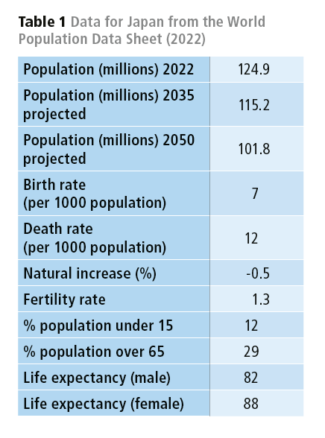
Demography and place in Japan
Why is there a housing crisis in Japan when its population is tumbling?
The table opposite provides some background data for Japan in 2022 from the World Population Data Sheet. You can update the Table here.

Slide 3
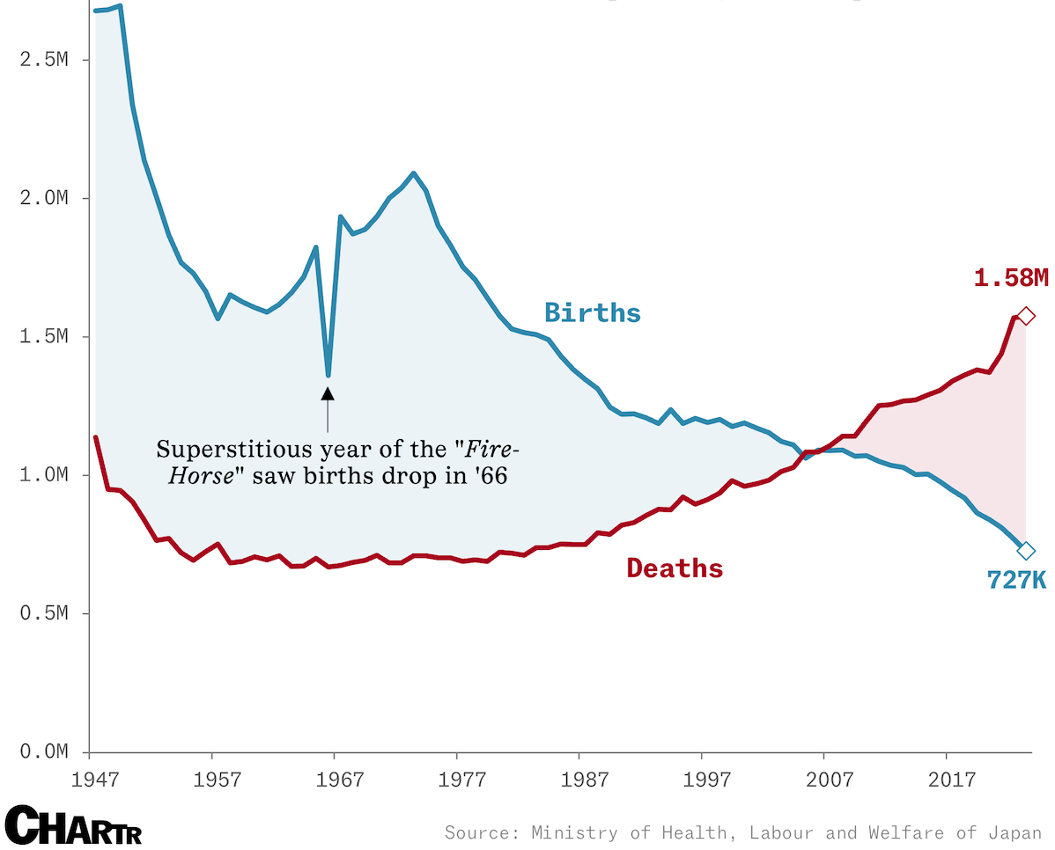
Japan’s population is shrinking naturally
The graph opposite shows the changes in numbers of births and death in Japan between 1947 and 2023 in millions.
There are now more than twice as many deaths in Japan each year as births.

Slide 4
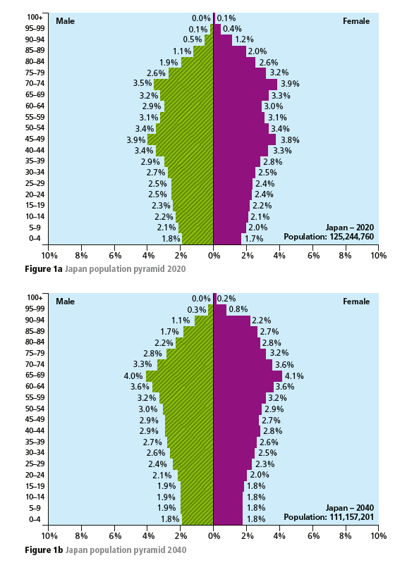
Potential impact on population structure
The Japanese fertility rate (the average number of children a woman has in her lifetime), has fallen to 1.3.
The largest decline in fertility was seen in women aged 25 to 29.
The population pyramids opposite shows the impact of falling fertility rates on the population between 2020 and 2040.
Hodder & Stoughton © 2024

Slide 5
Falling fertility (1)
The birth rate has fallen consistently for 8 consecutive years since 2016. This has been attributed to lower rates of marriage.
To address Japan’s record low birth (and marriage) rates, the Tokyo metropolitan government plans to release a dating app to help connect people who want to marry.
National authorities are seeking to reverse the city’s tumbling birthrate. Data published in June 2024 revealed a record low of 727k births in 2023, a 5.6% decline, an issue compounded by a 6% drop in the number of marriages.
The fee-based app will require legal documentation, tax slips (to verify income), details of personal characteristics such as height and occupation, and a signed letter confirming willingness to get married (rather than being more interested in a casual relationship).

Slide 6
Falling fertility (2)
Economic instability for couples of child-rearing age has been cited as a major contributing factor for falling birth rates.
The government has earmarked trillions of yen to tackle the problem through financial support, childcare services and parental leave, including sponsoring in-person events for singles and offering counselling on marriage.
The region with the lowest fertility rate was Tokyo — only 0.99 (see next slide)

Slide 7
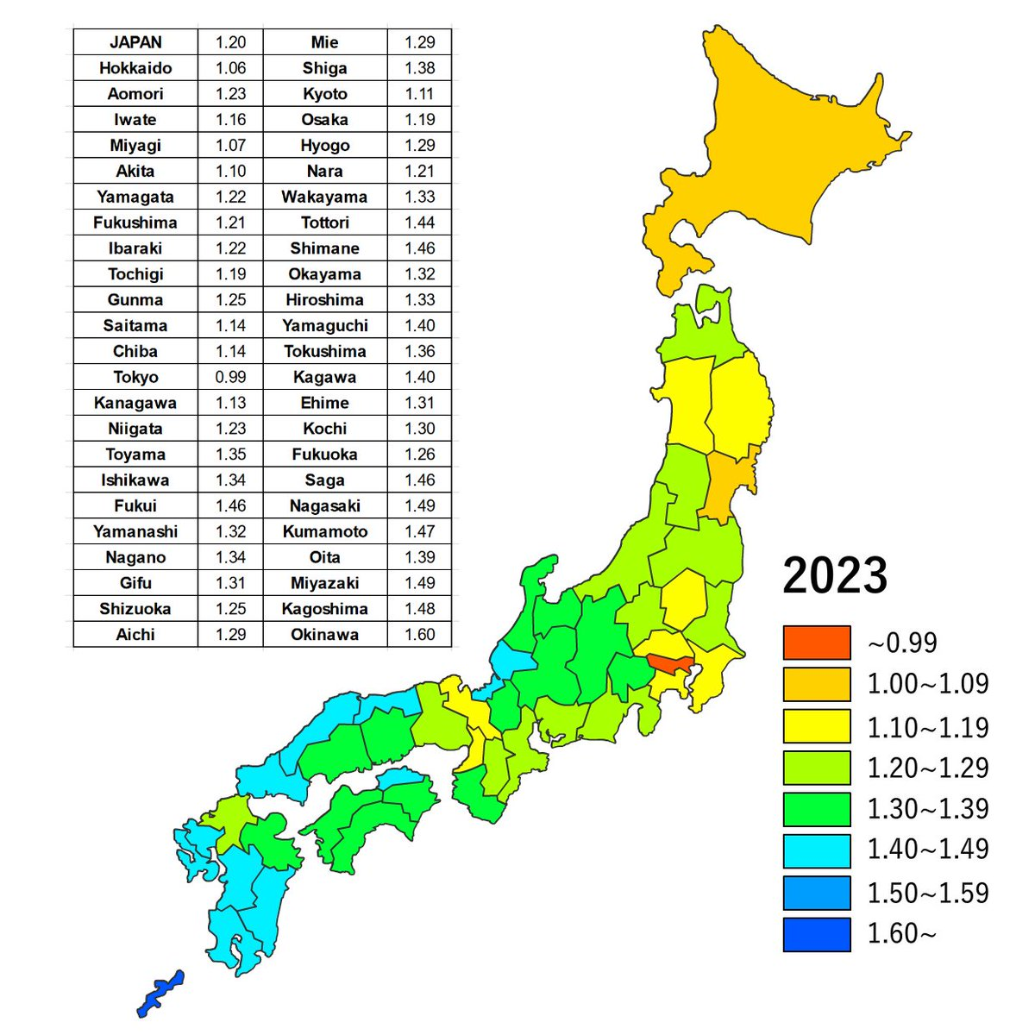
Fertility rates across Japan (by district) 2023
You could describe the regional differences in fertility rates across Japan.
For example:
are there any differences between the north and south of the country, and/or between the different islands that make up Japan?
Source: Nikkei

Slide 8
Other population-related points (2023)
The number of births, excluding foreigners, fell 5.6% from the previous year to 727,277.
The number of deaths increased by 0.4% from the previous year to 1,575,936, a record high.
The number of births has been below the number of deaths for 17 consecutive years.
The decline in the birth rate is due to various factors such as unmarried people and late marriages. The number of marriages fell 6.0% year-on-year to 474,717, falling below 500,000 for the first time since the end of the Second World War.
In Japan, where children born out of wedlock are few, a decrease in the number of marriages directly affects the number of births.

Slide 9
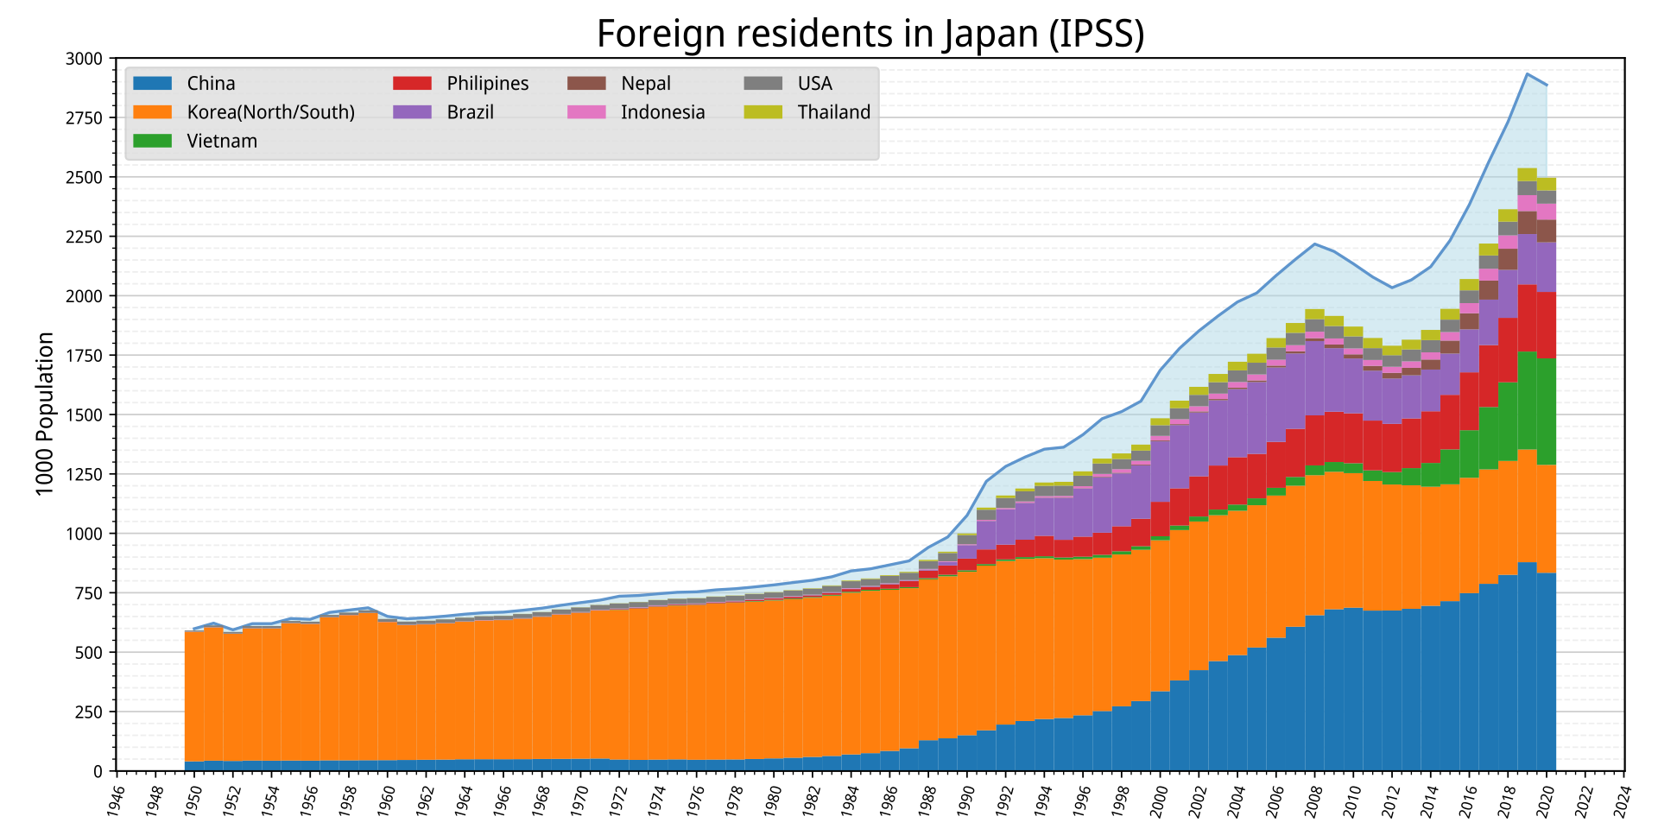
Immigration into Japan
The number of foreign residents in Japan has steadily increased since the Second World War, and the number of foreign residents was more than 2.76 million at the end of 2022.
Being a country with a total estimated population of 125.5 million in 2020, the resident foreign population in Japan amounts to 2.3% of the total population.
The years 2022 and 2023 have seen rising immigration after policy changes seemingly in reaction to labour shortages, particularly in retail and hospitality industries.
‘So far almost all the immigrants are from other Asian countries, which means the ethnic changes are not always visible to visiting Westerners. But it’s a very big deal to Japanese people.’
(Noah Smith)
Source: Yuasan

Slide 10
Elsewhere in eastern Asia
The declining birthrate in eastern Asia is even more serious than in Japan. Factors such as high education costs (including for so-called ‘cramming schools’ to meet the need to pass entrance exams) and housing prices are cited as the reasons for falling birth rates.
South Korea had the lowest fertility rate in the world at 0.72 in 2023. Successive governments have taken measures such as child allowances, subsidies for multi-child households, and insurance coverage for infertility treatments.
In Singapore, which encourages childbirth through subsidies, the fertility rate fell below 1 for the first time at 0.97 in 2023. The cost of living and education is rising. The government has doubled the length of public paid paternity leave that men can take to four weeks.
Taiwan is also suffering from a declining birthrate with a fertility rate of 0.87. Similar factors are cited — soaring housing costs and high education costs.

Slide 11
This resource is part of Geography Review, a magazine written for A-level students by subject experts. To subscribe to the full magazine go to: http://www.hoddereducation.co.uk/geographyreview

