Slide 1
Landscapes, tourism and time
Simon Oakes
© Hodder & Stoughton Limited 2024

Slide 2
Landscapes, tourism and time
Tourist landscapes are a synoptic geography topic.
We are linking ideas drawn from the study of (i) landscapes in physical geography and (ii) changing places in human geography.
This presentation explores people-environment interactions using examples from the UK and Eire (Ireland).

Slide 3
Landscape change over time
Physical landscapes change naturally over time.
They do so because of erosion, transport and deposition processes operating within physical systems.
Changes to physical landscapes that people call home, or are visiting as tourists, can be problematic. The loss of landscape features to erosion can modify or remove place characteristics that people value highly.
A careful balance must be struck between protecting landscapes and allowing them to change naturally.
We can explore examples of both approaches.

Slide 4
Preventing change: Brighton
Housing and infrastructure growth in popular coastal towns means the cost of not ‘holding the line’ against erosion continues to rise - especially when climate change and sea level rise are factored in.
Defences are all that stands between the sea and high-value hotels and businesses in popular resorts like Blackpool and Brighton.
But the planning, construction, maintenance and monitoring of sea walls and groynes in the UK runs to hundreds of millions of pounds each decade.
Each year, Brighton & Hove City Council returns around 15,000 cubic metres of shingle from around the Brighton Marina back to the beaches further west where longshore drift is removing it.
In 2024, a £35 million plan was announced that aims to protect Brighton’s coastline in its entirety — this is a very large investment.

Slide 5
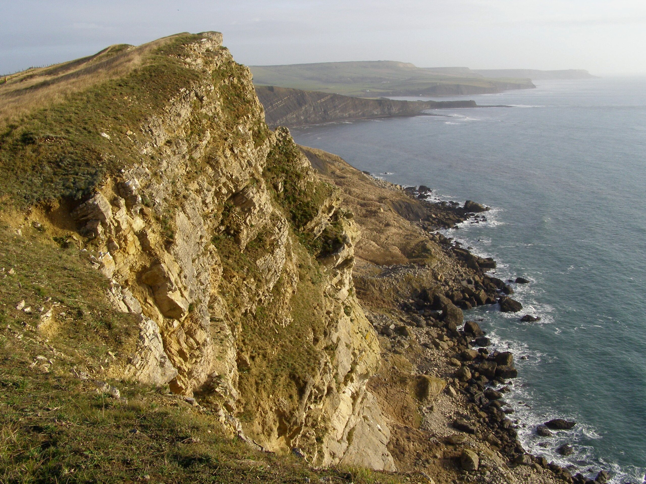
Accepting change: Jurassic Coast
In contrast to Brighton, the Jurassic Coastline (Devon and Dorset) is a place where physical system processes are left alone to operate naturally.

Slide 6
Accepting change: Jurassic Coast
England’s famous Jurassic Coast is a much-visited tourist landscape where erosion is left to take its course, rather than resisted.
Stretching from Exmouth in East Devon to Studland Bay in Dorset, this coastline was granted UNESCO World Heritage Site (WHS) status in 2001, on the grounds of its global importance in geological history — the cliffs contain fossils and rock formations spanning 185 million years.
The Jurassic Coast’s WHS status is central to the marketing, representation and identity of places in this part of England.
However, the landscape’s WHS status is dependent on coastal processes being mostly allowed to operate naturally — continually revealing new fossils and rocks while reshaping the landscape.
Only by permitting natural erosion, the argument goes, will the Jurassic Coast retain its authenticity and geological diversity, thereby offering great opportunities for tourism, education and research.

Slide 7
Accepting change: Jurassic Coast
Embracing erosion as a core element of the Jurassic Coast's place identity is aligned with UNESCO's commitment to sustainable development and future generations.
The UNECSO designation may provide the Jurassic Coast with governance challenges in light of the growing threat from sea level rise. Several tourist towns along the WHS may need coastal defences in the future, including parts of Sidmouth, Lyme Regis, Weymouth and Swanage.
The impact of any defences on erosional processes would need to be examined carefully. Any new defence structures that would affect the natural erosion processes, or obscure the exposed geology.

Slide 8
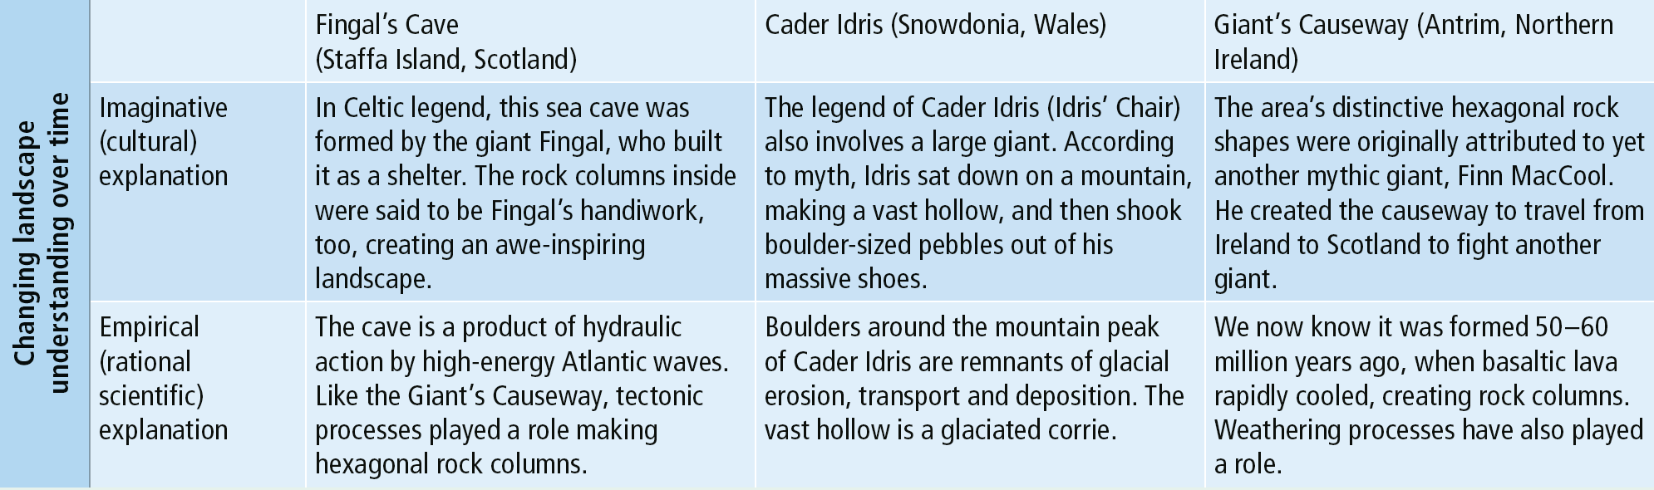
Changing place meanings
The way people understand landscapes has changed over time.
Science now explains the landscapes that tourists enjoy visiting.
But other origin stories continue to capture people's imaginations.
Can you think of any additional examples?

Slide 9
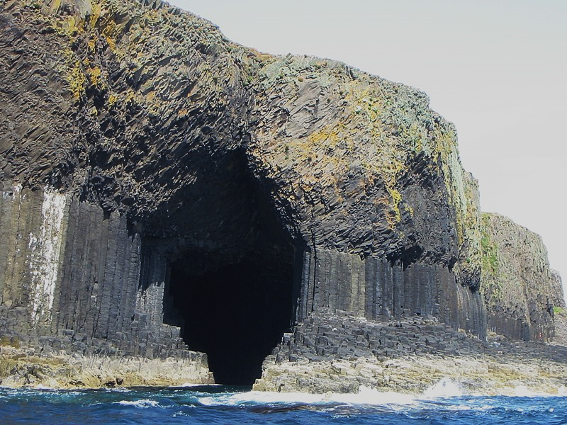
Fingal’s Cave
What physical processes are shaping this coastal landscape?
(In tourist literature, visitors are told that this sea cave was formed by the giant Fingal, who built it as a shelter.)

Slide 10
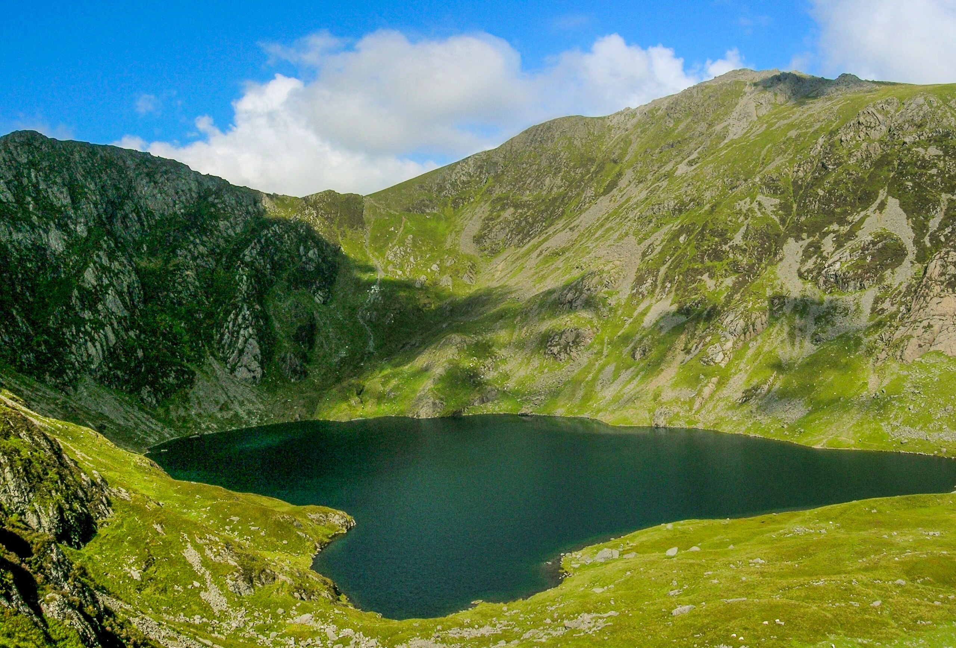
Cader Idris
What physical processes shaped this glacial landscape?
(In tourist literature, visitors are told that a giant called Idris sat down here, making a vast hollow, before shaking boulder-sized pebbles out of his shoes.)

Slide 11
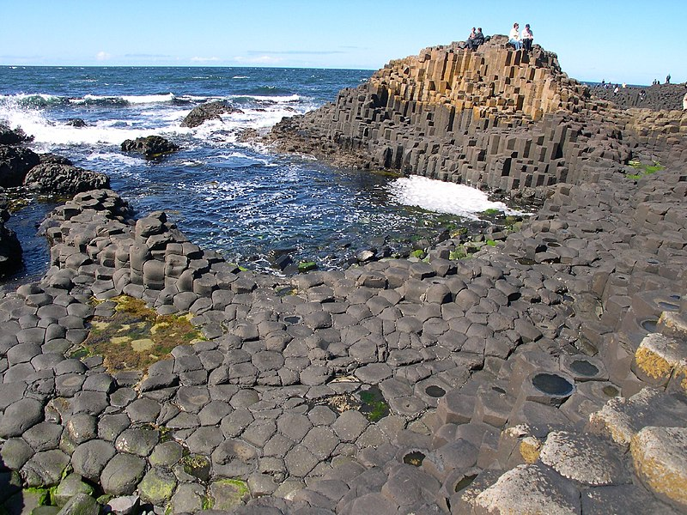
Giant’s Causeway
What physical processes are shaping this coastal landscape?
(In tourist literature, visitors are told that a giant — called Finn MacCool — created the causeway so he could travel from Ireland to Scotland to fight more giants.

Slide 12
This resource is part of Geography Review, a magazine written for A-level students by subject experts. To subscribe to the full magazine go to: http://www.hoddereducation.co.uk/geographyreview
Picture credits
Slide 1, 11 https://en.wikipedia.org/wiki/Giant%27s_Causeway#/media/File:Causeway-code_poet-4.jpg
Slide 5 https://en.wikipedia.org/wiki/Jurassic_Coast#/media/File:Gad_cliff_dorset.jpg
Slide 9 https://commons.wikimedia.org/wiki/File:Staffa_Fingal%27s_Cave_14712.JPG
Slide 10 https://en.wikipedia.org/wiki/Cadair_Idris#/media/File:Cadair_Idris_wide_view.jpg

