Slide 1
Essential topic update: Is globalisation being rebranded?
David Redfern

Slide 2
Is globalisation being rebranded?
This presentation supports the article in Geography Review Vol. 38, No. 1, page 6.
What follows is a series of graphs and maps that provide two of the Figures (1 and 2) in the article together with extra data which can be used to examine the concepts of decoupling, reshoring, near-shoring and ally-shoring.
The data concentrate on the interrelationships between USA, China, Mexico and Russia.
Teachers may want to allow students to analyse the main features of each data set, as is often the case in A level examinations. Short summaries of key points are also provided on some slides.

Slide 3
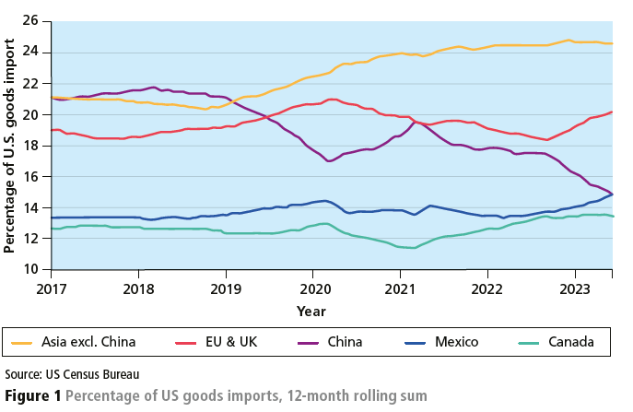
Origin of US goods imports: 12-month rolling sum (%)
Key points:
Significant falls in US imports (%) from China, especially since 2019. In 2024 US tariffs on Chinese electric vehicles (EVs) increased to 100%.
Increases in imports from the EU and UK, Mexico and Asian countries (not China).
Imports from Mexico now exceed those from China.

Slide 4
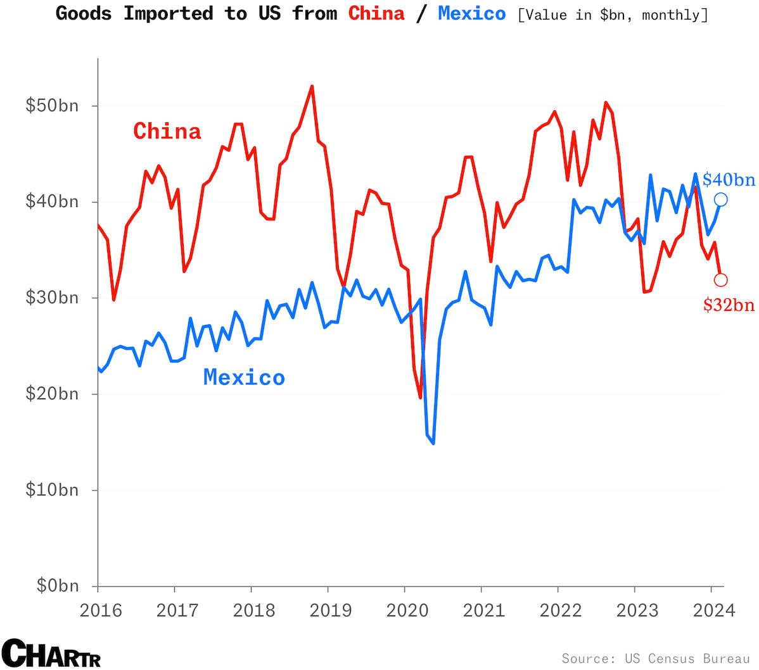
US goods imports by value: China vs Mexico
Key points:
Imports by value from China have oscillated between 2016 and 2024, but with a slight downward trend.
Imports by value from Mexico have almost doubled.
This is a sign of more manufactured goods being imported from Mexico.
Hodder & Stoughton © 2024

Slide 5
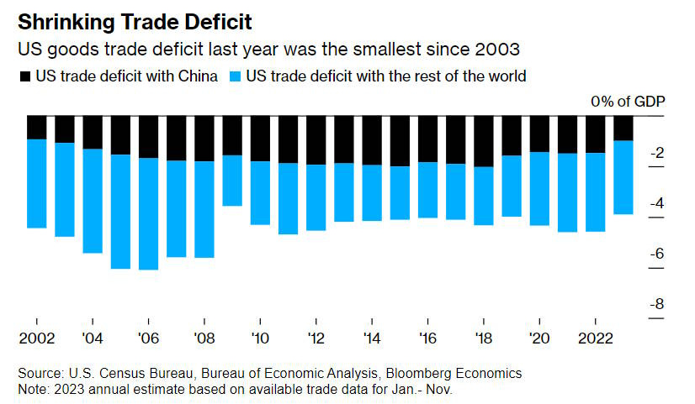
The changing US trade deficit
Key points:
The USA maintains a trade deficit in goods and has done for many years. It balances its trade by net exports of services and raw materials.
During the 2010s half of this deficit was due to trade with China.
In the 2020s the impact of China on the deficit has reduced significantly.
Hodder & Stoughton © 2024

Slide 6
FDI by China into Mexico (1)
China, sometimes known as the ’factory of the world’, is increasingly setting up new manufacturing branches in Mexico. The practice of Chinese companies bringing their production closer to the US — nearshoring — has seen a marked increase.
There are several reasons why foreign businesses may want to set up production outlets nearer to the USA. Saving on shipping is an obvious benefit for any overseas company.
Chinese firms have extra incentives: the strategy allows them to evade tariffs that can reach up to 25% when selling into the US (100% for Chinese-made EVs) — a cost that has risen since the escalation of a trade war (started by President Trump and continued by President Biden) between the countries.
[FDI – Foreign Direct Investment]

Slide 7
FDI by China into Mexico (2)
Those tensions have seen American imports from China drop significantly. In February 2024, the USA bought $32bn worth of Chinese goods, while imports from Mexico totalled $40bn, an increase of 25%.
While nearshoring is a financial benefit for Chinese manufacturers, it has also provided a welcome economic boost to the USA’s southern neighbour.
The Mexican Association of Private Industrial Parks has stated that this a driving force for greater industrial park capacity, with the association anticipating demand for a further 8 million square metres of new commercial space by 2027. (See next slide)

Slide 8
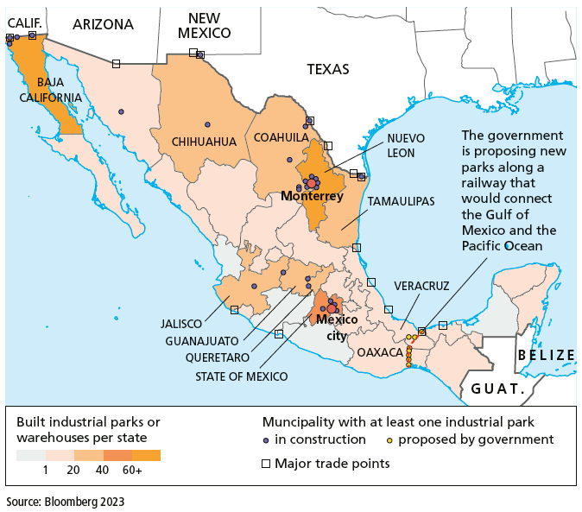
FDI into Mexico
Note:
The new industrial parks/warehouses are concentrated along northern border with USA, near Monterrey, and around the capital Mexico City.
Some are directly adjacent to the US/Mexico border.

Slide 9
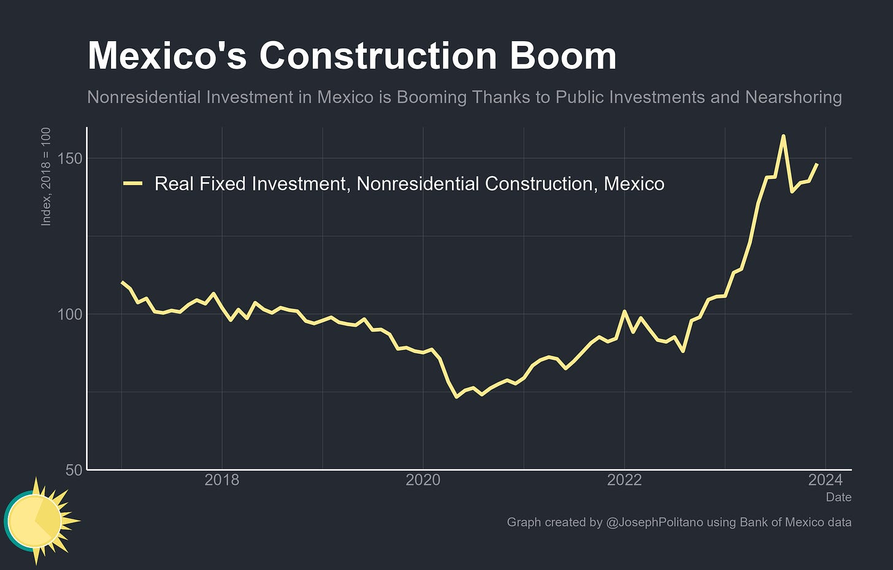
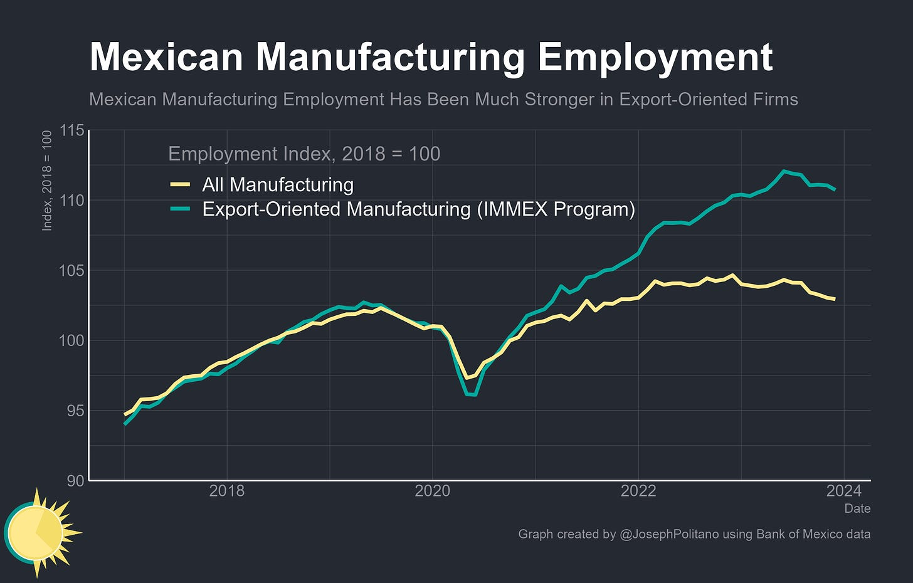
Impact on the Mexican economy (1): Employment in construction and manufacturing
Both graphs show significant increases since mid-2020.
Source: Joseph Politano

Slide 10
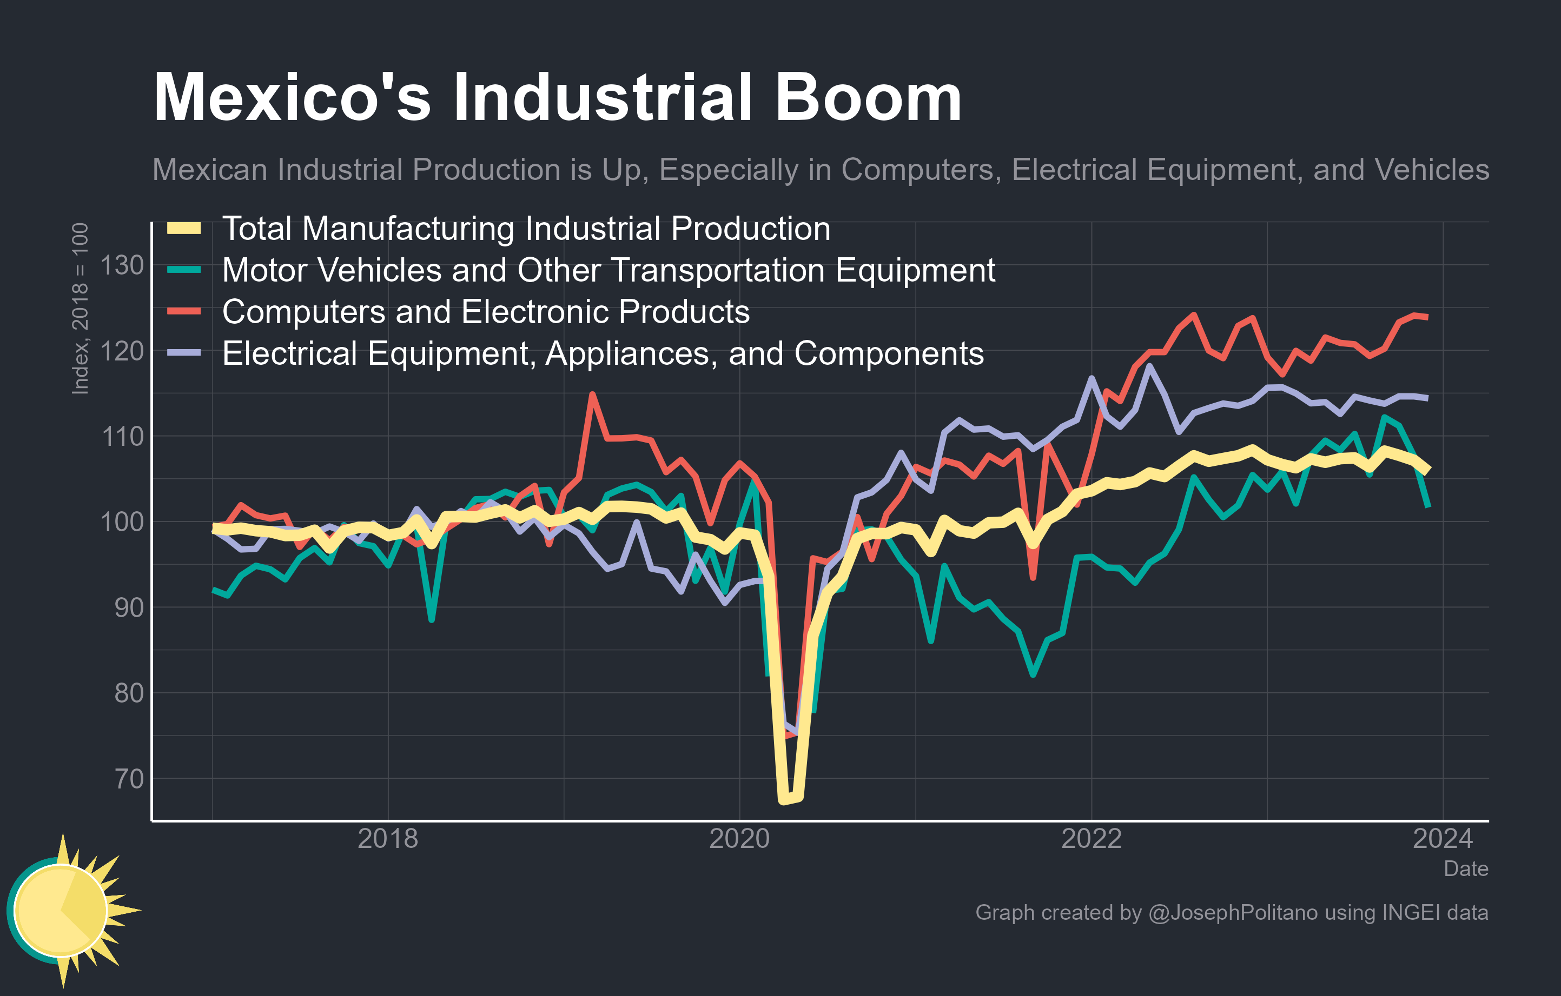
Impact on the Mexican economy (2): Relative rates of increase by type of manufacturing industry (100 = no change)
Note:
The nature of the industries that are growing – they are all high value domestic and consumer goods.
Source:
Joseph Politano

Slide 11
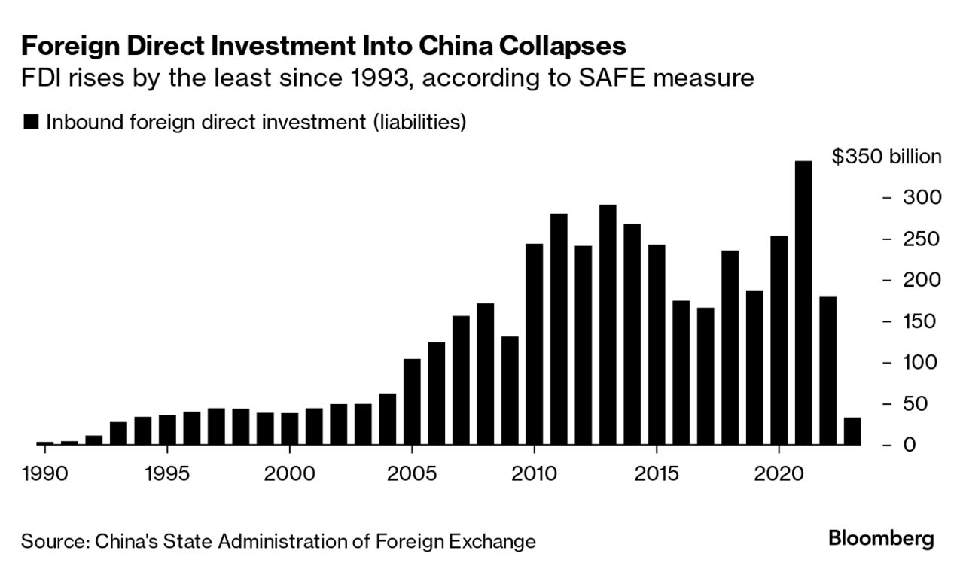
Impact on China (1): FDI into China
Key points:
From 1990 to the early 2010s FDI in China increased regularly.
During the mid 2010s FDI stabilized.
Peak FDI took place in 2021, but since then it has fallen markedly.

Slide 12
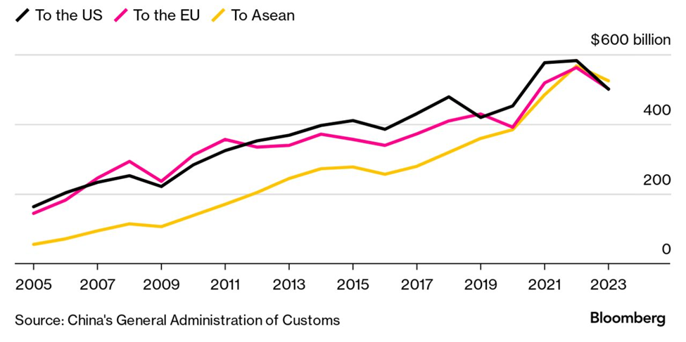
Impact on China (2): Exports to other parts of the world
Key points:
Exports to the USA have fallen, as stated earlier.
Exports to the EU have risen in recent years (except 2023)
Most marked increase in exports is to other Asian countries (ASEAN) e.g Vietnam (except 2023).

Slide 13
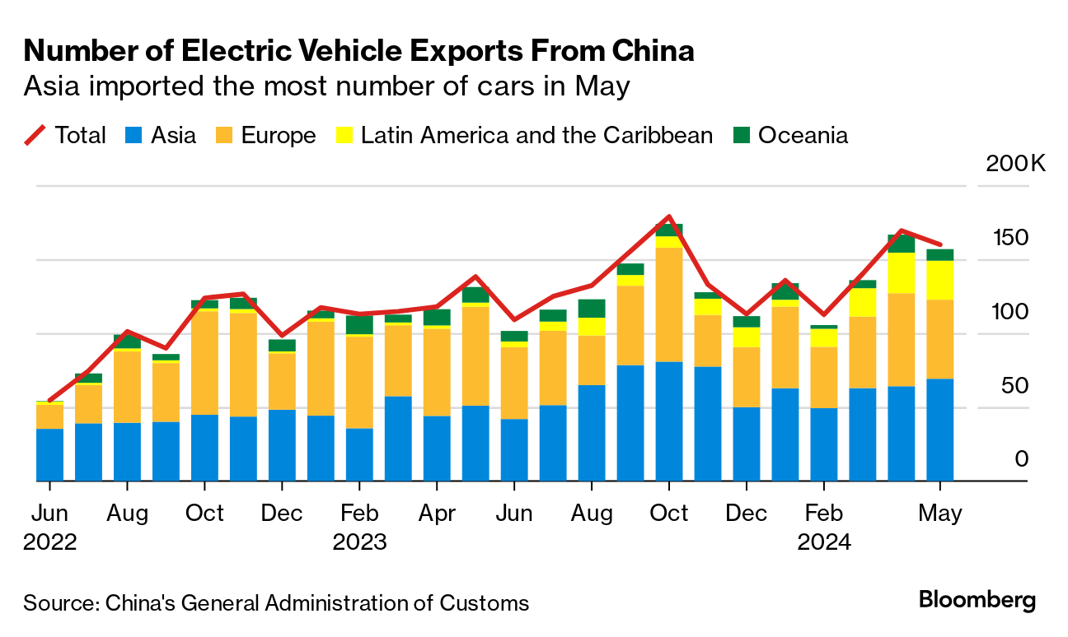
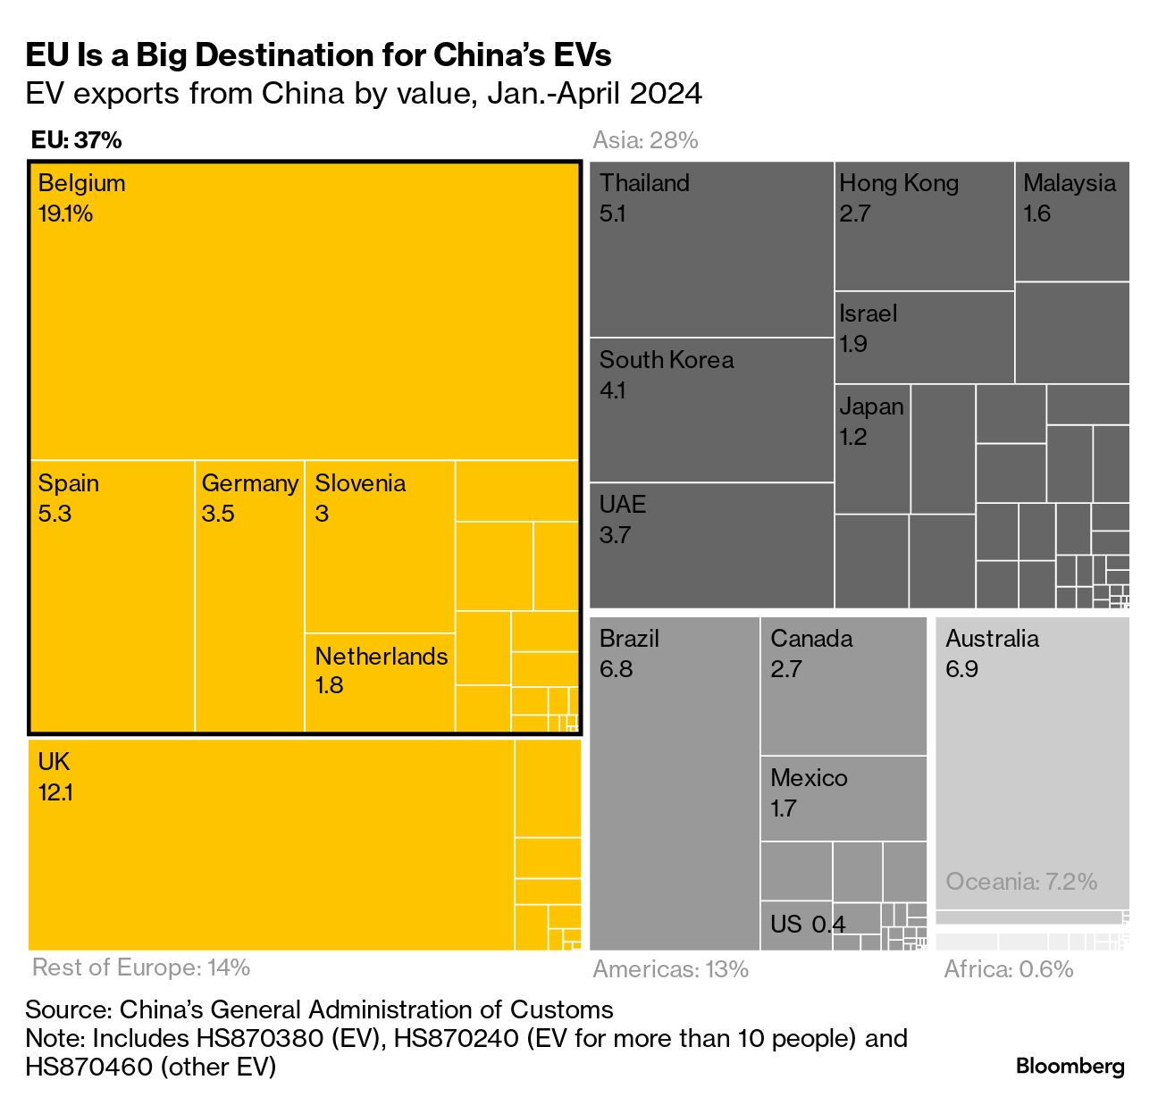
Impact on China (3): Exports of EVs
Key points:
Europe and Asia are the main markets for Chinese-made EVs, including the company BYD.
China has suggested that Germany’s luxury car manufacturers could benefit by a form of reciprocal agreement. (Note: German exports of BMW and Mercedes cars are already high.)

Slide 14
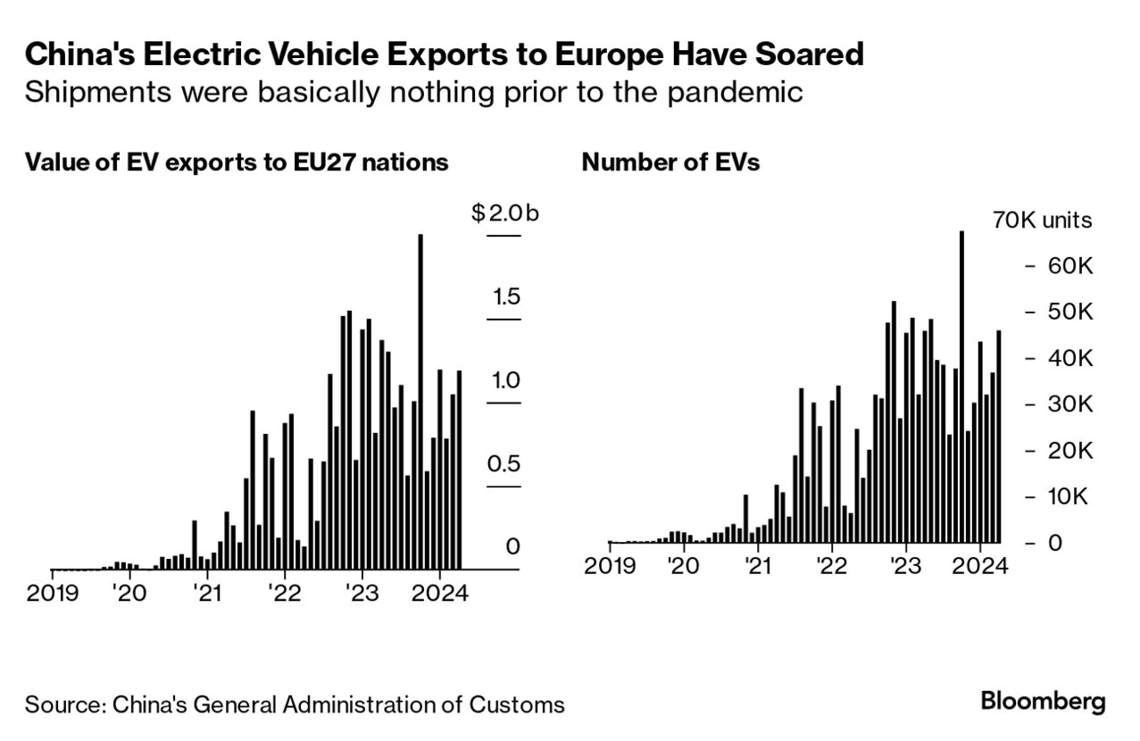
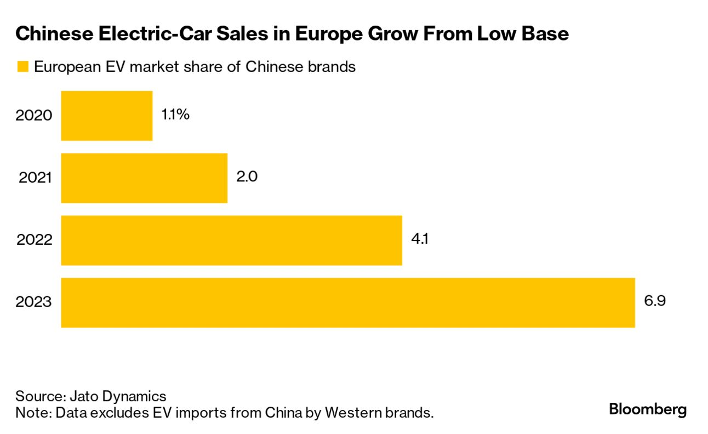
Impact on China (4): Exports of EVs to the EU
Key points:
The growth in EV exports from China to the EU has been rapid – they were very small before the Covid pandemic.
In June 2024 the EU Commission proposed introducing tariffs of up to 38% to restrict the import of Chinese-made EVs into Europe, but this was later withdrawn.

Slide 15
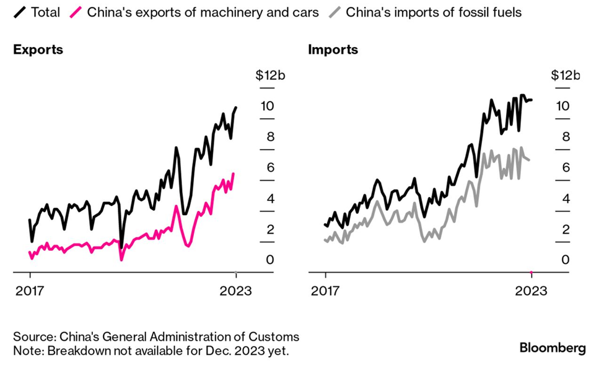
Impact on China (5): China–Russia trade
Key points:
Trade with Russia has increased significantly, particularly since 2020.
China has greatly increased exports of machinery and cars to Russia.
Imports of fossil fuels (mostly oil and gas) have similarly increased.
The war in Ukraine is a factor here.

Slide 16
This resource is part of Geography Review, a magazine written for A-level students by subject experts. To subscribe to the full magazine go to: http://www.hoddereducation.co.uk/geographyreview

