Slide 1

Oceans update
Managing a Global Commons
www.hachettelearning.com/geographyreview
© Hodder & Stoughton Limited 2026

Slide 2
Contents
1 Global governance of the oceans
2 Ocean resources and disputes
3 Ocean pollution and issues
© Hodder & Stoughton Limited 2025

Slide 3
Key terms used in the presentation
Term | Definition
Dead Zones (Hypoxic Zones) | Areas of water where dissolved oxygen levels fall below 2 millilitres per litre. These conditions cannot support most marine life, leading to declines in fish, seagrass, coral, and other organisms.
EEZs (Exclusive Economic Zones) | Areas of the ocean extending up to 200 nautical miles from a country’s coastline, where that country has exclusive rights to explore, use, and manage natural resources in the water and on or under the seabed.
Eutrophication | A process in which excessive nutrients (especially nitrogen and phosphorus) enter water bodies, causing rapid algae and plant growth. When they die and decompose, oxygen levels decrease, leading to hypoxia.
Microplastics | Plastic particles between 5 millimetres and 1 micrometre in size. They can be ingested by marine life and enter the food chain.
Nautical Mile | A unit of measurement used at sea. One nautical mile equals 1.15 land miles or 1.85 kilometres.
Thermal Expansion | The increase in water volume as it warms. As ocean water heats up, molecules move faster and spread apart, causing sea levels to rise.
© Hodder & Stoughton Limited 2026

Slide 4
Global governance of the oceans

Slide 5
In-depth focus: the global commons
Most of the ocean lies within the global commons—shared resources not controlled by any single country. The global commons include: the high seas (oceans beyond 200 nautical miles), the atmosphere, Antarctica and outer space.
Because no one owns these areas, everyone can access them. This often leads to overuse and damage. For example, overfishing and past commercial whaling have depleted marine life. Global commons also become “dumping grounds” for pollution, since no single nation is responsible. This is known as the tragedy of the commons—when shared resources are overexploited because individuals act in their own interest.
Managing global commons requires international cooperation. The Antarctic Treaty System protects Antarctica from exploitation. More recently, the High Seas Treaty aims to protect 30% of the oceans through Marine Protected Areas. However, such agreements depend on strong global commitment and enforcement to succeed.

Slide 6
Earth’s oceans – a global commons
The oceans cover 71% of Earth’s surface and form part of the global commons.
Beyond 200 nautical miles lies the high seas, where no country has sovereignty.
Because these vast areas lack clear ownership, they have often been treated as dumping grounds for waste and pollution.
Yet oceans regulate climate, support biodiversity, provide food and enable global trade.
Damage in one region affects the entire planet.
Understanding how oceans are governed is essential if we are to manage them sustainably and protect this shared resource for future generations.
© Hodder & Stoughton Limited 2026

Slide 7
Ocean governance and UNCLOS
The United Nations Convention on the Law of the Sea (UNCLOS) provides the legal framework for ocean governance.
It establishes maritime zones measured from coastal baselines: a 12‑nautical‑mile territorial sea, a 24‑nautical‑mile contiguous zone and a 200‑nautical‑mile Exclusive Economic Zone (EEZ).
Within the EEZ, states control natural resources but do not have full sovereignty. Beyond these limits lie the high seas and international seabed.
UNCLOS balances national rights with shared responsibilities, yet disputes over boundaries and resources remain common.
© Hodder & Stoughton Limited 2026

Slide 8
Analyse the international legal framework shown in Figure 1. In your answer you should identify:
key distances offshore
how rights and rules change with increasing distance offshore
© Hodder & Stoughton Limited 2026

Slide 9
The extended continental shelf
Unlike other zones, the continental shelf is defined by geology rather than distance alone.
Some countries possess broad continental margins extending beyond 200 nautical miles, known as the Extended Continental Shelf (ECS).
Claims must be scientifically verified by the UN Commission on the Limits of the Continental Shelf.
More than 80 states have submitted claims, often overlapping and causing disputes.
The ECS offers access to valuable seabed resources, increasing its economic importance and political sensitivity.
Slide 11 shows how the extended shelf is established
© Hodder & Stoughton Limited 2026

Slide 10
In-depth focus: making a claim
Article 76 of United Nations Convention on the Law of the Sea (UNCLOS) establishes how coastal states define the outer limits of their extended continental shelf (ECS). A state must first demonstrate the natural prolongation of its continental margin, either by measuring sediment thickness beneath the seabed (the “Gardiner Line”) or by identifying the foot of the continental slope and applying a 60-nautical-mile formula (the “Hedberg Line”).
Once entitlement is established, the outer limit is constrained by one of two maximum “cut-off” lines: either 350 nautical miles from coastal baselines, or 100 nautical miles beyond the 2,500-metre isobath (contour line). States may choose whichever formula is most advantageous.
Proposed outer limits are submitted to the Commission on the Limits of the Continental Shelf (CLCS), a body of 21 scientific and technical experts. Based on its recommendations, states finalize their ECS boundaries beyond 200 nautical miles. Although data collection is complex and costly, the process ensures internationally recognized and legally secure outer limits.

Slide 11
Figure 3 gives an insight into ways of establishing the outer limits a territory’s continental shelf. Can you see why it is a complex task?
© Hodder & Stoughton Limited 2025

Slide 12
Ocean resources and disputes

Slide 13
Resource competition and disputes
Marine resources drive many maritime disputes.
Offshore oil and gas within 200 nautical miles account for roughly 30% of global oil production.
As demand grows, attention is shifting toward deeper waters and ECS regions.
More than 20 countries have issued exploration leases in extended shelf areas.
Competition over hydrocarbons, fisheries and minerals raises geopolitical tensions.
Balancing economic development with environmental protection is increasingly difficult, making international cooperation and dispute resolution essential.
© Hodder & Stoughton Limited 2026

Slide 14
Beyond national jurisdiction
Two areas lie beyond national jurisdiction: the high seas and the international seabed.
The high seas cover about 64% of ocean space and allow freedoms such as fishing and scientific research.
The international seabed, covering over half of the ocean floor, is managed collectively through the International Seabed Authority (ISA).
States must gain ISA approval to mine seabed minerals.
As technology advances, managing these vast and remote areas sustainably becomes more challenging.
© Hodder & Stoughton Limited 2026

Slide 15
Seabed mining prospects
Seabed mining has been debated for decades.
Mineral resources on the international seabed are classified as the ‘Common Heritage of Mankind.’
Deposits include polymetallic nodules, sulphides near hydrothermal vents, and cobalt-rich crusts on seamounts.
These contain metals such as cobalt, copper and rare earth elements used in electronics and renewable energy.
While economically attractive, deep-sea ecosystems are fragile and poorly understood, raising serious environmental concerns about large-scale extraction.
© Hodder & Stoughton Limited 2026

Slide 16
Calls for a pause
Environmental risks have led many countries to question seabed mining.
Deep-ocean habitats contain rare species and recover extremely slowly from disturbance.
Mining may also threaten fisheries, particularly in regions overlapping tuna grounds in the Pacific.
Concerns about heavy metal contamination and biodiversity loss persist.
By late 2025, around 40 countries supported a pause or moratorium on mining. The precautionary approach argues that limited scientific knowledge justifies restraint.
© Hodder & Stoughton Limited 2026

Slide 17
Ocean pollution and issues

Slide 18
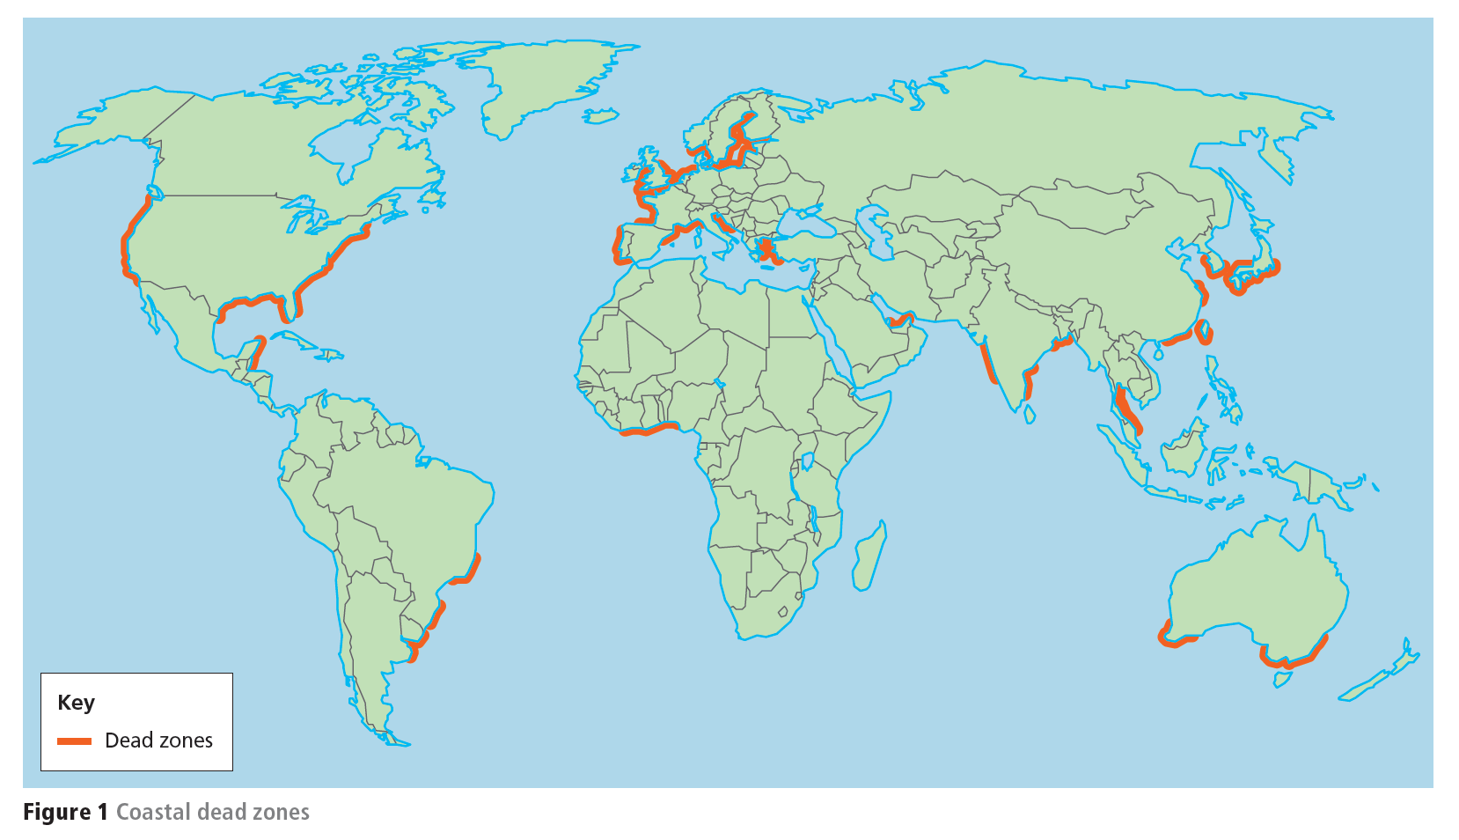
Pollution and dead zones
Ocean dead zones have increased by over 400% since the 1950s.
They form when nutrient runoff from agriculture, sewage and industry causes eutrophication.
Algal blooms remove oxygen from the water, creating hypoxic conditions that kill marine life.
Semi-enclosed seas are especially vulnerable. In 2025, a severe algal bloom off Adelaide killed hundreds of species and stretched 500 km.
Rising fertiliser use worldwide suggests the problem could worsen without stronger pollution controls.
The next slide shows the global distribution
© Hodder & Stoughton Limited 2026

Slide 19
Visualising data flows
Study the map of global data flows in 2017.
Describe the pattern.
Explain possible ways this pattern has changed since 2017.
Suggest how greater uptake of AI by different societies might affect this pattern in the future.
Study Figure 1.
Describe the pattern of dead zones in Asia.
Suggest reasons for this pattern.
© Hodder & Stoughton Limited 2025

Slide 20
Plastic pollution
Each year, 8–14 million tonnes of plastic enter the oceans.
Most originates on land and travels through rivers.
Plastic does not biodegrade but fragments into microplastics and nanoplastics over centuries.
Large debris entangles marine animals, while tiny particles enter the food chain and potentially human bodies.
Despite widespread awareness, global efforts to reduce plastic pollution remain limited.
Improved waste management and reduced plastic production are urgently needed.
© Hodder & Stoughton Limited 2026

Slide 21
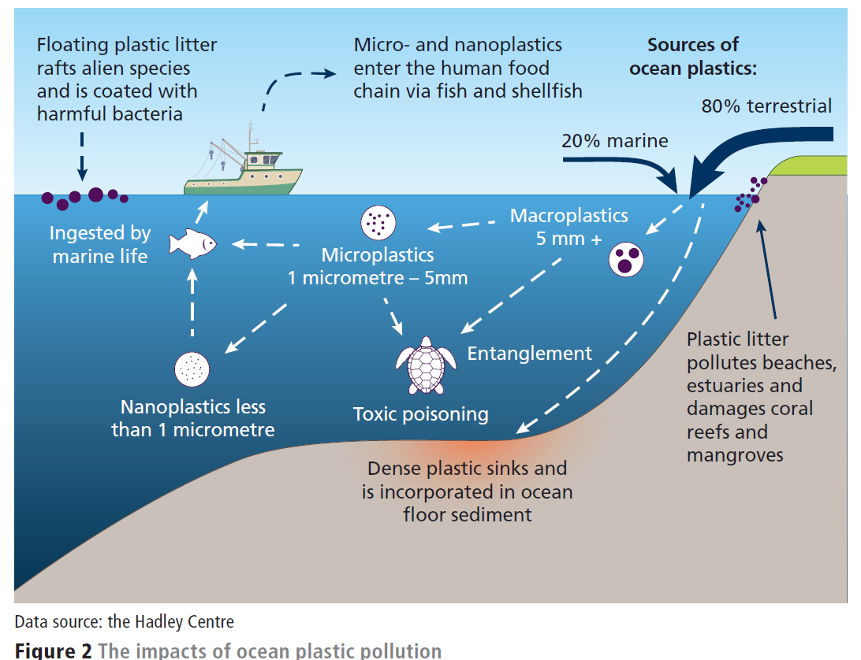
Study Figure 2.
Identify the sources of ocean pollution.
Explain why this pollution is harmful to ecosystems.
© Hodder & Stoughton Limited 2025

Slide 22
In-depth focus: taking global action
In 2022, the United Nations launched negotiations for a Global Plastic Pollution Treaty. After five rounds, talks culminated in Geneva in August 2025 but ended without agreement, leaving the process stalled.
Supporters of a strong treaty aim to phase out many single-use plastics, design products for easy recycling, reduce primary microplastics that enter oceans via rivers and drains, and strengthen global waste management.
Disagreement centers on production limits: the High Ambition Coalition seeks cuts to new plastic production, while several oil-producing nations prefer focusing on recycling, as plastics are primarily made from crude oil feedstocks.

Slide 23
Impacts of ocean shipping
Global trade depends on 50,000–60,000 ships operating at any time.
Container traffic has risen sharply since 2000 and is expected to keep growing.
Shipping spreads invasive species, produces noise pollution and occasionally causes oil and waste spills. Vessel strikes also threaten marine mammals.
Although international agreements exist, enforcement challenges remain.
Cleaner technologies and stricter monitoring are necessary to reduce environmental impacts.
© Hodder & Stoughton Limited 2026

Slide 24
Ocean warming trends
Ocean warming is one of the most serious threats to marine ecosystems.
Since 1990, global sea surface temperatures have risen about 0.5°C above the 1961–90 average.
Warming is accelerating in some regions, particularly the Arctic.
Higher temperatures damage coral reefs, seagrass and mangroves,
and contribute to sea-level rise through thermal expansion.
Without global climate action, local conservation efforts may not succeed.
© Hodder & Stoughton Limited 2026

Slide 25
Oceans and the carbon sink
Ocean warming is one of the most serious threats to marine ecosystems.
Since 1990, global sea surface temperatures have risen about 0.5°C above the 1961–90 average.
Warming is accelerating in some regions, particularly the Arctic.
Higher temperatures damage coral reefs, seagrass and mangroves, and contribute to sea-level rise through thermal expansion.
Without global climate action, local conservation efforts may not succeed.
© Hodder & Stoughton Limited 2026

Slide 26
Study Figure 3.
Analyse the trend shown.
Using Figure 3 and your own understanding, suggest reasons for the changes shown.
© Hodder & Stoughton Limited 2025

Slide 27
Study Figure 4.
Using Figure 4 and your own understanding, evaluate the severity of the impacts shown.
© Hodder & Stoughton Limited 2025

Slide 28
Questions for discussion
1
2
3
4
Why is it so difficult to reach international agreements on managing the oceans?
To what extent are rising ocean temperatures the main threat oceans face?
Would the oceans be in better, or worse, health if they were the sovereign territory of individual states rather than part of the global commons?
Oceans cannot be managed sustainably and have now reached a ‘tipping point’.
Do you agree or disagree with this statement, and why?
© Hodder & Stoughton Limited 2026

