Slide 1

Data centre patterns and trends
Simon Oakes
www.hachettelearning.com/geographyreview
© Hodder & Stoughton Limited 2026

Slide 2
Contents
1 Global systems and data centres
2 AI and data centre growth
3 Evaluating the challenges
© Hodder & Stoughton Limited 2025

Slide 3
Global systems, data flows and data centres

Slide 4
Global systems and data flows
Data flows are now as vital as movements of goods, money, people and ideas in global systems.
Digital networks enable instant communication, coordinate trade and finance, shape culture and support decision making.
Their speed and scale intensify interdependence, inequality and vulnerability, making governance, security and access key geographical concerns today.
But data must be stored somewhere – data centres are the focus on this presentation, along with the way artificial intelligence (AI) is driving demand further for data flows and stores.
© Hodder & Stoughton Limited 2025

Slide 5
Visualising data flows
Study the map of global data flows in 2017.
Describe the pattern.
Explain possible ways this pattern has changed since 2017.
Suggest how greater uptake of AI by different societies might affect this pattern in the future.
© Hodder & Stoughton Limited 2025

Slide 6
Data centres
Data centres (sometime called server farms) are hubs for global communications networks.
They are the physical sites where data is stored and accessed by internet users. The ten largest server farms in the world are mostly located in the USA – but many more are planned globally to meet growing demand for AI services.
Data centres are often built in places with reliable electricity, strong internet connections and cool climates that reduce the need for energy-intensive cooling, thus enhancing sustainability.
Governments and companies compete to host data centres because they bring investment, infrastructure and skilled jobs.
© Hodder & Stoughton Limited 2025

Slide 7
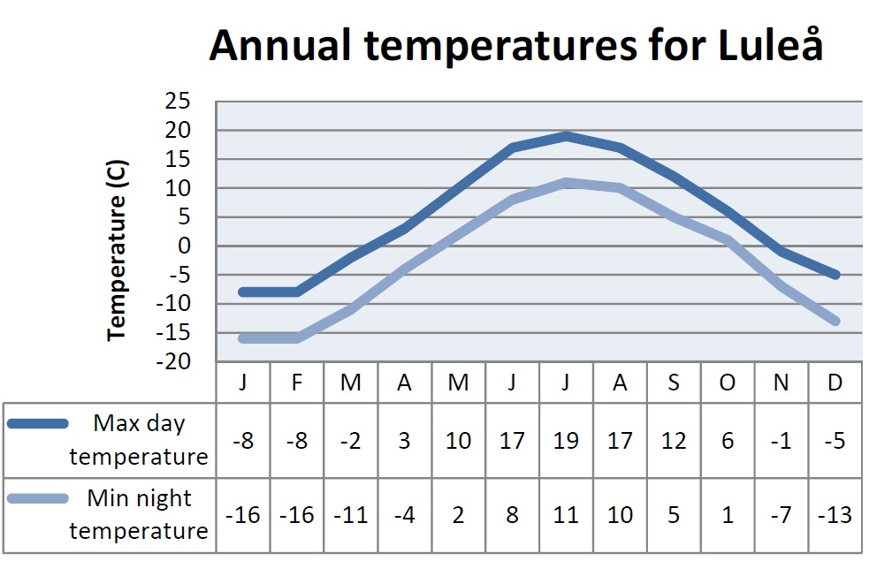
Data centre case study: Luleå, Sweden
Luleå in northern Sweden is a data-centre hub. Its cold climate lowers cooling costs, while abundant renewable hydroelectric power reduces carbon emissions.
100 km south of the Arctic Circle, this is a subarctic climate with short, mild summers and long, cold and snowy winters.
Winter temperatures are below freezing; summertime highs rarely climb above 25 degrees Celsius. For around eight months, the high-power computer equipment will cool itself at no cost using the icy outside air.
The low relief site also offers flat land with room for expansion (on a glacially-eroded wide valley floor).
The next slide shows the climate graph
© Hodder & Stoughton Limited 2025

Slide 8
Data centre case study: Luleå, Sweden
Study the climate chart.
Describe annual variations in temperature.
Explain why this place is a suitable location for data centres.
© Hodder & Stoughton Limited 2025

Slide 9
Artificial Intelligence (AI) and data centre growth

Slide 10
The rapid rise of AI
Artificial intelligence (AI) has been rolled out at speed since 2022. It includes digital systems and devices capable of performing tasks associated with human intelligence, such as learning from data, solving problems and making decisions.
AI appears in many familiar forms, including virtual assistants and the control systems of self-driving vehicles.
Major technology TNCs like Nvidia and Google are promoting its use across business, government, the military, public services, education and daily life.
© Hodder & Stoughton Limited 2025

Slide 11
The energy demands of AI
AI depends on vast data centres filled with powerful hardware for storing and processing enormous amounts of data.
A single centre can require as much energy as a small town and must use additional cooling systems. These energy costs are largely
The number of data centres worldwide is growing rapidly as demand for artificial intelligence, cloud computing, and digital services increases.
These facilities form the physical backbone of the digital economy, storing and processing vast quantities of information every second.
“AI demands a world of increased not reduced energy supply. It forces governments to accelerate phasing-out fossil fuel combustion.”
Noel Castree, Geography Review 39(3)
© Hodder & Stoughton Limited 2025

Slide 12
Evaluating the challenges

Slide 13
AI and the climate challenge
Because most global energy still comes from fossil fuels, expanding AI infrastructure risks increasing greenhouse gas emissions. Some data centres are even located near coal- or gas-fired power stations, potentially undermining climate-reduction efforts.
At the same time, AI’s huge energy demand may pressure governments to accelerate the shift toward renewable energy. Although AI was not created to solve climate change, its growth could indirectly push faster action toward cleaner energy systems.
© Hodder & Stoughton Limited 2025

Slide 14
Beyond Earth?
Some technology leaders, including Elon Musk, have discussed the possibility of building data centres in space.
Space-based facilities could use constant solar energy and reduce pressure on Earth’s land and power systems, but they would raise major technical, economic, and legal challenges.
Outer space is considered a global commons, meaning it belongs to all humanity rather than any single country or company. Expanding digital infrastructure into space would therefore require international cooperation, regulation and careful debate about fairness, access and environmental responsibility.
© Hodder & Stoughton Limited 2025

Slide 15
Questions for discussion
1
2
3
4
Outline how the expansion of data centres might affect local environments, including water use, land use and biodiversity.
How far might the economic benefits of data centres—such as jobs and investment—outweigh their environmental costs for local communities?
Explain possible ways in which the global distribution of data centres could reinforce or reduce existing inequalities between richer and poorer countries and regions.
‘Data flows are less of an environmental threat than trade flows.’
Do you agree or disagree with this statement, and why?
© Hodder & Stoughton Limited 2025

Slide 16

Further reading
1
Simon Oakes is the author of Geography: Global Interactions (source of Slide 5 image)
© Hodder & Stoughton Limited 2025

