Slide 1

Global trade and tariffs
Simon Oakes
www.hachettelearning.com/geographyreview
© Hodder & Stoughton Limited 2025

Slide 2
Contents
1 Tariffs and free trade
2 Why are tariffs on the rise?
3 Evaluating the impacts of tariffs
4 Conclusions and questions
© Hodder & Stoughton Limited 2025

Slide 3
Key terms used in this presentation
Global flow
Tariff
Free trade
Supply chain
Globalisation
Reshoring
Superpower
Shrinking world
© Hodder & Stoughton Limited 2025

Slide 4
Key terms used in this presentation
Worldwide movements of goods, people and information
Taxes imposed by government on imported goods
Trade between countries that is relatively free of restrictions like tariffs and quotas
The linked businesses that contribute to the production and distribution of certain goods
Increasing worldwide connections via flows of trade, data and people
When a TNC closes an overseas factory and returns production to its home country
A state with dominant global economic or military power & cultural influence (soft power)
The idea that global connections reduce perceived distance between places
© Hodder & Stoughton Limited 2025

Slide 5
Tariffs and free trade

Slide 6
What are tariffs?
Tariffs are taxes imposed by governments on imported goods, usually paid by buyers.
For instance, the UK Global Tariff (UKGT) applies to imports unless a free trade agreement exists.
Tariffs increase import costs, often leading to higher consumer prices.
According to economic theory, free trade – without tariffs - brings the benefits of lower prices and broader access to goods.
© Hodder & Stoughton Limited 2025

Slide 7
Key economic theories and ideas
Comparative advantage is an economic theory that supports free trade by arguing that countries should specialise in producing and exporting goods and services where they have a lower opportunity cost.
Through trade, countries achieve economies of scale, lowering unit costs. This specialisation and trade make goods cheaper globally, supporting prosperity through interdependence.
These theories and ideas are used to support the argument that free trade (trade without tariffs or other restrictions) is in the best interest of all countries and people.
© Hodder & Stoughton Limited 2025

Slide 8
A brief history of global tariffs and trade
High tariffs have historically harmed global growth. After World War I, protectionism surged - exemplified by the 1930 Smoot-Hawley Tariff Act - which triggered retaliation, collapsed trade and deepened the Great Depression.
After 1945, new global agreements reduced trade barriers and encouraged growth. Institutions like the IMF, World Bank and GATT promoted cooperation.
Lower tariffs enabled globalisation, supply chain growth and technological innovation.
© Hodder & Stoughton Limited 2025

Slide 9
The superpower influence of the US
During the 1945-2000 period of global governance, the US used its superpower status to build a global free trade system. Its economic and military dominance shaped postwar trade rules and global order.
The prevailing view was that interdependence prevented wars and encouraged prosperity.
NAFTA (1994) created a vast free trade zone between the US, Canada and Mexico, boosting regional trade and investment. Firms like Fender benefited from lower production costs.
© Hodder & Stoughton Limited 2025

Slide 10
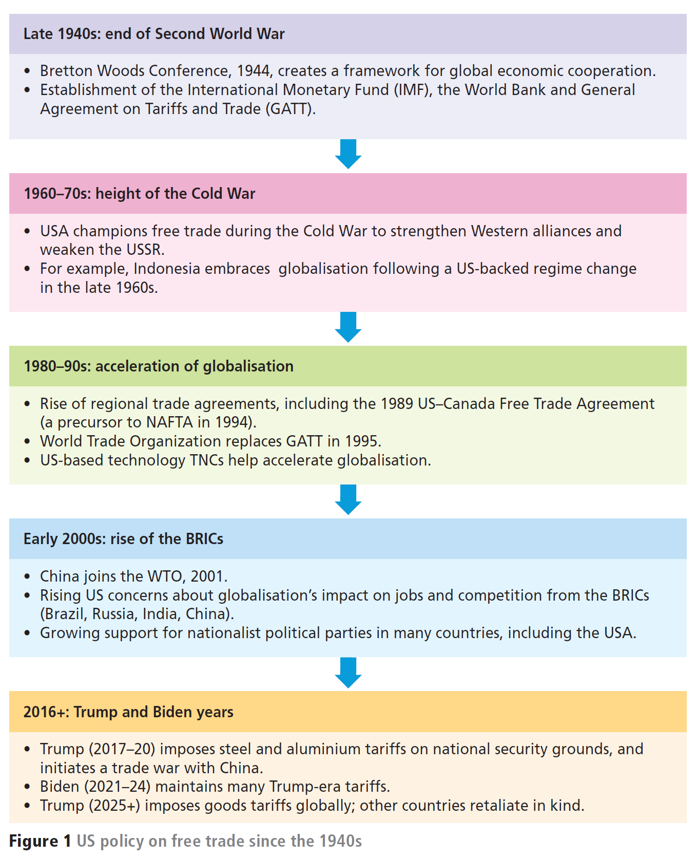
1945-2000 US influence on trade and global governance
In these first three time periods, the US was a key player in the promotion of global free trade and globalisation
© Hodder & Stoughton Limited 2025

Slide 11
Why are tariffs on the rise?

Slide 12
Free trade’s localized costs
While global free trade boosted growth, it caused job losses and deindustrialisation in some Global North regions, with many US jobs offshored to Mexico.
US manufacturing declined further after China joined the WTO (2001).
These changes helped deepen inequality, especially in the US Rust Belt - a region in the northeastern and midwestern US that used to be the heart of American manufacturing and industry (cities like Detroit, Cleveland, Pittsburgh and Buffalo had been famous for producing steel, cars and machinery).
Economic decline in these places complicates any evaluation of free trade’s overall benefits for the US or other deindustrialised countries like the UK and France.
© Hodder & Stoughton Limited 2025

Slide 13
“Tariff is the most beautiful word in the dictionary.”
President Trump’s tariffs
Returning to the White House in 2025, Trump reversed US support for free trade.
Early in his second term, he imposed:
25% tariffs on imported steel and cars
145% tariffs on Chinese goods (except phones)
10–50% tariffs on goods imported from other countries, including the EU and UK.
China and others retaliated with their own tariffs – as part of a new ‘trade war’.
© Hodder & Stoughton Limited 2025

Slide 14
President Trump’s tariffs
Trump cited three justifications for his use of tariffs:
Negotiating leverage over foreign policy goals. One stated aim of imposing tariffs on Canada and Mexico was to force both governments to work harder at curbing illegal flows of migrants and drugs into the US.
Promoting domestic industry and reshoring jobs. The aim being to encourage large transnational corporations (TNCs) to bring factory production back to the US, creating more jobs.
Raising government revenue. However, experts question the sustainability of tariff income claims (because if US companies eventually stop importing goods, then no import taxes will be paid).
© Hodder & Stoughton Limited 2025

Slide 15
2000+ US influence on trade and global governance
More recently, there has been rising scepticism within the US about the benefits of free trade.
President Trump believes free trade brought more costs than benefits to the US.
© Hodder & Stoughton Limited 2025

Slide 16
Evaluating the impacts

Slide 17
Thinking like a geographer
Recent US tariff decisions have ‘ripple effects’ that spread worldwide, affecting different places and societies over varying spatial and temporal scales.
Thinking geographically about tariffs means analysing interconnections between local economies and environments in an interdependent world.
Geographers will want to explore:
The complexity and scale of supply chain changes
The possible long-term place changes
The interconnected global effects
The environmental implications.
© Hodder & Stoughton Limited 2025

Slide 18
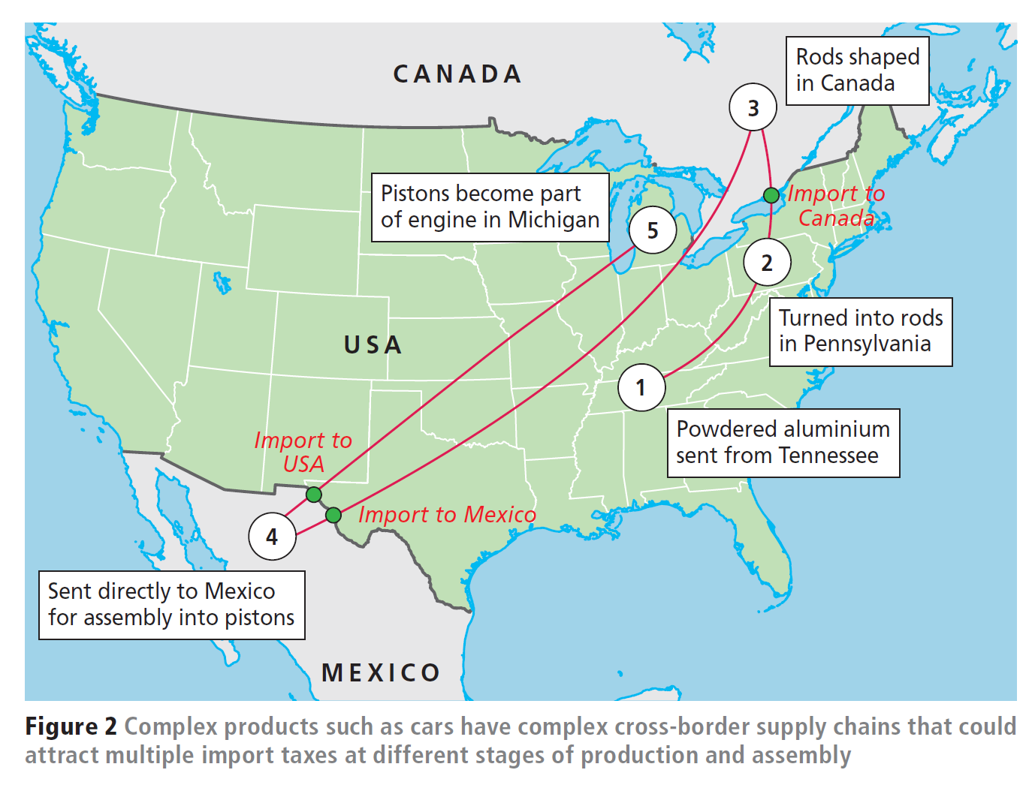
1. Supply chain changes
Tariffs disrupt intricate supply chains. Layered import taxes raise prices for goods like cars and phones.
Some firms may reshore or shift production to avoid tariffs, as Apple has done by moving from China to India.
© Hodder & Stoughton Limited 2025

Slide 19
2. Possible long-term place changes
The full effects of tariffs will unfold slowly. Relocating production requires years of planning.
Whether tariffs successfully revive US manufacturing or diminish its global influence remains uncertain.
3. Interconnected global effects
Because of global interdependence, US tariffs affect everyone. UK citizens may see reduced savings or pensions.
Other nations could face ‘dumping’ of excess goods, creating market disruption and job losses.
© Hodder & Stoughton Limited 2025

Slide 20
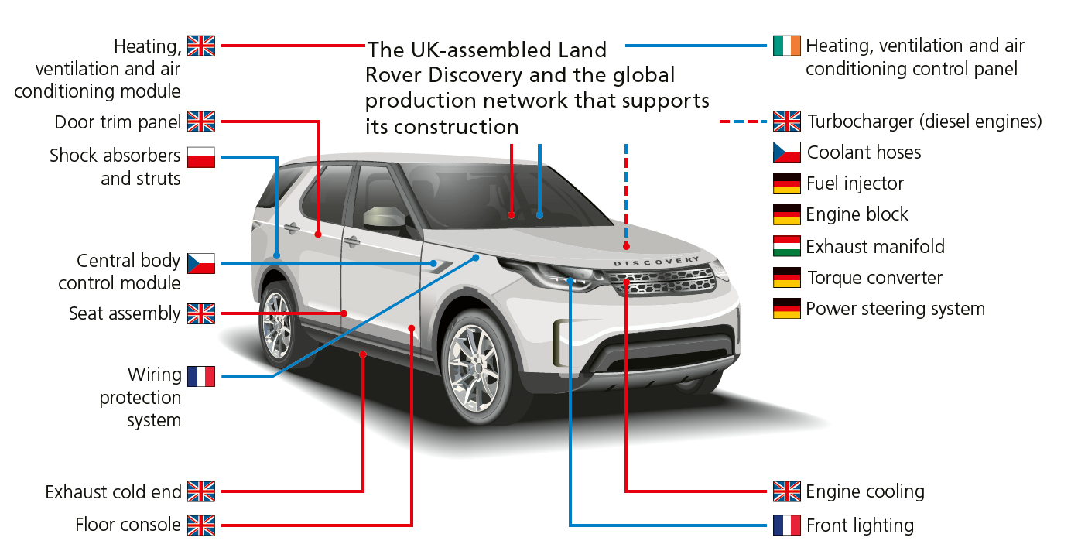
Think how the supply chain distances shown could affect the manufacturing carbon footprint of this car.
4 Environmental implications
Higher tariffs could reduce the consumption of luxury goods by raising prices - meaning demand falls.
Shorter supply chains might reduce carbon emissions.
© Hodder & Stoughton Limited 2025

Slide 21
Conclusions and questions

Slide 22
Conclusions
The future of global trade and tariff policy will be shaped in the months and years ahead by a range of players.
Economic theories about free trade are a good starting point for thinking about the issues, but what eventually happens will depend on the decisions and actions of political leaders, TNC managers, workers and consumers around the world.
Every choice, from government strategies to individual purchasing habits, will play a role in writing this latest chapter of globalisation.
© Hodder & Stoughton Limited 2025

Slide 23
Analyse and evaluate this!
As a final written activity:
Analyse the different links and connections shown in Figure 2.
Evaluate the likely impacts of higher tariffs on goods imported into the US.
© Hodder & Stoughton Limited 2025

Slide 24
Questions for discussion
1
2
3
4
Study Figure 2 (US supply chain).
What other products might similarly attract multiple layers of import taxes?
Imagine the UK government imposed high tariffs on the following imports: bananas, eggs, strawberries, cars.
In turn, discuss the positive and negative consequences for businesses, different groups of people and the environment.
What possible impacts could President Trump’s tariff policy have on the US’s superpower status?
‘Higher tariffs means the end of globalisation.’
Do you agree or disagree with this statement, and why?
© Hodder & Stoughton Limited 2025

Slide 25

Further reading
1
Some of the illustrations in this presentation are taken from Geography: Global Interactions published by Hodder Education, 2023.
Others are from Geography Review.
Simon Oakes is the author of Geography: Global Interactions.
© Hodder & Stoughton Limited 2025

