Slide 1

David Redfern
Economic development in India
Background to an emerging economic powerhouse
www.hachettelearning.com/geographyreview
© Hodder & Stoughton Limited 2025

Slide 2
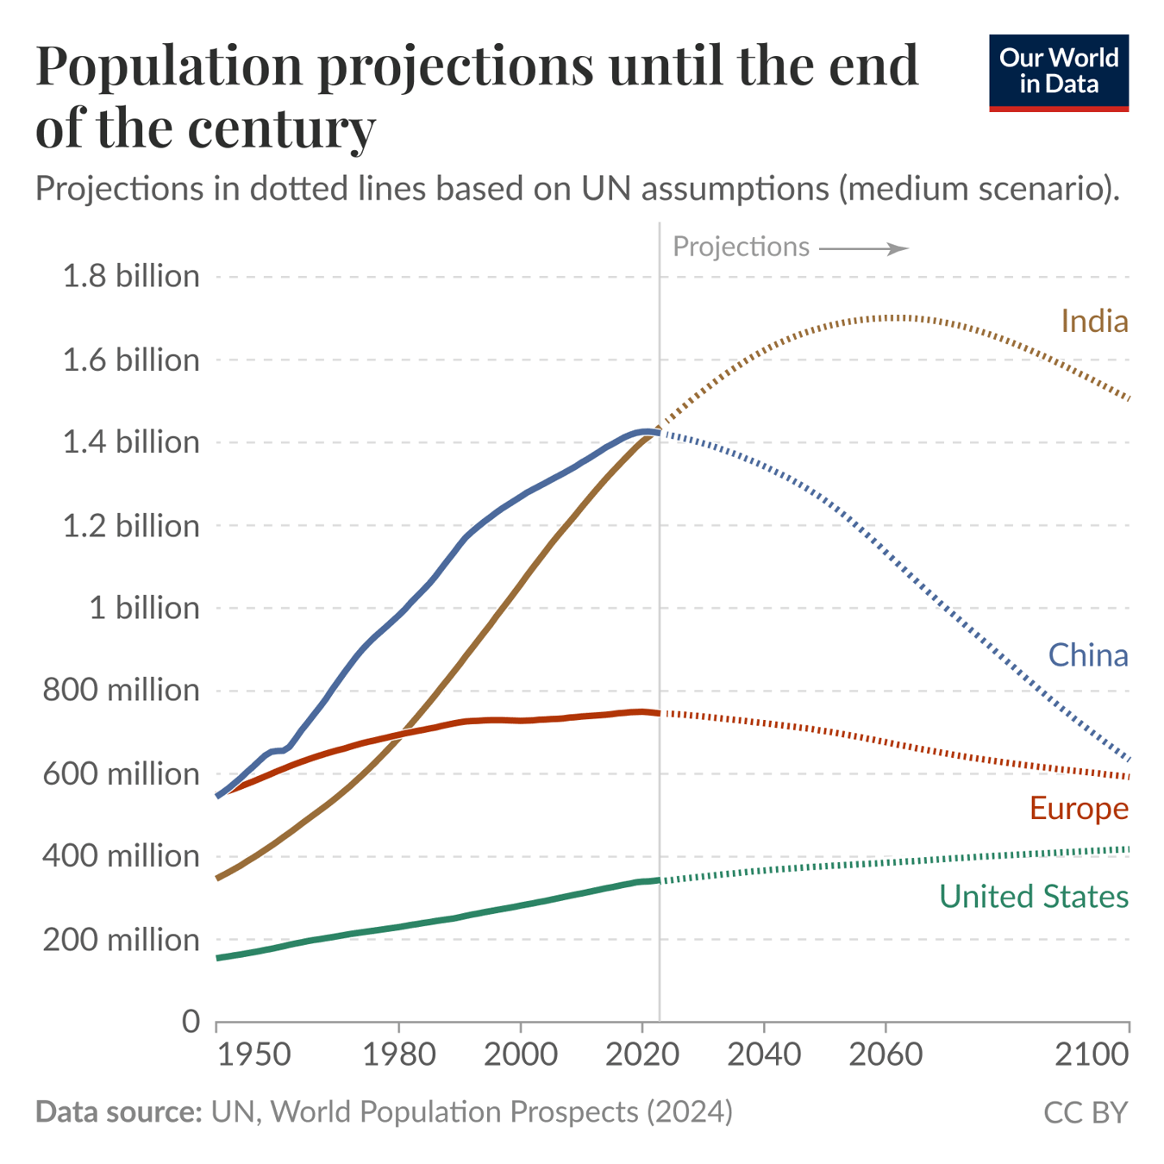
Population growth
This chart shows the demographic projections for four large populations: India, China, Europe, and the United States.
India and China are the world’s most populous countries, and the UN projects that both will remain at the top to the end of the century. However, their trajectories diverge sharply.
China’s population has begun to fall and is projected to more than halve to around 630 million by 2100. India, by contrast, is expected to keep growing for 40 years, reaching about 1.7 billion people in 2060 and gradually declining to around 1.5 billion.
In contrast, the United States and Europe are projected to change more gradually. The US is expected to grow slowly, reaching about 420 million people by the end of the century.
Europe’s population is projected to decline. Its population peaked around 750 million in 2020 and is expected to fall to about 590 million by 2100.

Slide 3
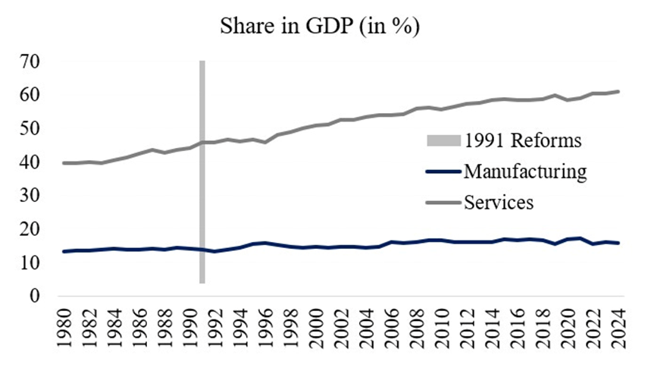
Share of India’s GDP: manufacturing v. services
Indian economic policymakers embarked on industrial reforms in 1991. The objective behind these reforms was to fundamentally re-orient the Indian economy from a planned economy to a market economy, hoping that such reforms would help India rapidly industrialise.
The figure opposite illustrates that the share of manufacturing in India’s GDP has remained relatively flat.
However, the services sector expanded significantly from 40% to 60% of GDP between 1980 and 2024.
India specializes in production of high-value services (and also goods such as pharmaceuticals and, more recently, electronics).
The following three slides show various aspects of GDP growth in India.
Source: Bloomberg

Slide 4
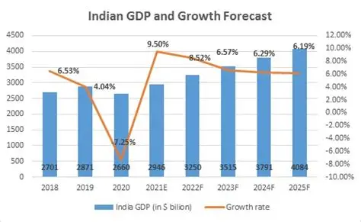
India: GDP growth (2018-2025)
The graph opposite shows that India has had a consistently high economic growth rate – over 6% - for most recent years (except for 2020 – the Covid year).
Consequently, the total GDP of the country has increased at a regular rate.

Slide 5
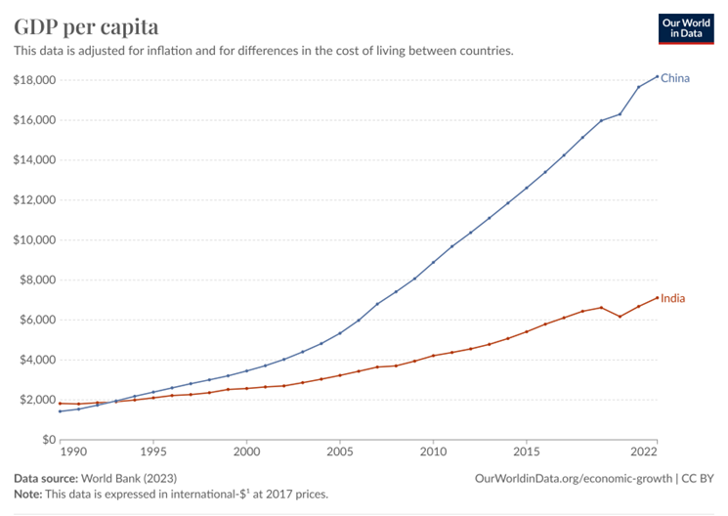
India v. China: GDP per capita growth (1990-2022)
This graph shows that, compared to China, the growth of GDP per capita in India still lags well behind, and it is increasing much more slowly.

Slide 6
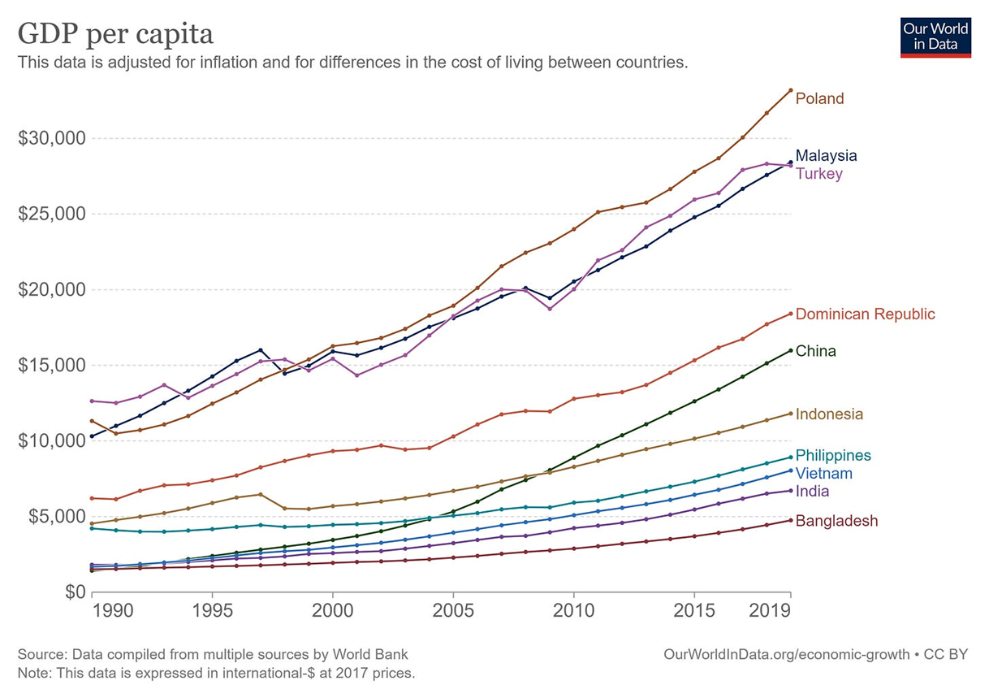
GDP per capita: India v. selected countries
(1990-2020)
Despite its remarkable economic growth (250% over the past three decades), India is still poorer overall than many other countries.
The graph opposite shows a comparison of GDP per capita for a number of selected countries.

Slide 7
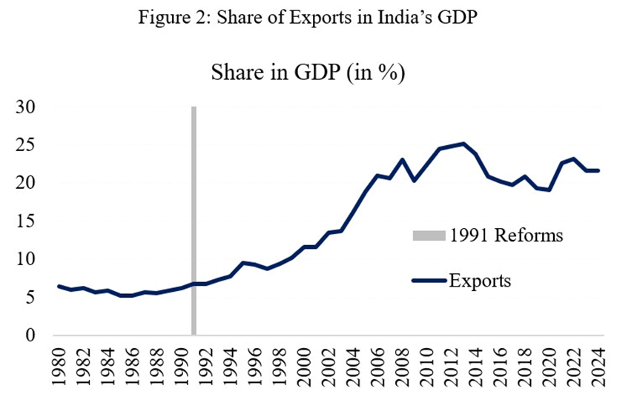
India: share of exports in GDP
The graph opposite illustrates the steady rise in the share of exports in India’s GDP since the 1991 reforms.
India’s combined exports of goods and services in GDP have been of the same magnitude as those of China. Even for manufacturing, the sectors that have performed well have been those that focused on export markets.
The recent trade agreement with the UK (2025) is an important development for both countries.
The situation with the USA is more delicate at the moment, with heavy tariffs (50%) being imposed by the Trump administration.
A trade agreement with the U.S. would eliminate tariff-related uncertainty and strengthen the economic partnership between the world’s largest democracies.
Source: Bloomberg

Slide 8
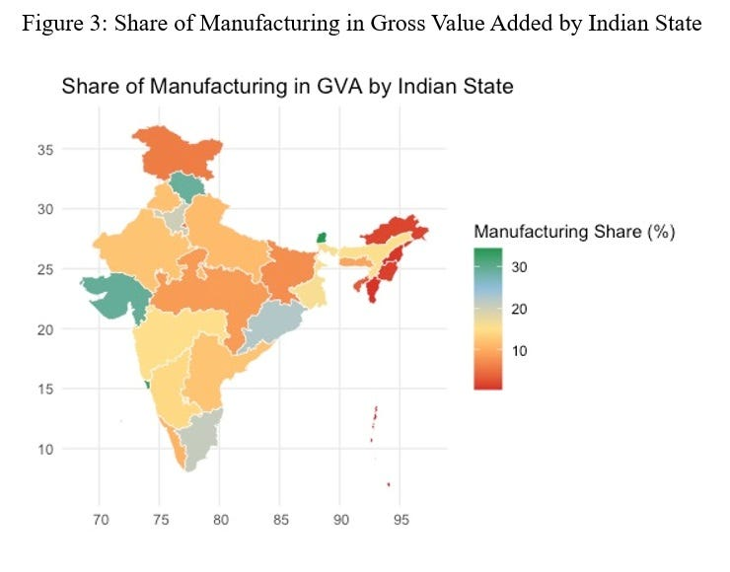
India: distribution of manufacturing by state (Gross Value Added - GVA)
The map opposite shows the share of manufacturing by Gross Value Added (GVA) for Indian states (see next slide for names of states).
The peninsular (south-central) states have a significantly higher share of industrial output relative to most of the land border states.
Access to ports is a natural advantage in many of these states but several of them have in addition undertaken reforms such as in land and labour laws.
Tamil Nadu and Gujarat, for instance, have emerged as major players in vehicle manufacturing. Both these states, along with Andhra Pradesh are now also wooing electronics and semiconductor firms to establish their manufacturing plants there.
Source: Noah Smith
[Note brighter colours indicate a lower share]

Slide 9
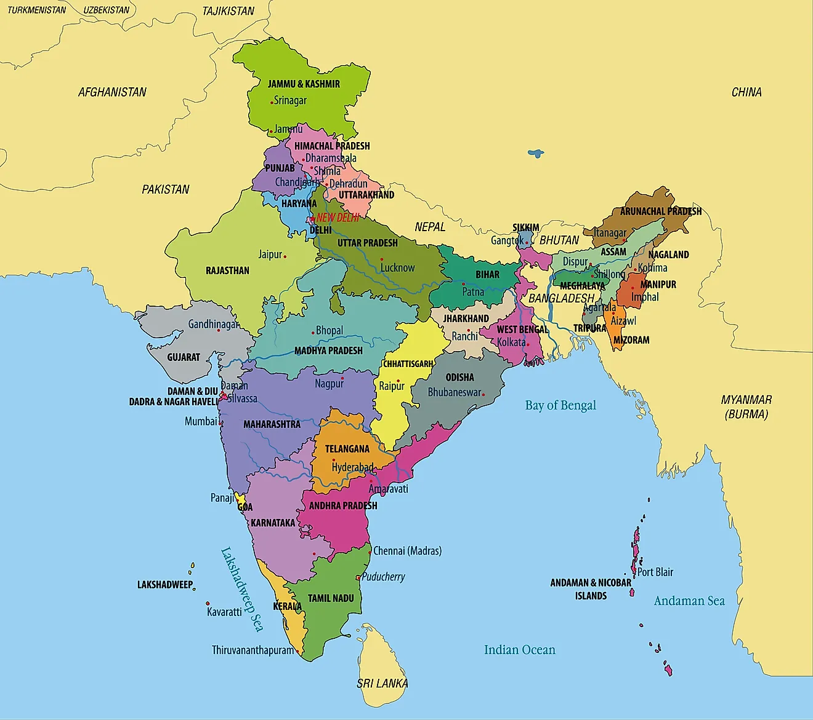
India: states

Slide 10
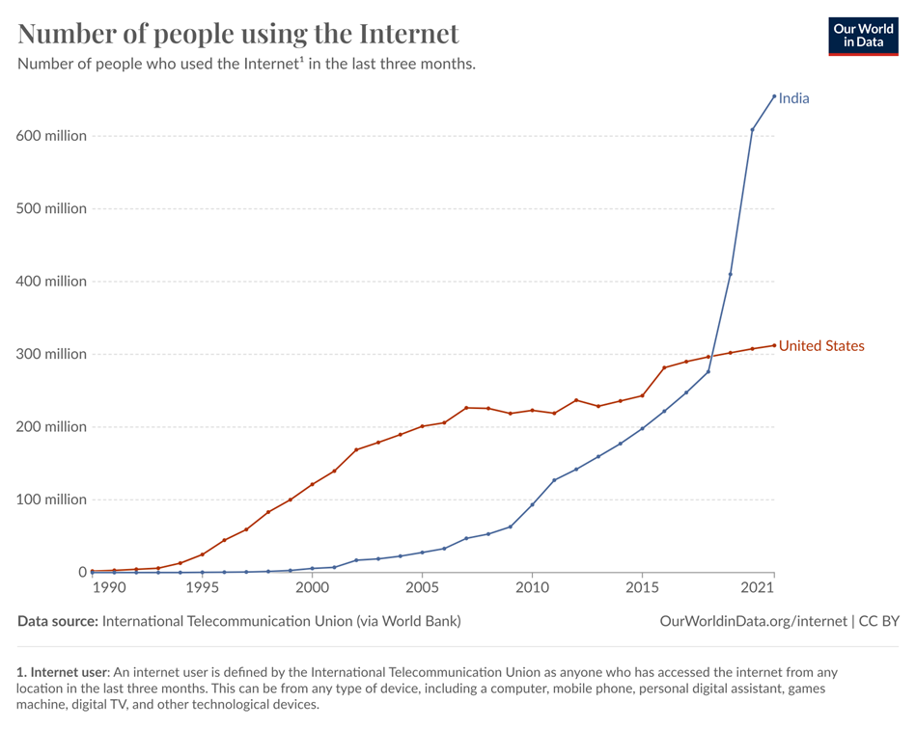
India: use of the internet and electronics manufacture
The use of the internet in India is growing rapidly compared to the USA (see graph opposite). (Obviously, the relative size of populations should be considered here.)
Consequently, there have been recent successes following a ‘Make in India’ policy push, particularly for electronics manufacturing.
Smartphone manufacture is an example of this success with both Samsung and Apple shifting their production to facilities based in India.
During 2025, India shipped more smartphones to the USA than China, reflecting a significant milestone for the Indo-US relationship.
Source: Bloomberg

Slide 11
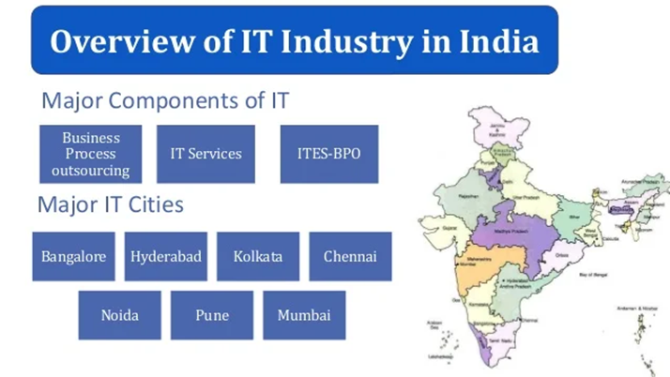
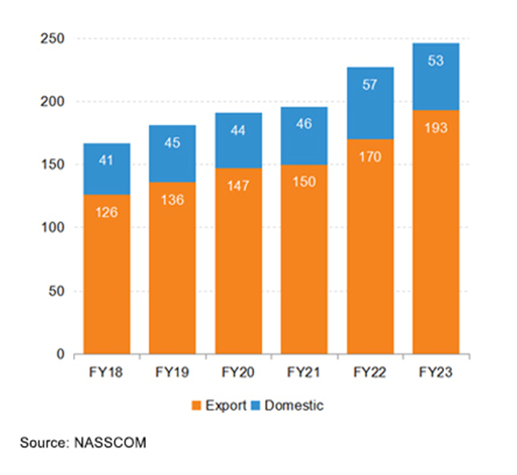
The IT industry in India
Revenue growth of Indian IT industry ($US billions)
(FY = financial year)
[ITES–BPO = Information Technology Enabled Services and Business Process Outsourcing i.e.combined activities
Coloured regions = states with a higher concentration of IT industries]
Note opposite how revenue growth is increasing, particularly for exports of IT related goods.

Slide 12
This resource is part of Geography Review, a magazine written for A-level students by subject experts. To subscribe to the full magazine, go to:
    www.hachettelearning.com/geographyreview

