Slide 1

Topic update: Carbon and water cycles
Drought and the ‘climate whiplash’ effect
www.hachettelearning.com/geographyreview
© Hodder & Stoughton Limited 2025

Slide 2
Contents
1 Defining drought
2 Drought in the water cycle
3 Drought and the carbon cycle
4 The ‘climate whiplash’ effect
© Hodder & Stoughton Limited 2025

Slide 3
Key terms in this presentation
Carbon flux
Climate whiplash
El Nino
IPCC
Precipitation deficit
Sequester
Systems approach
Water insecurity
© Hodder & Stoughton Limited 2025

Slide 4
Key terms in this presentation
The transfer of carbon between global (or local) stores, including the atmosphere, oceans, soil and ecosystems.
Sudden, large and/or frequent transitions between very dry and very wet conditions
compared to a long-term average.
Part of the El Nino Southern Oscillation (ENSO) short-term climate disturbance that starts in the Pacific Ocean.
A United Nations body of scientists that prepared Assessment Reports on climate change, which informs COP meetings.
A shortfall of rainfall compared to normal levels, leading to drought conditions and water scarcity.
The natural storage of carbon by physical or biological processes such as photosynthesis.
Studying the balance between inputs and outputs, and how energy and/or matter are moved between stores by flows.
The lack of reliable access to sufficient, safe water for drinking, sanitation and agriculture.
© Hodder & Stoughton Limited 2025

Slide 5
Defining drought

Slide 6
Defining drought
Drought means conditions that are drier than normal. Scientifically, it refers to a precipitation deficit compared to long-term average water availability in a region.
There are three main drought categories within the water cycle.
Meteorological drought happens when rainfall is below average for a season.
Hydrological drought means that low rainfall has reduced water storage in rivers, lakes and aquifers.
Agricultural or ecological drought occurs when plants are stressed because soils dry out and evaporation is high.
These types of drought are interconnected, creating a chain of impacts that flow through the water cycle.
© Hodder & Stoughton Limited 2025

Slide 7
Rising drought risks
Multiple organisations report that droughts are becoming more widespread.
The Lancet Countdown (2024) found that nearly 50% of Earth’s land surface experienced at least one month of extreme drought in 2024, compared to only 15% in the 1980s.
The Global Water Monitor Report (2024) recorded 38% more record-dry months in 2024 than in the 1990s.
The IPCC (2022) projects agricultural droughts will double at 1.5°C warming.
Evidence shows that climate change is intensifying drought conditions globally, with major implications for ecosystems, agriculture, and human societies.
© Hodder & Stoughton Limited 2025

Slide 8
Recent European drought evidence
During 2022, Europe experienced some of its most severe droughts in decades.
Soil water storage fell to the second-lowest level in 50 years.
Reduced rainfall and high evaporation stressed agriculture, ecosystems, and hydrological systems.
These patterns illustrate how droughts are not isolated incidents but instead part of larger climate trends.
Europe’s experience is consistent with global evidence of increasing hydroclimate instability under a warming atmosphere.
Summer 2025 was recently confirmed as the UK’s warmest on record, with dry conditions leading to drought in many regions.
© Hodder & Stoughton Limited 2025

Slide 9
Drought in the water cycle

Slide 10
Water cycle dynamics
When precipitation is reduced, cascading impacts ripple through the water cycle.
With fewer inputs, soils and groundwater recharge decline.
Evaporation continues, leading to soil moisture deficits, which restrict biomass growth and agricultural productivity.
Less surface runoff reduces flows into lakes and reservoirs, lowering water availability.
Rivers discharge less water, especially where geology limits groundwater storage.
Drought thus diminishes every major water store and flow, from soil to surface water, while also reducing vegetation cover. This interconnectedness explains why drought events spread widely across ecological and hydrological systems.
© Hodder & Stoughton Limited 2025

Slide 11
Drought and wildfire risk
Drought heightens the risk of wildfire by drying vegetation, soils and ecosystems.
When fires occur, they disrupt the water cycle further.
Biomass, which normally stores water and intercepts rainfall, is destroyed, accelerating runoff and erosion.
In California and the Mediterranean, plants like chaparral shrubs adapt to fire, yet more intense blazes are testing ecosystems.
In 2025, Southern California experienced its most destructive wildfires in history.
Globally, wildfire activity is increasing in forested regions, altering water storage and flows, while declining in some grassland regions converted to agriculture.
Now study the map on the next slide.
© Hodder & Stoughton Limited 2025

Slide 12
Global wildfire events
Create a table naming three world regions where wildfires occur naturally.
Add details to the table suggesting possible impacts of wildfires in your chosen regions.
© Hodder & Stoughton Limited 2025

Slide 13
Drought and the carbon cycle

Slide 14
Drought and the carbon cycle
Droughts weaken ecosystems’ ability to act as carbon sinks.
Forests and other biomes sequester carbon, storing it in biomass and soils.
But water stress reduces plant growth and increases tree mortality, limiting carbon storage capacity.
Severe droughts in the Amazon in 2023 and 2024 turned the region into a net carbon emitter. The 2023 drought, the worst in nearly 50 years, was linked directly to human-driven climate change.
Such events show how closely the water and carbon cycles are linked: drought not only disrupts water availability but also accelerates atmospheric CO₂ accumulation.
© Hodder & Stoughton Limited 2025

Slide 15
Drought, wildfires and carbon emissions
Wildfires are a major short-term driver of carbon emissions.
A 2024 study reported a 60% rise in emissions from forest fires since 2001, with tripling in boreal (coniferous) forests.
Drought and heat create fire-favourable weather, while wet periods boost vegetation growth, adding fuel for future fires.
In 2023–24, wildfires burned 3.9 million km² of forest, releasing 2,400 megatonnes of carbon – 16% above average. Canadian fires alone emitted 650 megatonnes, comparable to national fossil fuel outputs of entire countries.
While fires are decreasing in African grasslands, global fire-driven emissions remain a major contributor to climate change.
© Hodder & Stoughton Limited 2025

Slide 16
The ‘climate whiplash’ effect

Slide 17
Climate whiplash dynamics
Climate change is creating hydroclimate volatility, also called climate whiplash.
This describes rapid shifts between extreme wet and dry conditions.
For example, California experienced destructive 2025 wildfires after a drought that followed an unusually wet period, which boosted vegetation growth and fire fuel.
Whiplash intensifies impacts: floods are worse after droughts, because dry soils absorb less water.
Scientists attribute this to the warmer atmosphere’s greater capacity to hold water vapour. Droughts load the atmosphere with moisture through evaporation, which later falls as extreme rainfall.
The result is amplified climate instability worldwide. Study the next slide for evidence of climate whiplash events – and answer the questions.
© Hodder & Stoughton Limited 2025

Slide 18
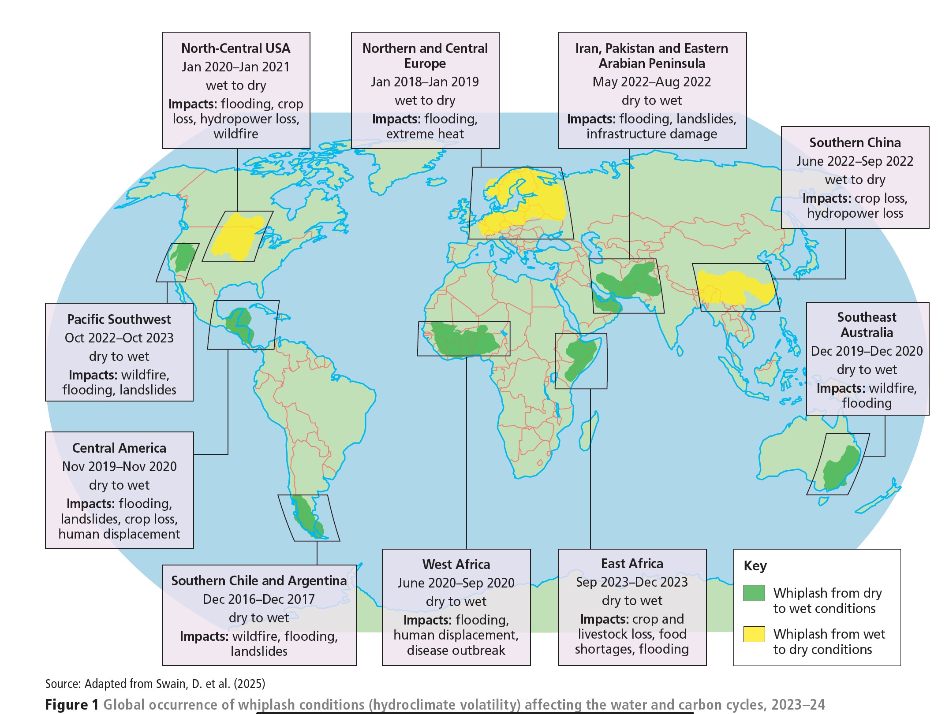
Practice questions
Describe the main features of the pattern.
Suggest why the costs of the impacts shown might vary from place to place.
© Hodder & Stoughton Limited 2025

Slide 19
The science behind whiplash theory
The mechanics of whiplash are relatively straightforward.
A warmer atmosphere acts like a sponge, storing more water vapour.
During drought, intense evaporation transfers water from land to air.
When conditions shift, this accumulated vapour is released as intense rainfall.
Researchers suggest that whiplash is one of the clearest emerging symptoms of climate change. These rapid transitions multiply risks, combining drought-induced wildfires with floods and landslides. As climate warming accelerates, whiplash dynamics may become a dominant global hazard.
Study the next slide carefully.
© Hodder & Stoughton Limited 2025

Slide 20
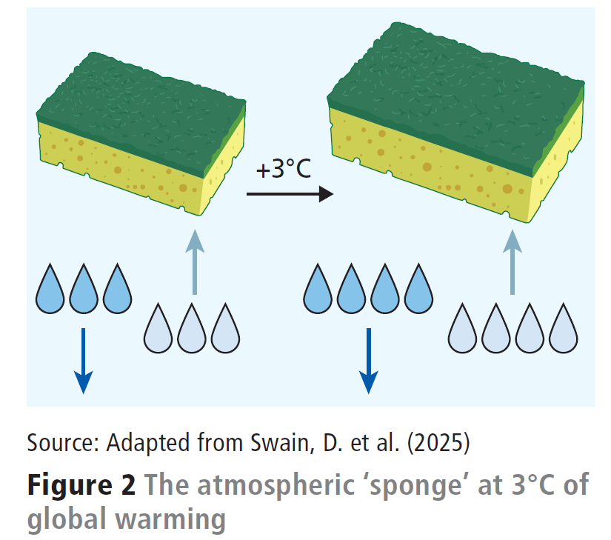
Whiplash explained
As Earth gets warmer, the air holds more water — about 7% more for every degree of warming. For example, at 3°C of global warming, the atmospheric ‘sponge’ will be nearly 25% larger than in the pre-industrial era (see Figure 2).
This is explained by the Clausius–Clapeyron relation. It means that with global warming, we’ll see heavier rainstorms and stronger droughts, even if other weather patterns don’t change.
A good way to picture it is like an expanding kitchen sponge: as it gets bigger with heat, it can both soak up more water and release more when squeezed. However, if there’s no water around (like in a desert), the bigger sponge can’t soak up anything.
© Hodder & Stoughton Limited 2025

Slide 21
Future feedback loops
Drought, wildfire, and climate change are locked in reinforcing cycles. As forests burn, they release greenhouse gases that fuel further warming. Warming makes droughts more likely, which in turn increases fire risk.
These positive feedback loops create a 'vicious cycle' of environmental change, reshaping the global water and carbon cycles. Ecosystems lose resilience, while human societies face greater risks to food, water and energy security.
Understanding these feedbacks is crucial for predicting future impacts. Without action, droughts and wildfires will increasingly destabilise the Earth system, amplifying global warming and hydroclimate extremes.
© Hodder & Stoughton Limited 2025

Slide 22
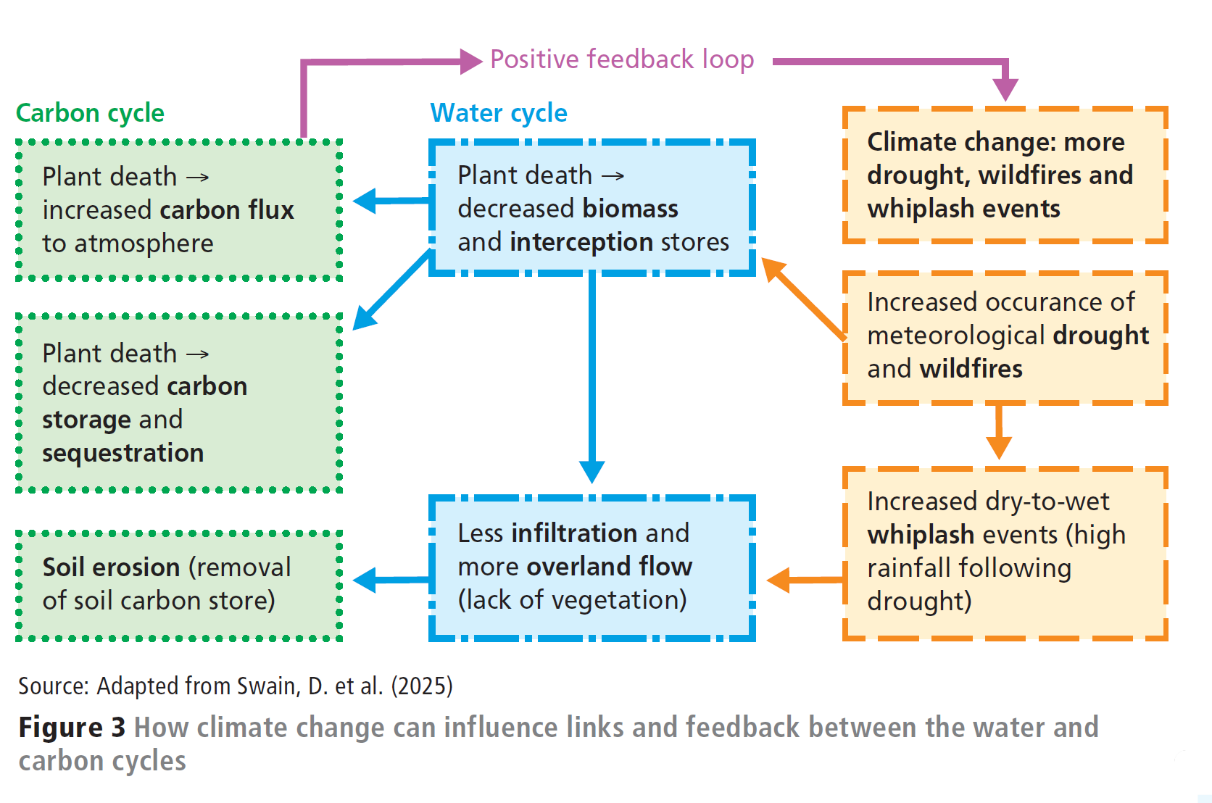
Analyse and evaluate this!
As a final written activity:
Analyse the different links and connections shown in Figure 3.
Evaluate the likely severity of the impacts shown for people, places and environments.
© Hodder & Stoughton Limited 2025

Slide 23
Questions for discussion
1
2
3
4
The article notes that river flows in drought conditions are usually lowest in river basins with impermeable geology. Can you suggest why?
Look back at Figure 1. Assess the possible impacts of whiplash events on the carbon and water cycles for two of the regions shown.
Look back at Figure 3. Use it as the basis for a class discussion on ways in which the water cycles and carbon cycles are interconnected and interdependent.
Looking back over the last 12 months of weather in the UK, has climate whiplash occurred? How could it have impacted on the water and carbon cycle locally? What challenges might this have created for people?
© Hodder & Stoughton Limited 2025

