Slide 1

David Redfern
Tropical cyclones and climate change How cyclone activity is changing in a warming world
www.hachettelearning.com/geographyreview
© Hodder & Stoughton Limited 2025

Slide 2
Introduction
Most scientists expect increases in tropical cyclone intensity, more rapid intensification, and greater amounts of rainfall to take place with climate change.
As a result, climate change is making tropical cyclones more destructive.
This trend is happening alongside rising populations in vulnerable coastal regions, with communities across the Global South being disproportionately at risk.
Therefore, the resilience of these regions needs to be bolstered to prepare for the rising probability of costly storms.
© Hodder & Stoughton Limited 2025

Slide 3
Cyclone intensity
Ocean temperatures are rising due to climate change. Oceans absorb a huge amount of the heat trapped by greenhouse gases. This additional ocean heat is fuelling more intense tropical cyclones. The proportion of cyclones reaching higher categories has risen over the last few decades (see map on following slide).
According to the Intergovernmental Panel on Climate Change (IPCC):
It is likely that the global proportion of Category 3–5 tropical cyclone instances … have increased globally over the past 40 years.
And:
… the proportion of Category 4–5 tropical cyclones will very likely increase globally with warming.
© Hodder & Stoughton Limited 2025

Slide 4
Map of tropical cyclone activity with colours indicating intensity categories, from weak tropical depressions to major storms
© Hodder & Stoughton Limited 2025

Slide 5
Sea levels and storm surges
Climate scientists expect sea surge impacts to worsen in the future. Sea levels are rising, which makes coastal inundation more likely.
Higher sea levels mean tropical cyclones now do more damage than an identical tropical cyclone in a cooler climate because the storm surge is riding on a higher sea level.
‘The most certain way in which hurricane risk is increasing due to climate is that, because of sea level rise, coastal flooding due to hurricane storm surge is becoming worse. Storm surge occurs when the winds from a storm push the ocean onto the land. The total flooding is determined by the surge (the part produced by the wind), the tide, and the background average sea level. As sea level has risen … the flooding is exacerbated by that amount.’
(Professor Adam Sobel – 2019. You can read more here: Congressional testimony )
To illustrate:
In 2011, Hurricane Irene hit the New York region with a storm surge of around 1.5m; existing flood infrastructure was able to handle the surge and there was little damage. Just a year later, Hurricane Sandy hit the New York region with 2.75m of storm surge, overwhelming flood infrastructure and leading to massive damages of $62 billion.
© Hodder & Stoughton Limited 2025

Slide 6
Rainfall amounts (1)
Rainfall from tropical cyclones is also increasing. A warmer atmosphere holds more moisture. In a warmer world, the potential for a tropical cyclone to deposit intense rainfall increases, and peak rainfall rates are predicted to increase by roughly 20% by the end of this century.
The latest World Meteorological Organization (WMO) update forecasts relatively high global temperatures are likely to continue up to 2029.
The graph on the following slide shows the 2025–29 WMO forecast for global near-surface temperatures as well as the actual increase in these temperatures since 1960, compared with temperature values in the late nineteenth century.
© Hodder & Stoughton Limited 2025

Slide 7
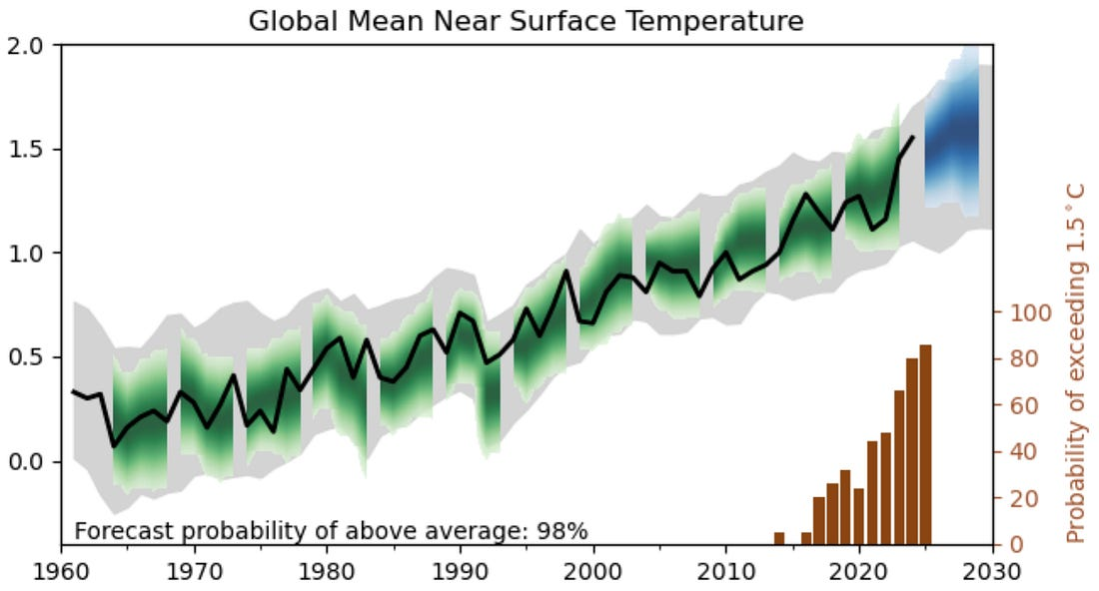
Rainfall amounts (2)
Annual predictions of global mean near-surface temperature relative to 1850–1900.
The extent of shading indicates the 90% confidence interval, with the intensity of shading indicating the level of likelihood.
The line graph shows that global surface temperatures have increased over the last few decades and will continue to do so.
The brown bar graph shows that the probability of these forecasts being accurate is also increasing.
Source: WMO
Annual global mean observations in black, forecast in blue, hindcast predictions in green.
© Hodder & Stoughton Limited 2025

Slide 8
Rainfall amounts (3)
According to the IPCC:
There is high confidence that anthropogenic climate change contributed to extreme rainfall amounts during Hurricane Harvey (2017) and other intense tropical cyclones. It is very likely that average tropical cyclone rain rates will increase with warming. (IPCC – AR5).
The increase in rainfall amounts has also been linked to the fact that some cyclones are moving at slower speeds.
As a result, because they are over a certain location for a longer time, more rain is deposited. This was why the flooding from Hurricane Helene in September 2024 was so severe.
© Hodder & Stoughton Limited 2025

Slide 9
Rates of intensification
We are also seeing more evidence of rapid intensification.
A moderate tropical storm can transform into a major hurricane in a single day.
In October 2023, Hurricane Otis underwent one of the most rapid intensifications on record – from category 1 to category 5 in only 18 hours – just before it struck the Mexican coast near Acapulco.
The number of rapid intensification events has risen over the last few decades, raising the prospect of communities facing severe cyclones with little warning more often.
Research suggests that increases in ocean temperatures are one of the causes of this trend.
© Hodder & Stoughton Limited 2025

Slide 10
Geographical spread
Sea-surface temperatures are also rising beyond the tropics.
In the North Atlantic, near-surface temperatures have increased by almost 1.5°C since 1870. This may be causing cyclones to travel further, into the subtropics and mid-latitudes, more often.
This would put the northeast USA and eastern Canada at greater risk and raises the possibility of cyclones reaching western Europe.
There are also poleward shifts in the latitude at which tropical cyclones form and reach their maximum intensity, and cyclones are reaching their peak closer to coastlines.
The number of North Atlantic tropical cyclones reaching the mid-latitudes is also rising.
© Hodder & Stoughton Limited 2025

Slide 11
Number of cyclones
Scientists do not know what controls the number of tropical cyclones in the atmosphere. There are currently about 80 tropical storms globally each year, but there is no solid theory for why it is that number rather than fewer or more.
Globally, the number of tropical cyclones is expected to decrease over the next century.
It is thought that the two major global atmospheric circulations – the Walker and Hadley circulations – will weaken under climate change. As a result, there will be less convection in the tropics to spawn cyclones and lower humidity in the mid-troposphere to intensify them.
However, we are also seeing humidity near the sea surface rise in some regions, which would have the opposite effect.
© Hodder & Stoughton Limited 2025

Slide 12
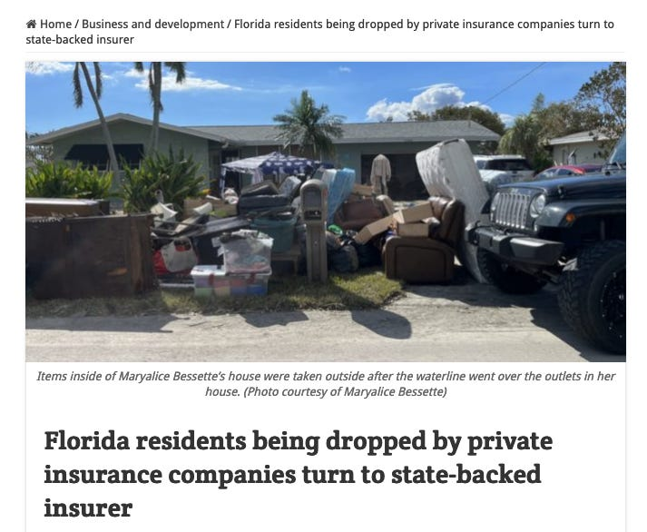
Economic consequences
A useful yardstick of the economic destructiveness of tropical cyclones is to consider the role of insurance companies.
Home insurance premiums in many areas of the southern USA are increasing rapidly.
Some private companies are not providing cover in places that are vulnerable to tropical cyclones e.g. in the states of Florida and Louisiana.
Source: Andrew Dessler
(Climate change is making hurricanes more destructive )
© Hodder & Stoughton Limited 2025

Slide 13
Further links
Climate change is making hurricanes more destructive
Why have hurricanes gone crazy? - by Andrew Dessler
Climate change made Helene's rainfall more severe
This resource is part of Geography Review, a magazine written for A-level students by subject experts. To subscribe to the full magazine go to: http://www.hachettelearning.com/geographyreview
© Hodder & Stoughton Limited 2025

