Slide 1
Linking hazards, place and resilience Hazard management models
David Redfern

Slide 2
Introduction
This presentation supports the following articles in Geography Review Vol. 38, No. 4:
Making the grade: Hazardous Earth, pages 26-29
Climate change and resilience, featuring the concept of antifragility, pages 30-33
Making connections: The Maui wildfire, Hawaii, pages 39-41

Slide 3
The value of modelling
Models identify order, general trends and patterns.
They allow deviations from the model in the real world to be highlighted.
Models therefore make such deviations easier to explain.
All the following models involve proactive stages of hazard management (mitigation and preparation) and reactive stages (response and recovery).
They help shape our understanding of ‘resilience’: ‘The ability of a system, community or society exposed to hazards to resist, absorb, accommodate to and recover from the effects of a hazard in a timely and efficient manner, including through the preservation and restoration of its essential basic structures, systems and functions.’ (United Nations)
Inherently they are all optimistic – lessons can be learnt for the future management of such events.

Slide 4

Hazard management models
There are four main hazard management models:
The hazard management cycle (HMC)
The Park model
The pressure and release (PAR) model
The Swiss Cheese model
Each make connections between a hazard and the place(s) affected by that hazard.

Slide 5
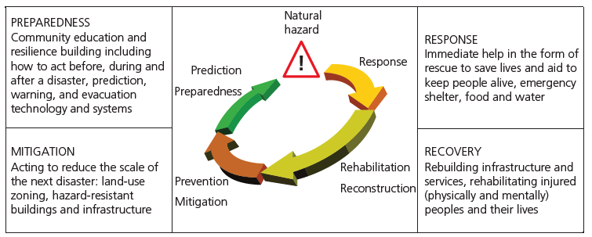
The hazard management cycle (HMC)

Slide 6
The hazard management cycle (HMC)
The HMC illustrates four stages in the management of hazards in seeking to reduce the scale of a disaster: preparedness, response, recovery, mitigation.
Note the recovery (‘returning to normal’) stage depends on:
the magnitude of the event
the level of development of the area affected
the level of governance of the area affected
the external help available

Slide 7
The hazard management cycle (HMC): evaluation
The HMC provides an easy to remember four–stage sequence.
It is also centred around four ‘P’s: prediction, prevention, protection and preparedness.
The model also features four ‘R’s: response, recovery, rehabilitation, reconstruction.
The model is criticised for being too generic and unquantifiable...but is this a strength?
Importantly, ‘place’ detail can be inserted into the model, rather than determining it.

Slide 8
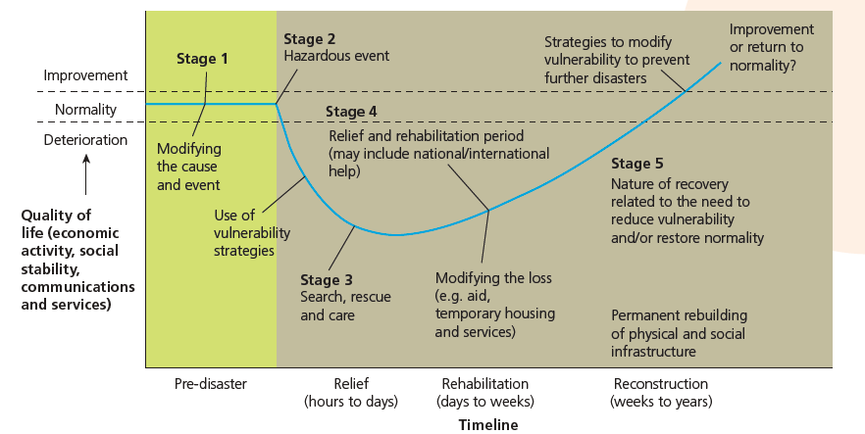
The Park model

Slide 9
The Park model
This model illustrates:
how quality of life is impacted by a hazardous event
how a range of management strategies can be used over time – from before the event to after the event
the importance of the roles of emergency relief agencies and rehabilitation
that different areas affected may have different response curves, depending on the level of preparedness and economic development of the place affected (see next slide)

Slide 10
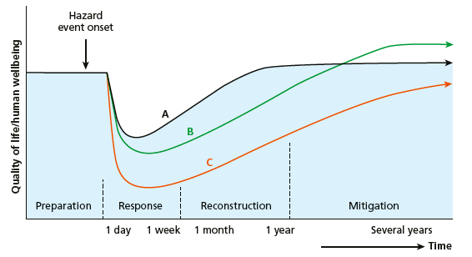
The Park model (with different outcomes for quality of life)
Quality of life declines rapidly once the event occurs, then improves as response and recovery take place.
The depth of the decline and the rapidity of the recovery will depend on the context.
Eventually, quality of life will stabilise, but this could be at a level below (outcome C), equivalent to (outcome A) or above (outcome B) the quality of life before the hazard event.
Outcome B is an example of antifragility (i.e benefits from the event).

Slide 11
The Park model: evaluation
The model focuses on three ‘R’s: relief, rehabilitation and reconstruction. All these help understanding of the ‘recovery’ phase after an event.
It is criticised for not accounting for different levels of economic development, or including other issues (social, political, environmental) that may play a role.
It is useful when comparing hazard events – they can have differing ‘curves’:
the steepness of the downward curve depends on the nature of the event
the depth of the downward curve reflects the scale of the event
the gradient of the upward curve depends on the level of development, and governance (provided both internally and externally)

Slide 12
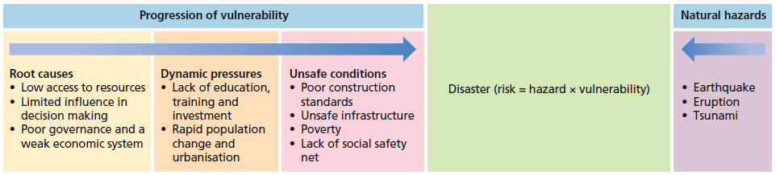
The pressure and release (PAR) model

Slide 13
The pressure and release (PAR) model
The PAR model shows that:
The socioeconomic context of the place is important: the political systems (governance), income levels, economic strength, levels of education and training, rates of population change and levels of investment in a place all impact on its degree of vulnerability.
The nature of the hazard is also key, whether a volcano, earthquake, storm or wildfire.
Both the context and the hazard put pressure on the place affected.
The release of that pressure comes with a reduction in the vulnerability of the place affected, which in turn often depends on the quality of governance in the place.

Slide 14
The pressure and release (PAR) model: evaluation
The PAR model shows how disasters occur when natural hazards affect vulnerable people.
A disaster occurs when two forces (socioeconomic pressure and physical exposure) interact (or ‘collide’).
The ‘root causes’ include all economic, demographic and political processes affecting the allocation and distribution of resources between different groups of people – which are a reflection of inequality in a population.
The ‘dynamic pressures’ are the economic and political processes which produce unsafe conditions for the most vulnerable people
‘Unsafe conditions’ express such vulnerability and include inadequacies in disaster-preparedness measures.

Slide 15
The Swiss Cheese model
The ‘layers of cheese’ represent human contexts, such as population density, economic development, inequality, and other factors that determine resilience. The ‘holes’ indicate weaknesses in the layers.

Slide 16
The Swiss Cheese model
This model states that a disaster occurs because of a series of coincidental factors and processes.
A disaster can be linked to a single physical event, but there is also a range of weaknesses in human contexts (the ‘holes’) that influence the hazard and increase vulnerability.
A hazard becomes a disaster when several holes line up (a trajectory of accident opportunity), which creates the conditions for loss of life, property, and livelihood.
The model only examines the possible causes an event, and not the subsequent events, including management.

Slide 17
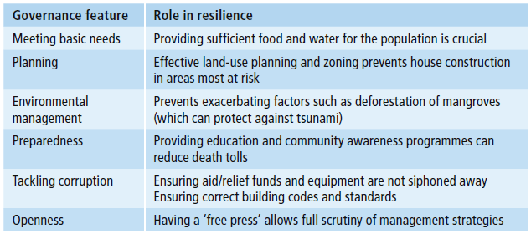
The importance of good governance
All the models show that effective governance has a significant impact on community resilience, before and after an event.

Slide 18
This resource is part of Geography Review, a magazine written for A-level students by subject experts. To subscribe to the full magazine go to: http://www.hoddereducation.co.uk/geographyreview

