Slide 1
Managing global flows The latest changes and challenges
Simon Oakes

Slide 2
Global glossary – do you know what these terms mean?
Global flow | Movements from one country to another of goods, services, people, money, data and ideas.
Shrinking world | The perception that places are closer together than they once were because technology reduces the time it takes to travel or communicate.
Remote working | Employment that is carried out wholly or partly online using digital technology. A hybrid worker splits their time between working from home and an office.
Digital nomad | Someone who provides services for an employer or client while moving regularly between different places where they stay and work for a period of time.
Click to reveal the definitions

Slide 3
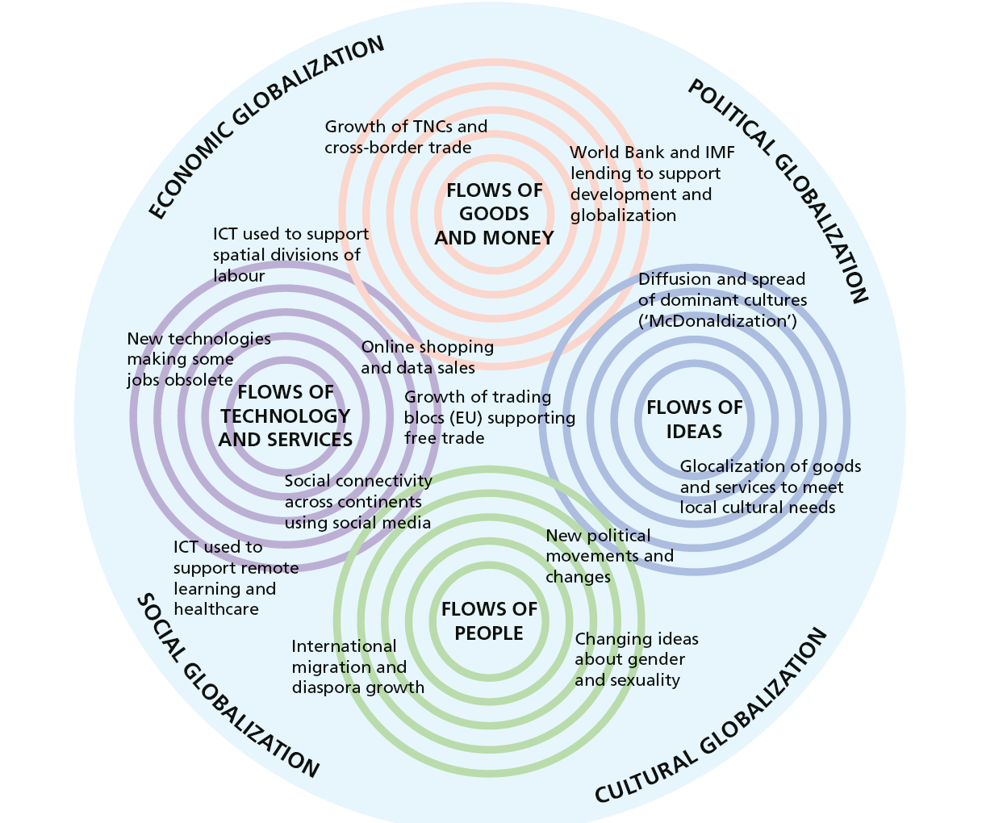
Global flows: an overview
Part of studying a networked world involves thinking sequentially about the different types of global flow (money, people, materials and goods, information and so on) that globalisation depends on.
Different global-scale processes (migration, trade, internet use) give rise to these different flows.
Global flows bring opportunities but challenges too. Some flows transfer wealth between places. Some countries benefit more than others from trade (a concern which has led US President Donald Trump to impose tariffs on imported goods). Ideas and new social norms become mobile in a globalised world - but are not welcomed everywhere.
Now study the next slide.
Using the Figure, analyse ways in which different global flows have led to the growth of globalisation.

Slide 4
Different types of global flow
Using the Figure, analyse the contribution of different global flows to the growth of globalisation.

Slide 5
Managing global flows
Types of flow | Ways in which a country’s government can try to increase these flows across its borders - or prevent them.
Flows of goods and merchandise
Flows of technology and services
Flows of data, ideas and information
Flows of people and culture
Flows of money and investment
Develop the detail
Copy this table into your exercise book or into a text document.
Add as many examples as you can to each row. For example, the Great Firewall of China or Donald Trump’s tariffs.
Don’t forget to include some positive actions that can increase flows – and not just actions that prevent them.

Slide 6
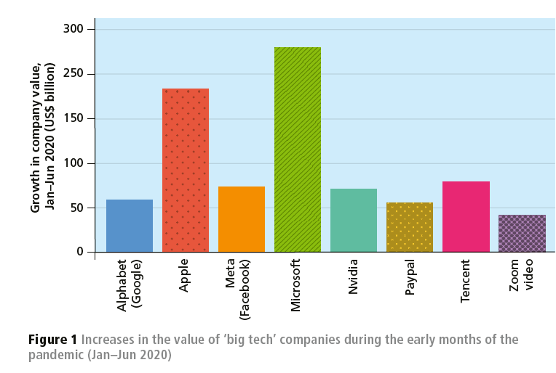
Case study: data flows
Information and communications technology (ICT) has transformed the way people interact, work and consume services and entertainment.
Increasingly, innovation is driven by profit-seeking TNCs.
The rate of progress was accelerated by the Covid-19 pandemic and its associated lockdowns, which spurred new research and innovation by ‘big tech’ industries, including Alphabet (Google), Meta and Microsoft. In fact, big tech TNCs were arguably the biggest ‘winners’ of the pandemic by financial outcomes (see Figure 1).
Study this image.
Analyse variations in the growth of company value.
Suggest reasons for the growth shown in Figure 1.
Evaluate the role of technology TNCs in the creation of a ‘shrinking world’.

Slide 7
Case study: data flows
Study the map of global data flows in 2017.
Describe the pattern shown.
Suggest ways in which this pattern may have changed since then.

Slide 8
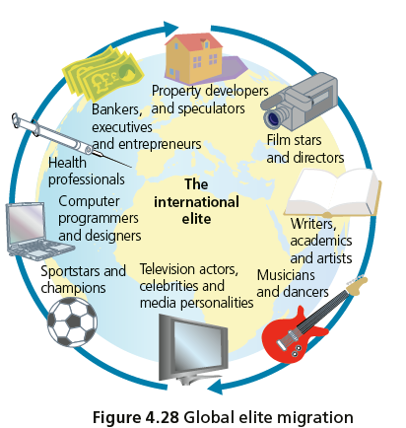
Case study: digital nomads
‘Nomad’ is a word traditionally used to describe people whose way of living requires repeated and/or regular movement from place to place, instead of having a fixed home location.
Workers in a wide range of creative, academic, technological and other industries are adopting the digital nomad lifestyle. One view is they belong to an ‘international elite’ of high-skilled migrant workers
It means living and working for several months or longer in one country before moving to another.
For example, a software designer from San Francisco might relocate to South Africa for the southern hemisphere summer, before moving northwards to Vietnam for the rest of the year.

Slide 9
The growth of digital nomads
In our shrinking world, remote working for an employer or client can be carried out almost anywhere provided a decent online connection is available.
Technology has made it possible – but social norms had to change too.
Growth of digital nomads
Improvements in ICT (e.g. Teams) over time – increased potential for remote working
Covid-19 pandemic lockdown – people were forced to work remotely
Growing social acceptance of remote working / changing social norms

Slide 10
Case study: digital nomads
Digital nomadism and cross-border working are creating new legal and economic challenges.
When a worker based in one country provides services for a company based in another country, what are the tax and social service arrangements?
Should taxes be paid to the government of the country they live in, the government of their employer’s country, or both?
Problem solving in geography
People who visit a country with a tourist visa may be breaking the law if they spend time working for an employer during their stay. Suggest how governments can respond – are new laws needed?

Slide 11
Practice question and answer plan
Assess the challenges associated with the management of one type of global flow you have studied.
Provide an outline of the variety of global data flows and internet uses e.g. social media, streaming services, money markets, remote working by digital nomads.
Create a thematic analysis of management challenges e.g. economic challenges of digital trade & cryptocurrency; legal challenges of ‘dark web’ and illegal activities; cultural and political challenges to states.
Weigh up the different challenges and formulate a view on which challenges(s) are greatest, taking into account possible government actions or other mitigations that could be introduced.
Notes:
BING AI IMAGE

Slide 12
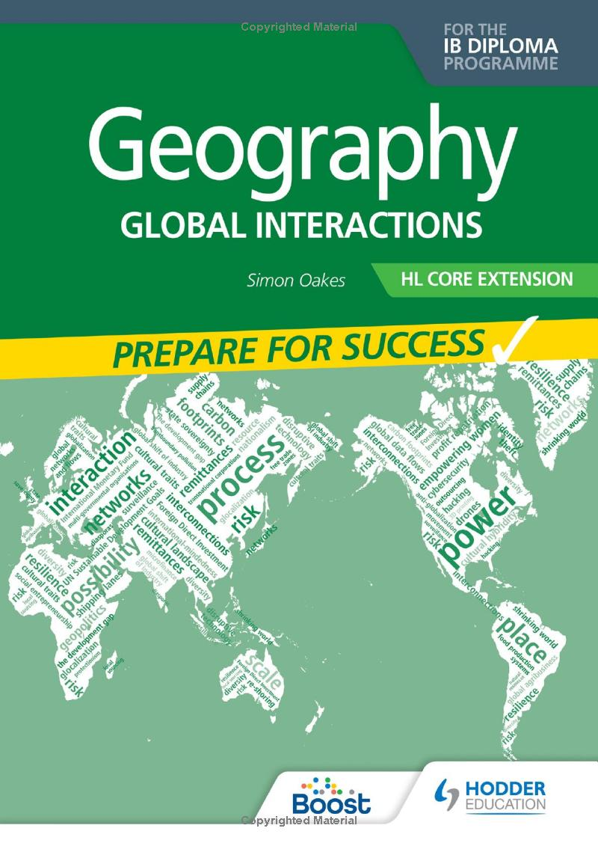
This resource is part of Geography Review, a magazine written for A-level students by subject experts. To subscribe to the full magazine go to: http://www.hoddereducation.co.uk/geographyreview
Simon Oakes is the author of Geography: Global Interactions (2023) published by Hodder Education.
Some of the illustrations in this presentation are taken from this book. Others are from Geography Review.

