Slide 1
Changes in the urban environment in the 2020s
David Redfern

Slide 2
The Covid-19 pandemic and city centres
City centre businesses (retail, hospitality and entertainment) experienced financial losses due to lockdowns.
Working from home (WFH) became common leading to a declining demand for commercial real estate in city centres.
People began to move out of city centres to suburban locations (see next slide).
The use of e-commerce and contactless services accelerated.
Demand for public transport decreased; taxi drivers saw substantial falls in revenue.
Cultural venues (theatres, museums) struggled to stay open and other tourist-related activities (hotels, restaurants) were hit badly.
Existing economic and social inequalities were exacerbated – vulnerable and marginalised communities faced greater challenges.

Slide 3
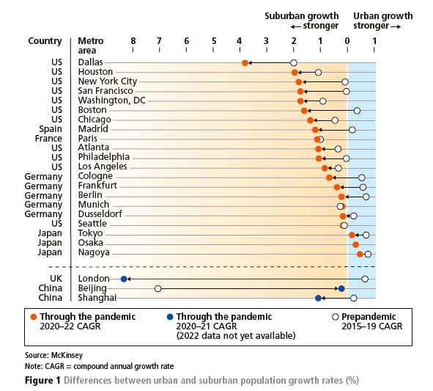
Impact of the Covid pandemic (1) – global
As the length of the pandemic increased and WFH became more prevalent, more people opted to move away from densely populated city areas to more suburban and rural areas.
This in turn led to changes in the demand for city-centre-based housing and a consequent increase in suburban-based populations.

Slide 4
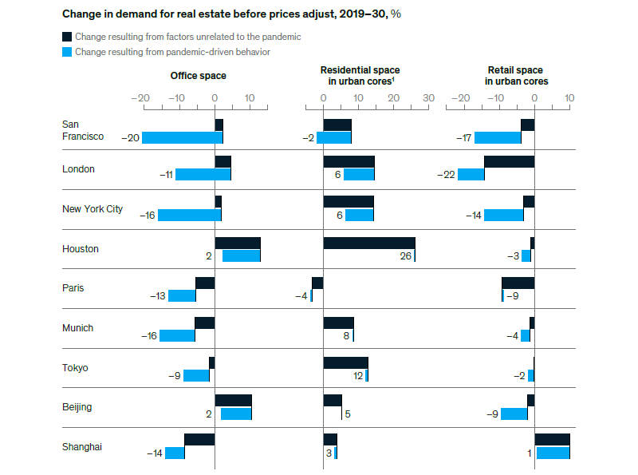
Impact of the Covid pandemic (2) – global
Changes in expected demand for office, residential and retail space 2019–2030, selected cities (%)
Many businesses now have more workspace than they are using.
It is unlikely companies will need the real estate footprint they had pre-pandemic.
The trend is for further declines in the demand for office and retail space.
Source: McKinsey

Slide 5
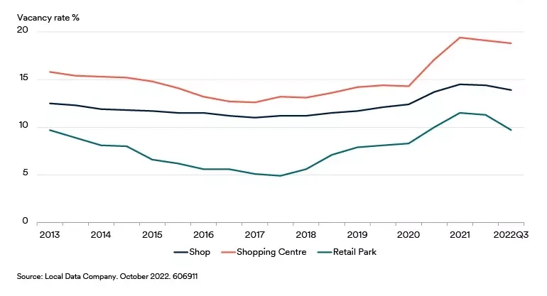
Impact of the Covid pandemic (3) – UK
UK retail vacancy rates (2013–2022)
The pandemic triggered a wave of retailer insolvencies in 2020 (e.g. Wilko). Some retailers like M&S and Next decided to relocate to out-of-town retail parks.
Rents and service charges on retail parks are generally lower than in town centres. Easy car parking and longer opening hours add to the appeal of retail parks for shoppers.
Source: Schroders

Slide 6
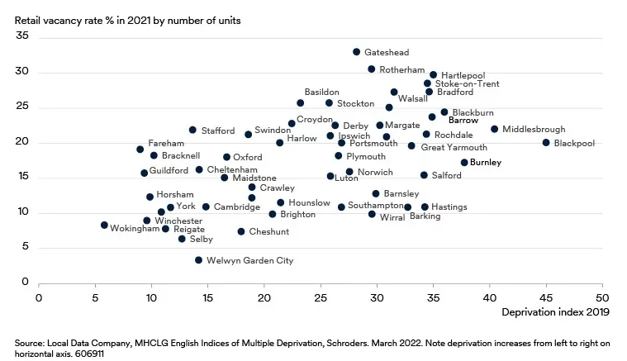
Impact of the Covid pandemic (4) – UK
UK retail vacancy rates and deprivation
Although all towns have been affected by the decline in high street shopping, poorer towns have generally been hit harder than more prosperous towns.
In the figure opposite, the most deprived UK towns are on the right and the least deprived are on the left.
Source: Schroders

Slide 7
The impact of the pandemic on urban regeneration schemes (1)
The terminology used to describe urban change has changed over the last few decades.
This change reflects an increasing focus on changing cities for the better and giving their public perception a make-over. [The table shows the various terms that have been used]
[You may also find this piece on the topic by Will Fry useful - here.]
Urban …. | Time | Meaning
Redevelopment | 1970s | Changing land use and buildings, e.g. from wasteland to industry and housing.
Renewal | 1980s | Focus on a ‘new start’: brand new, better buildings with new people (incomers) and prospects.
Regeneration | 1990s | Focus on a ‘fresh start’: revival and rebirth through new buildings, infrastructure and jobs.
Re-imaging | 2000s | Focus on the image the city projects to outsiders; how the city is perceived by others.
Rebranding | 2010s | A combination of re-imaging and regeneration; new physical infrastructure and a new image.

Slide 8
The impact of the pandemic on urban regeneration schemes (2)
Project delays and disruptions – some construction sites shut down temporarily.
Financial challenges – funding for projects became more uncertain, and investors became more cautious.
Re-evaluation of priorities: the focus of schemes moved towards enhancing public health, creating more green space and improving future resilience.
The relative proportions of residential, commercial and recreational spaces have been re-examined.
More flexible workspaces (hot-desking) and rethinking of the scale of offices.
Online shopping has led to more flexible and digitally orientated retail spaces.
Integration of technology into urban planning – smart city technologies.
Increased community engagement – more consultation with local people.

Slide 9
An example of a ‘new’ urban regeneration scheme (1)
The Huddersfield Blueprint - aims
‘The Huddersfield Blueprint is a ten-year vision to create a thriving, modern-day town centre. Huddersfield will be a busy, family-friendly town centre that stays open for longer with a unique culture, arts and leisure offer and a variety of thriving businesses.
The scale of investment and transformation will improve the desirability of the town centre as a place to live, providing new opportunities for residential development.’
Source: Hudds. Blueprint

Slide 10
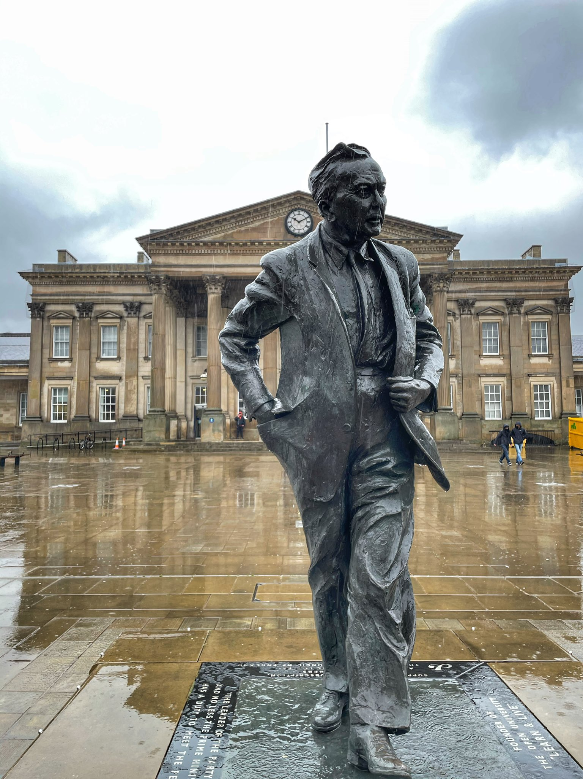
An example of a ‘new’ urban regeneration scheme (2)
The Huddersfield Blueprint – objectives
Increase opportunities to deliver a mix of residential developments, including making best use of heritage buildings.
Deliver housing schemes that provide opportunities to buy and rent across the town centre.
Boost the desirability of the housing market to potential residents and ensure affordable homes are built in the right places.
Improve how the town centre looks, how accessible it is, and enhance the quality of public spaces.
Deliver schemes that provide access to an attractive lifestyle with leisure, culture, shopping and dining at the heart of town centre living.
Huddersfield railway station and statue of Harold Wilson.
Photo: David Redfern

Slide 11
An example of a ‘new’ urban regeneration scheme (3)
Huddersfield Town Centre - Residential opportunity areas
You can find out more about the Huddersfield Blueprint scheme here.
Source: Hudds. Blueprint

Slide 12
How you can investigate urban regeneration schemes
Access past and present data from city councils (council websites usually contain relevant open data sources) to map changing land use.
Using the archives of the local press you could examine what the driving forces behind these changes are in your local urban centre.
You could interview local businesses to understand the pressures they are facing and the ways in which they are responding.
Past and present photography might help you to understand how the look and feel of a place has changed.
A possible research question could be : ‘How has the balance between retail, office and residential land use changed in ‘my local high street’ and what processes have caused these changes?’

Slide 13
This resource is part of Geography Review, a magazine written for A-level students by subject experts. To subscribe to the full magazine go to: http://www.hoddereducation.co.uk/geographyreview

