Slide 1
Tambora’s impacts:
investigating the causes and costs of historical hazards
Simon Oakes
© Hodder & Stoughton Limited 2024

Slide 2
Tectonic hazard themes
Key wildfire hazard themes in this presentation | Investigating the impacts of historical hazards. What data sources exist for historical hazard studies? What’s the difference between correlation and causation? Case study hazard event — Tambora, 1815. Tambora and the Frankenstein theory.
Practice exam question | After viewing this presentation, you will be ready to attempt the following mini-essay question: Assess the severity of the impacts of ONE tectonic hazard event on local and more distant places.
© Hodder & Stoughton Limited 2024

Slide 3
Key terms
Tectonic impact | Ways in which volcanoes, earthquakes and the secondary hazards they create have affected people and places. Different social, economic, and environmental impacts can be explored over different temporal and spatial scales. Very high magnitude events can have significant long-term and global impacts.
Correlation | A relationship between two variables, phenomena or events. If two events occur around the same time, we might say there is a correlation. Or we might identify an apparent correlation between two data sets (such as national income and life expectancy).
Causality | The influence that one thing has on another. Physical geographers are interested in establishing how particular environmental factors and processes are the cause of environmental changes, for example
Do you know what these terms mean?
Click to reveal the definitions
© Hodder & Stoughton Limited 2024

Slide 4
Historical hazards
Many different impacts are attributed to tectonic hazard events, ranging from pyroclastic flows devastating entire settlements to ash plumes that disrupt global air traffic flows and trade.
In historical studies of high magnitude hazards, researchers may seek to establish whether large volcanic eruptions affected global climate in ways that in turn harmed the welfare of some societies.
But noticing that two things happened round the same time is only the first step; we also want to know about the strength of any relationship and the extent to which a direct causal relationship exists. It is always important to remember that correlation does not necessarily imply causality.
Just because two events coincided, it does not mean that one caused the other. There might be other processes at work too.
© Hodder & Stoughton Limited 2024

Slide 5
The diagram shows three analytical steps you should take when investigating historical hazards and their alleged impacts.
Can you apply this investigative approach to any other examples of natural hazards you have studied or read about?

Slide 6
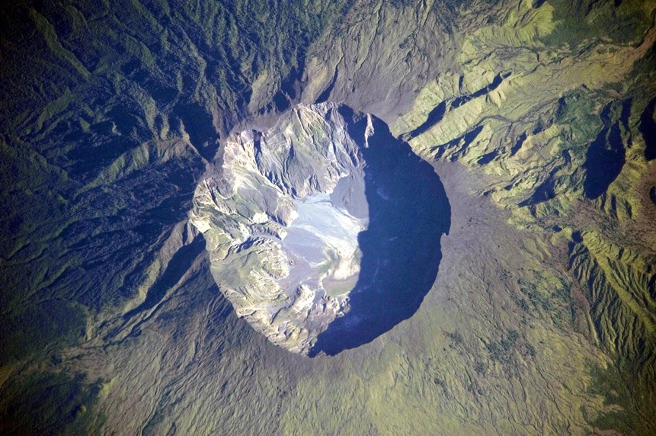
Case study: Tambora
The 1815 mega-eruption of Tambora on the island of Sumbawa in Indonesia.
This event was most likely 1,000 times stronger than the 1980 eruption of St Helens.
Much has been said and written about the global scale of Tambora’s impacts, especially the so-called ‘year without a summer’ that followed the huge eruption.
The huge caldera — 7 kilometres in diameter and 1,100 metres deep — formed when Tambora's estimated 4,000-metre-high peak was removed, and the magma chamber below emptied during the 1815 eruption. (NASA Earth Observatory)
© Hodder & Stoughton Limited 2024

Slide 7
Tambora's impacts
Tambora’s local and global impacts can be studied using a range of primary and secondary data sources.
How trustworthy are these different data sources? How confident can we be of these claims?
Data source | Evidence
Present-day landscape evidence | Studies of the 7 km-wide crater have led scientists to estimate that 40 km³ of rock and ash was ejected. Soil samples show 1 metre of ash close to Tambora. Smaller deposits of 1 cm have been found 1,000 km away. Sulphate aerosol deposits in Arctic ice cores have been dated to 1815–1816.
Historical climate records | 1816 was Oxford’s second coldest year ever recorded — most likely due to sulphate aerosols emitted into the stratosphere by distant Tambora. By combining many other local weather and climate records and archives, scientists have established mean global temperature fell by 0.5ᵒC.
Government records | Pyroclastic flows, famine and epidemic disease most likely claimed between 60,000 and 120,000 lives in Sumbawa and neighbouring parts of Indonesia.
Academic books and journals | Many social, economic and environmental impacts have been attributed to Tambora’s ash and gas cloud. Historians, geographers and biologists have argued that global dimming led to reduced photosynthesis, biological productivity and crop yields throughout Asia and Europe – causing famine and war. Some theories and opinions are better supported than others by facts.
© Hodder & Stoughton Limited 2024

Slide 8
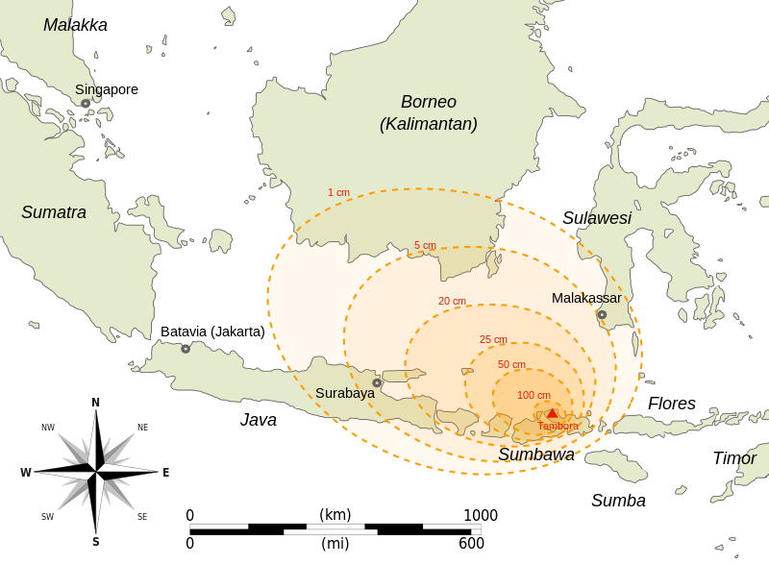
Tambora's impacts
This slide shows the distribution of ash, based on actual studies.
Practice question:
Analyse the pattern shown
© Hodder & Stoughton Limited 2024

Slide 9
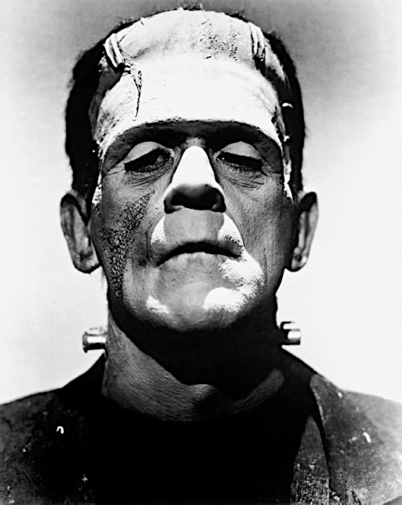
The Frankenstein theory
Some art historians claim a synoptic link exists between Tambora’s eruption and the creation of one of fantasy literature’s most well-known characters, the Frankenstein monster.
The writer Mary Shelley travelled on holiday to Geneva, Switzerland, in the summer of 1816.
There, Mary wrote her novel Frankenstein, in which Dr Frankenstein brings a monstrous corpse to life by harnessing the power of lightning bolts.
At the time, Geneva was experiencing unusually cloudy weather and lightning storms that have been attributed to Tambora.
A correlation therefore exists between two very interesting phenomena — volcanically induced extreme weather and Mary Shelley’s plot for her Frankenstein novel.
© Hodder & Stoughton Limited 2024

Slide 10
The Frankenstein theory: Too good to be true?
But does this correlation imply causality, as some academic writing suggests?
In a recent paper, social scientist Alan Marshall is critical of the ‘far-fetched’ Frankenstein connection.
Marshall notes that crop failures, death and human suffering throughout the world in 1816 had important human causes too. These included conflict (the Napoleonic Wars lasted until 1815), colonialism, land grabs and forced displacements of communities.
Perhaps blaming everything on a volcano helps perpetuate the belief that nature is more menacing and dangerous to humans than humans are themselves!
© Hodder & Stoughton Limited 2024

Slide 11
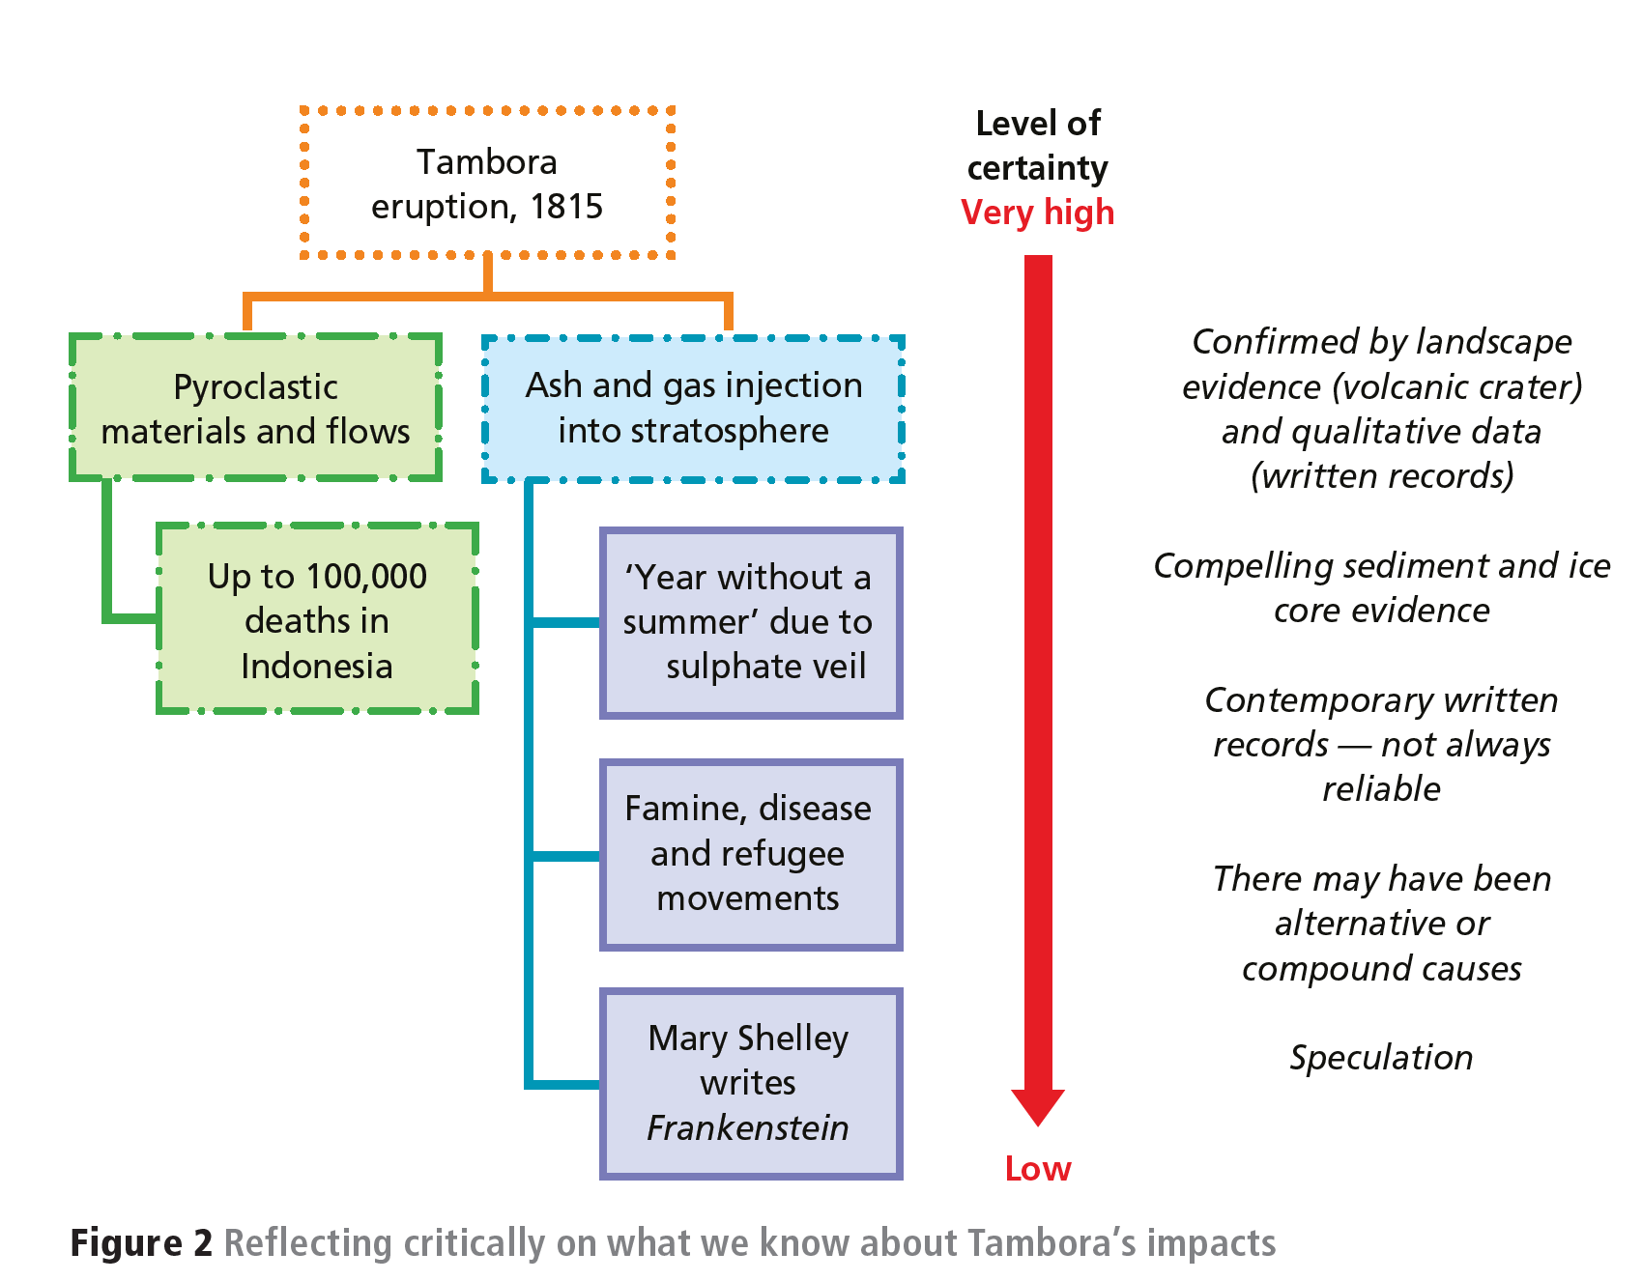
Impact summary
This diagram summarises what we know and can reasonably suggest about Tambora’s local & global impacts – and our levels of certainty.
© Hodder & Stoughton Limited 2024

Slide 12
Practice question and answer plan
Assess the severity of the impacts of ONE tectonic hazard event on local and more distant places.
The mega-eruption of Tambora in 1815 is a suitable case study because of its very high magnitude and severe global-scale impacts.
Quantitative, qualitative, primary and secondary data can be explored for evidence of severe social, economic and environmental impacts at varying scales.
‘Evaluate like a geographer’ by exploring how confident we can be when assessing the severity of the impacts — given the lack of direct evidence to support some theories.
© Hodder & Stoughton Limited 2024

Slide 13
Further research
Award-winning BBC podcast https://www.bbc.co.uk/sounds/play/b077j4yv
Study of Geneva’s climate in 1816 https://cp.copernicus.org/articles/8/325/2012/cp-8-325-2012.pdf
Critique of the Frankenstein hypothesis https://journals.lapub.co.uk/index.php/HB/article/view/1256
© Hodder & Stoughton Limited 2024

Slide 14
This resource is part of Geography Review, a magazine written for A-level students by subject experts. To subscribe to the full magazine go to: http://www.hoddereducation.co.uk/geographyreview
Slide 1 and 6 images:
www.tinyurl.com/umae2249
Slide 8 image
www.tinyurl.com/542zekja
Slide 9 image: www.tinyurl.com/5t4u95n5
© Hodder & Stoughton Limited 2024

