Slide 1
Managing tourism in Venice
David Redfern
© Hodder and Stoughton 2024

Slide 2
Managing tourism in Venice
This presentation supports the article in Geography Review Vol. 37, No. 3: Valuing and restoring coastal wetlands
The WaterLANDS project and the Venice Lagoon
[Photographs: David Redfern]
© Hodder and Stoughton 2024

Slide 3
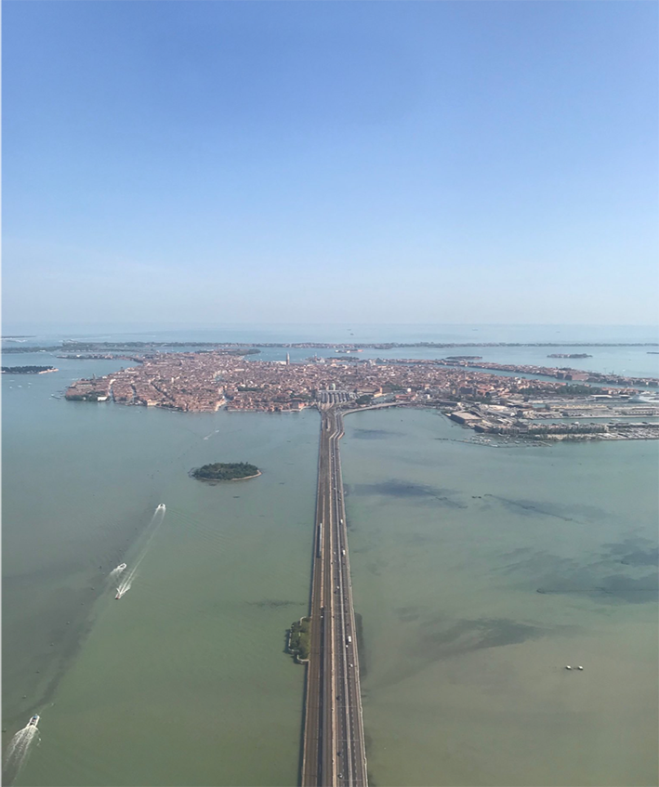
Venice from the air
Venice consists of a series of islands in the northern Adriatic Sea.
It is connected to the Italian mainland by a causeway along which there is a road and a railway line. These connect the city to Mestre and Venice’s airport.
Many tourists also visit the city by cruise ship.

Slide 4
Over-tourism in Venice: causes
There are 20 million visitors annually. Peak visitor days see 120,000 visitors arriving compared to the 55,000 residents. These visitors are the outcome of low-cost aviation, cruise ships, and home-sharing platforms such as Airbnb. There are also many day trippers who don’t contribute significantly to the local economy.
© Hodder and Stoughton 2024

Slide 5
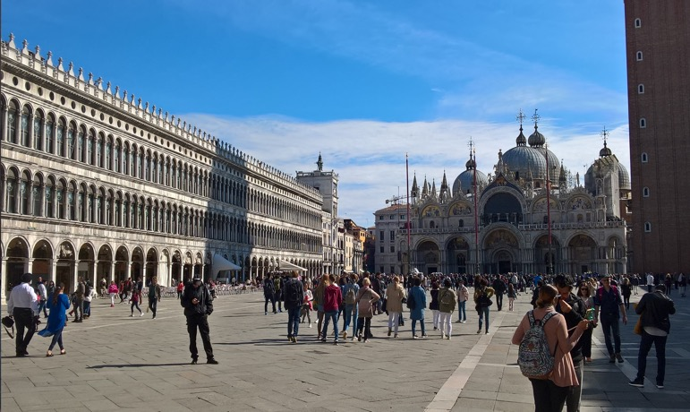
Overtourism in Venice: impacts
Overcrowded landmarks, such as St Mark’s Square, the Rialto Bridge and the Doge’s Palace are suffering wear and tear.
The local economy has become skewed towards tourism.
There has been depopulation of locals due to a lack of non-tourism-related jobs and high rental prices.
Many state that Venice’s character and essence are being diluted/destroyed.
St Mark’s Square (Piazza San Marco) with St Peter’s Basilica
© Hodder and Stoughton 2024

Slide 6
Countermeasures
There is now a ban (from 2021) on cruise ships over 55,000 tonnes in certain areas of the lagoon (St. Mark’s Basin and the Giudecca Canal). Turnstiles at major landmarks have been introduced. There are fines for inappropriate behaviour. A Venice Tourist Tax is being introduced. Starting in 2024, day visitors will be required to pay 5 Euros to visit the city. This tax will be in effect for 30 non-consecutive days, primarily during long weekends in the spring and weekends in the summer.
Overnight travellers will be exempt from this tax but are subject to a separate tourist tax introduced in 2011. The overnight travellers’ tax ranges from 1 to 5 Euros per person per night for the first five nights.
© Hodder and Stoughton 2024

Slide 7
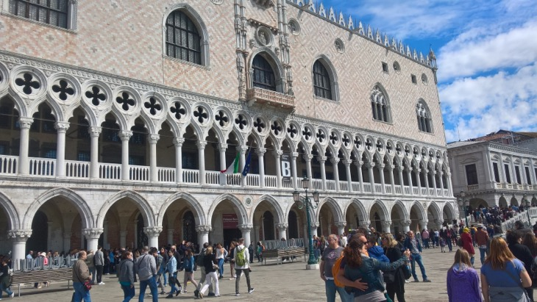
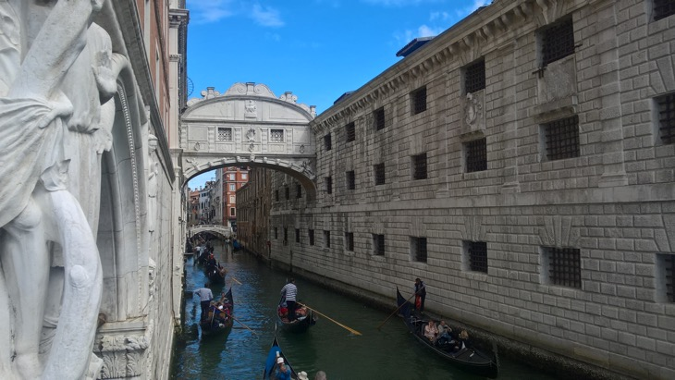
The Doge’s Palace and the Bridge of Sighs
© Hodder and Stoughton 2024

Slide 8
Visiting Venice sustainably (1)
Off-Peak Visits: Consider visiting Venice during the less busy seasons. Fewer crowds mean a more authentic experience and less strain on local resources.
Stay Local: Opt for locally-owned accommodation vis-a-vis large hotel chains or Airbnb rentals that drive up property prices for residents.
Spend Wisely: Invest in the local economy by dining at local restaurants, shopping at local markets, and hiring local guides.
Mindful Movement: Avoid cruise ships and consider arriving by train or eco-friendly modes of transport. Once there, walk or use public vaporettos rather than private water taxis.
Cultural Respect: Learn a few basic phrases in Italian, understand local customs, and respect public spaces. No picnicking on bridges or swimming in canals (the latter has a heavy fine).
Low-Impact Exploration: Stick to the less-trodden paths. Visit lesser-known landmarks and neighbourhoods to spread the tourist load.
© Hodder and Stoughton 2024

Slide 9
Visiting Venice sustainably (2)
Sustainable Souvenirs: Buy locally-made crafts and products rather than mass-produced trinkets. Consider Murano glass or Burano lace. (Murano and Burano are other islands in the lagoon)
Leave No Trace: Dispose of your waste properly. Venice has a fragile ecosystem that is easily disrupted by litter.
Educate Yourself: Before you go, read up on Venice’s history, culture, and the challenges it faces. Knowledge is the first step toward empathy and responsible action.
Advocate and Share: Use your social media platforms to educate others about responsible travel. Your influence can make a difference.
Support Local Initiatives: Contribute to local organisations that work to preserve Venice’s cultural and natural heritage.
Be Mindful of Photography: Respect people’s privacy and property when taking photos. Not everything needs to be Instagrammed.
© Hodder and Stoughton 2024

Slide 10
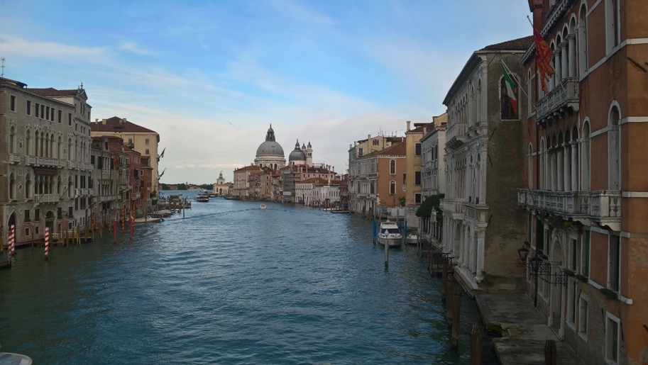
How Venice should be seen
The Grand Canal (from the Rialto Bridge)
© Hodder and Stoughton 2024

Slide 11
This resource is part of Geography Review, a magazine written for A-level students by subject experts. To subscribe to the full magazine go to:
http://www.hoddereducation.co.uk/geographyreview
© Hodder and Stoughton 2024

