Slide 1
Managing London’s sewage: a synoptic study
Simon Oakes

Slide 2
Synoptic geography
What are synoptic exam questions? | A level Geography courses include synoptic examination questions. These are designed to help students make links between different geographical themes, ideas and concepts. Synoptic exam questions allow students to work across different parts of their course and to show their accumulated knowledge and understanding of A level Geography.
Changing places and the water cycle | The focus of this PowerPoint is how urban growth requires careful management of water cycle flows and processes. Untreated sewage cannot be allowed to empty into rivers.
© Hodder & Stoughton Limited 2023

Slide 3
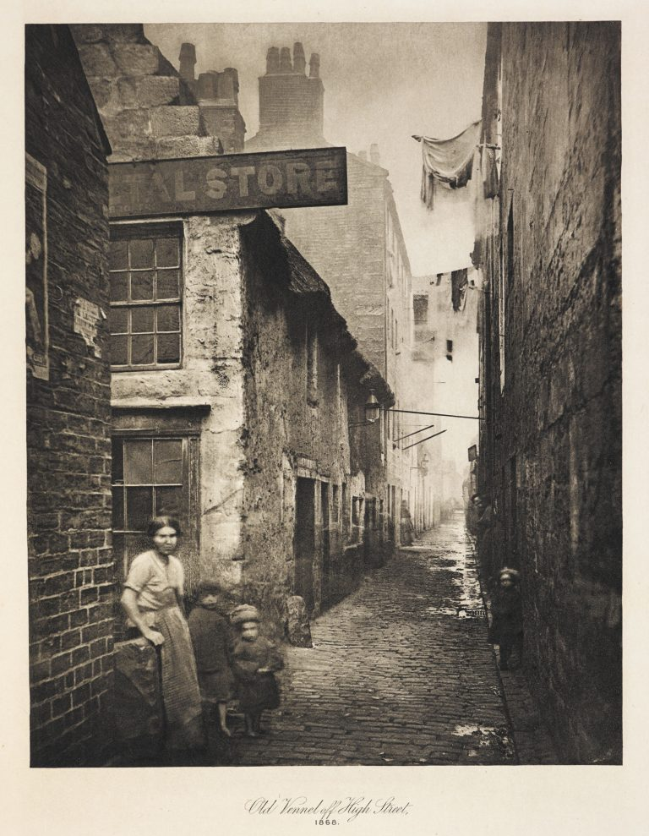
Sewage in nineteenth-century London
During the 1800s, an increasing volume of sewage entered British rivers from towns and cities.
Waste from houses spilled directly onto streets, from where it eventually ran into urban rivers.
By the hot summer of 1858, London’s ‘Great Stink’ (as it became known) was unbearable.
Outbreak of cholera, a water-borne disease, killed 30,000 Londoners during the 1840s and 1850s.
© Hodder & Stoughton Limited 2023

Slide 4
When and why did sewage become a problem?
London’s population doubled in size to 2.5 million between 1800 and 1850, resulting in far more waste being produced.
This also coincided with the end of a traditional ‘recycling’ waste economy.
Before the 1800s, human waste products were valued as a natural resource.
Excrement was carried away on carts during the night from people’s homes.
Called ‘night soil’, it was taken to the city edge for use as farmland fertiliser.
From today’s viewpoint, this was sustainable urban management.
But everything changed with the invention and widespread adoption of flushing lavatories in the early 1800s, leading to the River Thames becoming horribly polluted – because the new toilets drained straight into the streets.
What qualitative and quantitative data sources could you consult to help further research the urban changes that were happening in the 1800s? How reliable do you think they would they be?
© Hodder & Stoughton Limited 2023

Slide 5
What role did global systems play?
Global factors played a role in changing how cities like London managed their sewage waste in the 1800s.
Demand for ‘night soil’ lessened as farmers started making use of alternative sources of fertiliser taken from British Empire territories.
For example, huge quantities of guano (solidified bird droppings) were shipped to England from islands near the coast of southwest Africa.
200,000 mummified cats were taken from burial chambers in Egypt and transported to England where they were pulverised for use as agricultural fertiliser.
© Hodder & Stoughton Limited 2023

Slide 6
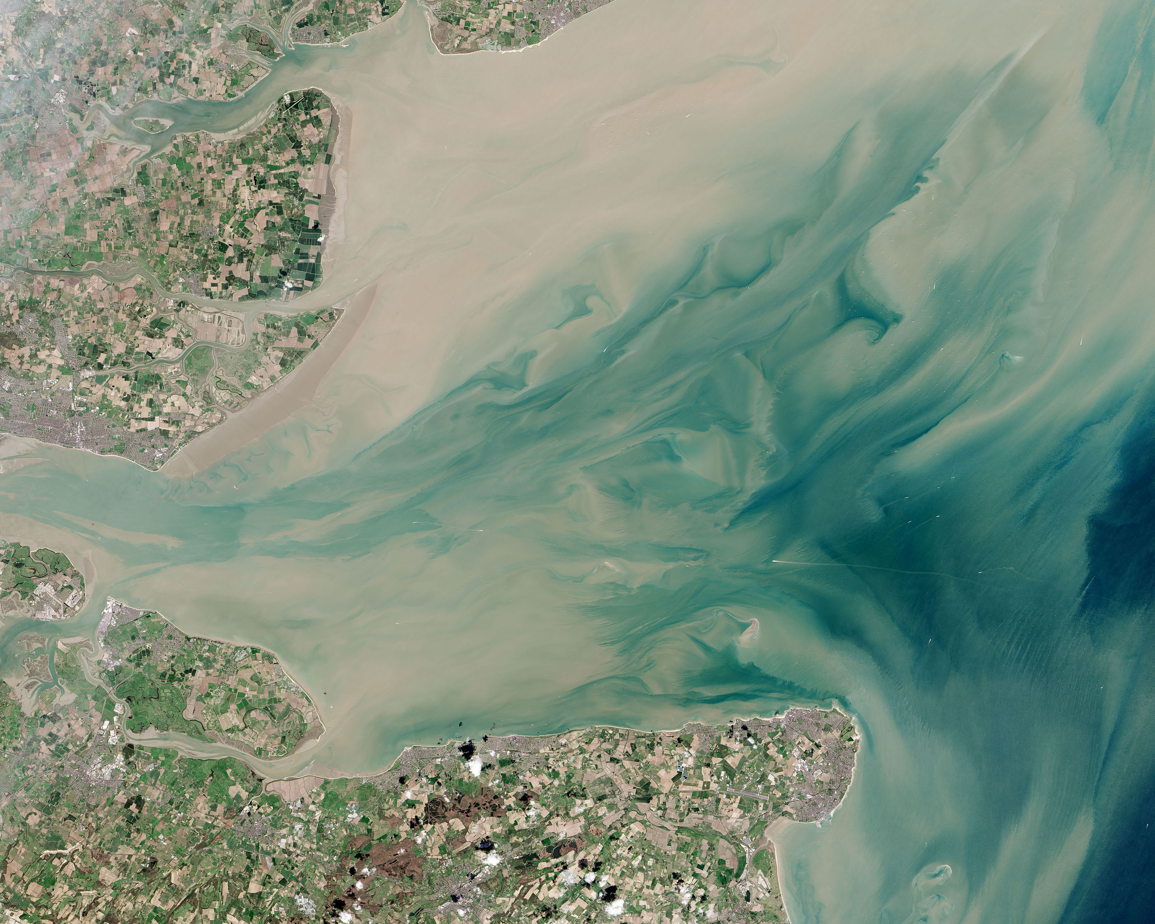
What role did physical factors play?
Although the Thames is connected to the North Sea, river transportation processes are hindered by tidal sea water incursion into the estuary twice each day.
This meant the growth of enormous rafts of slow-moving sewage along stretches of the river in London’s most densely populated areas.
© Hodder & Stoughton Limited 2023

Slide 7
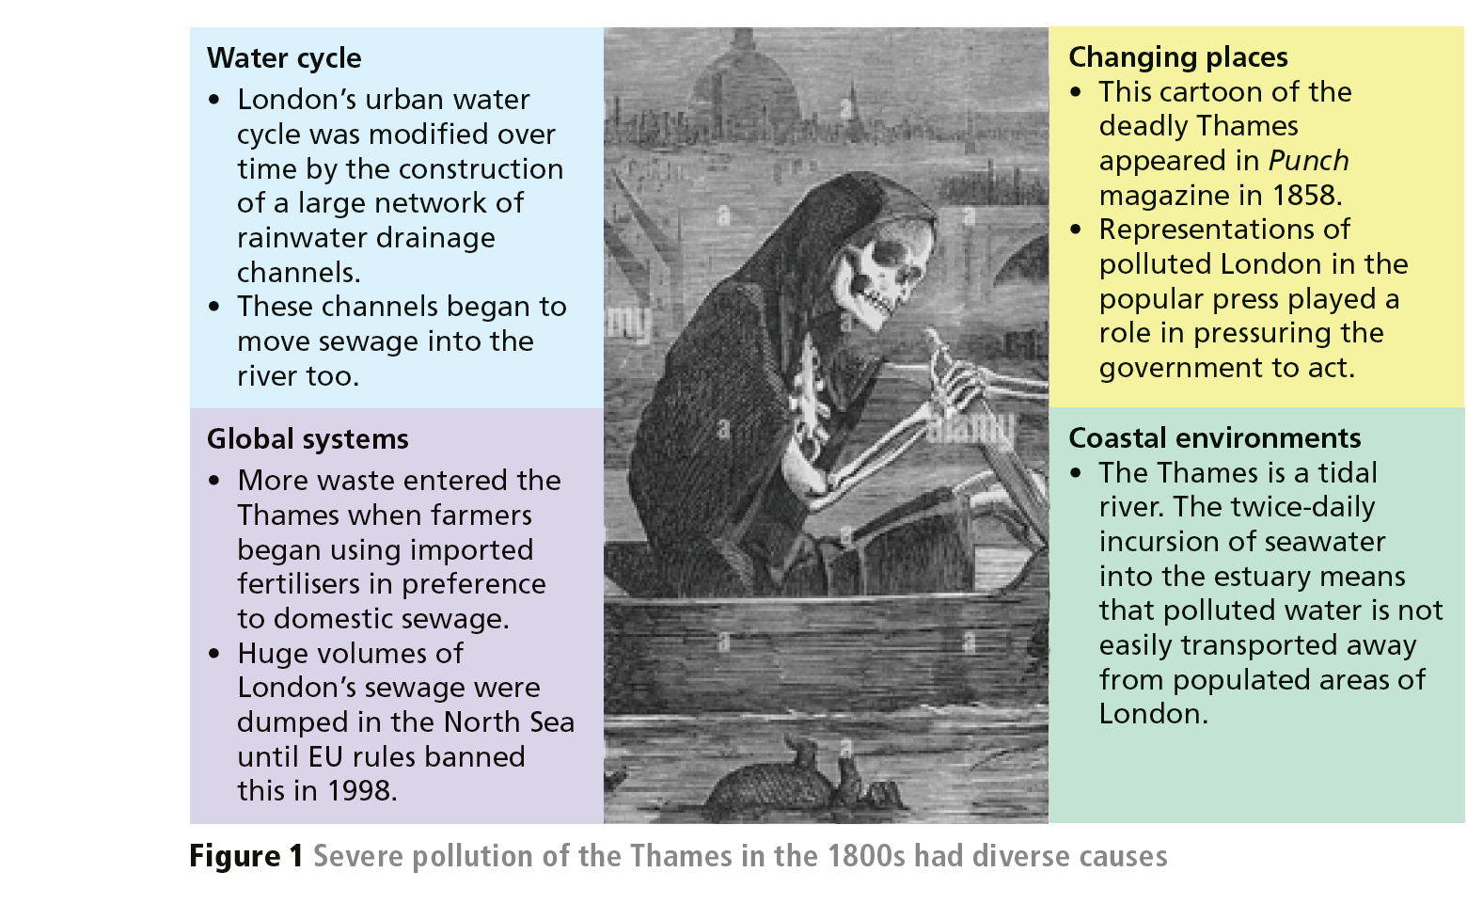
Synoptic summary
Ideas from four core geography topics help explain why the River Thames became so more polluted in the 1800s.
© Hodder & Stoughton Limited 2023

Slide 8
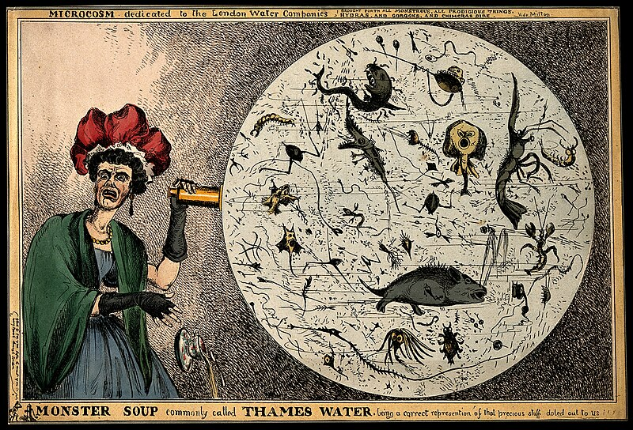
Solving the problem
Cartoons in newspapers, such as the one below, played a role in forcing the authorities to finally act.
The government of the day built a vast new underground sewer system during the 1860s — 1,800 km of new brick-lined tunnels.
82 pumping stations helped move waste towards a main treatment plant in Crossness, east of the city.
From 1887 onwards, solids from the sewer network were being dumped at sea from large barges called ‘bovril boats’. This practice continued until 1998 when European Union legislation outlawed it.
© Hodder & Stoughton Limited 2023

Slide 9
London’s twenty-first century sewage challenge
In the early 2000s, a decision was made to further improve London’s sewers.
The aim was to stop waste being flushed out of the Victorian network and into the river during heavy rainfall.
Extreme rainfall events are predicted to increase further due to climate change in coming years and decades.
Escaped sewage threatens fragile river ecosystems. This undermines work to restore ecological life in British rivers following all the damage done in the past by industry and agriculture.
Tourism and leisure in urban areas is vitally important for the post-industrial economies of London and other major cities; but polluted water can deter visitors from using riverside restaurants and bars.
The next slide summarises how several key issues are linked.
© Hodder & Stoughton Limited 2023

Slide 10
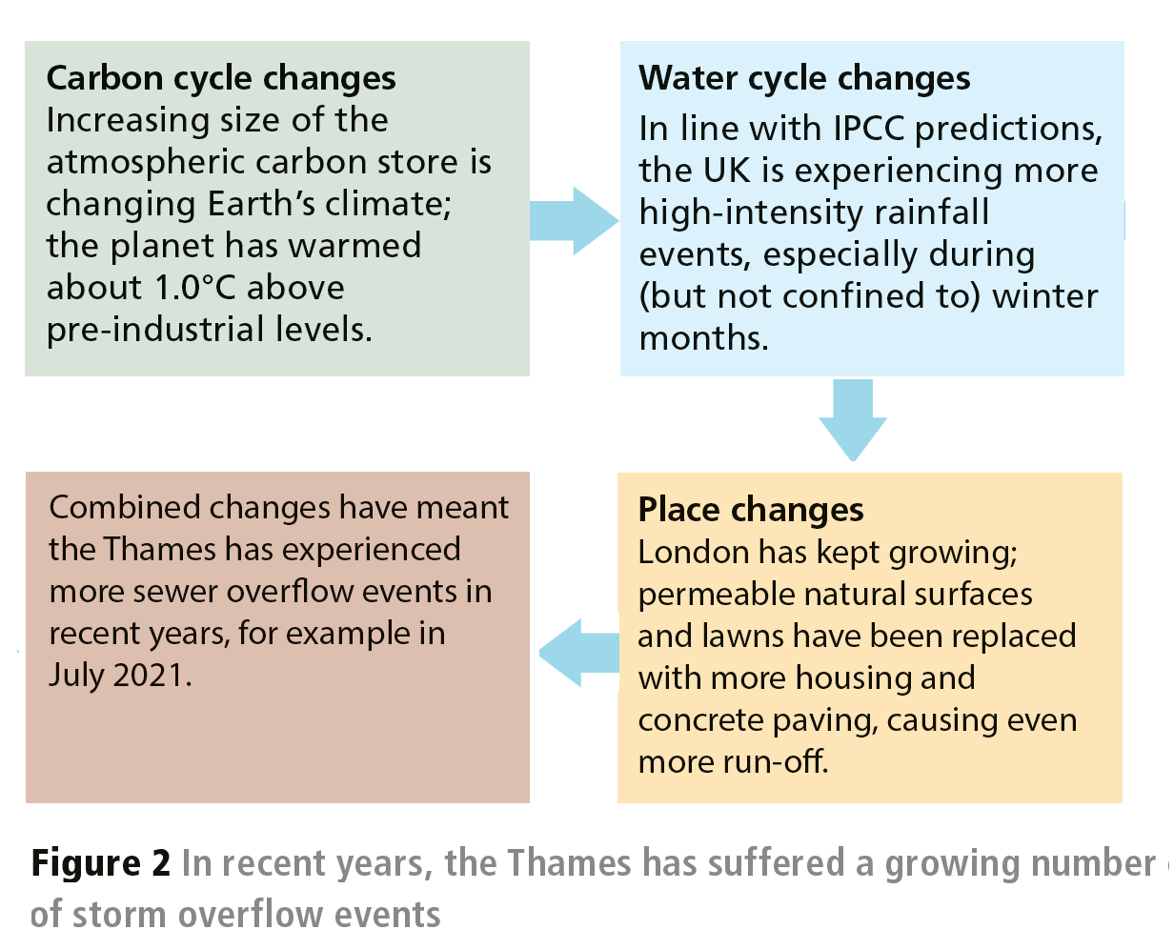
© Hodder & Stoughton Limited 2023

Slide 11
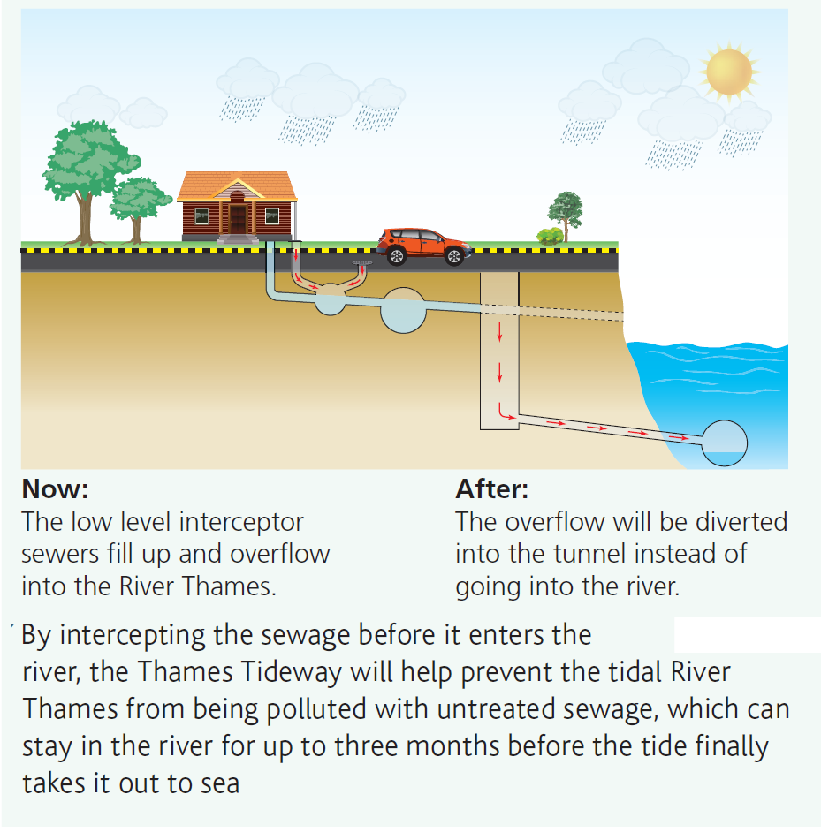
The Thames Tideway Tunnel
Work began in 2016 on the Thames Tideway Tunnel (TTT).
From 2025 onwards, any overflow will instead be intercepted by the TTT.
The TTT’s price tag of around £4.5 billion demonstrates the importance society attaches to good river water quality, even though lives are not directly at risk in the way they once were.
© Hodder & Stoughton Limited 2023

Slide 12
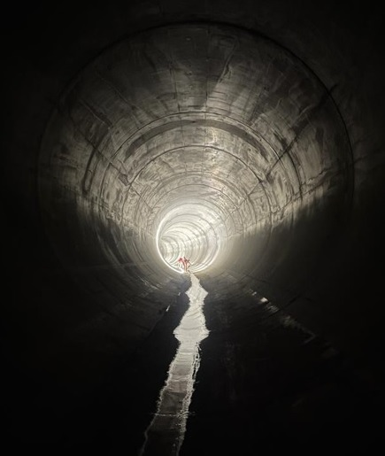
London’s new super sewer
Running 60 metres below the River Thames, the new 7-metre-wide ‘super sewer’ is 40 km long.
© Hodder & Stoughton Limited 2023

Slide 13
Sewage in the news
UK water companies are legally required to make improvements where required.
However, weak enforcement of the rules helps explain why only 14% of English rivers were awarded good ecological status in 2022.
Sewage dumping by private water companies in England is now a major political issue.
In 2023, England’s water companies issued an apology for their poor performance.
Why are so many of the UK’s rivers and coasts polluted? Where do problems arise, and why has more not been done already to tackle the issue ? Are there any stories about other polluted UK rivers or coastlines that you have read or heard about recently?
© Hodder & Stoughton Limited 2023

Slide 14
Further research
BBC podcast about ‘The Great Stink’: https://www.bbc.co.uk/programmes/m001gjcm
Thames Tideway Tunnel website: https://www.tideway.london/the-tunnel/
Could our sewage be re-used as fertilizer or fuel, like it used to be?
https://www.anthropocenemagazine.org/2019/01/sustainable-bricks-made-from-sewage/
Water and sewage companies in England apologise for sewage spills and launch massive transformation programme: https://www.water.org.uk/news-item/apology-transformation-programme/
© Hodder & Stoughton Limited 2023

Slide 15
This resource is part of Geography Review, a magazine written for A-level students by subject experts. To subscribe to the full magazine go to: http://www.hoddereducation.co.uk/geographyreview
Slide 3: https://commons.wikimedia.org/wiki/File:111418-25-History-Poverty-Victorian-England-London-768x989.jpg
Slide 6: https://en.wikipedia.org/wiki/Thames_Estuary#/media/File:Thames_Estuary_and_Wind_Farms_from_Space_NASA.jpg
Slide 7: https://en.wikipedia.org/wiki/Great_Stink#/media/File:The_silent_highwayman.jpg
Slide 8: https://en.m.wikipedia.org/wiki/File:Monster_Soup_commonly_called_Thames_Water._Wellcome_V0011218.jpg
Slide 11: From Hodder AQA A-level Geography
Slide 12: Jonah Fisher (reproduced with permission)
© Hodder & Stoughton Limited 2023

