Slide 1
The global commons
David Redfern
Notes:
This presentation supports the article in Geography Review Vol. 37, No. 2: Outer space: A global commons?

Slide 2
The global commons (1)
The term ‘the global commons’ was first used in the World Conservation Strategy, a report on conservation published in 1991 by the International Union for Conservation of Nature and Natural Resources (IUCN) in collaboration with UNESCO, the UNEP (United Nations Environment Programme) and the World Wildlife Fund (WWF). It stated:
‘A commons is a tract of land or water owned or used jointly by the members of a community. The global commons includes those parts of the Earth’s surface beyond national jurisdictions - notably the open ocean and the living resources found there, or held in common, notably the atmosphere. The only landmass that may be regarded as part of the global commons is Antarctica.’

Slide 3
The global commons (2)
Since 1991, two further global commons have been suggested: outer space and cyberspace (the internet).
The World Conservation Strategy stated that all people on the planet have a right to the benefits of the global commons. At the same time, for the rights of all people to sustainable development, it should be acknowledged that all the global commons require protection.
The protection of one of the major ‘global commons’ – the atmosphere – has been central to the battle against climate change, with many global meetings (called COP — Conference of the Parties) taking place in recent years. The most notable being those that produced the Kyoto Protocol (1997), and the Paris Agreement (2015).

Slide 4
Management of the global commons (1)
The key challenge of the concept of the ‘global commons’ is the design of governance structures and management systems capable of addressing the complexity of multiple public and private interests.
Management of the global commons requires a range of legal entities, usually international and supranational, public and private, structured to match the diversity of interests and the type of resource to be managed.
Such entities should be stringent but with adequate incentives to ensure compliance.
The purpose of such global management systems is to avoid a situation whereby the resources held in common become overexploited.
© Hodder & Stoughton 2023

Slide 5
Management of the global commons (2)
In general, several of the global commons (the atmosphere, Antarctica) are non-renewable on human time scales.
Thus, resource degradation is likely to be the result of unintended consequences that are unforeseen, not immediately observable, or not easily understood.
For example, the carbon dioxide emissions that drive climate change will continue to do so for at least a millennium after they enter the atmosphere, and species extinctions last forever.
Several environmental protocols have been established as a form of international law — these have tended to be intergovernmental documents intended as legally binding with a primary stated purpose of preventing or managing human impacts on natural resources.
© Hodder & Stoughton 2023

Slide 6
Management of the global commons (3)
International environment protocols have become a common feature with environmental governance of trans-boundary environmental problems such as acid rain in the late 1950s and 1960s.
Following the Stockholm Intergovernmental Conference in 1972, the creation of international environmental agreements has proliferated.
However, environmental protocols are not a panacea for global commons issues — often they are slow to produce the desired effects and lack monitoring and enforcement.
They also take an incremental approach to solutions where sustainable development principles suggest that environmental concerns should be mainstream political issues.

Slide 7
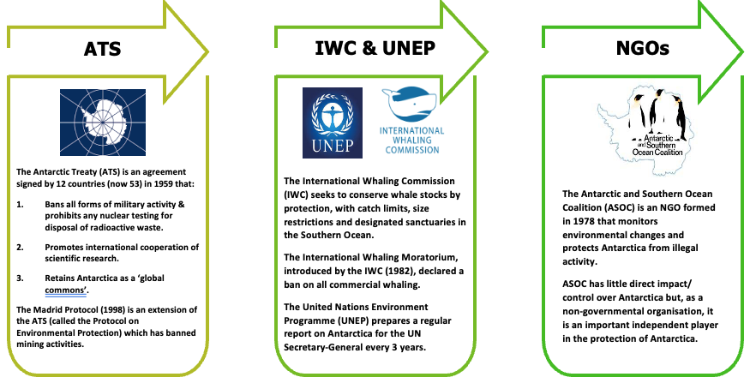
An example of management: Antarctica

Slide 8
Pressures on the global commons
The global commons are under increased pressure from:
Industrialisation/development: increased demand for resources (food, water, minerals, etc.) and waste creation (e.g., CO₂ in the atmosphere, chemical waste in oceans, e-waste in landfill sites – see also the article ‘The Global flow of e-waste’ in this edition (Page 22)
New technology (1): enables easier access to places that were previously less accessible (e.g. outer space, the high seas & Antarctica).
New technology (2): the demand for ‘new’ products e.g. electric cars and renewable energy, and the associated mining of rare earths and lithium and cobalt from locations such as the sea floor, and possibly the moon.

Slide 9
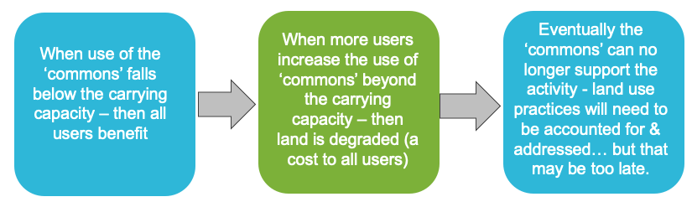
The ‘tragedy’ of the commons
In 1968 Garrett Hardin wrote a scientific paper called ‘The Tragedy of the Commons’ in the journal Science.
He stated that the tragedy of the commons occurred ‘when short term self-interest leads to a tragedy for all.’ He summarised there being three stages of the ‘tragedy’:

Slide 10
This resource is part of Geography Review, a magazine written for A-level students by subject experts. To subscribe to the full magazine go to: http://www.hoddereducation.co.uk/geographyreview
See also the presentation on ‘Digital Divides’, produced by Simon Oakes for Geography Review Vol. 35, No. 1
© Hodder & Stoughton 2023

