Slide 1
Studying hydrographs
David Redfern

Slide 2
The drainage basin hydrological cycle: key terms (1)

Slide 3
The drainage basin hydrological cycle: key terms (2)
A drainage basin is the area of land drained by a river and its tributaries.
Groundwater store is water which collects underground in pore spaces in rock.
Groundwater flow is the movement of groundwater. This is the slowest transfer of water within the drainage basin and provides water for the river during drought. It is sometimes called base flow.
Infiltration is the movement of water from the surface downwards into the soil.
Interception is the process by which precipitation is prevented from reaching the soil by leaves and branches of trees as well as by plants and grasses.
Overland flow (or surface run off) is the movement of water over saturated or impermeable land.
Percolation is the downward movement of water from soil to the rock below or within rock.
Runoff is all the water that flows out of a drainage basin.
Stemflow is the water that runs down the stems and trunks of plants and trees to the ground
Throughfall is the water that drips off leaves during a rainstorm.
Throughflow is the water that moves down-slope through soil.

Slide 4
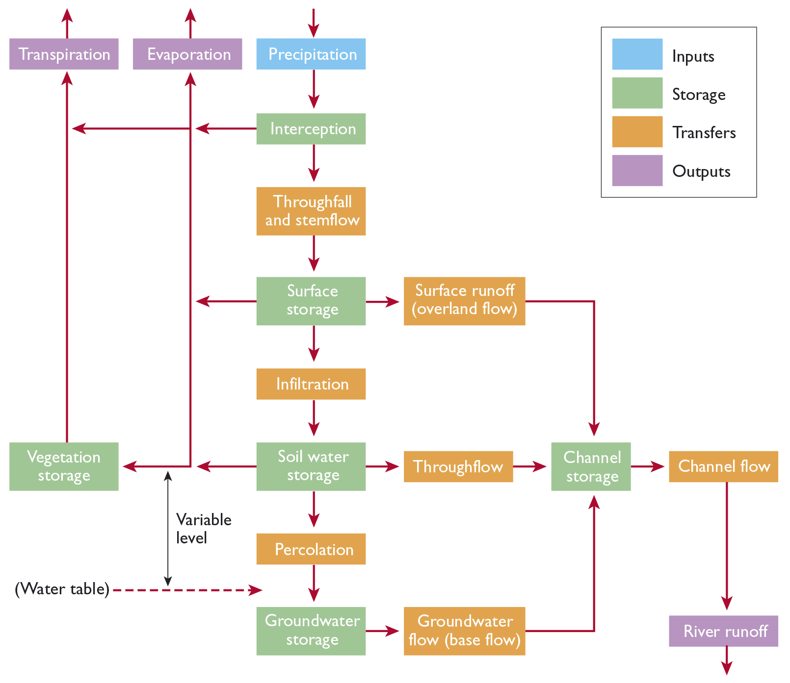
The water cycle as a system
The drainage-basin water cycle is an open system.
Inputs of precipitation eventually exit the basin as outputs of river discharge or as evaporation and transpiration.
Overland flow, throughflow and groundwater flow are key processes that transfer water through the system.
A rainfall event (storm) and the pattern of rainfall over a year impact how a drainage basin and its river react in terms of its channel flow, and its overall runoff pattern (regime).
© Hodder & Stoughton 2023

Slide 5
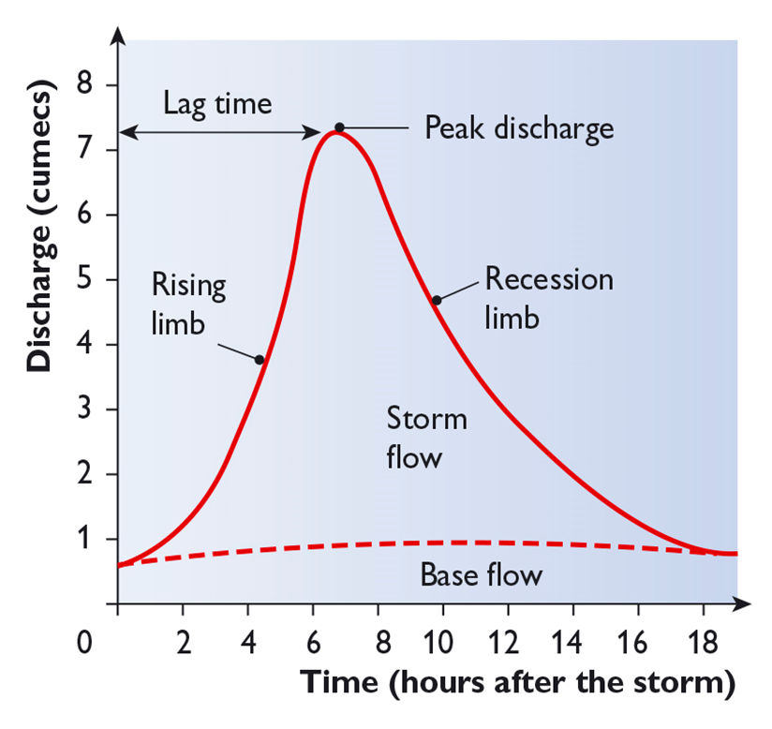
Storm hydrographs (1)
A storm hydrograph shows how a river responds to one period of heavy rainfall.
‘Lag time’ is the time between the peak rainfall and the peak discharge of the river.
Lag times can vary depending on the relief of the drainage basin, the underlying rock type, the vegetation, the land use and the drainage density.
The diagram opposite shows the key labels of a storm hydrograph. (More detail is provided on the following slide.)
© Hodder & Stoughton 2023

Slide 6
Storm hydrographs (2)
Short-term storm events (e.g. a thunderstorm) result in a large input of water and create:
an extremely steep rising limb, and a very short lag time
an equally steep recession limb - the river returns to normal conditions within hours.
Periods of cyclonic rainfall can add substantial amounts of water to a river catchment. They:
have a timeline measured in days from the onset of rainfall to the flood peak
have a similar period for the recovery back to normal conditions
can cause multiple flood events in the same catchment that can last several weeks.

Slide 7
Hydrological pathways
Stormflow involves surface runoff, when rainfall is unable to infiltrate the soil, either because the infiltration capacity is too low or because the ground is already saturated.
Shallow subsurface runoff may contribute to stormflow, either where water flows out from the soil, or where the soil is sufficiently permeable to allow subsurface flow to quickly contribute to the storm hydrograph.
Baseflow is provided by slow, steady inputs of groundwater. Some permeable rocks like limestone can provide large quantities of groundwater whereas impermeable rocks like granite will provide very little.

Slide 8
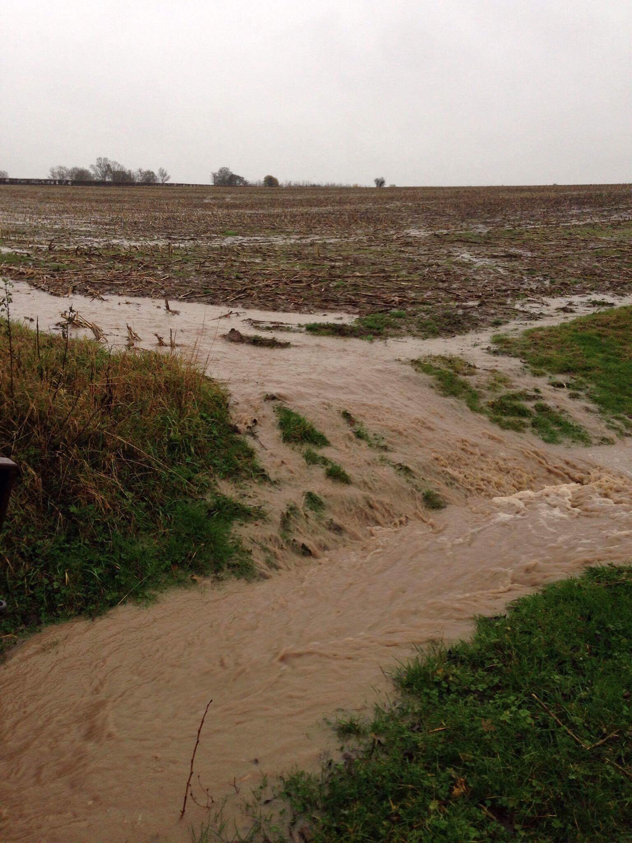
Overland flow
There are two different mechanisms of overland flow:
Infiltration - excess overland flow occurs when high-intensity rainfall outstrips the infiltration capacity of the soil. This sometimes occurs in arid environments, or in the UK when a summer convectional downpour follows a dry period (especially when a baked and trampled soil surface has been left with a low infiltration capacity). See photo.
Saturation overland flow occurs during a long period of steady rainfall. The amount of water that has already entered the soil builds up to a point where further inputs of water are prevented. With nowhere else to go, water now flows downhill over the soil surface.

Slide 9
Storm hydrographs: variables (1)
Several variables within a drainage basin can affect the shape of the storm hydrograph:
1. Antecedent rainfall — rain falling on a ground surface which is already saturated will produce a steep rising limb and a shorter lag time.
2. Snowmelt — large amounts of water are released greatly increasing discharge and rapidly, especially if the ground surface is still frozen as this reduces infiltration.
3. Vegetation — in summer deciduous trees have more leaves so interception is higher, discharge is lower, and lag times are longer.
4. Basin shape — water takes less time to reach the river in a circular drainage basin than an elongated one. (see next slide)

Slide 10
Storm hydrographs: variables (2)
5. Slope — in steep sided drainage basins water gets to the river more quickly than in an area of gentle slopes
6. Geology — permeable rocks allow percolation to occur which slows down the rate of transfer of water to the river. Impermeable rocks allow less percolation and have greater amounts of overland flow and hence greater discharges and shorter lag times
7. Urban growth — impermeable roofs and roads are shaped to get rid of water quickly. Combined with a dense network of drains, this means that water gets to the river very quickly, reducing lag time and increasing discharge.

Slide 11
River regimes
A river regime shows how the discharge of a river varies over a longer period of time — usually a year. A river regime indicates how the runoff response reflects the regional climate, and in particular the seasonal changes within the drainage basin.
Factor | Commentary
Climate | Determines the nature, amount, seasonality and intensity of precipitation Determines temperature, which affects evaporation and the occurrence of glacial meltwater
Geology | Influences the degree of permeability, and the rate of percolation in groundwater stores
Soil | Influences the rate of infiltration and throughflow
Location | Combines the influences of the above. Equatorial regions have less variability of regime; monsoonal and colder regions have more variable regimes

Slide 12
Characteristic river regimes
Note: All the regimes shown are in the northern hemisphere.
A regime dominated by ice and snow melt e.g. a high altitude or a high latitude area
A mid-latitude area with low summer discharge caused by high evaporation rates
A tropical monsoonal regime dominated by high rainfall inputs during summer and a long dry winter
The complex pattern of an equatorial river with rainfall throughout the year, but with two peaks.

Slide 13
This resource is part of Geography Review, a magazine written for A-level students by subject experts. To subscribe to the full magazine go to: http://www.hoddereducation.co.uk/geographyreview
© Hodder & Stoughton 2023

