Slide 1
Human rights The 2022 World Cup in Qatar
David Redfern

Slide 2
Introduction
This presentation supports the following article in Geography Review Vol. 36, No. 4:
Economies before human rights? — page 39.
This PowerPoint examines the issue of human rights in the context of Qatar, in the build up to the 2022 World Cup, during the event and the aftermath.

Slide 3
The Qatar World Cup 2022
The most expensive ever – estimated cost of $300 billion (£250 bn)
The shortest ever – played over just 28 days
The first to take place in the European winter months – during the main European season for football
The first in the Middle East, and the first in an Arab nation
The most compact tournament – all games were within a 40-minute travel distance from the capital Doha
All games were played within 8 stadia – 7 of which were brand new

Slide 4
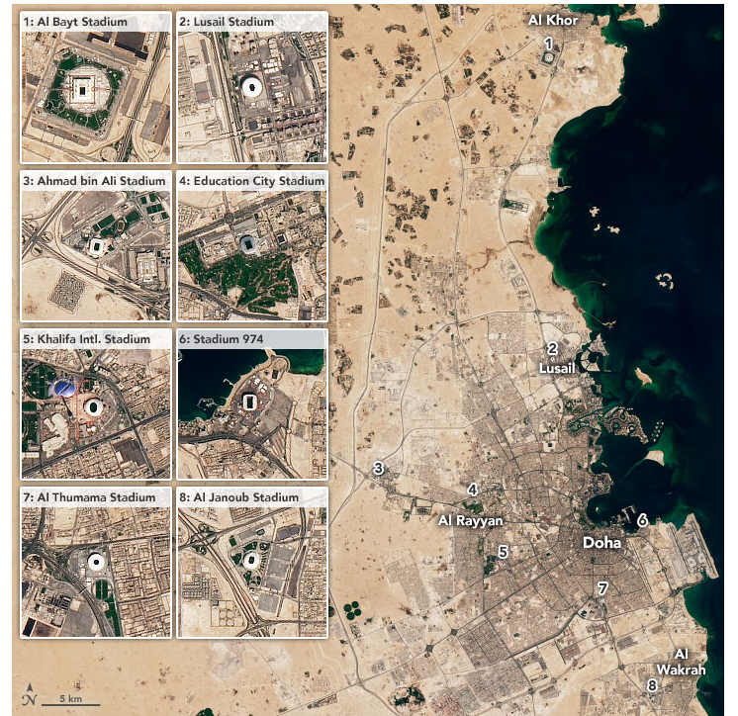

The stadia
Qatar
Photo: NASA
Stadium City Qatar (nasa.gov)

Slide 5
Human rights – before the tournament: Migrant workers
The migrant population comprised 95% of the total workforce during construction
Most came from Kerala, southern India; others came from other parts of India, Pakistan and Bangladesh
Workers were dependent on the Qatari employers for legal residency and status. Passports were often confiscated, meaning that ‘absconding’ was illegal
There was little data transparency on worker deaths and injuries. Eventually the death toll was officially confirmed at ‘400–500’ though other estimates from human rights observers were much higher
Union membership and protests were banned.

Slide 6
Human rights – before the tournament: Women’s rights
A guardianship system exists: women need the permission of male guardians (e.g. a father, brother, husband) for key life decisions
As a result, access to marriage, travel abroad, employment and reproductive health care are restricted
Women are disproportionately prosecuted in laws criminalising non-marital sex
There have been concerns over the handling of rape and sexual violence by the police
According to the World Economic Forum Global Gender Index, Qatar is ranked 137th out of 145 countries.

Slide 7
Human rights – before the tournament: LGBT+ rights
Same-sex sexual conduct between men, or between women, is illegal
Consensual sexual relations between men above 16 is punished by up to 7 years’ imprisonment
There is a penalty of up to 3 years for any male who ‘instigates’ or ‘entices’ another male to ‘commit acts of sodomy or immorality’
There have been reports of LGBT+ people being denied access to legal representation and medical care
In November 2022, a Qatari FIFA Ambassador described homosexuality as ‘damage in the mind’ in a television interview

Slide 8
Human rights – before the tournament: Freedom of speech
The following acts are criminalised in Qatar:
Criticising the Emir
Insulting the Qatari flag
Defaming the Islamic religion
Inciting to ‘overthrow the regime’
Spreading ‘false news’ or ‘intending harm to national interests’
Posting online content that ‘violates social values’
In 2022, Qatar was ranked 119 (out of 180) in the Reporters Without Borders Freedom Index.

Slide 9
Human rights – during the tournament: LGBT+
The captains of several European teams (e.g. England, Wales, Germany) planned to wear OneLove armbands. However, following the threat from FIFA of a booking for the players, the plan was dropped
FIFA also banned the word ‘Love’ printed on the inside of the collar of the Belgium strip
The German team covered their mouths during a team photo as a protest, signaling that they had been silenced by FIFA
Rainbow flags, and symbols, were banned throughout the tournament – including on hats, T-shirts and wrist bands
However, no other incidents concerning LGBT+ fans were reported

Slide 10
Other issues
The Iranian team did not sing their national anthem before their game with England. Many considered this as support for the street protests taking place in Iran at the time
There were problems with the digital ticketing system during some of the earlier matches, causing late entry to the games
Attendance figures appeared to be exaggerated in some games, and there were several empty seats even during some of the quarter-final matches
A late decision to ban alcohol sales, except for VIPs, broke a promise made by FIFA before the tournament, and caused discontent from a large US sponsor, Budweiser
On the pitch, the number of yellow and red cards was one of the lowest ever

Slide 11
After the tournament
Several of the stadia are to be demolished or re-purposed. One is to become a base for women’s sports, one an education facility and another a wedding venue (see below)
The Arab Nation football cup is to be held in Qatar in 2024
In 2023 and for 10 years, Qatar is to host a Formula One Grand Prix, making use of many of the facilities such as hotels and fan-zones
Indian weddings are being encouraged as a source of revenue. It is anticipated that one stadium will act as a host of several weddings at a time, with hundreds of guests
The Qataris have declared that their main projected in-bound tourist destinations will be Asian and African, in contrast to their near-neighbour, Dubai

Slide 12
Other resources
A review of the World Cup based in Qatar can be read at:
https://news.sky.com/story/while-qataris-may-view-the-world-cup-as-a-job-well-done-as-fans-go-home-with-positive-views-the-legacy-remains-that-more-change-is-needed-12770290
A video produced by France 24 (English version) examining the conditions faced by migrant workers in Qatar can be viewed at:
The plight of migrant workers in Qatar • FRANCE 24 English – YouTube
A video of the interview with Piers Morgan with the FIFA Ambassador broadcast on TalkTV can be viewed at:
Qatar World Cup Chief Reveals Migrant Workers Death Toll To Piers Morgan - YouTube

Slide 13
This resource is part of Geography Review, a magazine written for A-level students by subject experts. To subscribe to the full magazine go to: http://www.hoddereducation.co.uk/geographyreview

