Slide 1
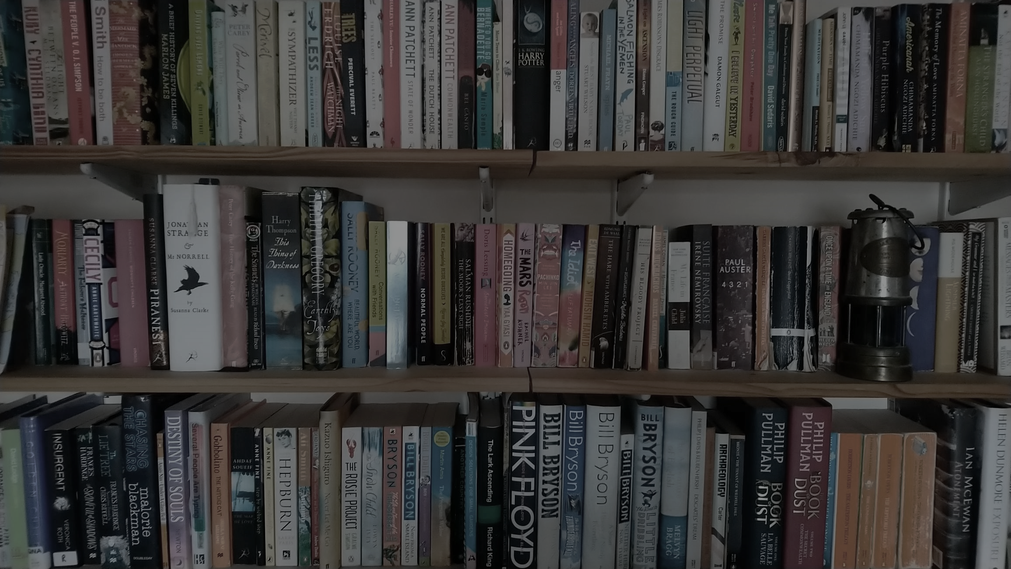
Changing places Using texts as qualitative data sources

Slide 2
Key terms
Place representation | The diverse ways in which places are portrayed in different kinds of media and texts, ranging from films to personal photographs and diaries.
Text | Any culturally-produced representation of something which is considered to contain meaning. The word can refer to a range of qualitative data sources that include – among other things – television, films, music and other sounds, diaries, newspapers, art, cartoons and photographs.
Formal and informal texts | Formal texts are produced by political, social and cultural agencies (including local government and tourist boards), along with large businesses; informal texts are produced by individuals or small groups of people working outside of formal sector institutions.
Do you know what these terms mean?
Click to reveal the definitions

Slide 3
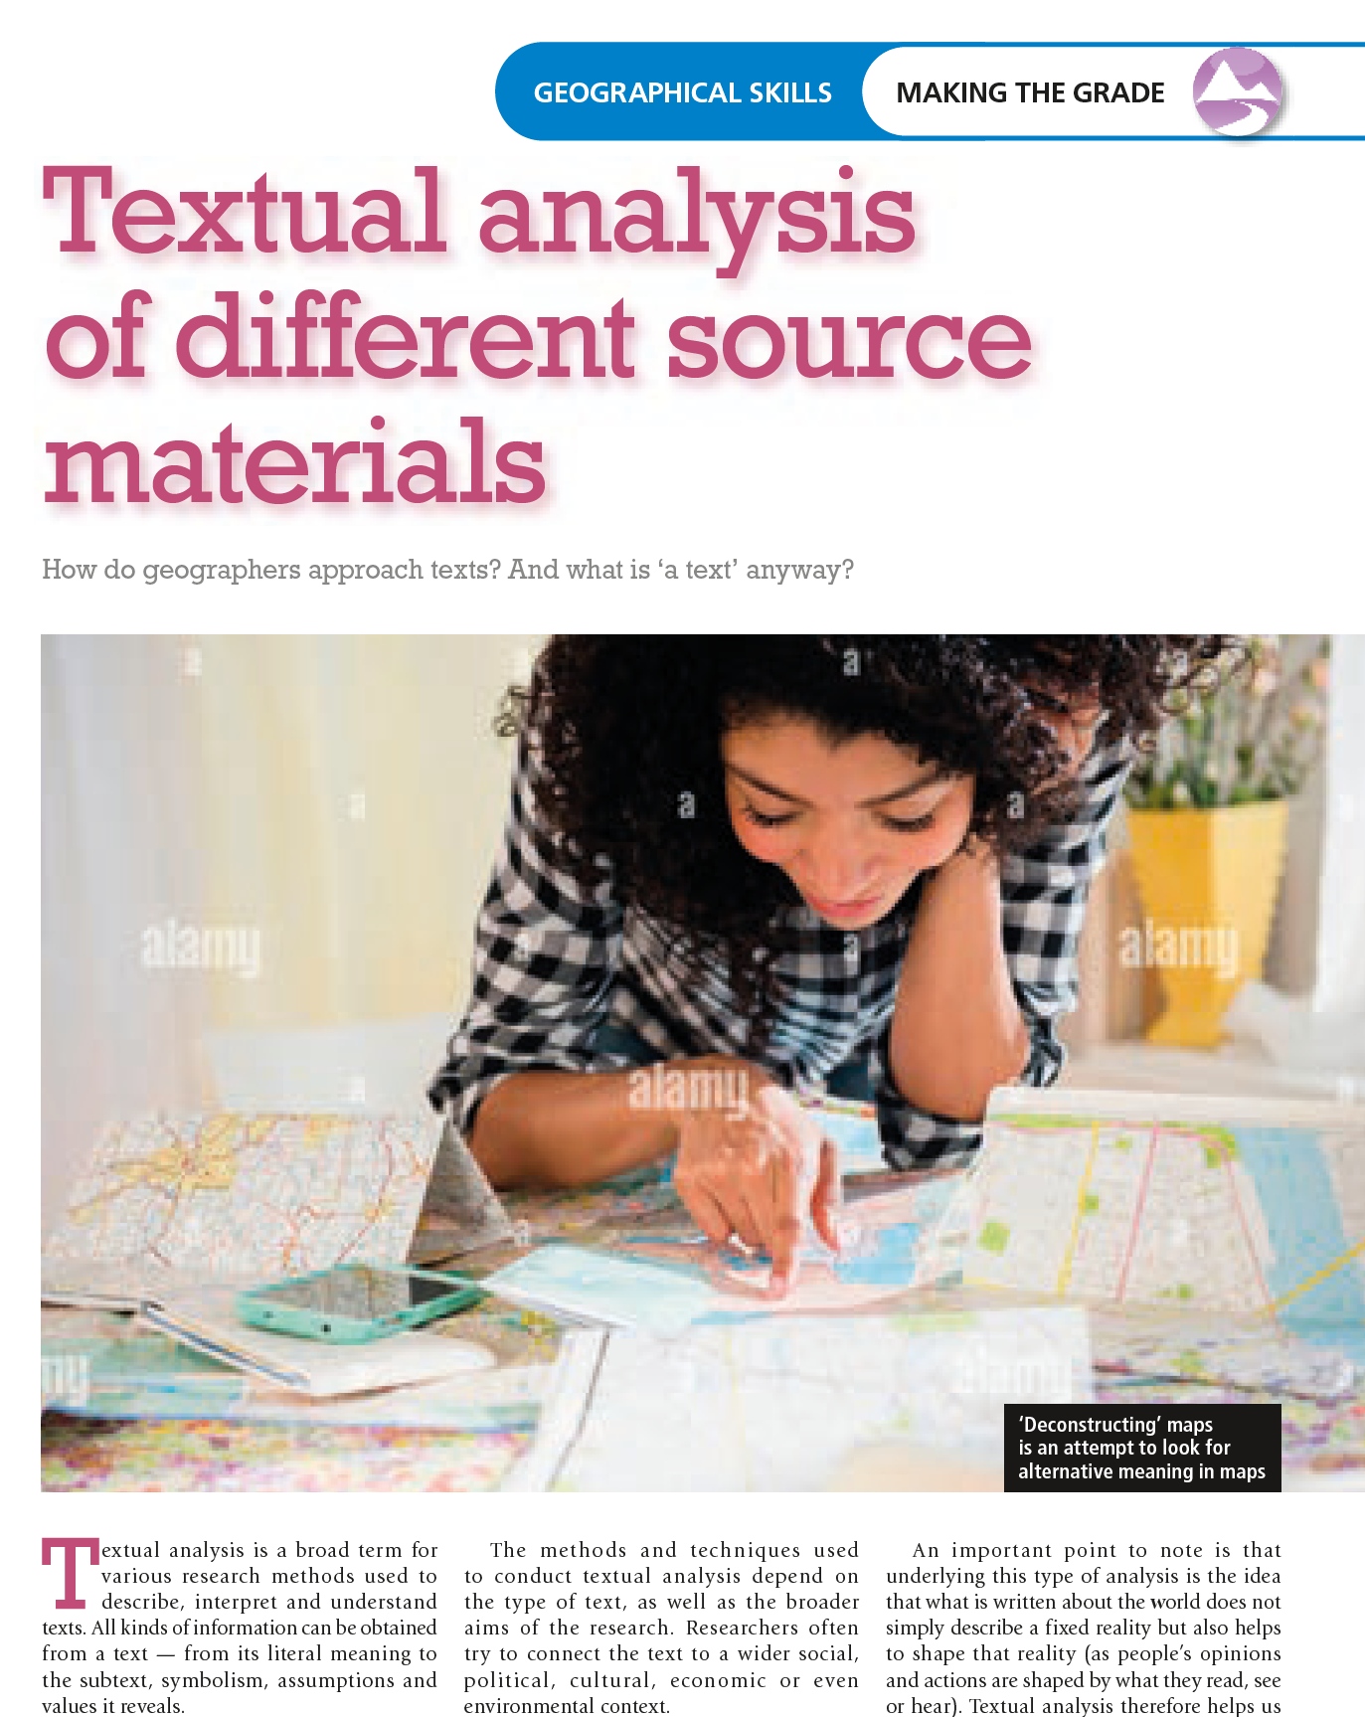
What is a text?
Geography Review Volume 36, Number 4 (April 2023) explores the technique of textual analysis.
A text is a piece of writing, such as a book, a magazine article or a social media post.
A text can also be any object whose meaning and significance you want to interpret: a film, a piece of music, an image, even a map.
Older texts are sometimes described as analogue data (for example, a printed book or vinyl record) and may be stored physically in libraries.
More recent texts are typically digital data: these representations of life are created on a computer or phone and uploaded to an online platform.
When depth interviews are carried out as part of primary data collection, the transcript (record of the interview) can also be described as a text.

Slide 4
Types of text
Class activity
The table explores five possible types of text a geographer might make use of when carrying out research.
Working in pairs, choose one of the examples and evaluate its possible uses.
Think about:
the topics you might be investigating
possible strengths and weaknesses of your chosen type of text from the table

Slide 5
Formal or informal texts?
The formal and informal parts of any aspect of human life are, by definition, difficult to pin down. The advent of social media and crowd-sourced data has made the distinction even less clear in recent years.
Formal texts and place representations are produced by political, social and cultural agencies (including local government, education institutions, tourist boards and national heritage agencies) along with large businesses.
Informal texts place representations are produced by individuals or small groups of people working outside of formal sector institutions. For example, a lone fiction writer or artist can legally say pretty much anything about a place, blurring fact and fiction. Anyone who wants to can write an opinionated online blog about the city or neighbourhood where they live (indeed, a highly biased or prejudiced account may prove attractive to readers who share the writer’s views).

Slide 6
Texts and issues
Analysis of texts
Competing perspectives
Conflict and tension
You could initially be surprised to find yourself studying ‘texts’ and place ‘representations’ — because we typically associate these words with language studies, rather than geography. But you might be far less surprised by the kinds of issues geographers typically investigate using qualitative texts. These include:
competing perspectives on whether places should be managed or marketed as tourist destinations (and the way different groups of people express their varying views or discourses using traditional or online media)
tension and conflict between different players or stakeholders (for example, in relation to how places have been represented in the media and the real-world implications of these actions for processes, such as migration).

Slide 7
Reading and ‘decoding’ texts
Meanings are ‘encoded’ into texts (books, pictures, music) by their authors with the expectation that most of the audience will successfully ‘decode’ the intended message.
The producers of the different texts we study use their own art form’s ‘language of signs’. For instance, film soundtracks contain musical ‘clues’: certain sounds or musical expressions alert the audience to the fact that something romantic or scary is about to happen.
Advertisers may use particular words to make a product or place sound appealing to a certain audience — words like ‘breathtaking’ or ‘lively’ might appear in an advert for a rural or urban tourist destination, for example.
These kinds of communication only work because people have learned to recognise or ‘read’ the textual clues.
The model shown in the next slide shows how the encoding-decoding process is meant to operate.
In A-level geography, you can make use of theories and models as part of your explanation and evaluation of important concepts and issues.

Slide 8
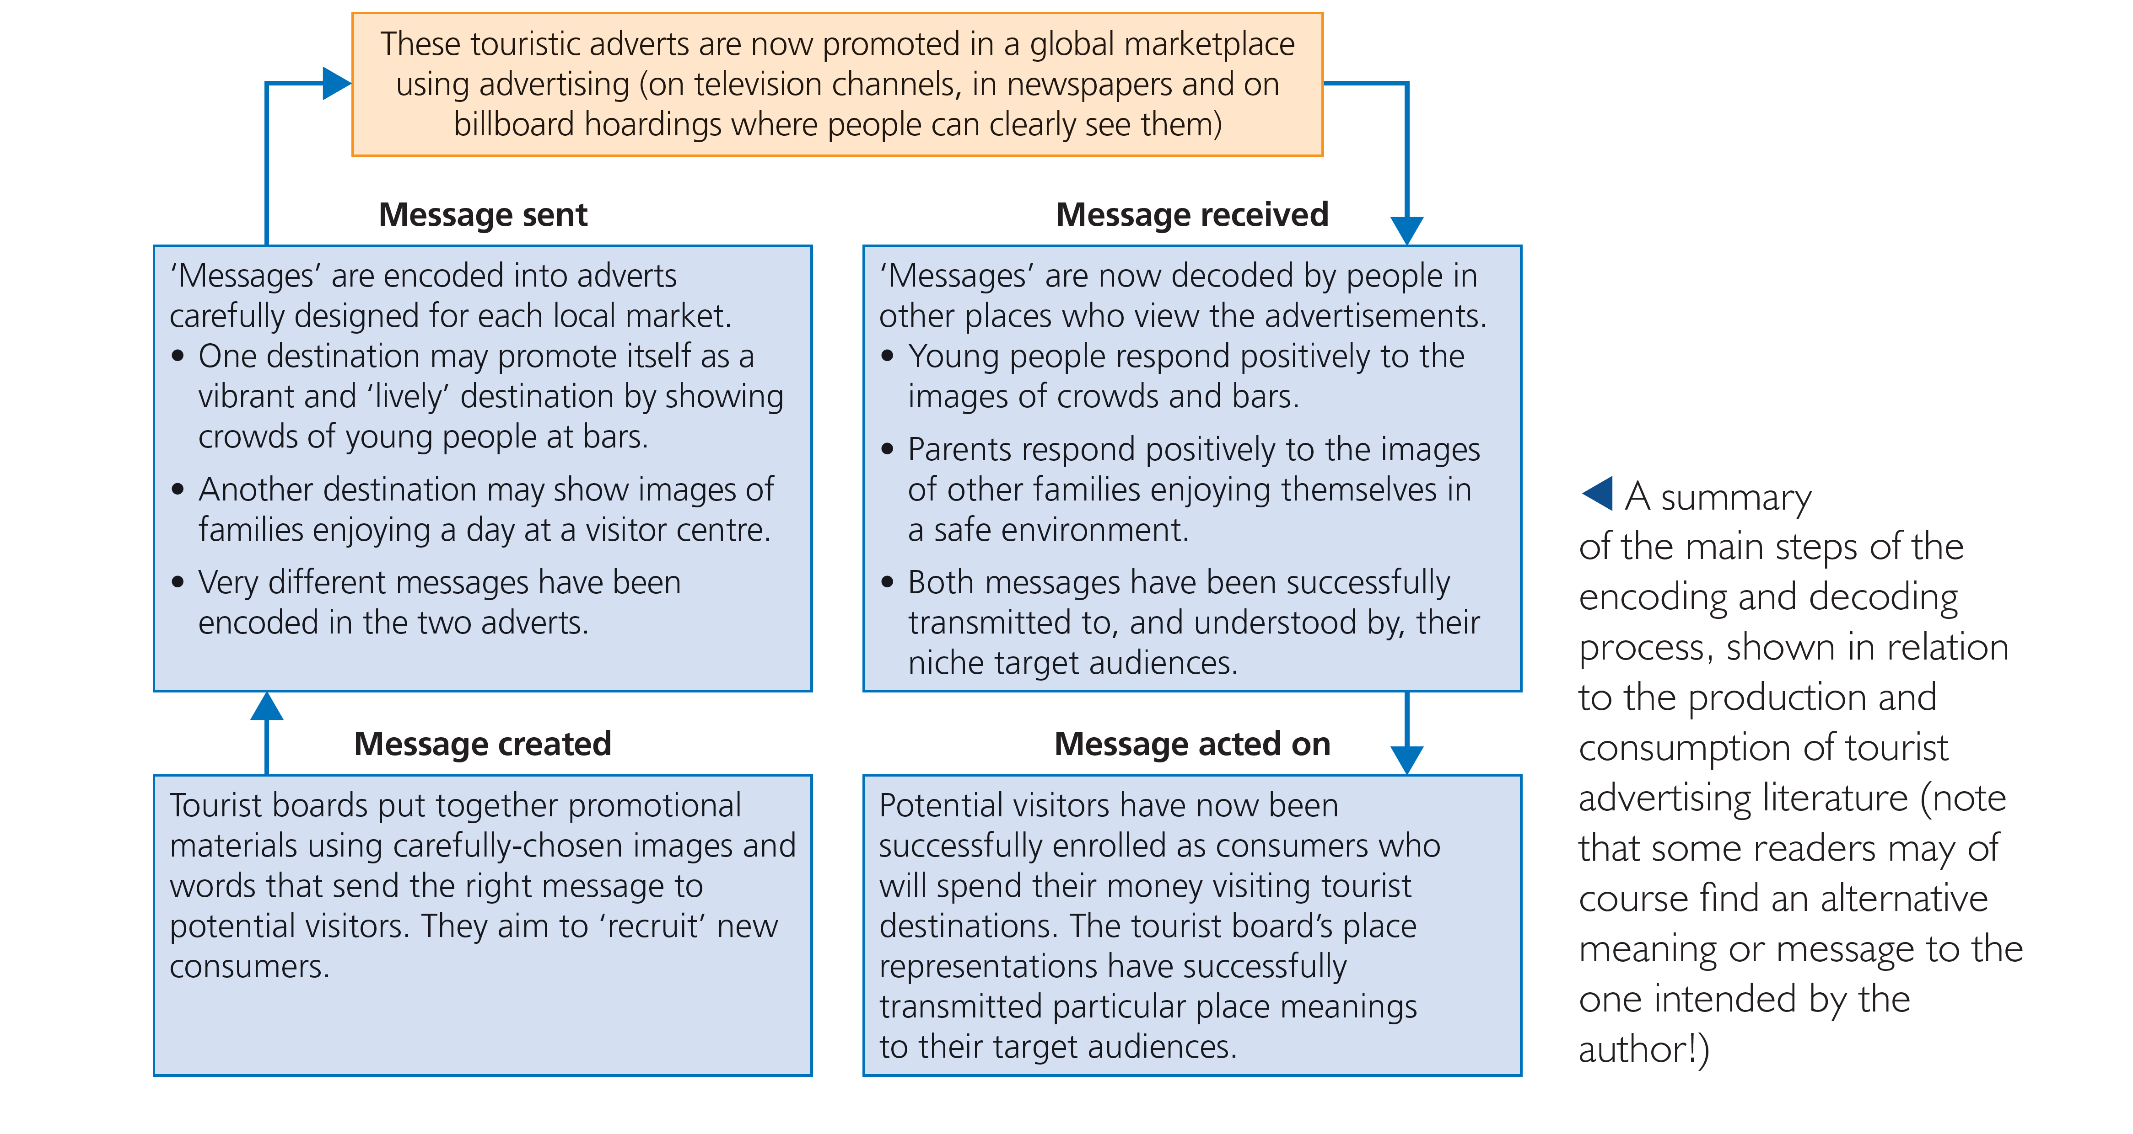
The encoding-decoding model

Slide 9
Maximising your use of texts
Class activity
A geographical analysis of different texts — and the views of the people who have constructed them — can be carried out sequentially using the 8 steps shown in the diagram.
In pairs, students can (i) choose a novel or film that is relevant to geography, and (ii) apply the 8 stages.

Slide 10
Textual analysis techniques
‘Textual analysis’ is sometimes carried out using the following commonly-used four-stage procedure:
1 Denotation — this means identifying and defining the most basic elements of the image.
2 Connotation — this means working out how the image (or parts of it) also suggest additional ideas and meanings (a picture of a log fire could be used to represent ‘home’ for instance).
3 Mise-en-scène (literally ‘placing on stage’) — this involves looking more closely at the subtle ways in which the image has been arranged and framed. Everything in an image contributes to its meaning and message, from people’s facial expressions to the clothes they are wearing.
4 Organisation — when someone takes a photograph or paints a picture, they decide what to include and what to avoid. The composition of the image (for example, some elements are made larger or more in focus than others), the time of day and the angle it is taken from can have an important effect on how an audience responds.
Now try to apply this process to the image on the next slide (Stratford, London)

Slide 11
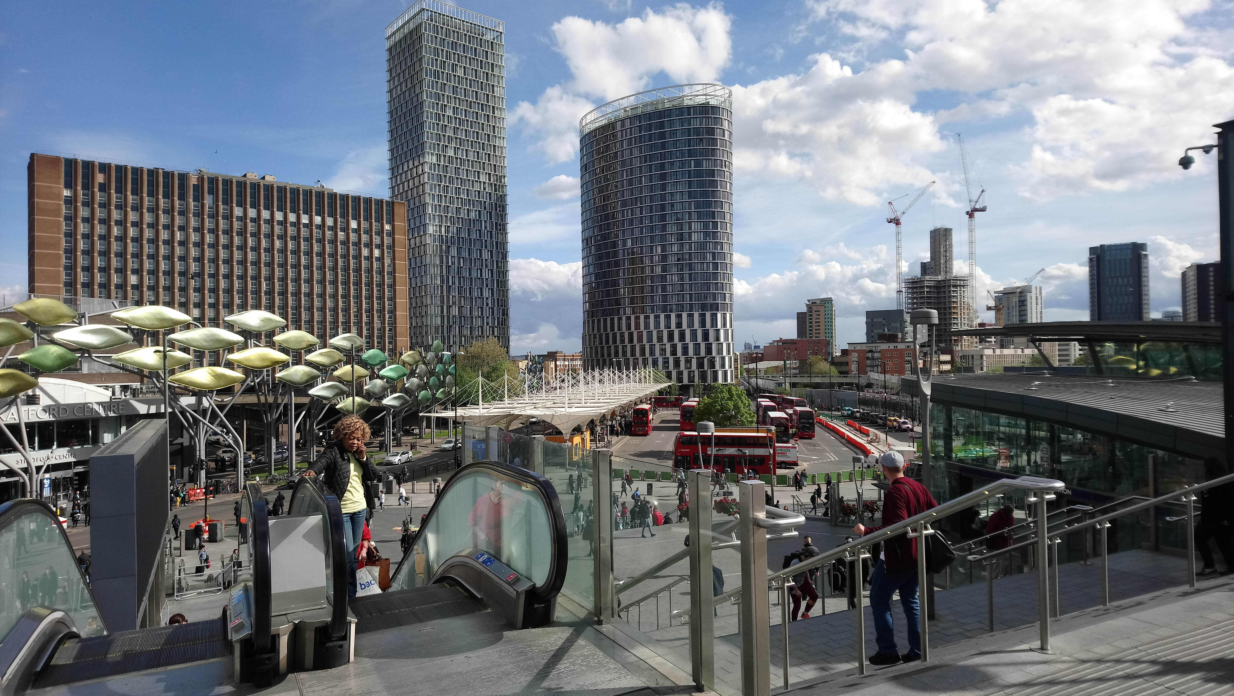
Textual analysis techniques
It’s your turn to carry out textual analysis of this image using the four stages:
Denotation (2) Connotation
(3) Mise-en-scène (4) Organisation

Slide 12
Final points
Textual analysis is an important way of ‘doing geography’, particularly in the context of human geography work on changing places, and therefore is a useful method for some Year 12 students to apply as part of their NEA research.
Texts are always unavoidably political, biased and personal. That’s what makes them interesting — as well as challenging to use and interpret.
Textual analysis almost always involves some level of subjective interpretation, which can affect the reliability and validity of the results and conclusions. It’s important to acknowledge this if you do use the technique in your NEA.

Slide 13
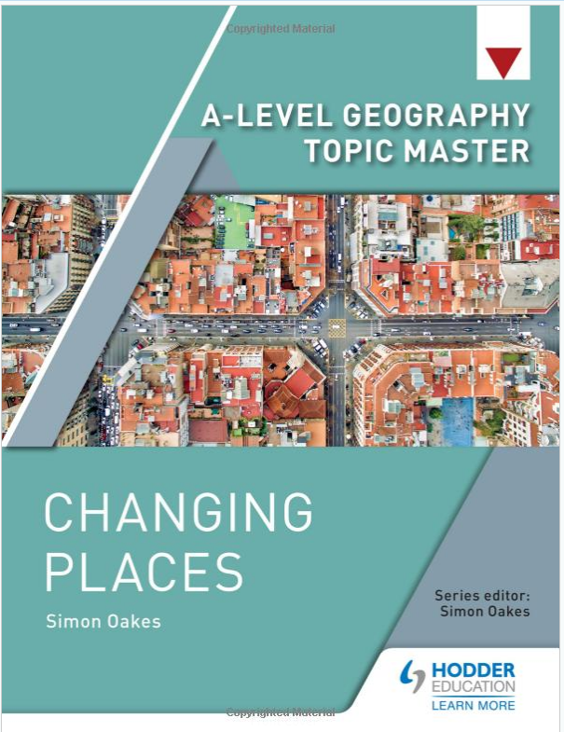
This resource is part of Geography Review, a magazine written for A-level students by subject experts. To subscribe to the full magazine go to: http://www.hoddereducation.co.uk/geographyreview
Some figures in this presentation appear in David Holmes’ article in Geography Review Volume 36, Number 4. Other figures are sourced from Changing Places (A-level geography Topic Master)
Photograph in slide 11 used with permission of Simon Oakes.

