Slide 1
Geographical aspects of two ‘rare earths’
Lithium and neodymium
David Redfern

Slide 2
Introduction
This presentation supports the following article in Geography Review Vol. 36, No. 3:
New Horizons: Making Connections
President Trump, Greenland, Australia and the mining of rare earths — page 39.
This PowerPoint builds on some aspects of the above article regarding two specific elements — lithium and neodymium — the latter being one of the rare earth elements and the former often classified (incorrectly) as one.

Slide 3
What are rare earths? (1)
The term ‘rare earths’ refers to 17 chemically similar elements (15 lanthanides, plus scandium and yttrium)
The element Lithium is often used alongside other ‘rare earths’, and is of equal importance for the batteries for electric vehicles (EVs). It has been called ‘white oil’.
The term ‘rare earth’ is something of a misnomer — they were named as such when they were first discovered in the late 1700s, but we now know that they proliferate in many locations around the world.

Slide 4
What are rare earths? (2)
These metals have magnetic and electronic properties that lend them an important array of applications:
Cerium is used to colour glass, and is found in pink glassware and rose-coloured spectacles; it is also used as a ‘signal booster’, particularly in undersea cables that enable global internet communications.
Yttrium and Europium are used in smartphone batteries and display screens.
Samarium is used to treat lung cancer.

Slide 5
What are rare earths? (3)
Some ‘rare earths’ have crucial energy applications e.g. wind turbines or EV batteries, making them vital for the move away from fossil fuels — the ‘Green Transition’.
Hence, in some ways, this small group of metals has replaced natural gas and oil as the critical raw material that defines a brutal competition for natural resources between China, the USA and Europe.
China has dominated the mining and refining of these materials - as early as 1992, Deng Xiaoping observed ‘the Middle East has oil, China has the rare earths’. In 2010 China mined 97% of global production; in 2021 it was 78%.
China is also dominant in processing them, particularly for magnets, wind turbines and EV engines.

Slide 6
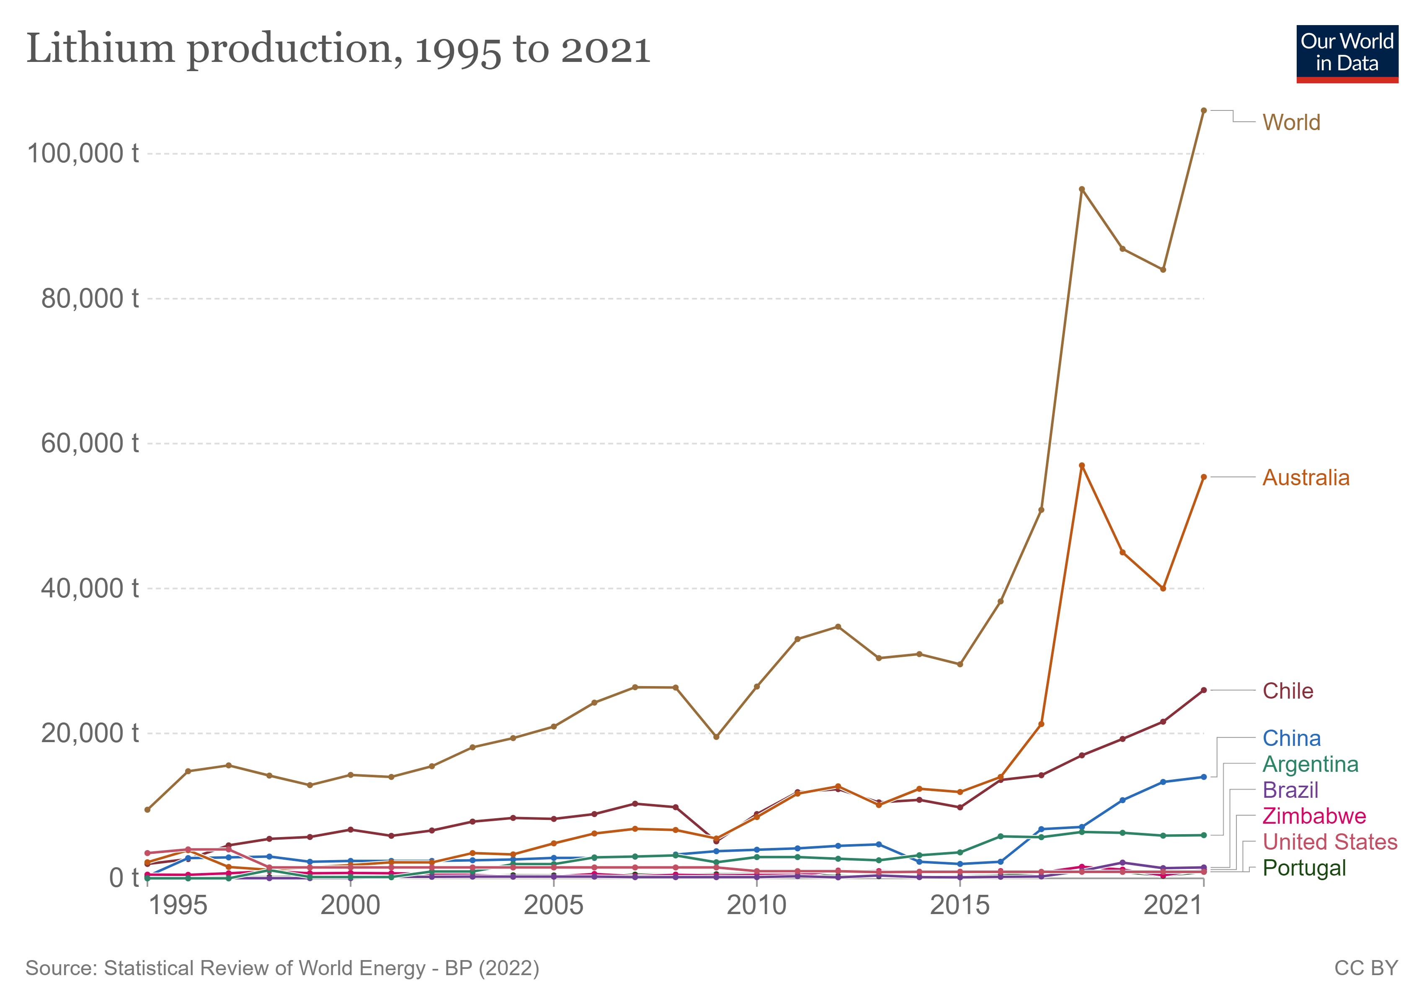
Lithium: global production
New reserves have been found in France, Serbia, Ukraine, Turkey and Greenland.

Slide 7
Lithium: Portugal
Portugal has 10% of Europe’s lithium deposits — amounting to over 60,000 tonnes.
In February 2022, the Environment Ministry gave the go-ahead to the mining of lithium at six sites across the country.
However, at some of the sites, including Barroso and Pinhel in the north of the country, local people have mounted campaigns to stop the mines.
Barroso, which is also an environmentally protected area, has deposits worth £1.5 billion over the next 15 years, according to the mining company Savannah Resources.
The company says that 800 jobs will be created. It says money will be invested back into the community — houses, social facilities and energy supplies.
However, the local mayor states that 95% of the population of the area are against the mine.
They fear environmental damage such as loss of irrigation water and contaminated land.

Slide 8
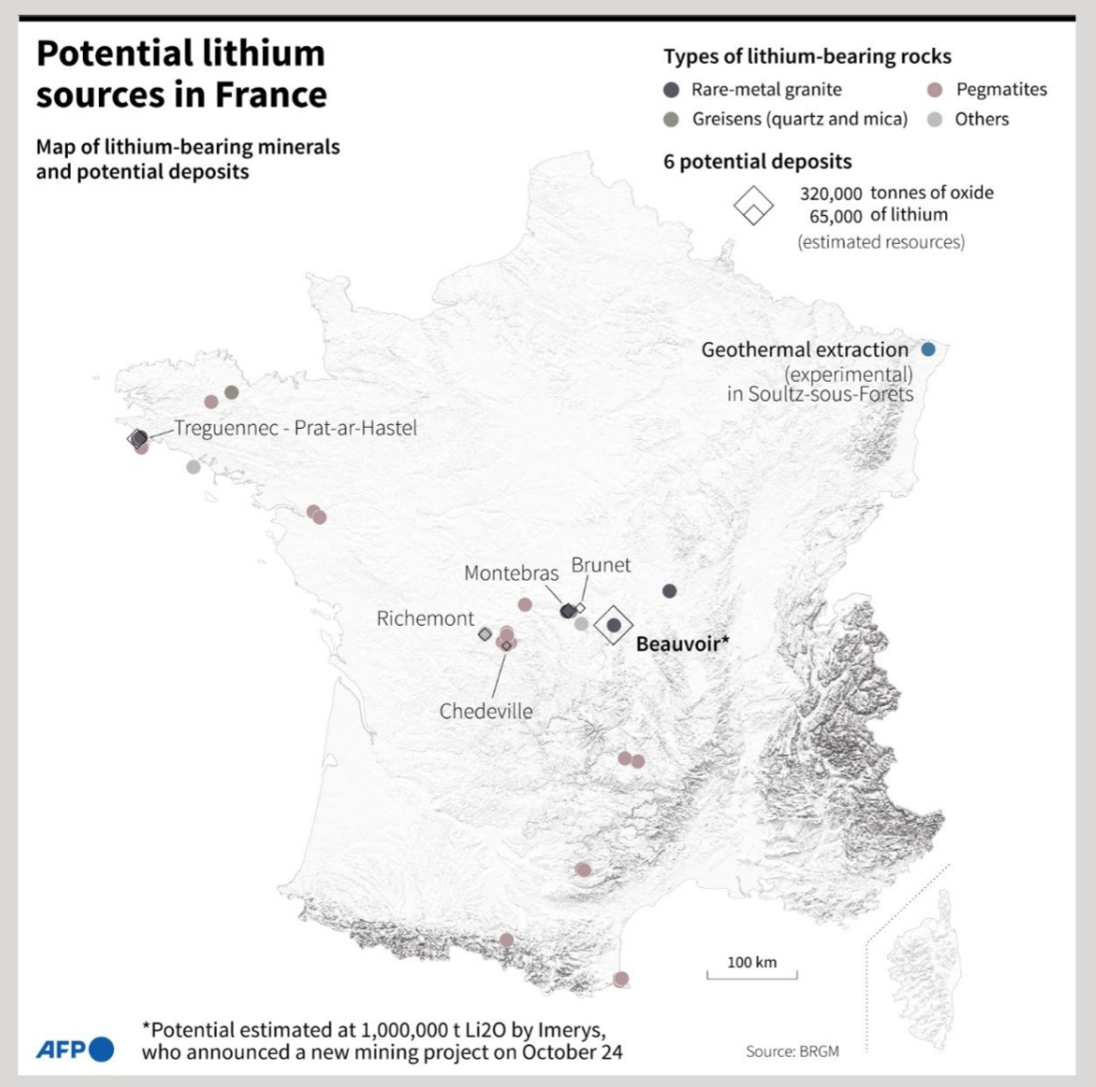
Lithium: France
In October 2022, the French mining company, Imerys, revealed plans to develop a new lithium mine in central France (near Beauvoir).
The aim is to produce 34,000 tonnes of lithium hydroxide per year — enough for 700,000 EV batteries for 25 years — from 2028.
The mine would also improve the EU’s industrial sovereignty at a time when car and battery manufacturers are heavily dependent on imported lithium — a key element in the Green Transition.
The EU plans to stop the sale of new diesel and petrol vehicles in 2035, causing the high demand for lithium batteries.

Slide 9
Neodymium (1)
Neodymium is vital for wind turbines and EVs.
When combined with iron and boron as an alloy, it becomes a super-magnet (called a ‘permanent magnet’) capable of holding the weight of a large set of revolving blades to the shaft of a wind turbine.
It also enables wind turbine operation at both lower and higher than average wind speeds.

Slide 10
Neodymium (2)
In EVs the permanent magnets act as the drive unit and provide the torque required for the electric motor.
In 2020 China mined 62% of global deposits of neodymium and refined 84% of the final product. Refining produces a lot of environmental pollution.
However, some refining and processing has been moved to Myanmar thereby ‘exporting’ the pollution produced to another country.

Slide 11
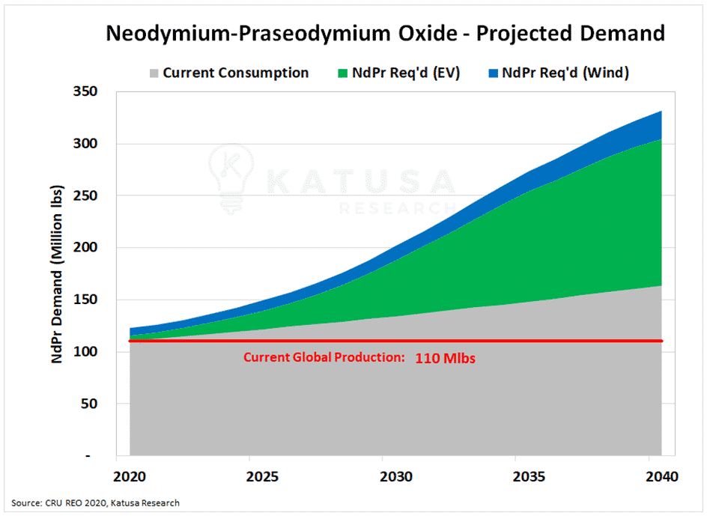
Neodymium (3)
Extraction and processing are being expanded into Australia, Malaysia, Greenland, Brazil and Angola.
A processing plant exists at Saltend (Hull, UK) to ‘feed’ the expanding wind farm operation in the North Sea — e.g. Hornsea 1 and 2 (the largest offshore wind farms in the world).
Hornsea 2 became operational on 31 August 2022. It lies 90km off the Yorkshire Coast and will power 1.4 million homes with power.
Source: KATUSA Research.
Units: million pounds (Mlb)

Slide 12
The future: the EU
The EU is keen to be more self-sufficient in rare earths in order to move away from import dependency — their aim is to have 20% sourced from EU countries by 2030.
Portugal and Serbia are key countries in this move. The EU Commissioner Maros Sefcovic has stated that attitudes to rare earth mining should ‘move from Nimby (Not in My Back Yard) to Pimby (Please In My Back Yard)’.
This change of attitude could be achieved by companies feeding back profits into local communities. [NB a similar idea was touted recently by the UK government re fracking].
Alternative sources could also come from recycling or reusing current electronic uses of the metal — a process called ‘Urban mining’.
Some economists, such as Kate Raworth, describe ‘urban mining’ as part of the ‘circular economy’.

Slide 13
The future: Ukraine
The need for rare earths adds another dimension to the conflict in Ukraine.
Ukraine has enormous potential for rare earth mining — some suggest this is why a potential accession into EU in the near future has been fast-tracked.
However, much of the rare earth deposits in Ukraine are in the eastern part of the country — the Donbas. This area is currently under the control of Russian-backed governments.
Russia is also keen to move into the Green Transition, with more EVs, solar farms and wind farms.

Slide 14
The future: a paradox
A fundamental paradox that exists is that in order to facilitate the Green Transition, i.e. to be more sustainable and ‘green’ by using more renewable energy and EVs, we need more rare earths.
However, this means that there would be damage to the environment to extract/access these minerals.
The risk is that a green future will require excessive damage to key environments (such as permafrost zones, mountains and rainforests).

Slide 15
Other resources
A series of short podcasts produced by the BBC on rare earths can be found at:
The Scramble for Rare Earths - 1. The Magnificent Seventeen - BBC Sounds
A short video regarding lithium mining in Portugal can be viewed at:
Portugal's government approves lithium mining despite growing concerns | Euronews
A short video regarding lithium mining in France can be viewed at:
France to develop major lithium mine as Europe moves to electric vehicles • FRANCE 24 English
Learn more about the ‘circular economy’ and ‘doughnut economics’ from Kate Raworth at:
DEAL (doughnuteconomics.org)

Slide 16
This resource is part of Geography Review, a magazine written for A-level students by subject experts. To subscribe to the full magazine go to: http://www.hoddereducation.co.uk/geographyreview

