Slide 1
Post-pandemic places
Simon Oakes

Slide 2
Key terms
Place connections | Ways in which places are linked together over time by flows of people, money, commodities and information. Physical geography creates place connections too: rivers, tides and winds help move people and objects from place to place. Place links vary in scale, from local to global connections.
Place meanings | The importance people attach to particular locations. These attachments arise due to personal experience (people’s lived experience of their home place or neighbourhood), or due to broader historical or cultural factors creating shared place meanings for entire communities.
Pandemic | A disease epidemic occurring worldwide, or over a very wide world region, crossing international boundaries and usually affecting a large number of people, for example the Covid-19 pandemic (as declared by WHO, the World Health Organisation, in March 2020).
Do you know what these terms mean?
Click to reveal the definitions

Slide 3
Changing places and the Covid-19 pandemic
1. Place identity and character
Lockdown impacts for businesses and high streets
Migration and community changes
2. Place meanings, experiences and feelings
People’s changing experiences of local places during Covid-19 lockdowns
3. Place connections and links
Restricted travel
Increased online connectivity
Supply chain disruptions
In this presentation, we explore THREE ways in which students can make links between the ‘geography-in-the-news’ topic of the Covid-19 pandemic and their own classroom studies of Changing Places.

Slide 4
1. Changing place identity and character
Changes in place identity (economic and social character) caused by the Covid-19 pandemic
Long-term business costs and closures due to Covid-19 — with implications for town and city CBDs
Stimulus to use new technology (Amazon, Zoom) — leading to fewer people commuting, reduced traffic
Stimulus to migrate, for example from urban to rural areas (counter-urbanisation) in search of larger homes with a garden
Discussion
The diagram shows geographical changes associated with the Covid-19 pandemic and national lockdowns in the UK during 2020–22.
Has your own home places, or another place you know or have read about, been affected in any of these ways?
Can you evaluate the changes — are they positive or negative changes?

Slide 5
1. Changing place identity and character
Activity
The table explores four possible types of place change in greater depth.
Working in pairs, choose one of the questions and carry out an evaluation of the issue.
What is your answer to the question — yes or no? What key ideas and information have helped you to arrive at this judgement?

Slide 6
1. Changing place identity and character
Practice exam questions
Analyse the changes shown in Figure 2. (5 marks)
Suggest possible causes and consequences of the changes shown in Figure 2. (10 marks)

Slide 7
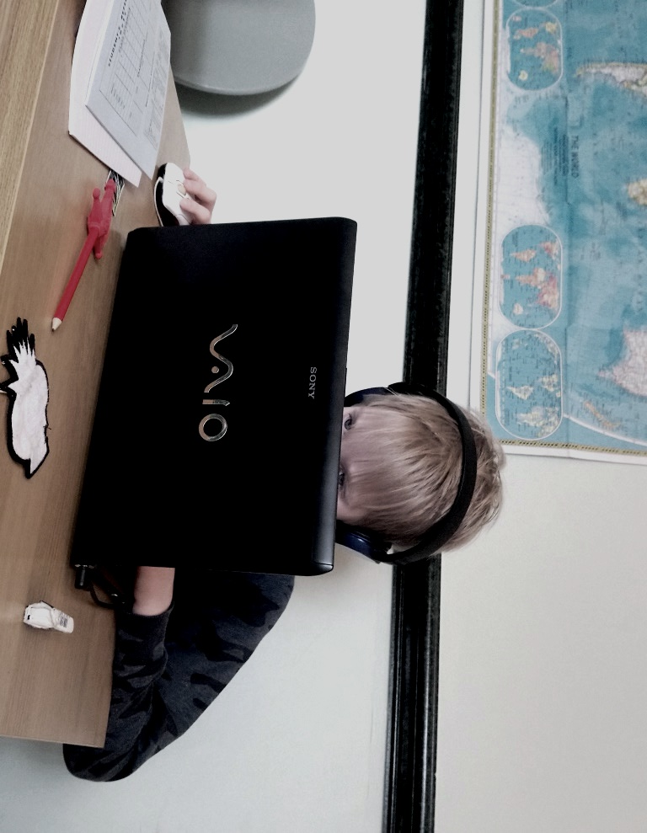
2. Changing place meanings and experiences
Reflection
What was life like during lockdown in your own home place?
How did your own experiences of everyday life – including school and leisure time – change as a result of the pandemic?
Were changes mainly negative, or were there any positive changes?

Slide 8
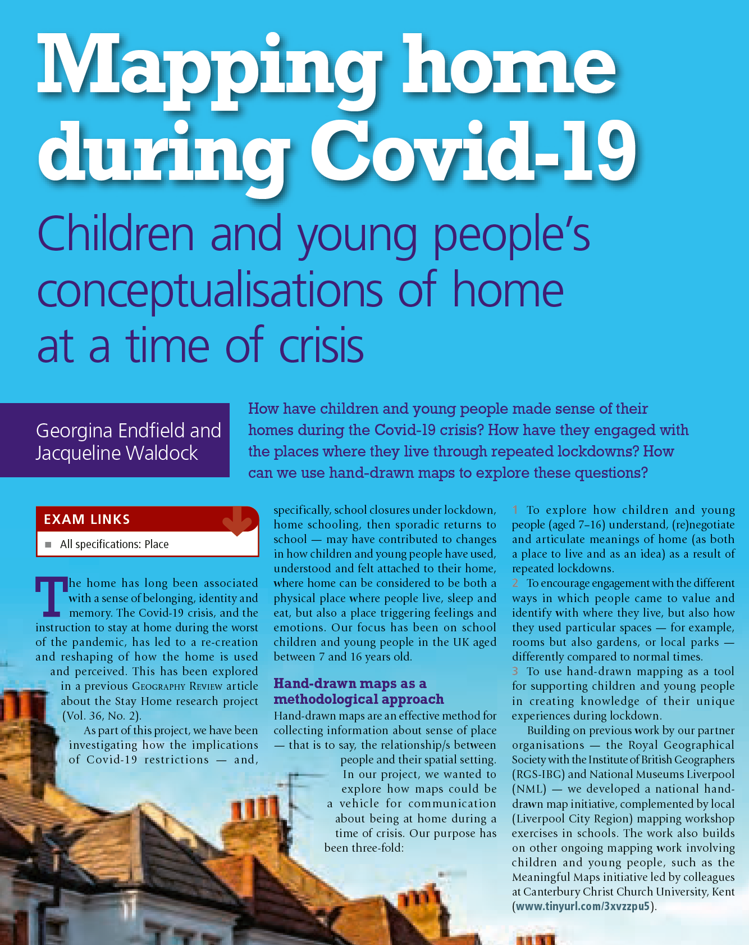
2. Changing place meanings and experiences
Geography Review vol. 36, no. 3 (February 2023) explores the experiences of young people during the Covid-19 crisis.
The everyday place of the home, and features within the home, came to assume more or new importance.
Green spaces, whether these are balconies, gardens or local parks, became particularly important places for children and young people during lockdown.
Covid-19 lockdowns led to new boundaries being constructed (places people could go, places they could not) or perhaps blurred (for example, homes becoming at once places of work, recreation and school).

Slide 9
3. Changing places — links and connections
Different places become connected together by flows of people, information, money and trade. Over time, these connections can help give a place part of its character. For example, migration may contribute to long term changes in a place’s cultural identity and landscape.
During the pandemic, the normal operation of these flows was interfered with. Lockdowns and travel restrictions meant that people could not travel from place to place. Flows of commodities and merchandise were often interrupted: you may have personally experienced shortages of products in local supermarkets as a result.
However, flows of information increased greatly during the pandemic, as people began to rely more on virtual forms of working, shopping and entertainment. If these changes become permanent, this could be the most important lasting impact of the pandemic on places.

Slide 10
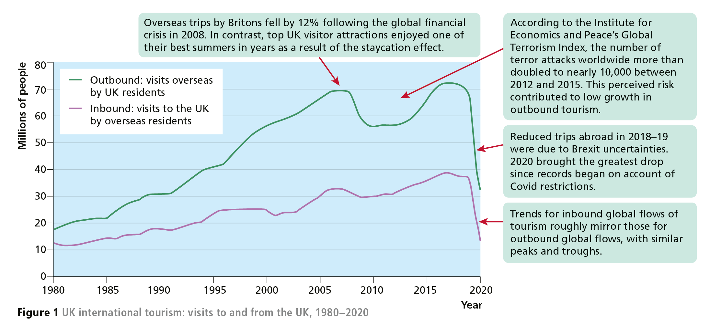
3. Changing places — links and connections
This diagram helps explore what happened to flows of people during the pandemic.
What happened to touristic connections between the UK and other countries in 2020?

Slide 11
3. Changing places — links and connections
This diagram looks at flows of commodities.
What happened to export connections between China and other countries in 2021?

Slide 12
3. Changing places — the shrinking-world effect
Soon after the UK entered lockdown, it was apparent that increasing numbers of people were adopting remote-working technologies — including Zoom and Teams – for purposes of:
work — many tertiary industries that had previously resisted home-working requests from employees quickly discovered that staff were in fact able to carry out their duties perfectly well from a home office or kitchen table!
education — primary and secondary schools and universities adapted immediately to the crisis by increased use of online learning platforms, including virtual classrooms and Zoom lectures.
leisure — unable to meet in person, people began socialising online using an ever-growing number of social media apps and platforms.
Global flows of information therefore increased during the pandemic.

Slide 13
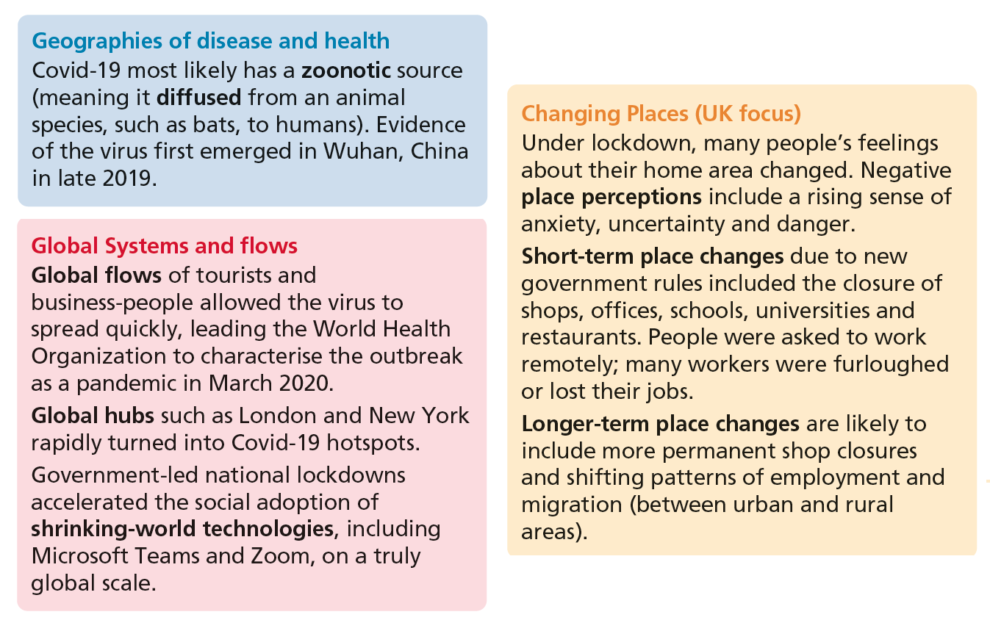
Thinking synoptically
This diagram shows how different topic areas in geography can be connected together. Changes in the geography of disease impacted on global flows in ways that affected the character of places.

Slide 14
Questions for discussion
Based on your own experiences of lockdown, what local place changes did you see? Were any changes positive?
Will UK towns and cities eventually return to ‘business as usual’ or will they be permanently changed?
Why might some individuals have felt more threatened than others by Covid-19 and how could this affect their feelings about shared public spaces?
Have lockdown experiences changed the way you think about and use different rooms or spaces within your home and how you understand your local environment?
Green space features as a key theme on the maps. How important was green space for you during lockdown?

Slide 15
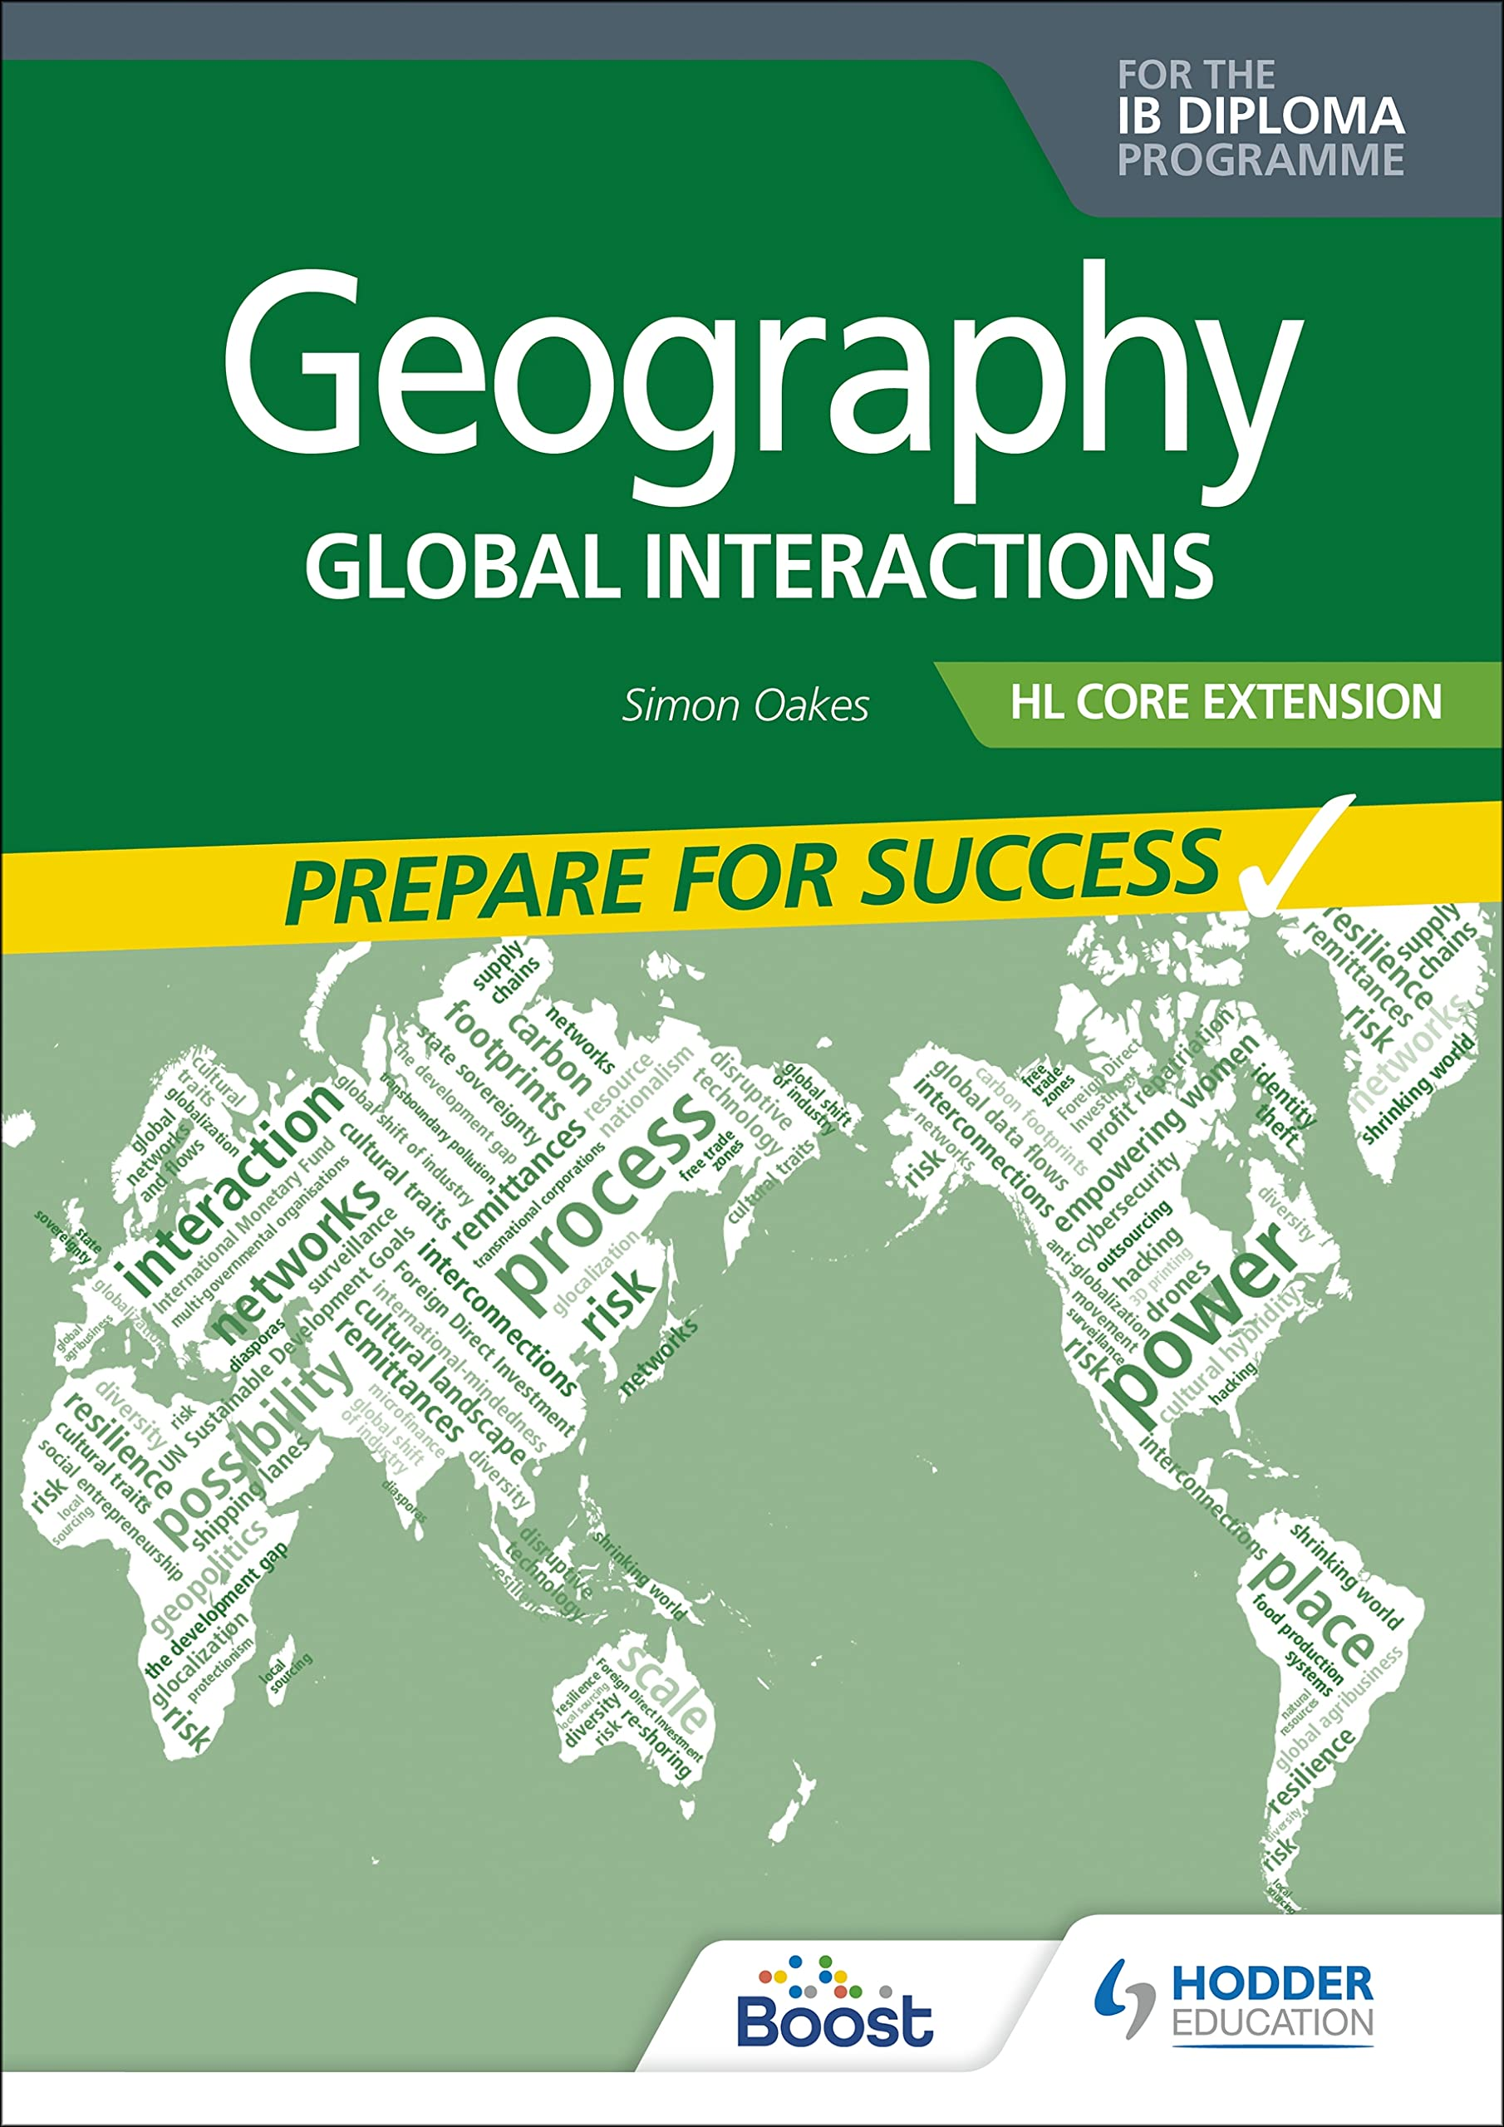
This resource is part of Geography Review, a magazine written for A-level students by subject experts. To subscribe to the full magazine go to: http://www.hoddereducation.co.uk/geographyreview
Charts and figures in this presentations are re-used from Geography Review 34:4 and 36:3.
Slide 11 shows Figure 6.5 from the second (2022) edition of Geography: Global Interactions by Simon Oakes.
Photograph in slide 7 used with permission of Simon Oakes.

