Slide 1

David Redfern
Essential topic update: India
More background on the emerging economic superpower
(See also slides produced in November 2025)
www.hachettelearning.com/geographyreview
© Hodder & Stoughton Limited 2026

Slide 2
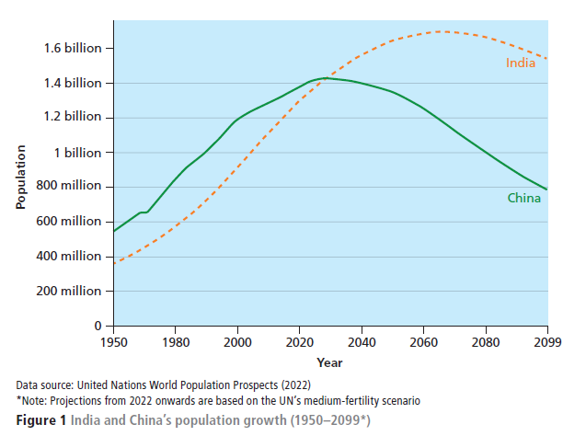
Population growth
India v. China
This chart shows the demographic projections for India and China.
India and China are the world’s most populous countries, and the UN projects that both will remain the largest by population to the end of the century. However, their trajectories diverge sharply.
China’s population has begun to fall and is projected to more than halve to around 630 million by 2100. India, by contrast, is expected to keep growing for 40 years, reaching about 1.7 billion people in 2060 and gradually declining to around 1.5 billion.
India ‘overtook’ China in December 2024 when its population reached 1.45 billion.

Slide 3
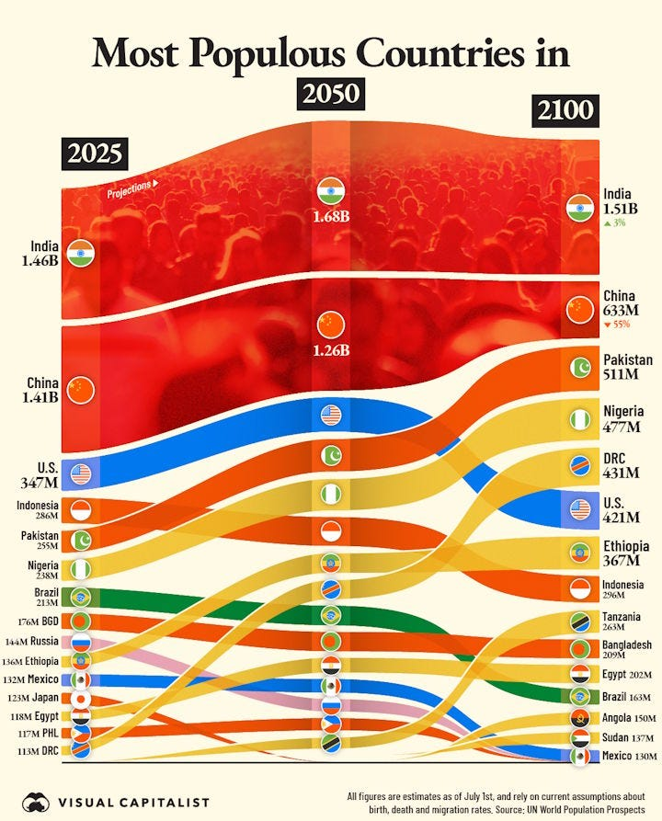
Most populous countries
2025 - 2100
This chart shows the changing rank order of the most populous countries on the planet.
Note:
India and China remain the top two most populous countries
The rapid rise of Pakistan, Nigeria, Democratic Republic of Congo (DRC), Ethiopia and Tanzania
The decline (in rank) of the USA, Brazil and Mexico
The overall increase in African countries in the largest 15 countries.
Source: Visual Capitalist

Slide 4
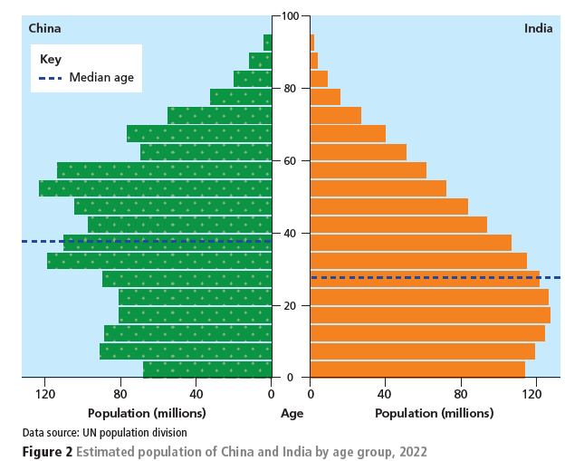
China v. India: population pyramids
This chart compares the population pyramids of China and India in 2022.
Note:
A large demographic dividend in India, whereby the working age population is larger than the non-working age population.
This is reflected by the median age of the Indian population being almost 10 years younger than that of China.

Slide 5
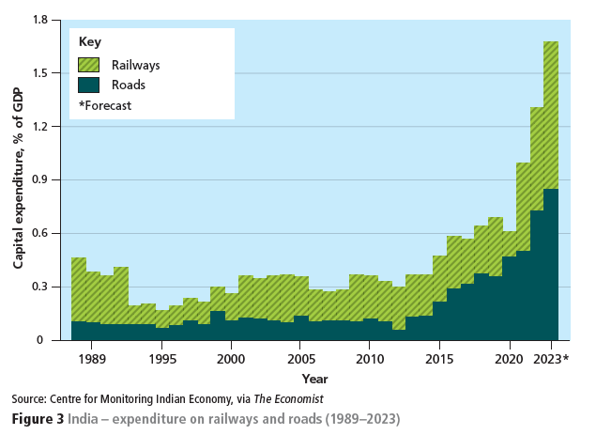
India expenditure on roads and railways (1989-2023)
India has made significant investment in its transport and digital infrastructure
Better roads, high-speed railways and smart cities have all improved connectivity and productivity.
A digital revolution, including greater digital governance, universal identity cards and digital payment systems, has reduced ‘red tape’ and corruption, thereby boosting efficiency.

Slide 6
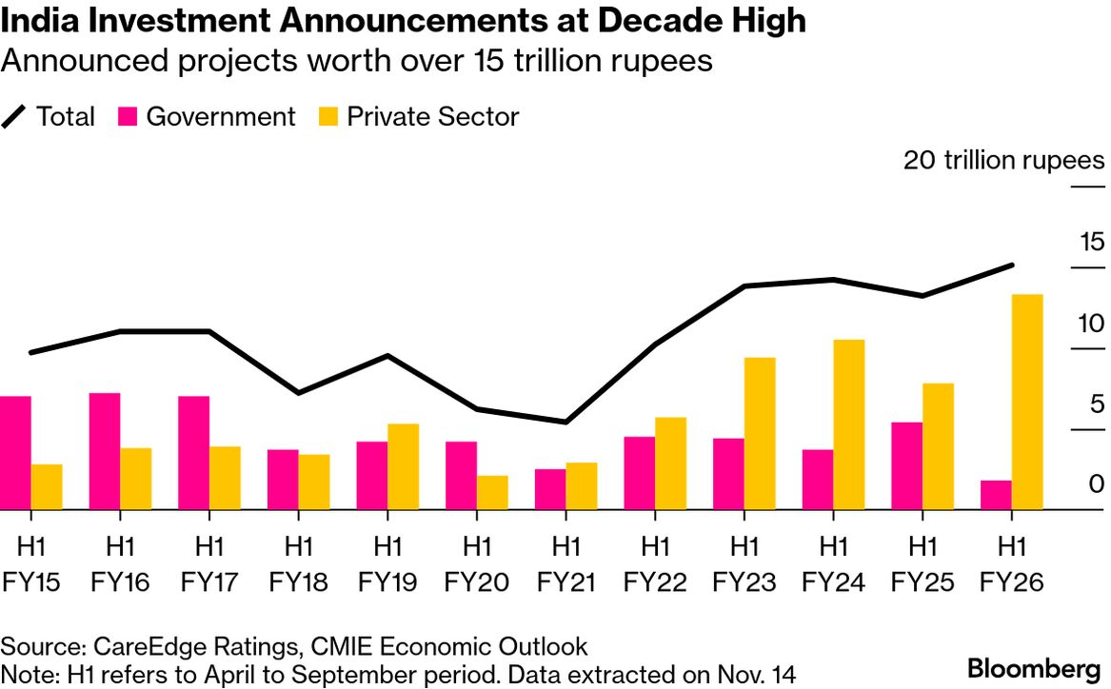
India: types of investment (2015 – 2026)
Investment in the Indian economy over the past decade has shifted from government investment to private sector investment.
Companies investing in India range from local companies e.g. Tata to international e.g. Google

Slide 7
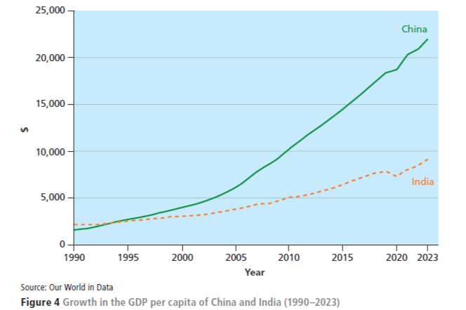
GDP per capita: China v. India (1990-2023)
Until recently, India’s economic growth had been overshadowed by China’s.
India started its period of rapid growth about 10 years later than China and has grown at around 7% rather than the 10% China managed for several decades.
It is now expected that India’s growth rate will exceed that of China, although India’s GDP per capita is still more than half that of China.

Slide 8
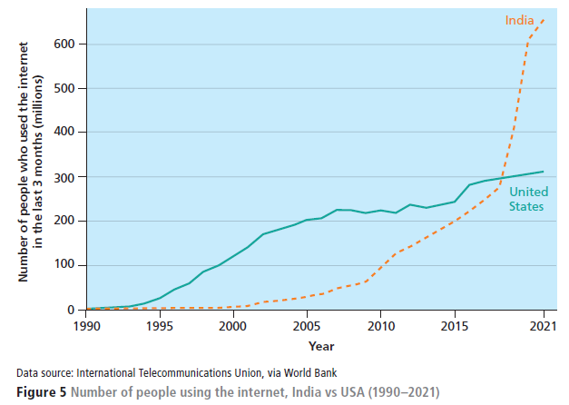
India v. USA: number of people using the internet (1990-2021)
The use of the internet in India is growing rapidly compared to the USA. (Obviously, the relative size of populations should be considered here.)
Consequently, there have been recent successes following a ‘Make in India’ policy push, particularly in electronics manufacturing.
Smartphone manufacture is an example of this success with both Samsung and Apple shifting their production to facilities based in India.
During 2025, India shipped more smartphones to the USA than China, reflecting a significant milestone for the Indo-US relationship.
Source: World Bank

Slide 9
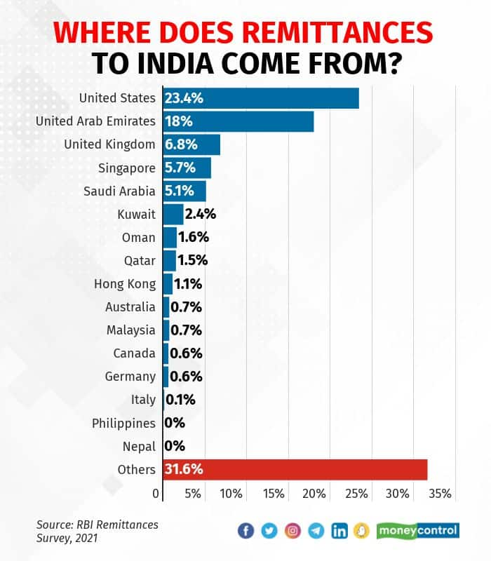
India: remittances
Remittances are a vital pillar of the Indian economy and help to offset its trade deficit.
In 2024, India received $135.46 billion in remittances, a 14% increase from the previous year.
This makes India the largest recipient of remittances globally, ahead of countries like Mexico, China, and the Philippines.
Traditionally, Gulf countries were the primary source of remittances to India.
However, the U.S. has now overtaken the Gulf, reflecting a shift toward a more skilled Indian diaspora in advanced economies.

Slide 10
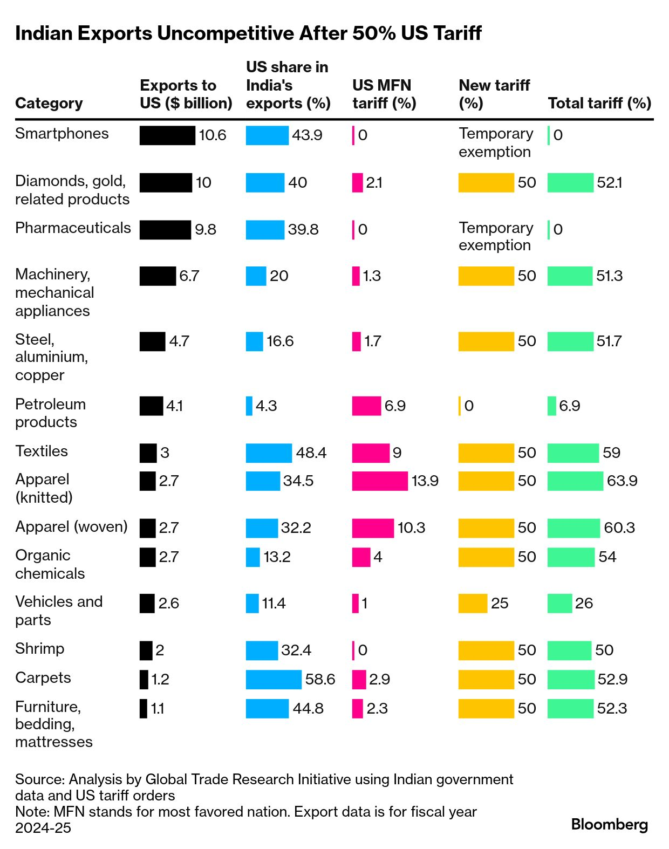
Trade with the USA and the impact of the ‘Trump tariffs’.
As with the rest of the world, India is currently having to manage the instability caused by the tariffs introduced into the USA by President Trump.
The chart opposite shows:
the main exports from India to the USA in rank order of value (black)
The importance of these US imports relative to the total export of these goods (blue)
The current (December 2025) tariff on those goods into the USA (green).
Electronics , gems and jewellery, pharmaceuticals, engineering and textiles/clothing, are all high-employment sectors that depend on access to US markets.
Note also: IT services — Indian outsourcers draw up to 40% of their revenue from North America..

Slide 11
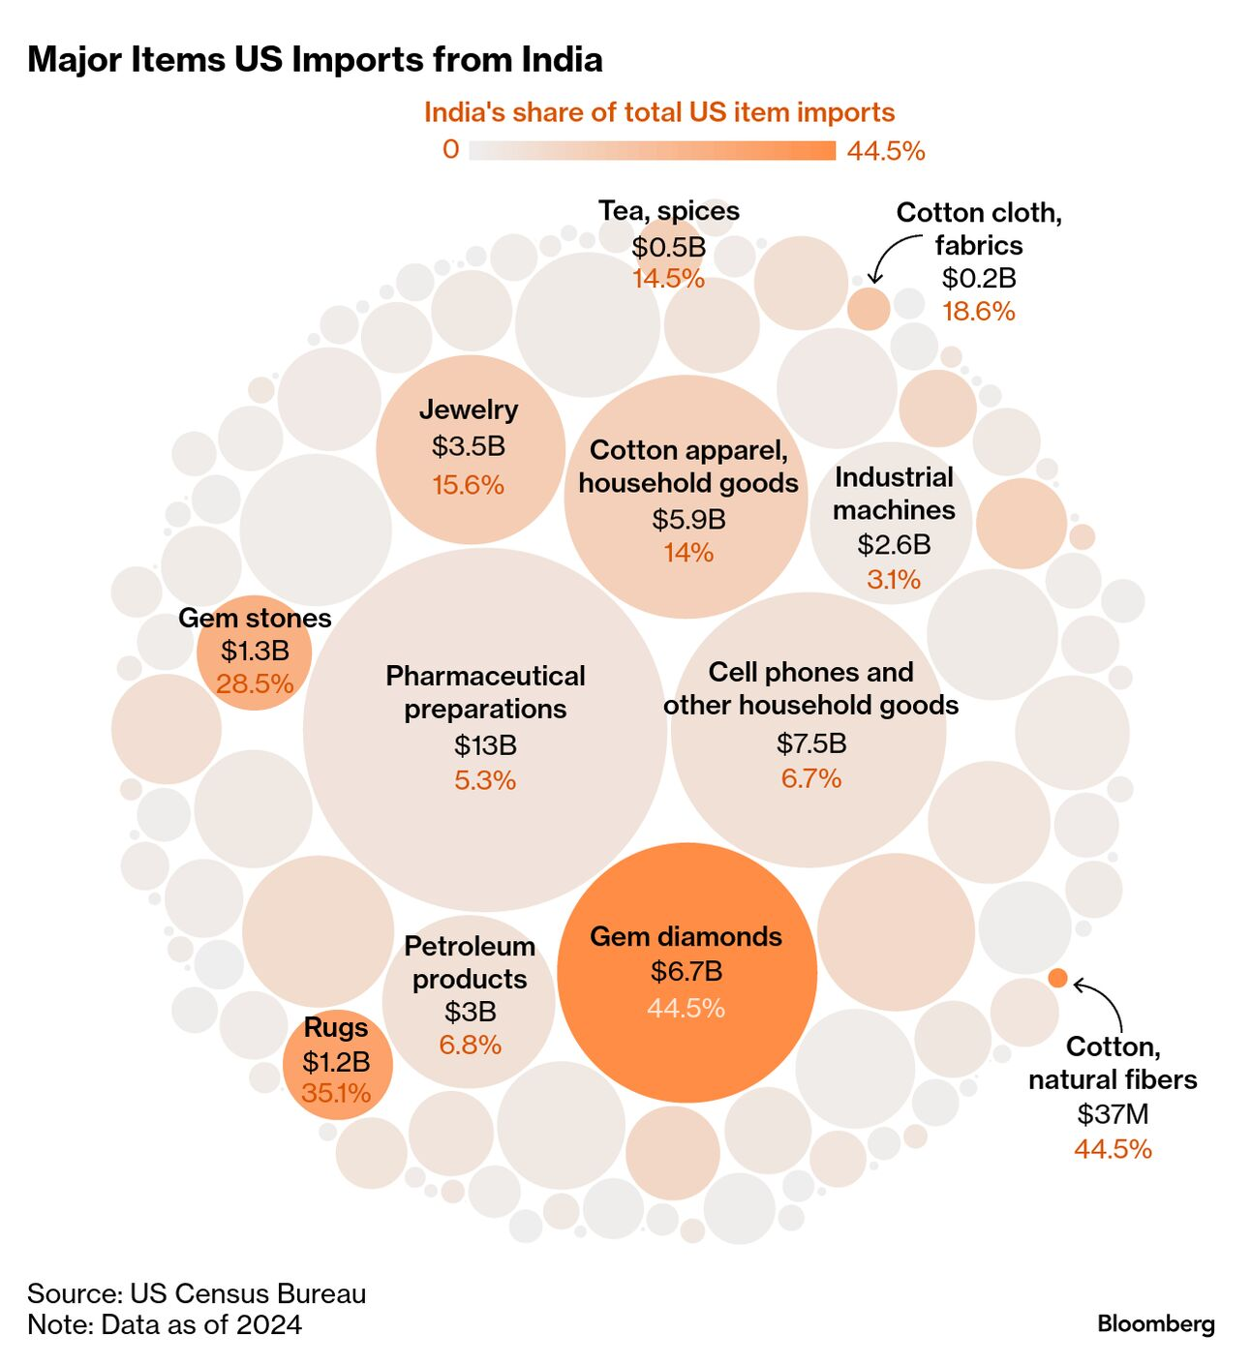
Trade with the USA – type of imports from India
The USA is India’s largest trading partner, biggest export market for goods and services, and third-largest source of foreign direct investment.
However, India does not rank among the US’s top 10 trading partners. In labour intensive industries such as electronics, textiles and clothing, gems and jewellery, Indian exports to the USA face stiff competition from China, Vietnam, Indonesia, Mexico.
Some of these countries have lower labour costs than India.

Slide 12
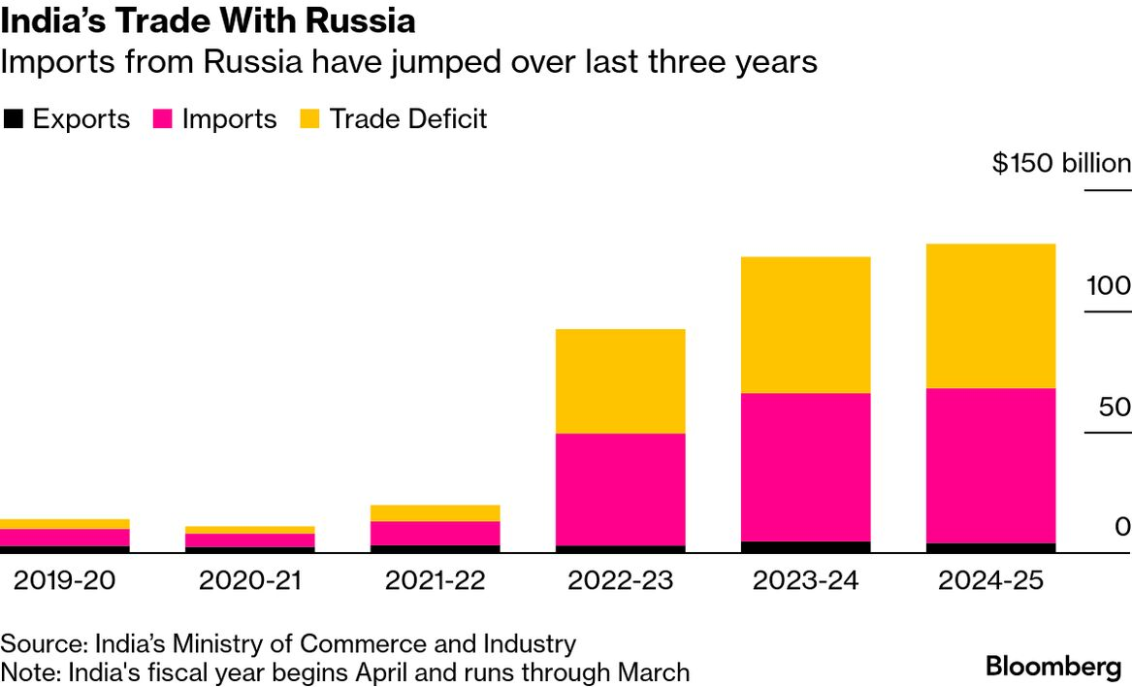
Trade with Russia
President Trump wants the Russian President Putin to agree to a peace deal in the war in Ukraine.
This would require India to stop buying Russian oil.
However, as can be seen opposite, imports from Russia (mostly oil) have increased significantly.
In return, India wants to sell more shrimps and agricultural products to Russia.

Slide 13
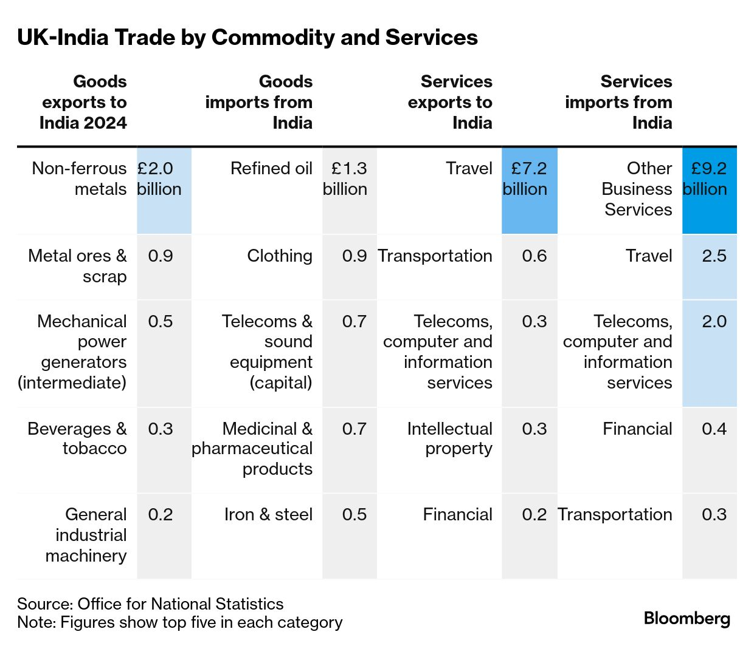
UK: trade with India
In May 2025, the UK and India agreed a trade deal that, amongst other things, will boost British exports of whisky and high-value motor vehicles, and Indian exports of ready-made garments and skilled workers.
The free-trade agreement made steep reductions on over 90% of previous tariff restrictions between the two countries.
However, costed at $57 billion, total India-UK annual trade is less than a third of India-US trade ($130 billion) and about an eighth of UK-US trade ($420 billion).
Note: the significantly high value of trade in services between the two countries:
Tourism mostly from UK to India
Back-office services from India to the UK

Slide 14
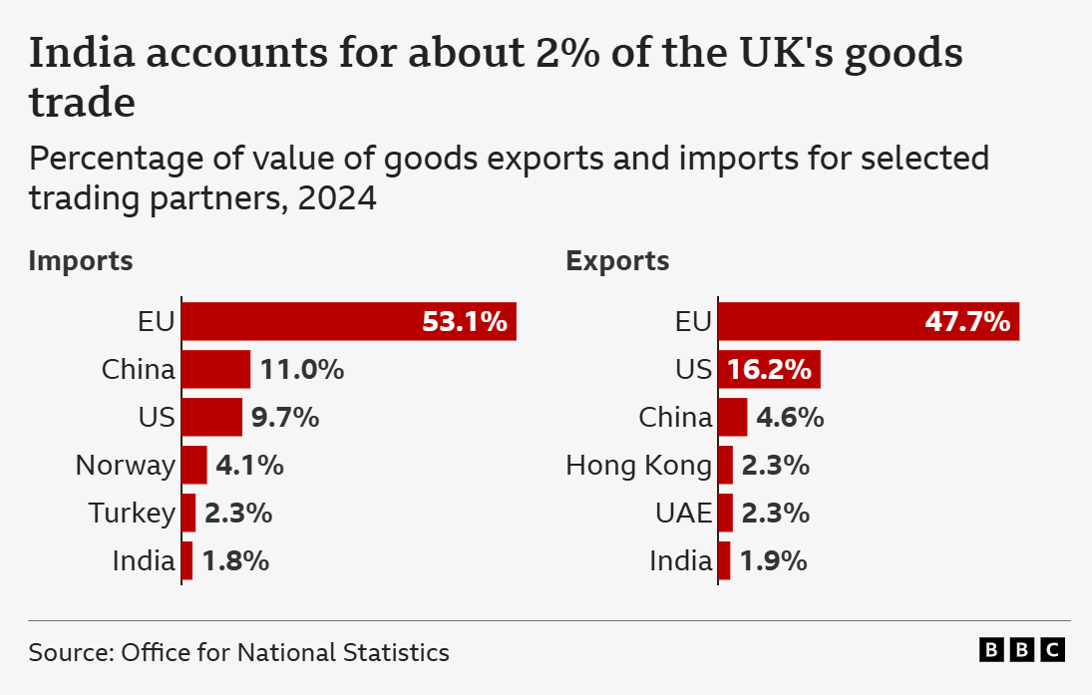
UK: trade with India relative to other trading partners
The proportion of UK trade with India is still very low (<2%) compared to the UK’s main trading partners.
The EU dominates UK trade (averaging 50%) with China and the USA being next two largest trading partners.
Note: The UK has also agreed to exempt temporary Indian workers and their employers from paying National Insurance contributions for a period of three years. The Indian government believes this will make hiring Indian talent more competitive and create more job opportunities for Indians in the UK.

Slide 15
This resource is part of Geography Review, a magazine written for A-level students by subject experts. To subscribe to the full magazine, go to:
www.hachettelearning.com/geographyreview

