Slide 1
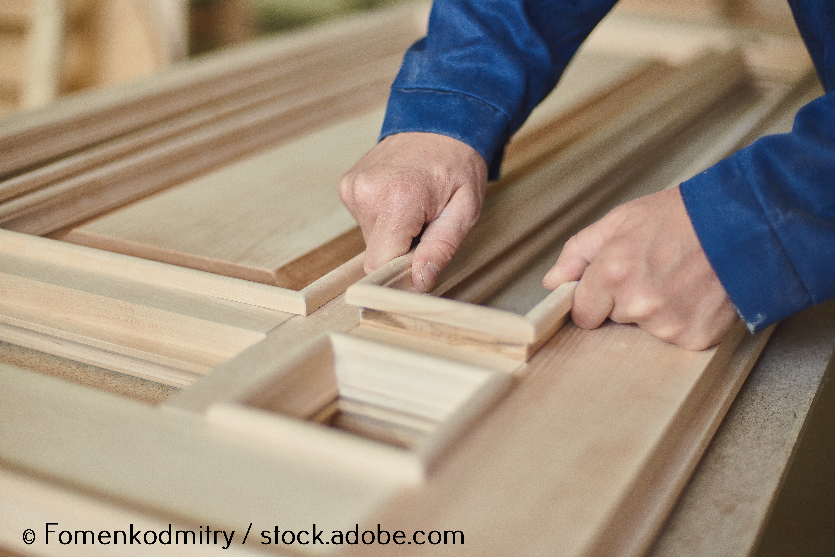
Architectural joinery

Slide 2
Introduction
This section explores architectural joinery and the processes involved in creating bespoke items. It will help you to:
  understand the purpose and scope of architectural joinery
  explore the tools, equipment and materials used in traditional and modern methods
  learn the key stages of production, including setting out, marking out and manufacturing
  identify different types of joints and construction techniques used in specialist joinery.

Slide 3
Types of joinery
Traditional joinery involves the construction of items such as staircases, windows, doors, frames and linings. This type of joinery is usually bespoke (purpose made) and uses natural timber to manufacture items using a range of woodworking joints such as mortice and tenons and housing joints.
Modern joinery is often contemporary in design and includes the use of a range of materials such as laminates, plastics and metals. Modern joinery is produced using a range of automated woodworking machinery such as computer numerical control (CNC) machines for efficient and accurate production.

Slide 4
Setting out architectural joinery
If an item of architectural joinery is unique in design, then it may have to drawn full size to illustrate different elevations before it can be made. These types of drawings are known as ‘rods’.
To draw a rod, the following sources may be needed for design or construction details:
  drawings
  specifications
  building regulations
  cutting lists
  manufacturer’s information (component standards).

Slide 5
Tools used in measuring and setting out architectural joinery
  Rule
  Tape measure
  Set square and tee square
  Combination square
  Roofing square
  Sliding bevel
  Protractor
  Compass
  Divider
  Trammel heads and beam
  Pencil

Slide 6
Setting out rods
A setting out rod is used for critical information for the joinery to be manufactured. A typical rod for a door may include:
  overall dimensions
  component positions
  joints
  rebates
  grooves
  mouldings and profiles
  beading
  glazing
  panels.

Slide 7
Cutting lists (1)
Cutting lists are produced once the design or setting out rods (drawings) have been completed. Cutting lists were traditionally handwritten by joiners, but they are now produced with the use of a software design package used on a computer at the initial stage of production.

Slide 8
Cutting lists (2)
A cutting list includes the following information for the machinist:
  Type of material (e.g. maple veneered, medium-density fibreboard (MDF), ash timber).
  Component or item number.
  Quality.
  Sawn sizes (before planing) – length x width x thickness.
  Finished sizes (after planing) – length x width x thickness .
  Additional information (e.g. grain direction, profile detail).

Slide 9
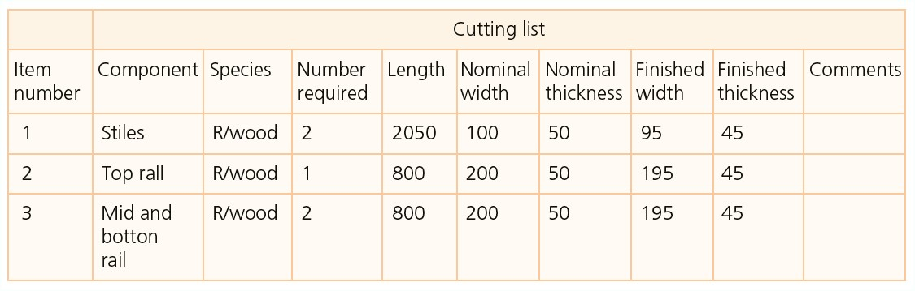
Cutting list example
Notes:
[02.08_02]

Slide 10
Face and edge marks
Once timber has been initially planed smooth, straight and square by the machinist using the information in the cutting list, it’s ready for the next stage of production. At this stage, the joiner will usually label the best face and edge on each piece with face and edge marks.
These symbols are used to mark and transfer important lines around each component, and they are also referenced at the next stage of machining the timber.

Slide 11
Marking out architectural joinery
‘Marking out’ is a term used to describe the process of marking the positions of joints and profiles onto each component before the second stage of machining. Accurate marking out with a sharp 2H pencil is vital at this stage to ensure the completed joinery is to a high standard.

Slide 12
Tools used for marking out architectural joinery
  Marking gauge
  Mortice gauge
  Cutting gauge
  Try square
  Combination square
  Box square
  Mitre square
  Dovetail square or template
  Sliding bevel
  Pencils
  Marking knife

Slide 13
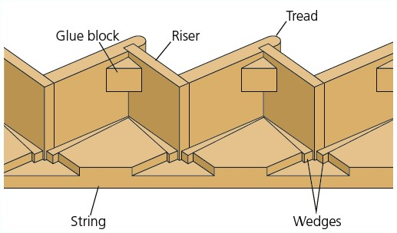
Manufacturing architectural joinery (1)
A view showing the housing joints in the string of a staircase.
Step into string joint
Notes:
[02.08_04]

Slide 14
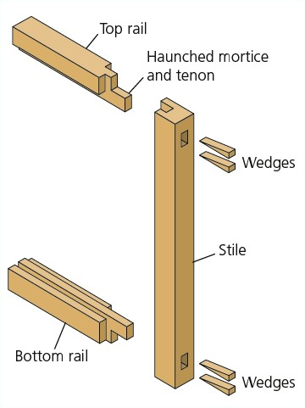
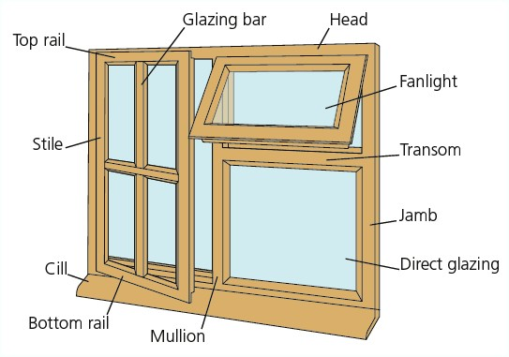
Manufacturing architectural joinery (2)
A typical window frame and casement showing mortice and tenon joints.
Typical window components
Casement window showing mortice and tenon joints

Slide 15
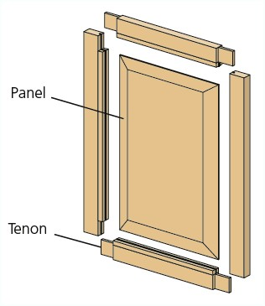
Manufacturing architectural joinery (3)
A view showing a range of mortice and tenon joints used to make a door.
Framed-up door with a panel and tenon joints

Slide 16
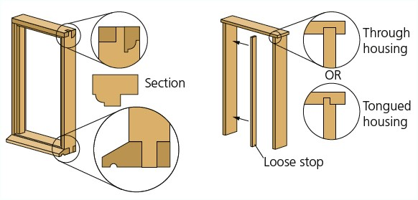
Manufacturing architectural joinery (4)
An illustration of a door frame (left) and door lining (right).
Notes:
[02.08_08]

Slide 17
Assembling architectural joinery
You should follow the steps below in sequence when assembling joinery (‘gluing-up’):
  Prepare the area to assemble the joinery.
  Sand the internal surfaces of the work.
  Apply appropriate adhesive to the joints.
  Assemble the components of the job.
  Clamp the joints together and secure them, if necessary, with wedges, dowels, screws or nails.
  Remove excess adhesive with a damp cloth and check the job is flat and square.
  Sand the surfaces flat and smooth with a sander.
  Remove the arises from the joinery by lightly sanding the corners to complete the work.

Slide 18
Tools and equipment used to manufacture architectural joinery (1)
Examples of hand tools:
  chisel
  hammer
  mallet
  saw
  plane
  tape measure
  rule
  clamps.

Slide 19
Tools and equipment used to manufacture architectural joinery (2)
Examples of power tools:
  sander
  router
  circular saw
  rail (track) saw
  drill or driver
  jigsaw.

Slide 20
Tools and equipment used to manufacture architectural joinery (3)
Examples of woodworking machinery:
  mortiser
  tenoner
  sander
  CNC machine
  spindle moulder
  table router
  cross-cut saw
  bandsaw
  circular saw
  surface planer
  thicknesser
  four-sided planer.

Slide 21
Typical joints used for traditional joinery
Joinery | Staircases | Windows | Doors | Linings and frames | Units
Range of joints | Mortice and tenon Tongue and groove Housing joint Mitre | Mortice and tenon Finger joint Dovetail Housing joint Bridle Halving Mitre | Mortice and tenon Dowel Tongue and groove | Housing joint Mortice and tenon | Housing joint Dovetail Biscuit Cam and dowel Wooden dowel Domino Mitre

Slide 22
Safety and best practice
Collective measures Isolate the source of the hazard (e.g. noise) Guards 110V and battery powered tools Good housekeeping Safe use, storage and disposal of hazardous materials | Personal protective equipment (PPE) Eye protection Ear defenders Googles Safety footwear Maintenance and storage
Respiratory protective equipment (RPE) Breathing apparatus Respirator (filtering device) | Local exhaust ventilation (LEV) Classification M dust extraction

Slide 23
Sustainability and modern trends (1)
Eco-friendly materials
The most eco-friendly timbers in the UK are pine, larch, oak and Douglas fir. Sustainable timber is also imported from Europe to keep up with industry demand.
Timber from a renewable source can be identified with the FSC (Forest Stewardship Council) logo or the PEFC (Programme for the Endorsement of Forest Certification) logo.

Slide 24
Sustainability and modern trends (2)
Trends
It’s important to consider the environment that the materials selected will be used in. For example, they may have to be moisture or fire resistant or able to withstand the elements in exterior use. Some materials are naturally resistant to moisture, while others will be treated with preservative.
Currently, Accoya wood is a popular choice with joiners for exterior work because it’s sustainable, durable and stable. It also doesn’t contain any toxic substances.

Slide 25
Summary
  There are three main stages of joinery production: setting out, marking out and manufacturing.
  A full-size setting out drawing is known as a rod.
  Face and edge marks are important references used in the marking out process.
  The type of timber and joints used to make joinery items should be carefully considered.
  Sanding the inside faces of joinery before assembly and removing the arises to complete the joinery provides a professional finish.

